Slide 1
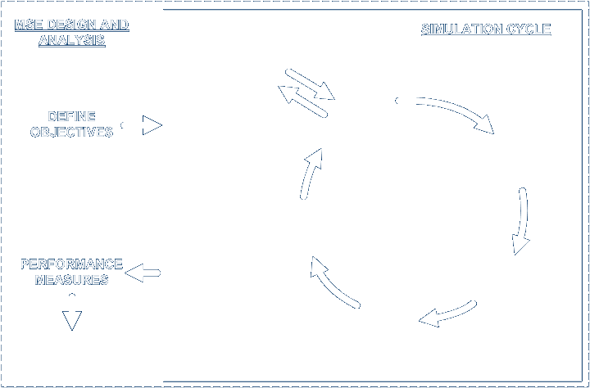










BUILDING Atlantis

Slide 2
Atlantis – MSE framework
Observations
Monitoring and Indicators
Observations
Ecology
and
Assessments and
Fishing
1 year
Assessments and
1 year
Parameter
cycle
Parameter
Estimation
Estimation
Implementation
Management policies:
quotas, MPAs, nutrient and toxin reduction

Slide 3
Build Atlantis - code
  All components described elsewhere slotted together ► Atlantis
    physics = atphysics.lib
    ecological = atecology.lib
    assessment = atassess.lib
    fisheries and management = atmanage.lib
    socioeconomics = atecon.lib
    main loop = atlantismain.exe

Slide 4
Build Atlantis - files
  Parameter files follow similar grouping
    physics = physics.prm and force.prm (+ ts files)
    ecological = biology.prm
    assessment = assess.prm
    fisheries and management = harvest.prm
    socioeconomics = econ.prm
    run definition = run.prm
    initial conditions = in.nc
Dynamics parameters = PRM Initial conditions = CDF or NC

Slide 5
.bat file
Output
Initial conditions
atlantisemocc -i Emocc_bio_StartJan2009_HollandStewart.nc -o EmoccOut.nc -r at_run_LessFPS.prm -f at_force_nuts__CatchHist.prm -p at_physics_nutsB.prm -b BiolNewCodeBuildToIsaac.prm -h at_harvest_emocc.prm -a ams_assess.prm -e Emocc_econ.prm -s functionalGroups.prm
forcing
Eco. dynamics params
Notes:
C:\Documents and Settings\kaplanis\My Documents\Atlantis\EMOCC_AtlantisWorkingCopy\run_emocc\RealNewellAug2009Hi0Free

Slide 6
.bat file
Output
Initial conditions
atlantisemocc -i Emocc_bio_StartJan2009_HollandStewart.nc -o EmoccOut.nc -r at_run_LessFPS.prm -f at_force_nuts__CatchHist.prm -p at_physics_nutsB.prm -b BiolNewCodeBuildToIsaac.prm -h at_harvest_emocc.prm -a ams_assess.prm -e Emocc_econ.prm -s functionalGroups.prm
forcing
Ecol. dynamics params
    These are the best place to start, to begin organizing data.
    I’ll show you messy text files, then Peter will show clean Excel sheets that (mostly) replace them.
Notes:
C:\Documents and Settings\kaplanis\My Documents\Atlantis\EMOCC_AtlantisWorkingCopy\run_emocc\RealNewellAug2009Hi0Free

Slide 7
CDF (biology initial conditions)
It is useful to remember that Atlantis has age structured vertebrates that have time-varying weight-at-age, but just biomass pools of invertebrates. Therefore the biology.cdf file must specify these things:
Concentration (mg N/m^3) of invertebrates and nutrients
Numbers-at-age for vertebrates (# individuals per age class per box)
Reserve (meat+gonad) weight-at-age for vertebrates (mg N/individual)
Structural (bone) weight-at-age for vertebrates (mg N/individual)
See handout for more…
Example: C:\Documents and Settings\kaplanis\My Documents\Atlantis\EMOCC_AtlantisWorkingCopy\run_emocc\RealNewellAug2009Hi0Free
Notes:
C:\Documents and Settings\kaplanis\My Documents\Atlantis\EMOCC_AtlantisWorkingCopy\run_emocc\RealNewellAug2009Hi0Free

Slide 8
PRM (ecology dynamics or rate parameters)
What matters most?
Recruitment (Beverton Holt params)
Consumption rates (mum, C_ )
Diet interactions (pPREY)
Imposed linear and quadratic mortality (“1-EE”)
Weight of recruits (KWSR, KWRR)
Seasonal distributions (S1, S2, S3, S4)
Growth and mortality while outside the model (migrators)
See handout…
Example: C:\Documents and Settings\kaplanis\My Documents\Atlantis\EMOCC_AtlantisWorkingCopy\run_emocc\RealNewellAug2009Hi0Free

Slide 9
End
Peter will show you the shortcuts in Excel and VB!

Slide 10
End

Slide 11
Build Atlantis - output
  Structuring of output also matches these divisions somewhat
    physics = out.nc
    ecological = out.nc, outTOT.nc, outPROD.nc, biol.txt, YOY.txt
    assessment = indicator files (long list grouped by indicator type)
    fisheries and management = outF.nc, outFTOT.nc, catch.txt, effort.txt, catch_per_fishery.txt
    socioeconomics = econ.txt

