Slide 1


Ontology Learning:
State of the Art and Open Issues
(Lina Zhou)
Jacob Kalakal Joseph
CS 586 (Fall 2011) | Class Presentation | Oct 10, 2011
Notes:
Introduction
Myself
Hello everyone, my name is Jacob and I am here to present this paper – Ontology learning : state of art and open issues
Author (http://userpages.umbc.edu/~zhoul)
The paper was written by Dr. Lina Zhou in 2007
She is a Professor of Information Systems at University of Maryland
“The semantic web and ontology” is one of her chief research areas
Paper
The paper talks about Ontology Learning – a fast growing field

Slide 2
Outline
Motivation
Proposed Solution
Challenges
Notes:
Outline
Motivation
Proposed Solution
Challenges

Slide 3


The problem with computers!
I love Tintin
Notes:
The problem with computers!
They do not understand :P At least it is safe to say that they do not understand the way we do
They communicate like the parrots – that is, they speak without really comprehending the meaning

Slide 4




The solution – Ontology development
Notes:
The solution – Ontology development
Semantics
Information Interoperability
Ontology
Semantic Web
etc

Slide 5

Bottleneck of Ontology Acquisition

Slide 6
Bottleneck of Ontology Acquisition
  Explosive growth of WWW
  SMEs and Ontology Engineers are scarce
  Manual ontology development is labor-intensive and time-consuming
  Human biases and inconsistencies
Notes:
Bottleneck of ontology acquisition
Explosive growth of WWW
SMEs and Ontology Engineers are scarce
Manual ontology development is labor-intensive and time-consuming
Human biases and inconsistencies

Slide 7
…the proposed solution
Ontology Learning
Notes:
Key terms:
Ontology – conceptualization of a domain
Learning – (or machine learning) – pattern and relations recognition by machines
Ontology learning– (semi-) automatically discovery of ontological knowledge - An ontology learning technique usually starts with formalizing data with a set of features indicative of ontological knowledge, then generates internal representations of candidate models from the formal input of data, and finally applies the best models selected based on certain criteria to produce ontological knowledge

Slide 8
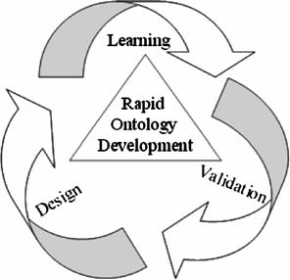
ROD
Notes:
Rapid Ontology Development – learning-oriented model of ontology development –3 phase iterative model
Design: Human experts help in domain analysis – selection of appropriate domain sources
Learning: Use appropriate learning techniques to discover ontologies from domain sources
Information extraction
Ontology Discovery
Ontology Organization
Clustering synonyms
Deriving inverse relations
Discovering concept islands
Building higher-level ontologies
Validation: Human experts check for redundancy, conflicts, missing information

Slide 9
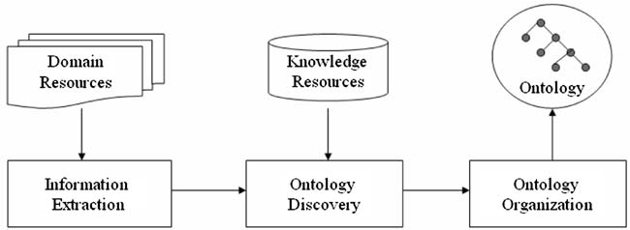
Ontology Learning
Notes:
Learning: Use appropriate learning techniques to discover ontologies from domain sources
Information extraction
Ontology Discovery
Ontology Organization
Merging synonyms
Deriving inverse relations
Discovering concept islands (clustering)
Building higher-level ontologies

Slide 10
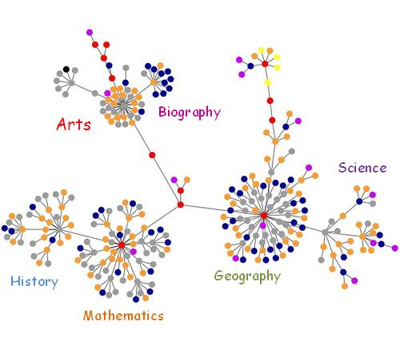
Ontology Organization
Merging synonyms
Deriving inverse relations
Concept Islands

Slide 11
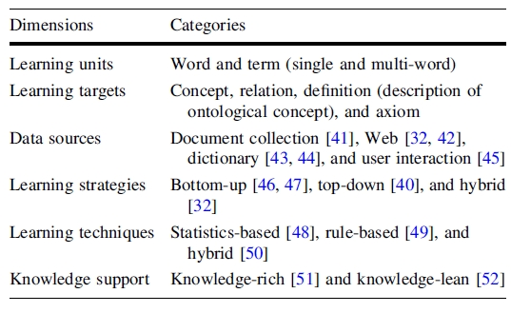
Ontology Learning Approaches

Slide 12
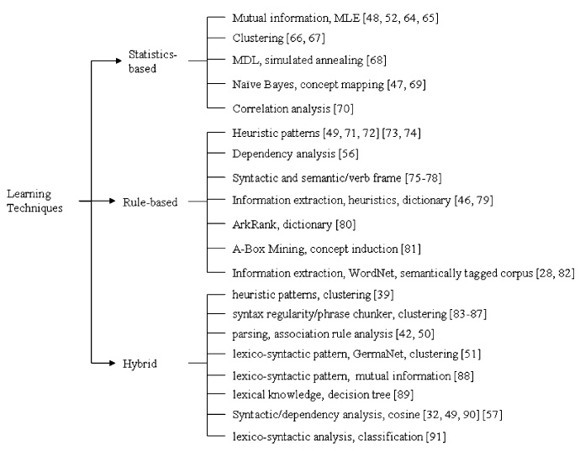
Ontology Learning Algorithm
Notes:
Taxonomy
Statistics based
Rule based
Hybrid

Slide 13
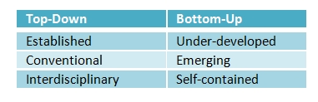
Learning strategies X Domains

Slide 14
Open Issues…
Human understandable vs. Machine understandable (bridging the gap)
Learning Specific relations (IS-A, Part-Whole)
Learning Higher-degree relations (1-2-3)
Learning new definitions
Term filtering (cut down the noise early)
Notes:
Open issues and challenges
Bridging the gap between Human (Natural Language) and Machine (Formal Language)
Learning specific relations like part-whole, related-synonym in addition to taxanomy-relation
Higher-degree relations, beyond binary
Learning new definitions
Term filtering
Filtering noise right in the begining

Slide 15

…Open Issues
Mapping to high-level ontology (bootstrapping, seeding)
(automatic) Evaluation benchmark
Incremental Ontology Learning (reuse)
Levels of Ontology Learning (Dell-Notebook debate)
Multi-agent Learning (team-work)
Learning Beyond Text

Slide 16

Group Discussion
Notes:
The paper demonstrates that Ontology Development can benefit from Ontology Learning

