Slide 1


Combating Web Spam with TrustRank
(Zoltan Gyongyi, Hector Garcia-Molina, Jan Pedersen)
Jacob Kalakal Joseph
CS 586 (Fall 2011) | Class Presentation | Nov 07, 2011

Slide 2
Outline
Challenge: Webspam
  Algorithmic webspam detection is difficult
  Human experts are slow and expensive
Solution: TrustRank
  Intuition
  Algorithm
Evaluation
  Experiments, results and analysis

Slide 3
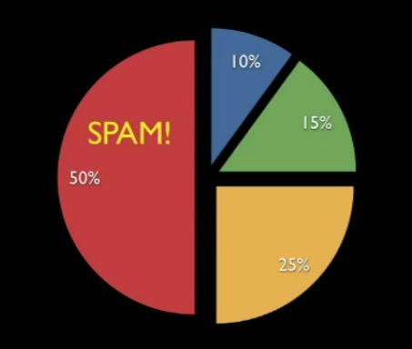
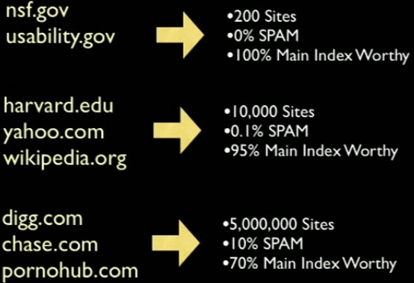
Webspam
Notes:
Image: http://vimeo.com/14611892

Slide 4

Webspam
Malicious techniques to achieve better than deserved search engine ranks
AKA: Spamdexing, search spam, search engine spam, or Search Engine Poisoning
Techniques:
  Content spam (keyword stuffing, hidden text, etc)
  Link spam (link farms, honey-pots)

Slide 5

Web Model
Edge = Link
Node = Web page

Slide 6

Web Model
Outlink
Inlink
Inlink

Slide 7
Web Model
Outdegree =1
Indegree = 2

Slide 8

Web Model
Non-referencing page
Isolated page
Unreferenced page

Slide 9


Simplifications
Collaspe

Slide 10

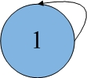
Simplifications
Discard

Slide 11



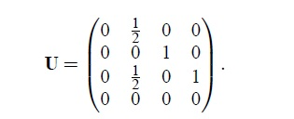
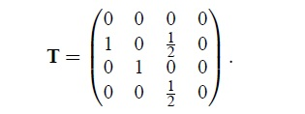
Transition Matrix and Inverse Transition Matrix

Slide 12

Assessing Trust – Oracle function
Human evaluation - Expensive and slow

Slide 13
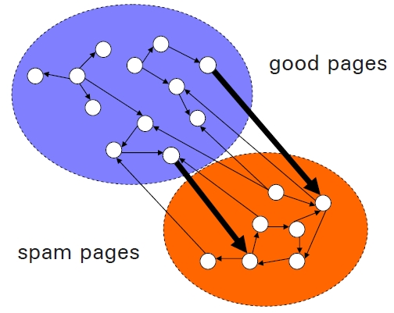
Assessing Trust – Approximate Isolation

Slide 14



Assessing Trust – Trust Function
Ideal Trust Property
Ordered Trust Property
Threshold Trust Property

Slide 15



Evaluation Metrics
Pairwise Orderedness
Precision
Recall

Slide 16
TrustRank Algorithm
Intuition: Good pages point to other good pages
Select Seeds
Propagate trust
Repeat Step 2 with decay factor=0.85 and 20 iterations to convergence

Slide 17
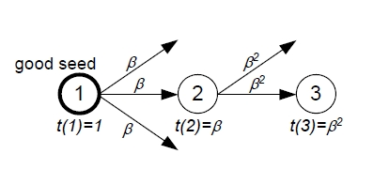
  Trust Attenuation - Dampening

Slide 18
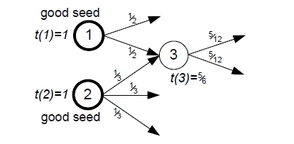
  Trust Attenuation - Splitting

Slide 19
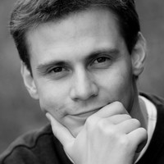
Experiments - DataSet
Altavista crawl of August 2003
Simplification: Several billion pages to 31 million sites using proprietary algorithm
Observation: 1/3 sites were unreferenced; however they do not matter much since they get low rankings
First author was the oracle

Slide 20
Experiments - Seed Selection
Two Schemes
  Inverse PageRank
  High PageRank
Observation
  Some top ranked pages were spam
Selection
  31million->25,000 (top inverse PR) ->7,900 (listed sites) -> 1,250 (manual evaluation) ->178 (seeds)

Slide 21
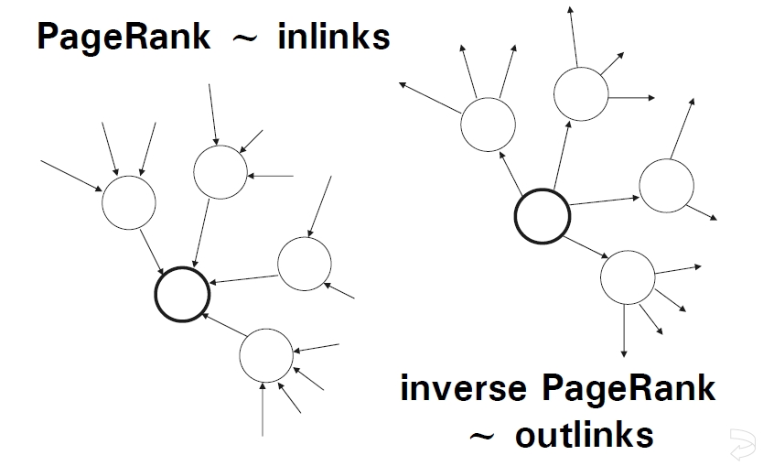
Experiments - Seed Selection
Notes:
Since trust flows out of the good seed pages, one approach
is to give preference to pages from which we can reach
many other pages

Slide 22
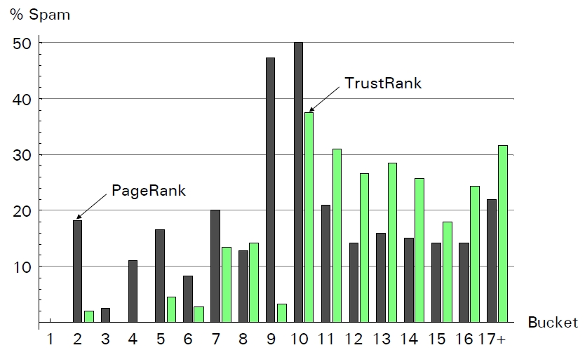
Experiments - % Spam per bucket

Slide 23
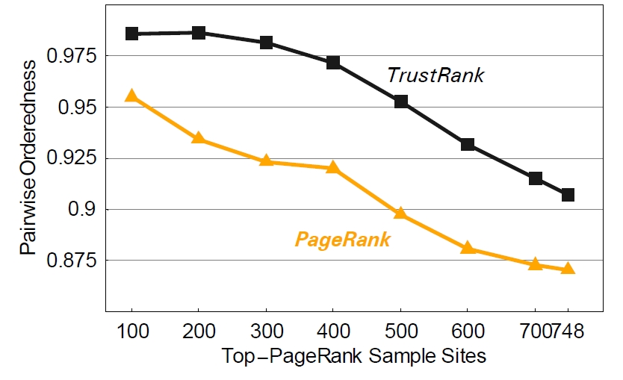
Experiments – Pairwise Orderedness

Slide 24
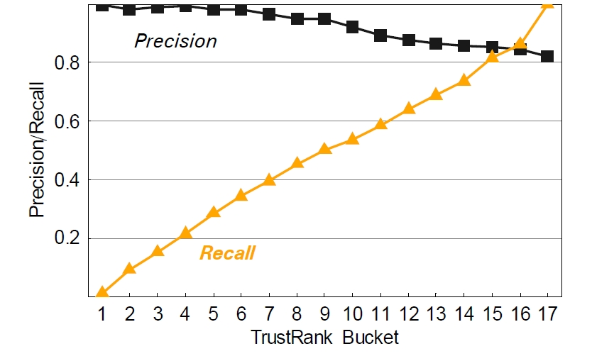
Experiments – Precision and Recall

Slide 25
Contributions
Formally defined webspam and webspam detection algorithms
Defined matrices for accessing the efficacy of algorithms (Pairwise orderedness)
Defined seed selection schemes (Inverse PR and High PR)
Introduced TrustRank
Experiments

Slide 26
Related Work
Builds upon PageRank
Spam detection in Text (Machine Learning)
Spam detection in Link (Graph Clustering)
Future Research
Experiment with various combinations of dampening and splitting for trust propagation
Select seeds iteratively

Slide 27
References and Resources
http://dl.acm.org/citation.cfm?id=1316740
http://infolab.stanford.edu/~zoltan
http://en.wikipedia.org/wiki/Spamdexing
http://en.wikipedia.org/wiki/PageRank

Slide 28
☺

