Slide 1
CPSC 481 Final Presentation
Sam Wong, Frank Tat, Alexander Richard, Cam Chow, Jacob Krmpotic

Slide 2
INTRODUCTION

Slide 3
OUR IDEA
We looked for a way that something could become “smart”
Smart Devices, Smart Function, anything Smart

Slide 4
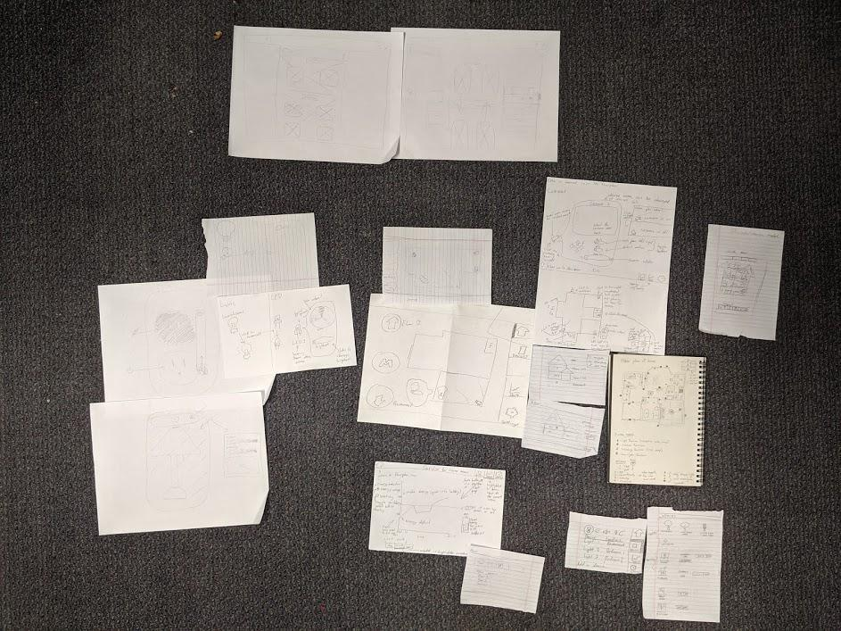
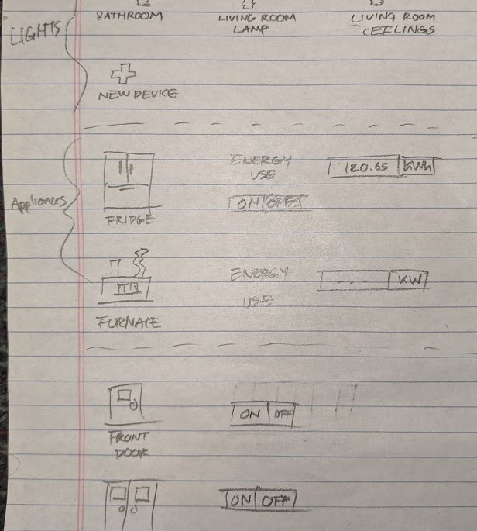
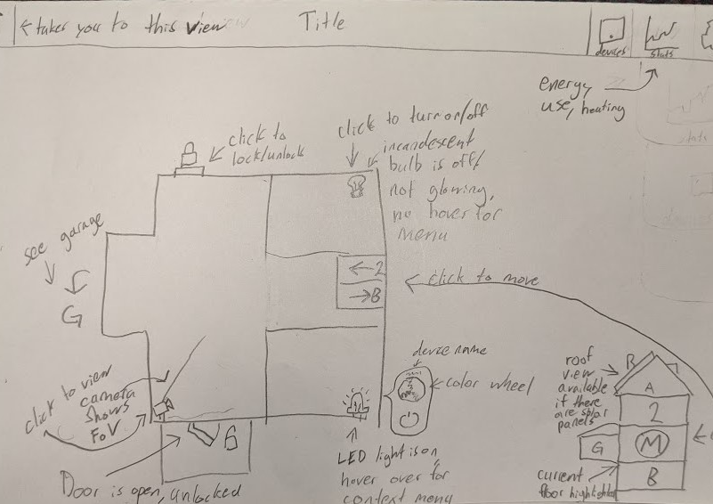
Sketches

Slide 5

Settling on an idea
Leaning towards improvement of smart systems rather than trying to be a creator.
BOTTOM LINE:
Smart Device Management was disorganized and inconsistent.

Slide 6
Design Problem

Slide 7
The Details
What is the design problem?
Usable - Minimal amount of effort
Accessible - used within your home, and sometimes externally
Usefulness - must solve a user’s problem; user’s have a solution to a problem, but it is not through an app
Valuable - using the app is only valuable if it’s the only option; don’t force users to use an app
Desirable - don’t have a mass amount of smart devices to manage, other methods are more desirable, or not efficient to use

Slide 8
End-Users and StakeHolders

Slide 9
Who will use our product?
Who are they, and what do they do?

Slide 10
Anyone with a home
People who needs control of their home, who wants control of their home
The homeowner should have the most control.
Relatives/roommates will have access as well.
Within the home, users will do normal, routine activities they would always do like turning on lights, turning on the TV, managing home temperature, etc.

Slide 11
Companies
Companies that both make and/or don’t make smart devices
Doors, cameras, phones, lights, outlets, appliances, etc.
They may want our app to be compatible with their devices.
They are impacted by seeing an application that supports smart devices and may pursue it themselves.
We still envisioned being able to integrate non-smart devices into our app...

Slide 12
User Research

Slide 13
Methods of Research
Shadowing - Google Home’s UI is minimalistic but hard to use and prone to user errors, it had very minimal device compatibility for complex devices so other device specific apps are needed.
Extreme User Interview - people prefer voice recognition or perform the action in real life. App isn’t valuable
Questionnaire - People don’t like that they can’t see the state of apps from the main screen when using Google Home and some people like the minimalistic design while others wish there was more to it.

Slide 14
What we discovered
People want a simple convenient, and flexible option to control their smart devices.
App’s use is not rigorous; it is a second option, but still consistently works.
Issues with convenience

Slide 15
Design Ideas and Decisions

Slide 16
Should-Haves vs Could-Haves
Should-Haves
Floor plan, top-down view of home
Devices tab for advanced/technical users
Options for primary users and users with special conditions (elderly homeowners)
Minimalism
Could-Haves
More specifics of your home statistics (special cases, e.g. solar panels)
Specific customization of devices

Slide 17
Finalized Design Ideas
Minimalistic Design - Minimal details on the floor plan with enough detail to distinguish rooms and maximize clarity
Functional Format - Web based design and a centralized console for use with a mobile app to be deployed in the future
Expanding Functionality - Displays only the minimal details but allows for more complex functionality when needed

Slide 18
Design Justification

Slide 19
Catering to Users
Convenience, Familiarity
Minimalistic and abstract direction

Slide 20
Heuristic Evaluation & Improvements

Slide 21
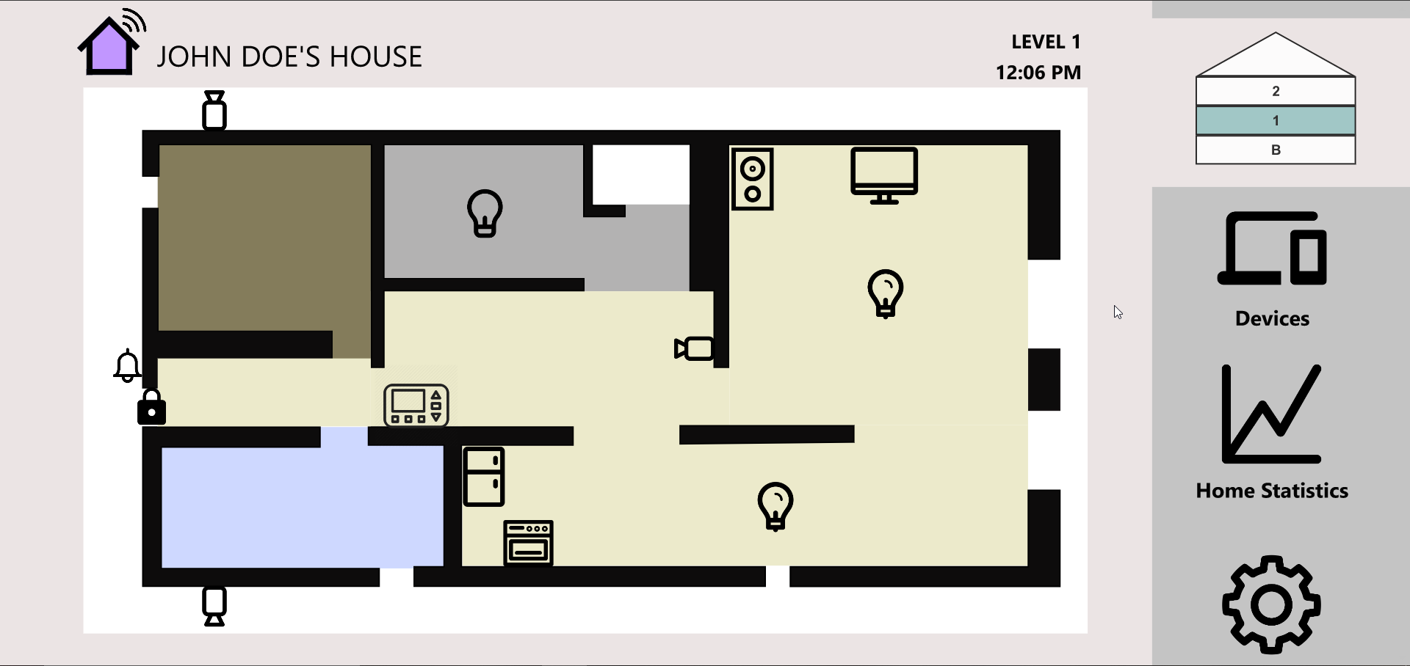
Initial Hi-Fi Prototype

Slide 22
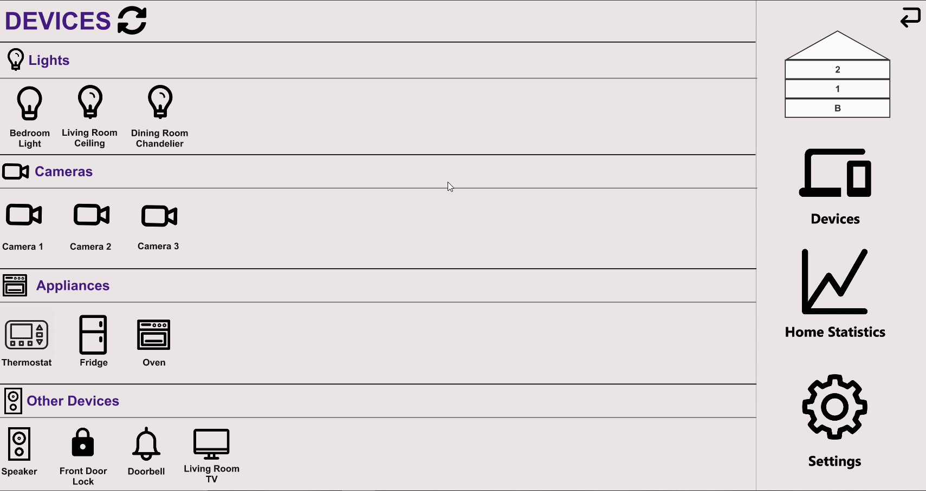
Initial Hi-Fi Prototype

Slide 23
Initial Hi-Fi Prototype, Issues
Device Functionality
The devices tab had limited detail and no implemented functionality
Consistency
There were inconsistencies when navigating through the application, creating confusion for the user
Aesthetics and Clarity
The application was not aesthetically pleasing and there were some clarity issues when in came to regards with the floor plan itself

Slide 24
Changes, Solutions
Device Functionality
We implemented extra functionality in the device section increasing usability
Consistency
We removed redundant features that improved the usability of the system
Aesthetics and Clarity
We designed a theme that was implemented across the application and added details to the floor plan to reduce users’ confusion

Slide 25
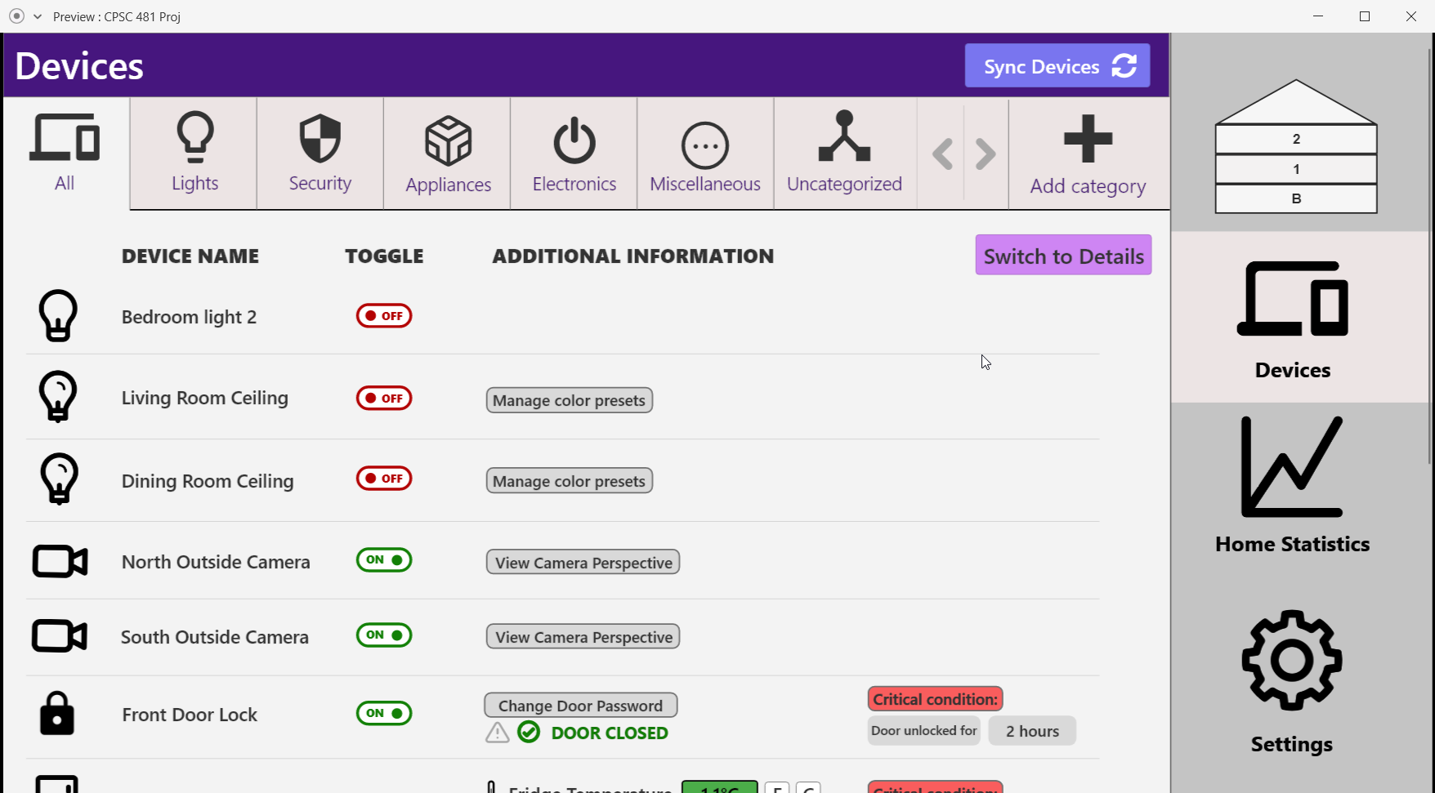
Final Hi-Fi Prototype

Slide 26
The Next Iteration
Consistency, Mobile Friendly

Slide 27
For the Future
Mobile variant of our application to increase accessibility
Motion-tracking feature within home
Make Home Statistics panel more insightful
Adaptation of design with accessibility options (Large-Text/Voice-to-Text mode)

Slide 28
Things we learned
Adobe XD is great to create prototypes, but cloud beta
Designing from users perspective takes time to get use to
Focus on a theme and style quickly
HCI is incredibly important and we often take it for granted

Slide 29
THANK YOU!
SMARTSPACE
Manage your home from anywhere.

