Slide 1
CPSC 481 - Phase 4
Sam Wong, Frank Tat, Alexander Richard, Cam Chow, Jacob Krmpotic

Slide 2
Initial Hi-Fi Prototype
What went well:
We learned how to use Adobe Xd without difficulty.
We were able to create our initial prototype fairly quickly.
Issues we came across:
Major issues getting Adobe Xd to run without issues.
Adobe is laggy and crashes often.

Slide 3
Initial Hi-Fi Prototype
https://xd.adobe.com/view/6e4804e6-7507-4b58-575a-919de9aa4298-1879/?fullscreen

Slide 4
Our Heuristic Evaluation
The evaluation that we completed was for Group 1.2.
We did the evaluation based on the template given to us on D2L, by Jakob Nielsen

Slide 5
Report
Important elements that we improved for this phase:
Adding the location of the user in the floorplan and improving its clarity.
Adding extra functionality to buttons, adding prompts for clarity, and consistency between buttons.
Improved the devices pane to go from informative to functional.
Less important elements to improve for phase 5:
Improving the help menu, saving preferences after logging off, and improving large text in the Accessibility settings.
Suggestions for future projects:
Completing the Large Text functionality for accessibility.
Adding more interactivity within the devices page that is beyond the capabilities of Adobe Xd.

Slide 6
Our Final Prototype
What went well:
We were able to improve the detail and aesthetics of the interface.
We overhauled the devices tab to improve functionality and design.
We were able to optimize connections to reduce the number of panels.
Issues we came across:
The ability to encompass every single state of the house was next to impossible (around 800 panels to cycle through if we wanted to include everything)
Consistency in design; still having difficulty with a general color theme and certain aspects of design

Slide 7
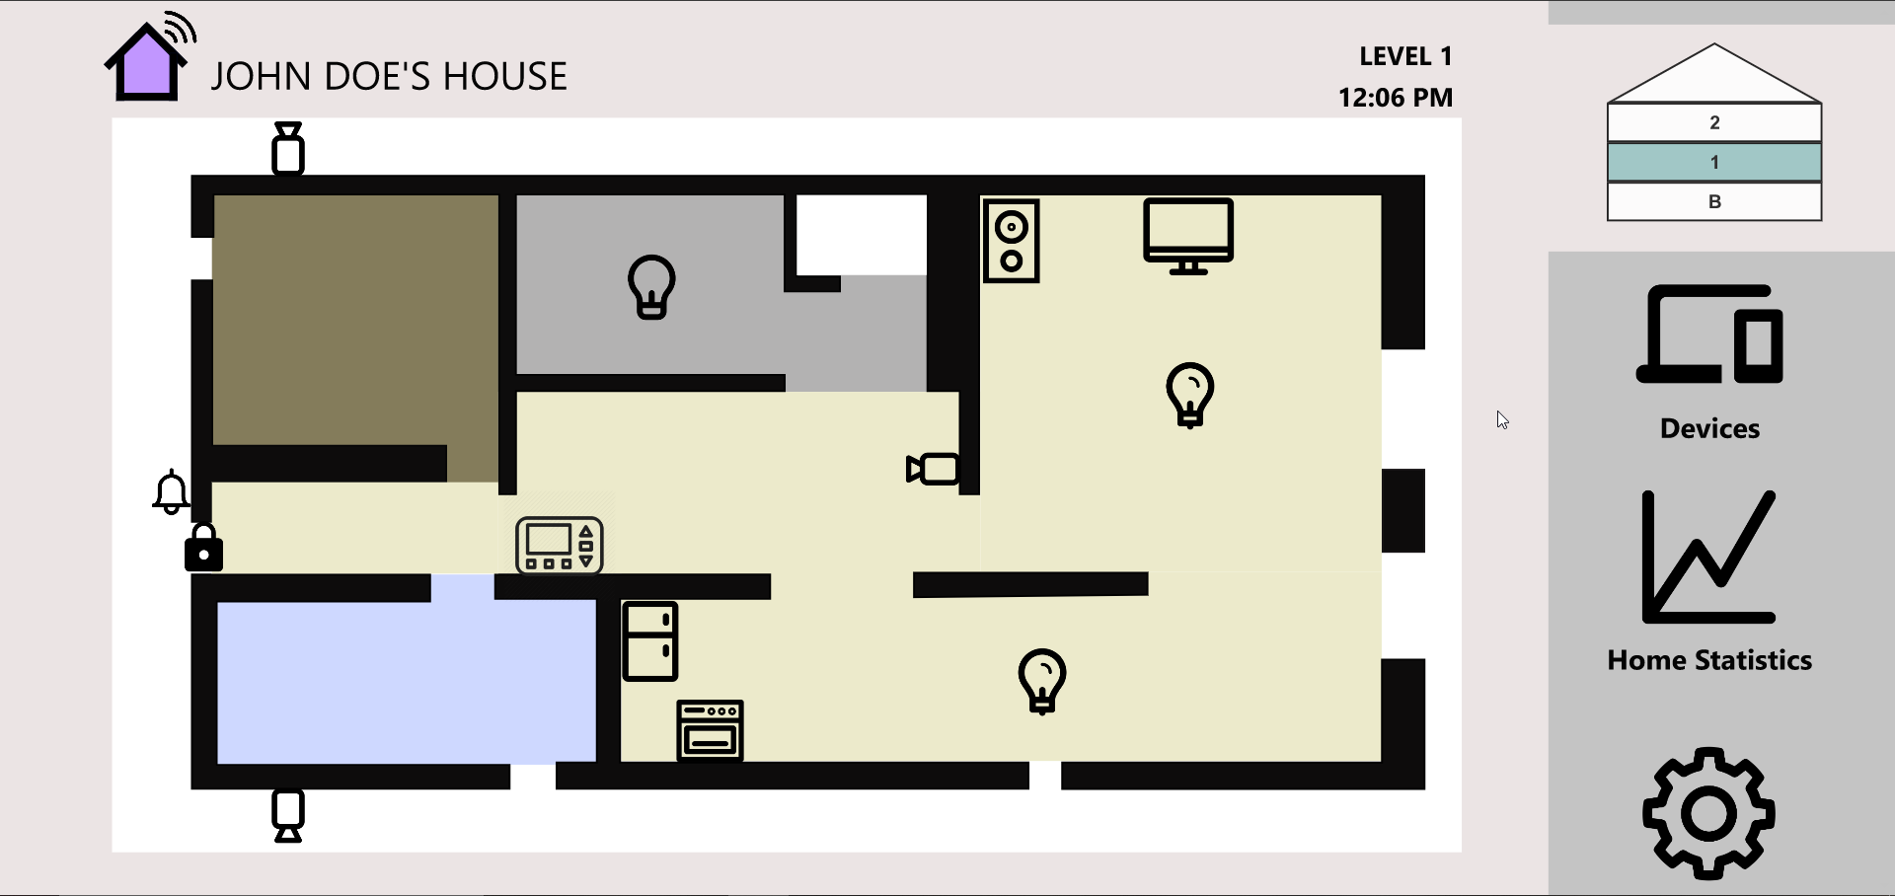
Initial Prototype

Slide 8
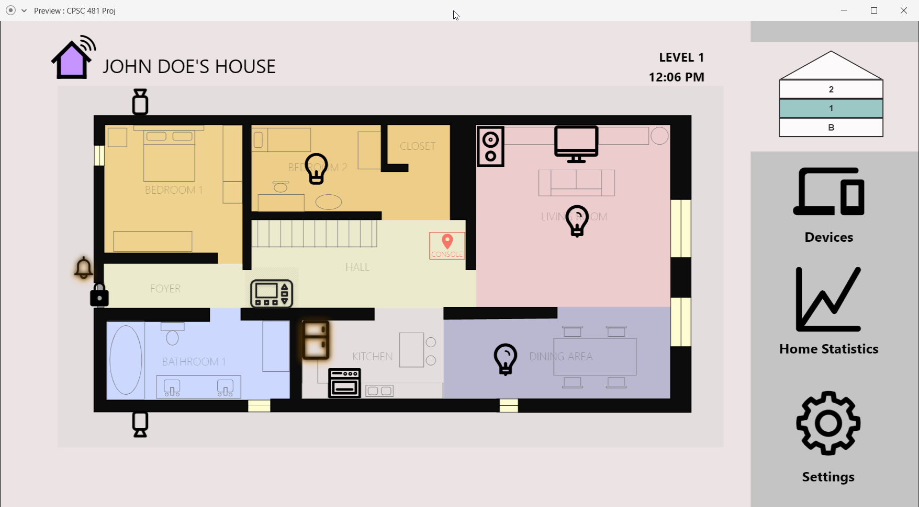
Final Prototype

Slide 9
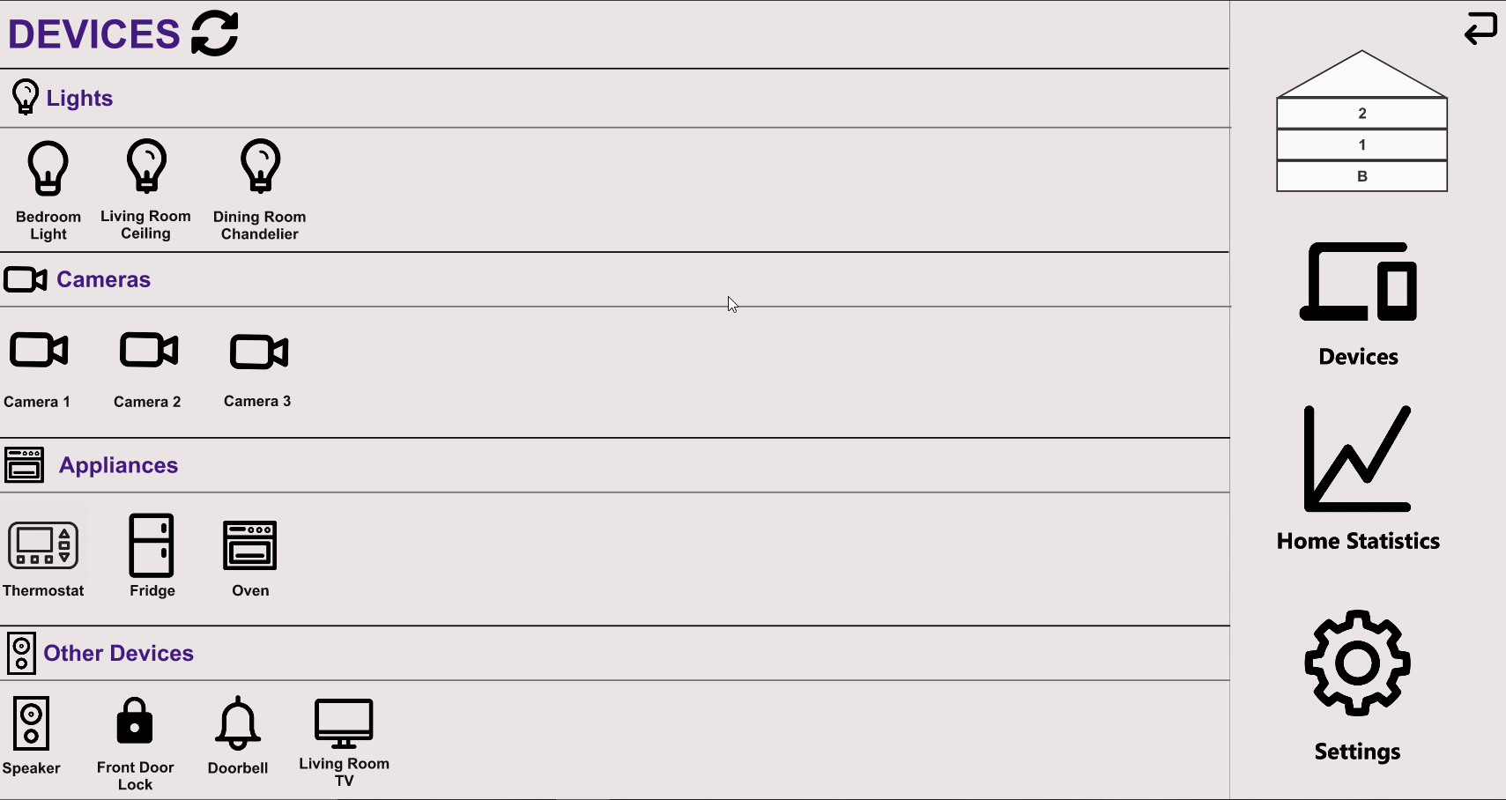
Initial Prototype

Slide 10
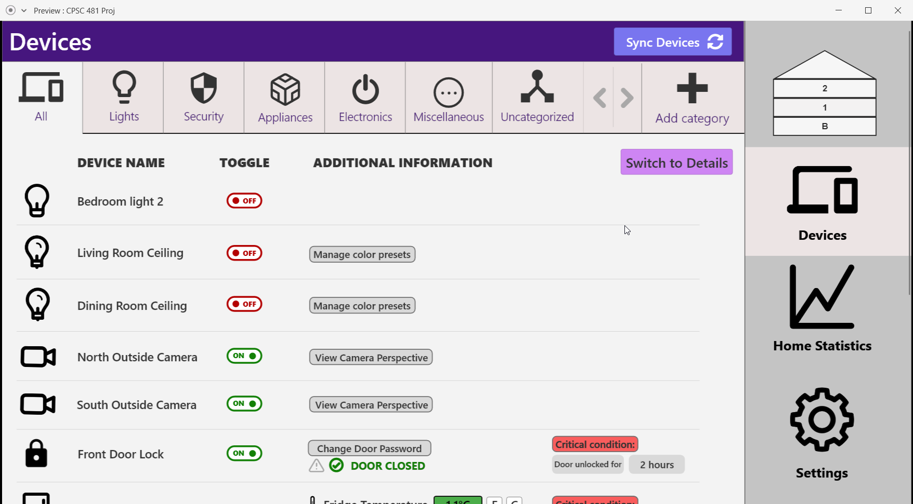
Final Prototype

Slide 11
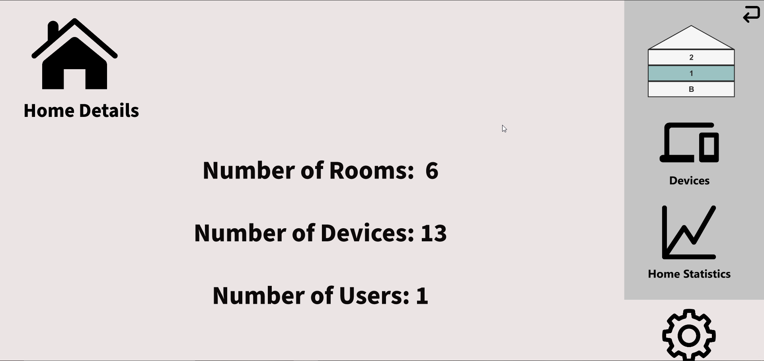
Initial Prototype

Slide 12
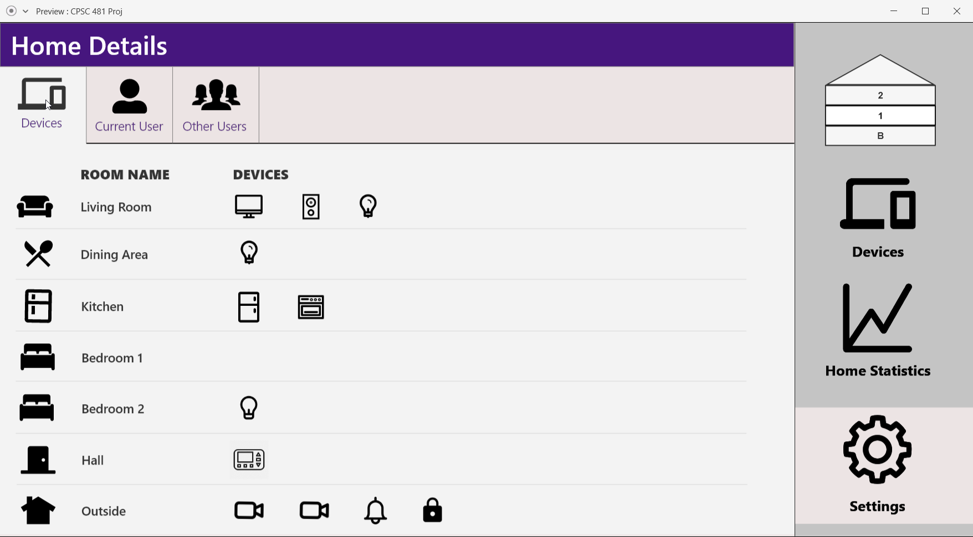
Final Prototype

Slide 13
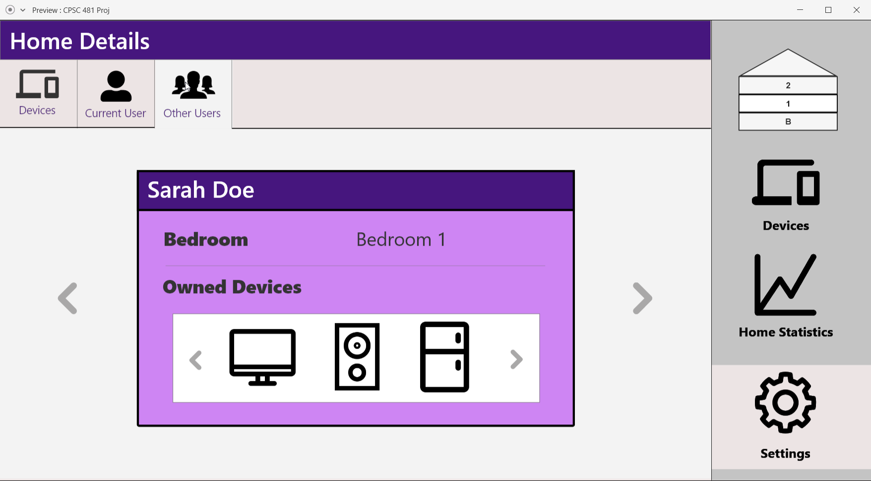
Final Prototype

Slide 14
Final Hi-Fi Prototype
https://xd.adobe.com/view/367c853f-9e22-4e1e-6688-2350bbd28618-404d/?fullscreen&hints=off

Slide 15
Questions?

