Slide 1
Palette Scorer
Eric Fernandez and Jacob Kattampilly

Slide 2
What we are trying to do
Given a set of designer palettes that are inspired from images (and assumed to be good) can we train a model to score new palettes?

Slide 4
Strategies used for Algorithmic Palettes
K means
Mini Batch K means
Random Sampling

Slide 5
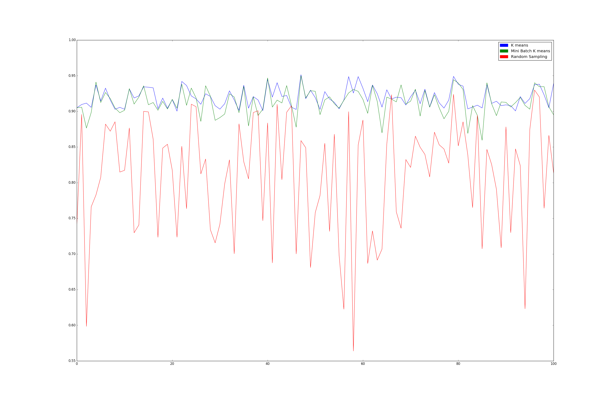

Slide 6
Scorer
Uses Bipartite matching and generates a score for palettes compared to an ideal palette (artist palettes are considered ideal palettes).
Score = 1 – (normalized distance from ideal palette)

Slide 7
Feature Extraction
We use the following features for training the model:
Pixel Coverage Features
Lightness Coverage
Saturation Coverage
Soft Recoloring Error
Color Diversity Features (Within Palette)
Mean Distance
Max Distance
Min Distance

Slide 8
Features Observations
The coefficient of detemination:
Features | Accuracy
All | 80%
Pixel Coverage | 79-80%
Color Diversity | 0.05 %

Slide 9
Training the Model
We use Lasso Regression to create the model.
We were able to achieve an accuracy of approximately 80 % while training

Slide 10
Validation
We give an input of a good and bad palette to the model in order to generate scores.
These good/bad palettes are chosen by a designer
The scores reflect how good/bad the palette is with reference to a designer palette.

