Slide 1
Acquiring Diverse Skills using Curriculum Reinforcement Learning with Mixture of Experts
Onur Celik
Aleksandar Taranovic
Gerhard Neumann
Presented by: Jacob Lapenna*
Background (CEPS)
Energy-based curriculum model
Tractable lower bound optimizations
Results
*None of the views presented here reflect those of the authors, this is just my present understanding of the topic.

Slide 2
Contextual Episodic Policy Search (CEPS)
Does not rely on the SARSA Markov assumption
Can learn with an unknown state space, the input is a context
Context remains fixed for >= episode
Context usually encompasses a goal:
As presented:
Desired strike location of a tennis ball
Extend to:
Desired genre of fiction
Desired return from financial markets
Output
As presented
Motion primitive (i.e., a trajectory for an object held by a robotic arm)
Extend to:
A writing primitive (i.e., tone and style, vocabulary and syntax, etc)
A trading primitive (i.e., entry and exit thresholds, time horizons, etc)
Notes:
I would argue the universe is Markovian we just don’t always have access to the needed state space. For this reason, contextual learning is needed. We can always define a context or goal. A robotic arm placing an object at a desired location,

Slide 3


Exploration via Maximum Entropy
Note we are only optimizing WRT $π\left(θ | c\right)$
Expectation over $p(c)$
No automatic curriculum adjustments

Slide 4
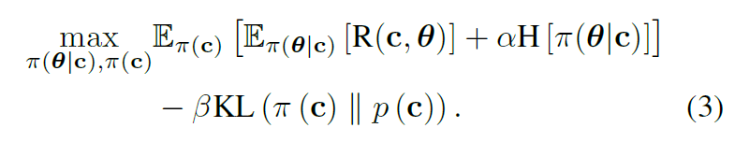
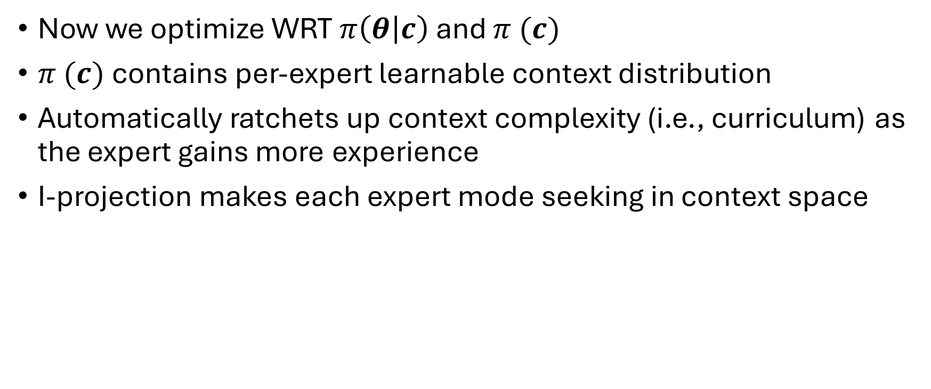
KL-Regularization of Learnable Context Policy
Now we optimize WRT $π\left(θ | c\right)$and $π (c)$
$π (c)$ contains per-expert learnable context distribution
Automatically ratchets up context complexity (i.e., curriculum) as the expert gains more experience
I-projection makes each expert mode seeking in context space

Slide 5
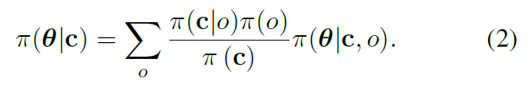

MoE Policy
The policy is a distribution over experts using a learnable gating policy
This policy definition allows each expert $o$ to adjust its curriculum by explicitly optimizing for$π(c|o)$, the per-expert context distribution

Slide 6


MoE Policy
The policy is a distribution over experts using a learnable gating policy
This policy definition allows each expert $o$ to adjust its curriculum by explicitly optimizing for$π(c|o)$, the per-expert context distribution
$$π(o|c)$$

Slide 7
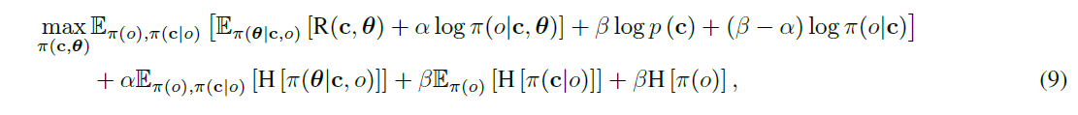
MoE Optimization
This policy makes the optimization intractable
Solution: determine a surrogate optimizations for each expert’s context distribution and policy which, together, form a conservative estimate of the optimization (i.e., lower bounds)
See Celik et al. 2022 for derivations
Notes:
Interdependence of main policy on per-expert context distribution makes the optimization intractable.

Slide 8
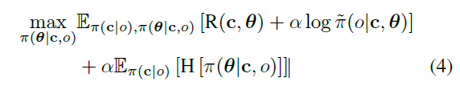
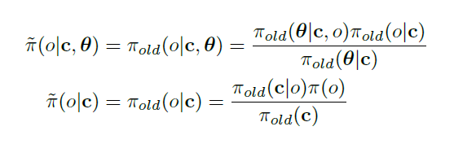
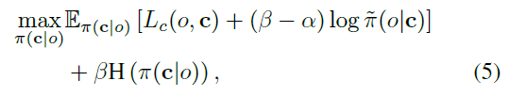
Tractable Lower Bounds
As derived in Celik et al. 2022

Slide 9
Tractable Lower Bound Surrogate
Specialization
As derived in Celik et al. 2022

Slide 10
Tractable Lower Bound Surrogate
Diversity
As derived in Celik et al. 2022
Notes:
In (4), H prevents the expert from becoming overly deterministic. In (5), H allows multiple experts (differing skills) cover the same context (i.e., diversity of skills for the same problem). This is robustness.

Slide 11
Tractable Lower Bound Surrogate
Specialization
Last Iteration
Diversity
Present Iteration
Incentivizes each expert to fully explores its space
As derived in Celik et al. 2022
Notes:
In (4), H prevents the expert from becoming overly deterministic. In (5), H allows multiple experts (differing skills) cover the same context (i.e., diversity of skills for the same problem). This is robustness.

Slide 12
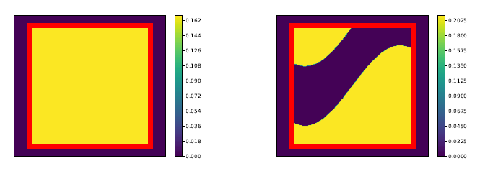
This has all been done before…
Gaussian context distributions and other standard normalizing flows cannot approximate discontinuities and invalid context space as easily, causing invalid contexts to be learned, wasting compute

Slide 13

This has all been done before…
What’s novel about this paper is stepping away from Gaussian curriculum distributions to energy-based models. A nonlinear, learnable energy function allows for discontinuities and deeper complexity in the context space.

Slide 14
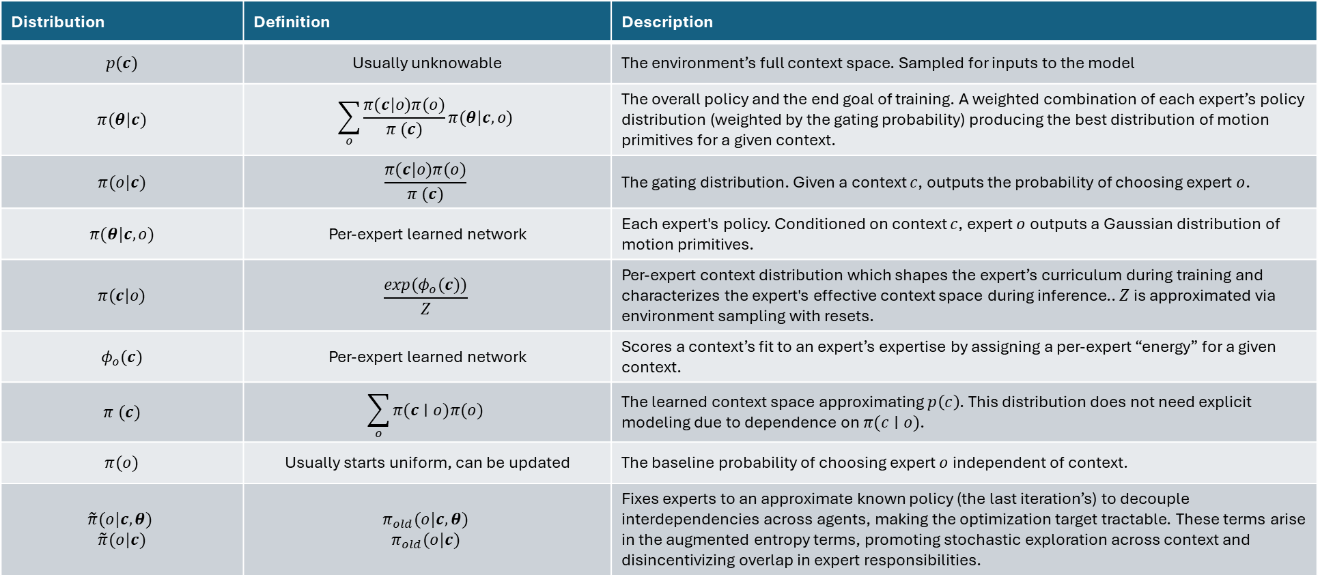
Distribution | Definition | Description
$$p(c)$$ | Usually unknowable | The environment’s full context space. Sampled for inputs to the model
$$π(θ|c)$$ | $$\sum_{o}{\frac{π(c|o)π(o)}{π (c)}π(θ|c, o)}$$ | The overall policy and the end goal of training. A weighted combination of each expert’s policy distribution (weighted by the gating probability) producing the best distribution of motion primitives for a given context.
$$π(o|c)$$ | $$\frac{π(c|o)π(o)}{π (c)}$$ | The gating distribution. Given a context $c$, outputs the probability of choosing expert $o$.
$$π(θ|c, o)$$ | Per-expert learned network | Each expert's policy. Conditioned on context $c$, expert $o$ outputs a Gaussian distribution of motion primitives.
$$π(c|o)$$ | $$\frac{exp(φ_{o}(c))}{Z}$$ | Per-expert context distribution which shapes the expert’s curriculum during training and characterizes the expert's effective context space during inference.. $Z$ is approximated via environment sampling with resets.
$$φ_{o}​(c)$$ | Per-expert learned network | Scores a context’s fit to an expert’s expertise by assigning a per-expert “energy” for a given context.
$$π (c)$$ | $$\sum_{o}{π(c∣o)π(o)}$$ | The learned context space approximating $p\left(c\right)$. This distribution does not need explicit modeling due to dependence on $π(c∣o)$.
$$π(o)$$ | Usually starts uniform, can be updated | The baseline probability of choosing expert $o$ independent of context.
$$\tilde{π}(o|c,θ)$$ $$\tilde{π}(o|c)$$ | $$π_{old}(o|c,θ)$$ $$π_{old}​(o|c)$$ | Fixes experts to an approximate known policy (the last iteration’s) to decouple interdependencies across agents, making the optimization target tractable. These terms arise in the augmented entropy terms, promoting stochastic exploration across context and disincentivizing overlap in expert responsibilities.

Slide 15
Distribution | Definition | Description
$$p(c)$$ | Usually unknowable | The environment’s full context space. Sampled for inputs to the model
$$π(θ|c)$$ | $$\sum_{o}{\frac{π(c|o)π(o)}{π (c)}π(θ|c, o)}$$ | The overall policy and the end goal of training. A weighted combination of each expert’s policy distribution (weighted by the gating probability) producing the best distribution of motion primitives for a given context.
$$π(o|c)$$ | $$\frac{π(c|o)π(o)}{π (c)}$$ | The gating distribution. Given a context $c$, outputs the probability of choosing expert $o$.
$$π(θ|c, o)$$ | Per-expert learned network | Each expert's policy. Conditioned on context $c$, expert $o$ outputs a Gaussian distribution of motion primitives.
$$π(c|o)$$ | $$\frac{exp(φ_{o}(c))}{Z}$$ | Per-expert context distribution which shapes the expert’s curriculum during training and characterizes the expert's effective context space during inference.. $Z$ is approximated via environment sampling with resets.
$$φ_{o}​(c)$$ | Per-expert learned network | Scores a context’s fit to an expert’s expertise by assigning a per-expert “energy” for a given context.
$$π (c)$$ | $$\sum_{o}{π(c∣o)π(o)}$$ | The learned context space approximating $p\left(c\right)$. This distribution does not need explicit modeling due to dependence on $π(c∣o)$.
$$π(o)$$ | Usually starts uniform, can be updated | The baseline probability of choosing expert $o$ independent of context.
$$\tilde{π}(o|c,θ)$$ $$\tilde{π}(o|c)$$ | $$π_{old}(o|c,θ)$$ $$π_{old}​(o|c)$$ | Fixes experts to an approximate known policy (the last iteration’s) to decouple interdependencies across agents, making the optimization target tractable. These terms arise in the augmented entropy terms, promoting stochastic exploration across context and disincentivizing overlap in expert responsibilities.
Notes:
This is what’s novel in this paper.

Slide 16
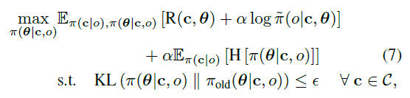
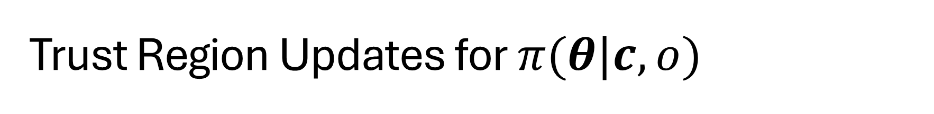
Trust Region Updates for $π(θ|c, o)$
Valid for smooth, continuous distributions (KL is an integral over probability mass)
The expert policy is a Gaussian distribution (smooth and continuous)

Slide 17
Trust Region Updates for $π(θ|c, o)$
Valid for smooth, continuous distributions (KL is an integral over probability mass)
The expert policy is a Gaussian distribution (smooth and continuous)

Slide 18
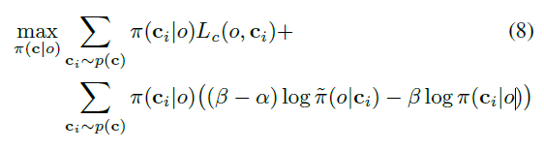

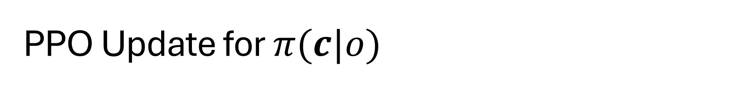
PPO Update for $π(c|o)$
The curriculum is not smooth due to $Z$ approximation (stochastic and discrete) and $φ_{o}​(c)$ (non-smooth changes between iterations)
Rewrite as sum over context samples:

Slide 19
PPO Update for $π(c|o)$
The curriculum is not smooth due to $Z$ approximation (stochastic and discrete) and $φ_{o}​(c)$ (non-smooth changes between iterations)
Rewrite as sum over context samples:

Slide 20
PPO Update for $π(c|o)$
The curriculum is not smooth due to $Z$ approximation (stochastic and discrete) and $φ_{o}​(c)$ (non-smooth changes between iterations)
Rewrite as sum over context samples:

Slide 21
PPO Update for $π(c|o)$
The curriculum is not smooth due to $Z$ approximation (stochastic and discrete) and $φ_{o}​(c)$ (non-smooth changes between iterations)
Rewrite as sum over context samples:
$$\min\left({r(c}_{i})A\left(c_{i}\right), clip\left(r\left(c_{i}\right), 1−ε, 1+ε\right)A(c_{i})\right)$$

Slide 22
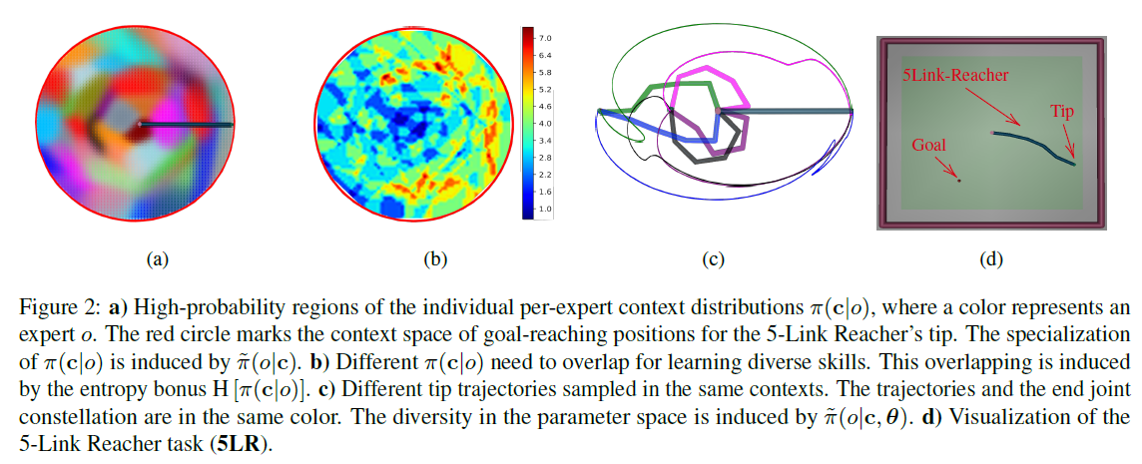
Diversity & Specialization Emerges
Notes:
If pi_old already shows a high probability in that space, the context is rewarded, incentivizing specialization (figure (a)). The entropy terms encourage diversity or a high entropy per-expert context space, inducing overlap (figure 2 shows expert count for a region of context space). Figure c shows a samples set of motion primitives for a given context. Figure d shows the 5-link reacher task (note swaure context space but (a) shows the reacher’s possible context).
Interestingly, in (b) the expert overlap correlates to likely initial conditions of the reacher indicating that experts prefer low energy trajectories and these are the easiest to solve. This is also likely the curriculum adapting. Most experts still have their most easily learned expertise.

Slide 23
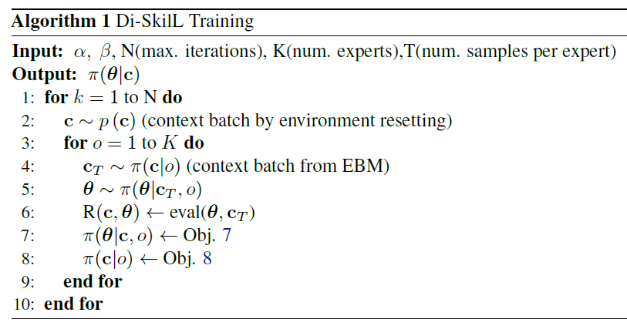
Algorithm – Training

Slide 24
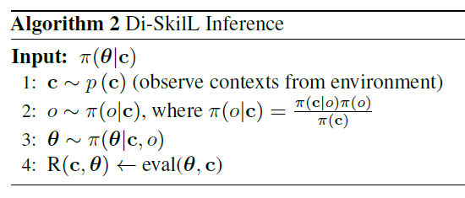
Algorithm – Inference
For each expert:

Slide 25
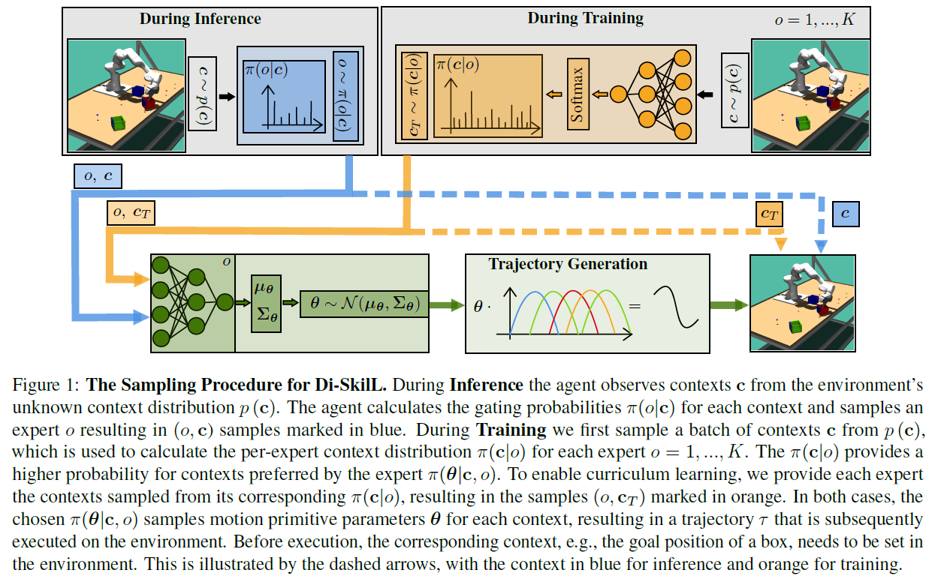

Slide 26
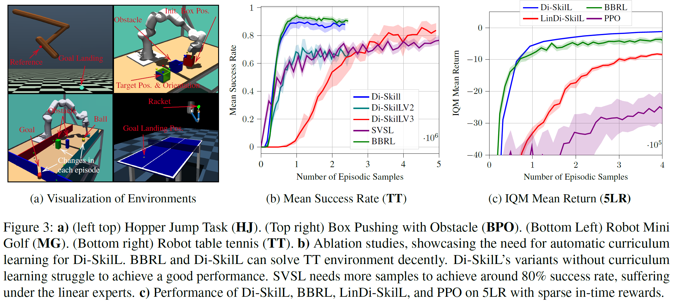
Experiments/Results

Slide 27
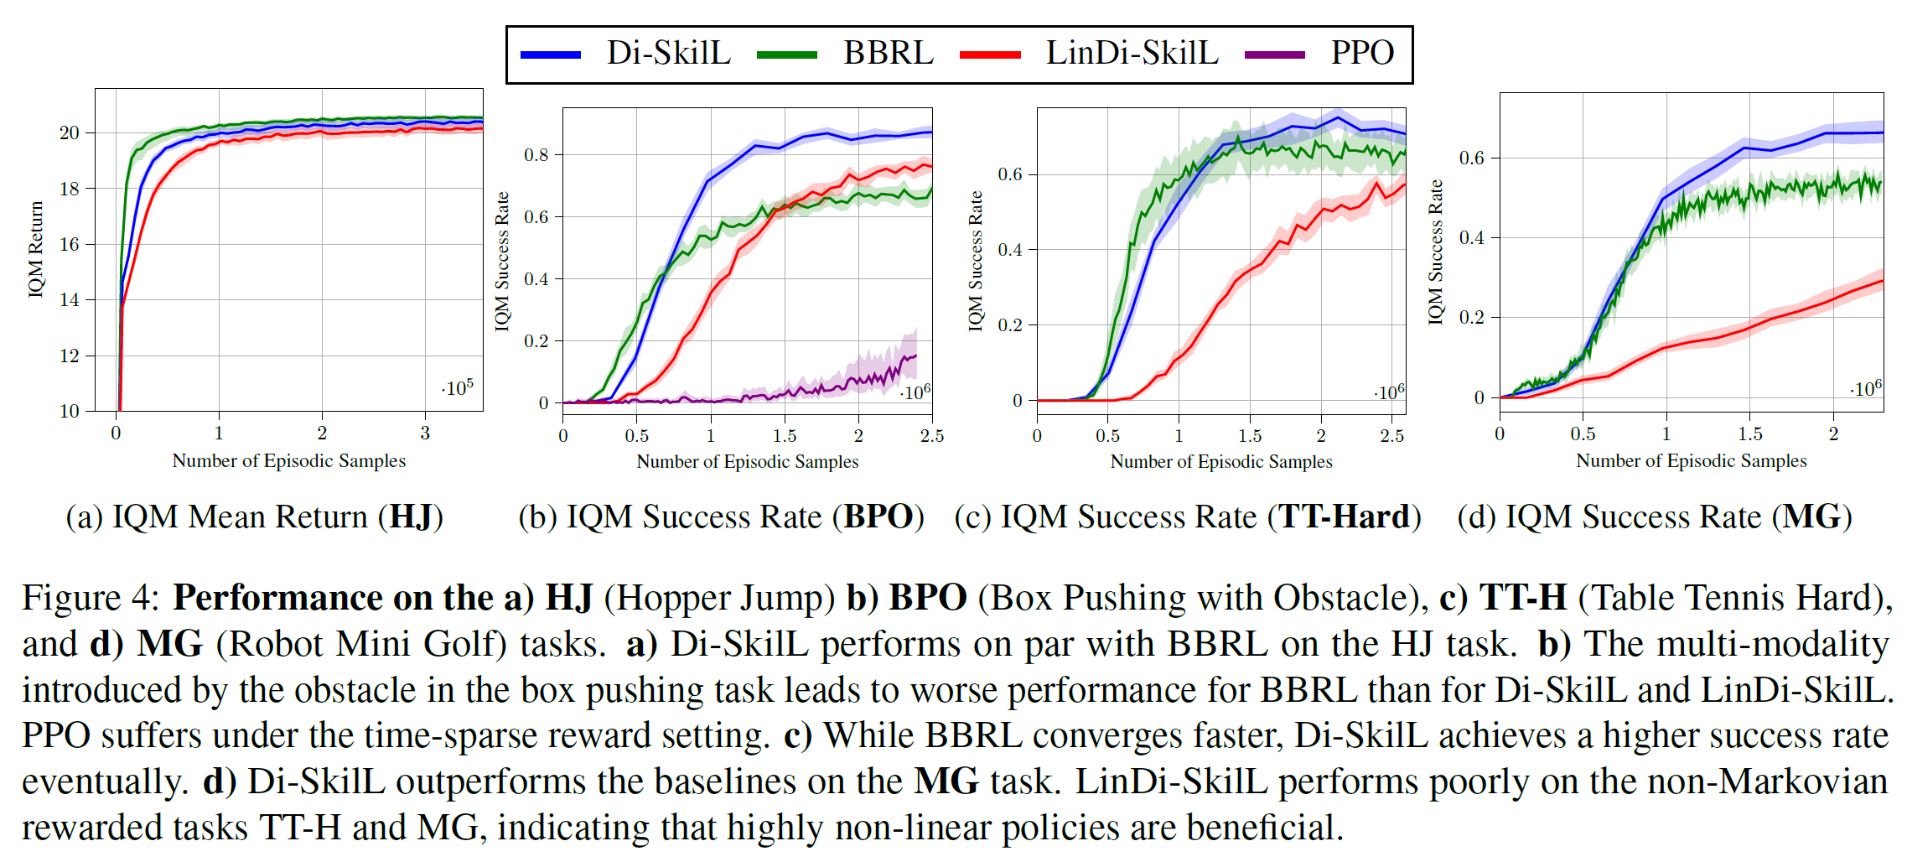
Experiments/Results

Slide 28
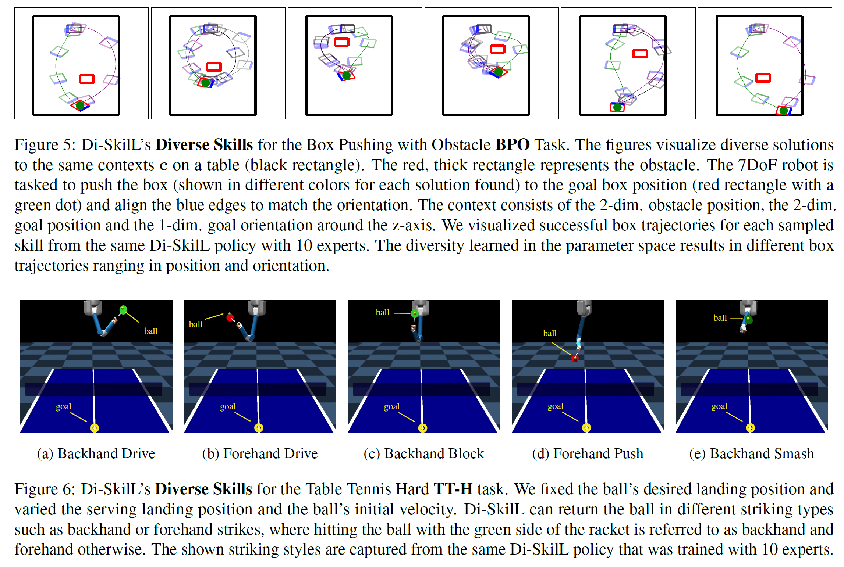
Experiments/Results

