Slide 1
Capstone: Math Review & NeuralNetworkClass
Instructions:
Give your presentation a name and be sure to put your group number in the placeholder.
This template will be use for the final delivery of your project
By: Jacob Goodman
Adviser: Michael Schulte

Slide 2
Agenda
Instructions:
Do not edit this slide
Overview
Learning Math
Neural Network Class
Why a Neural Network
Sample Problems
Next Steps
Lessons Learned

Slide 3
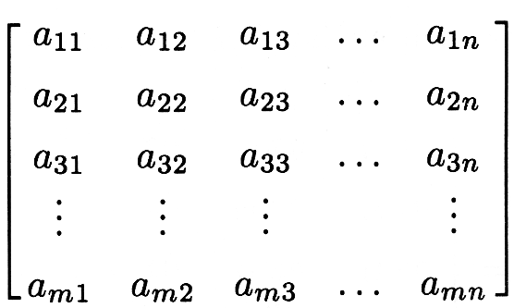

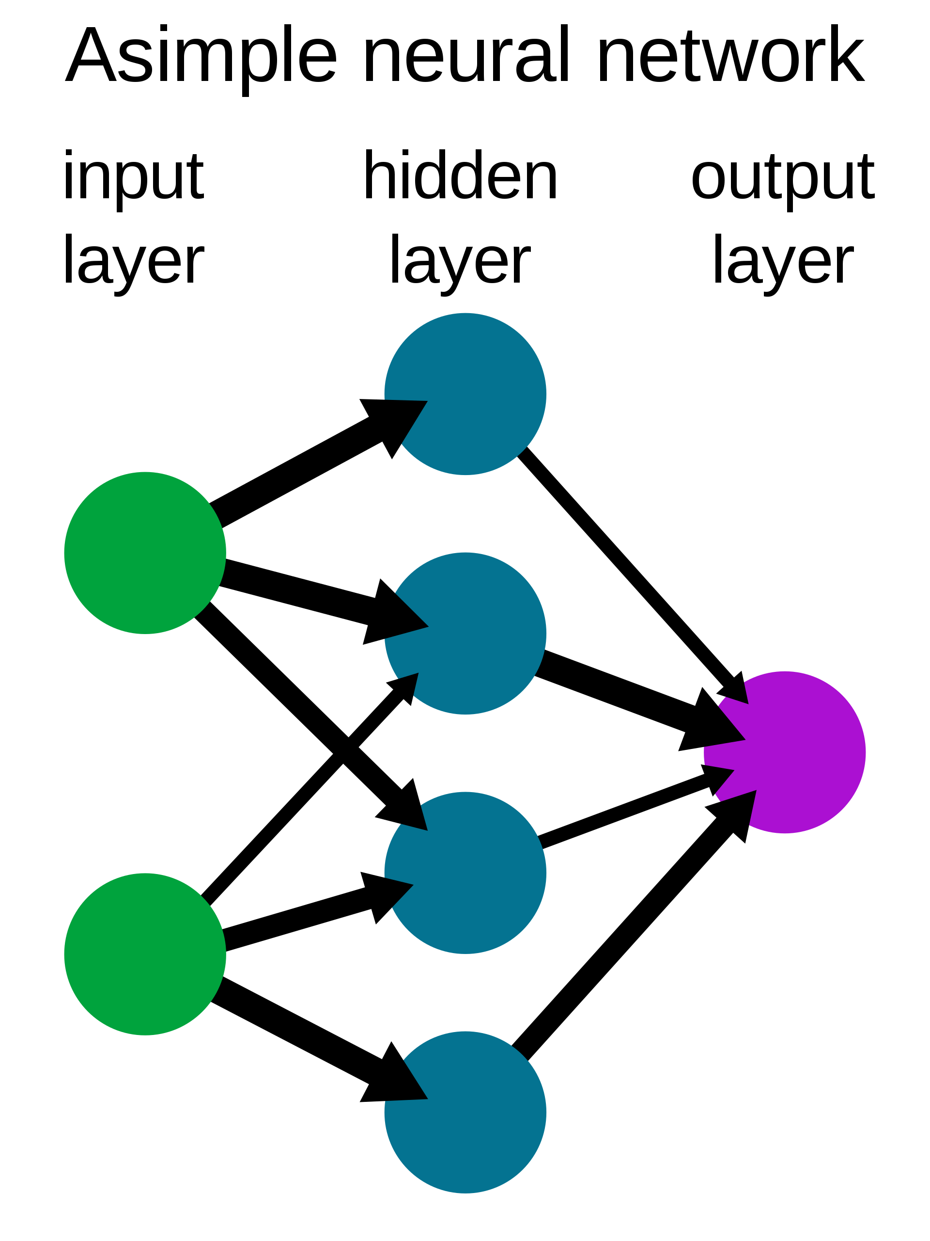
Overview
Instructions:
Use this slide to describe your project in as brief as 3 sentences. Feel free to update this with graphics
The goal of my Capstone was work was to rectify my foundational weakness in math and then utilize those skills to build a NeuralNetwork.
Linear Algebra
Calculus
Neural Network

Slide 4
Did I replace Keras/Tensorflow?

Slide 5
Nope!

Slide 6
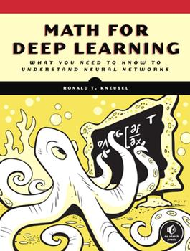
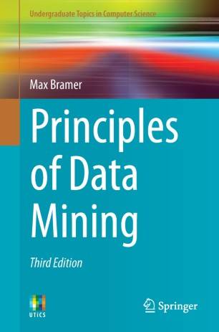


Learning Resources

Slide 7
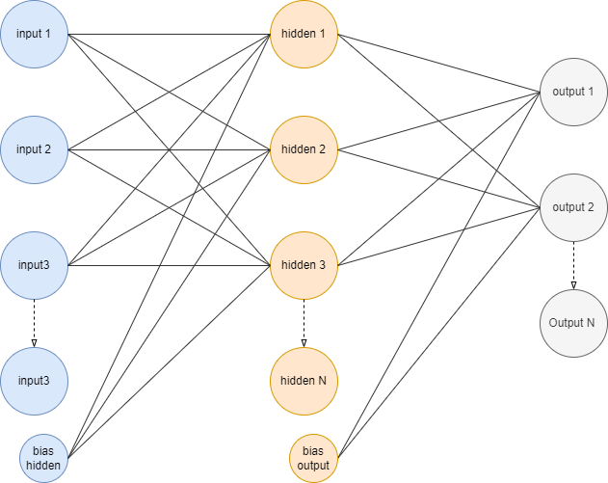
My Neural Network Class
Feed forward Neural network OR MLP
Only Dependency: Numpy
Makes predictions based on internally stored weight matrix’s
Trains via gradient descent
single record
stochastically
mini batch
•Activation functions:
Sigmoid
Tanh
ReLU

Slide 8
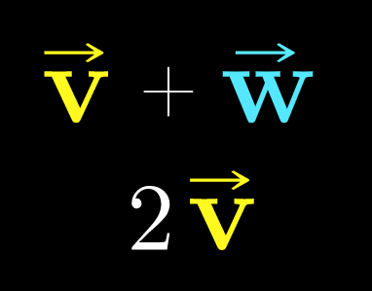
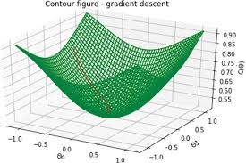
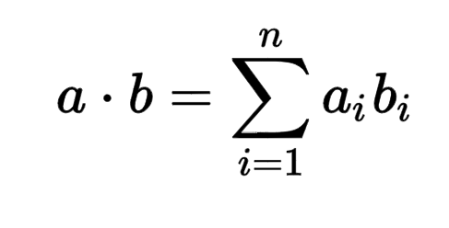
Math and Neural Networks
Linear Algebra|Forward Propagation
Calculus | Gradient Descent
Vectors
Dot product
Distance
Derivatives
Chain rule

Slide 9
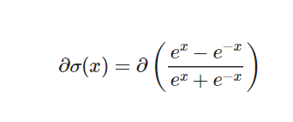
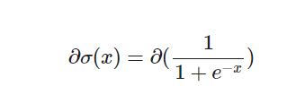

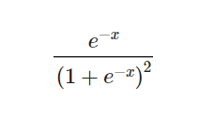
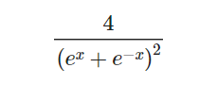
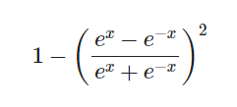

Activation Functions
Sigmoid
Hyperbolic Tangent
RELU
Their Derivatives

Slide 10
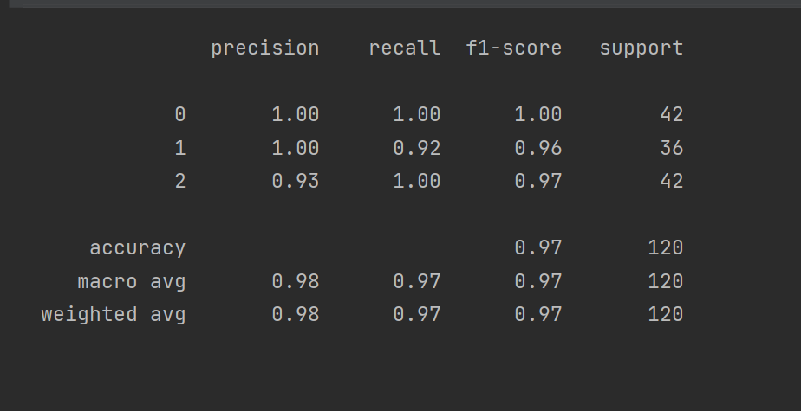
Iris data set
Problem type: classification
Activation function: Sigmoid
Alpha: .1
Network shape:
input: 4
Hidden: 3
Output: 3
Data set: info

Slide 11
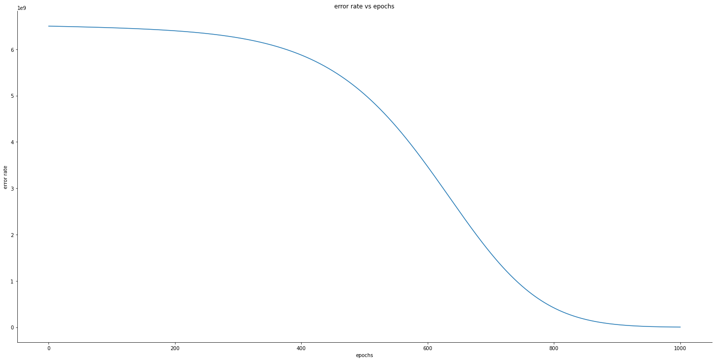
Hitters data set:
Problem type: Regression
Activation function: ReLU
Alpha: 1e-06
Batch size: 10
Network shape:
input: 21
Hidden: 15
Output: 1
Num Epochs = 1,100
Final r² = 881,455
Data source

Slide 12

Possible next steps for this project
Instructions:
Describe the top 3 challenges of your project and why they were a challenge
Gradient Clipping
Other Error functions:
Cross entropy (binary, multiple)
Mean absolute error
Log error
Different activation functions only on output nodes:
Softmax

Slide 13

Lessons Learned
The following are the key lessons learned from the project.
Trying to be less sophomoric.
Understanding what's going on under the hood so you fix things when they doing work right.
Data science is 80% programming
Learning enough to be able to continue to learn

