Slide 1
Capstone: Math Review & NeuralNetworkClass
Instructions:
Give your presentation a name and be sure to put your group number in the placeholder.
This template will be use for the final delivery of your project
By: Jacob Goodman
Adviser: Michael Schulte

Slide 2
Agenda
Instructions:
Do not edit this slide
Overview
Math review
Neural Network class
Demo
Challenges
Lessons Learned

Slide 3
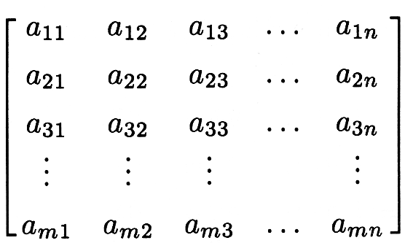

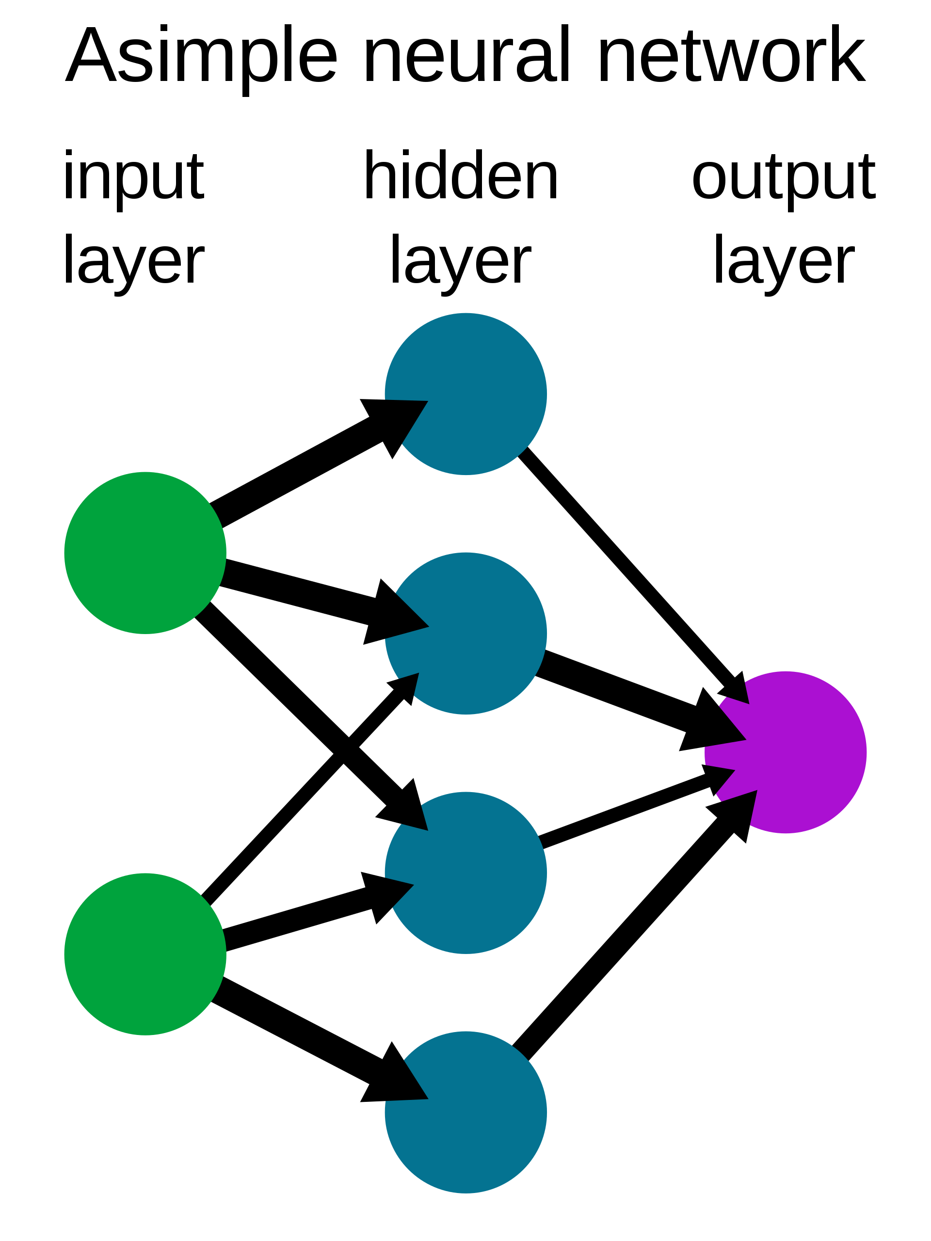
Overview
Instructions:
Use this slide to describe your project in as brief as 3 sentences. Feel free to update this with graphics
The goal of my Capstone was work was to rectify my foundational weakness in math and then utilize those skills to build a NeuralNetwork.
Linear Algebra
Calculus
Neural Network

Slide 4
Did I replace Keras/Tensorflow?

Slide 5
Nope!

Slide 6
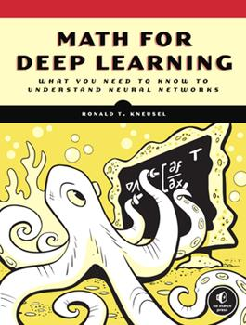
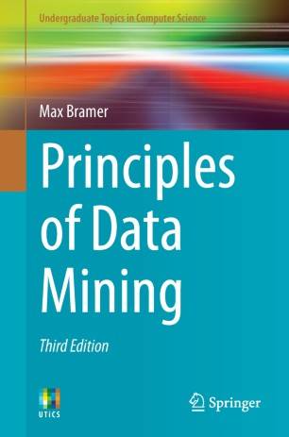
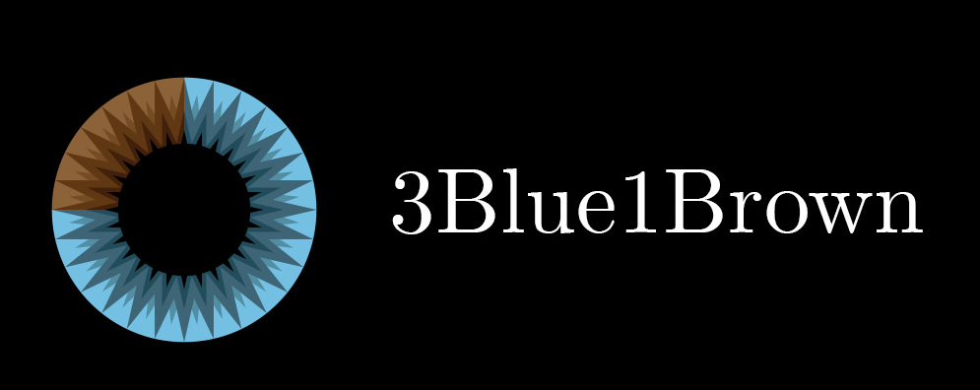

Learning resources

Slide 7
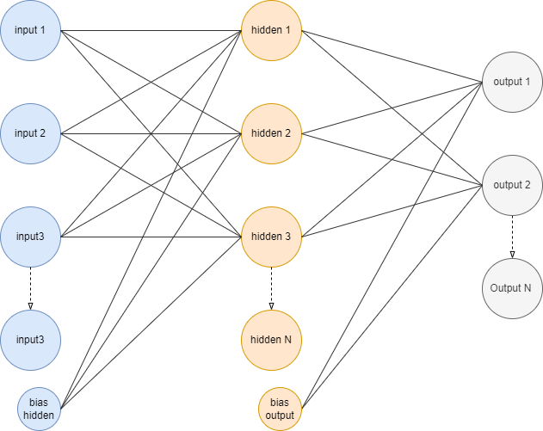
My Neural Network class
Feed forward Neural network OR MLP
Makes predictions based on internally stored weight matrix’s
Trains via gradient descent
single record
scholastically
mini batch
•Activation functions:
Sigmoid
Tanh
ReLU

Slide 8
Math and Neural Network
Forward Propagation / Linear Algebra
Backward Propagation / Calculus Differentiation

Slide 9
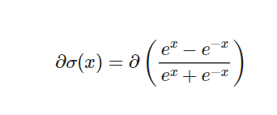
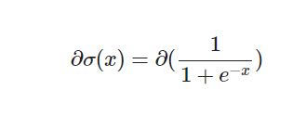

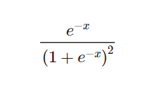
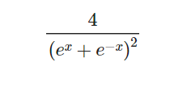
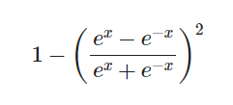

Activation functions
Sigmoid
Hyperbolic Tangent
RELU
Their derivatives

Slide 10
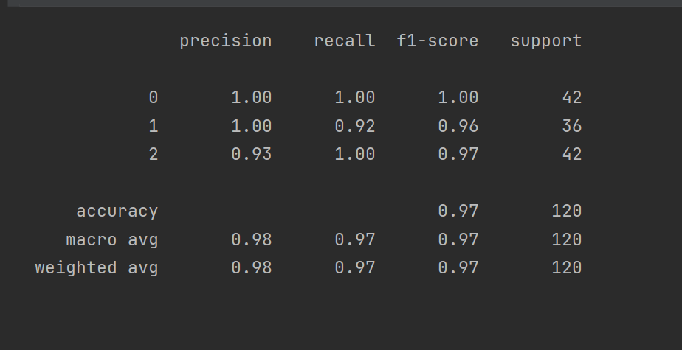
Iris data set
Problem type: classification
Activation function: Sigmoid
Alpha: .1
Network shape:
input: 4
Hidden: 3
Output: 3
Data set: info

Slide 11
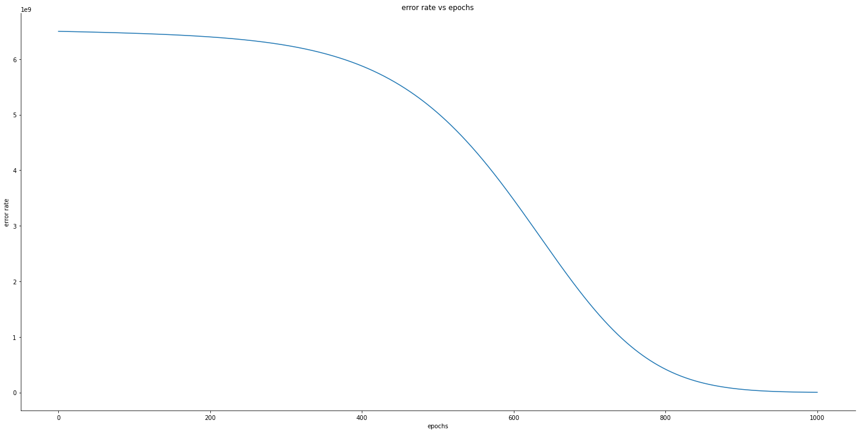
Hitters data set:
Problem type: Regression
Activation function: ReLU
Alpha: 1e-07
Batch size: 10
Network shape:
input: 4
Hidden: 3
Output: 3
Num Epochs = 1,100
Final r² = 881,455
Data source

Slide 12

Possible next steps for this project
Instructions:
Describe the top 3 challenges of your project and why they were a challenge
Gradient Clipping
Other Error functions:
Cross entropy (binary, multiple)
Mean absolute error
Log error
Different activation functions only on output nodes:
Softmax

Slide 13

Lessons Learned
The following are the key lessons learned from the project.
Maths!!!
They don’t have to be scary
Trying to be Less sophomoric
Becoming a better programmer
speak up early and often if you need help

