Slide 1
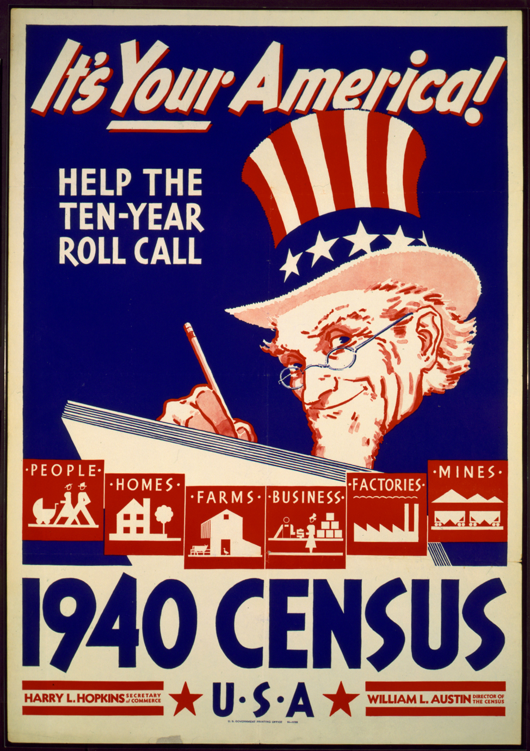
Mining Census Data
A DBSCAN Algorithm

Slide 2
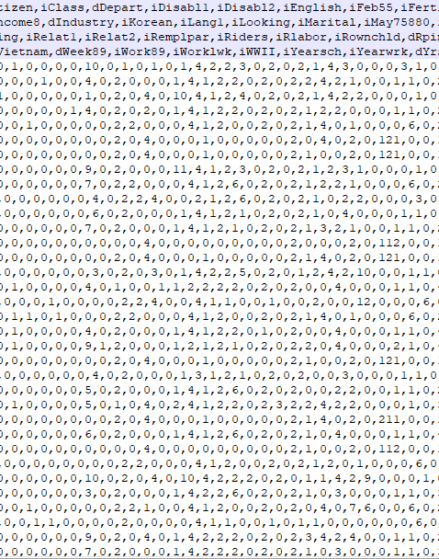
The Data
1990 US Census Data
Lots of attributes
LOTS of data

Slide 3
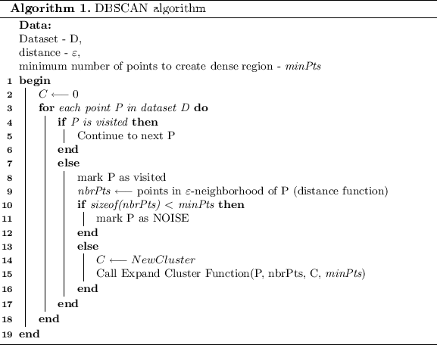
The Algorithm
DBSCAN – density based clustering algorithm
Clusters of arbitrary shape
Clustering is unsupervised learning
DBSCAN starts with arbitrary point
Clusters can merge

Slide 4
The Implementation
Java
Data too big at first
Implementation was difficult, as expected

