Slide 1

Digital Moment World Map
Morgan Stanly Code to Give 2022 Hackathon
In collaboration with Digital Moment

Slide 2

The issue
Teens and young adults need a web-based platform to discuss different issues, topics and idea with others all around the world

Slide 3
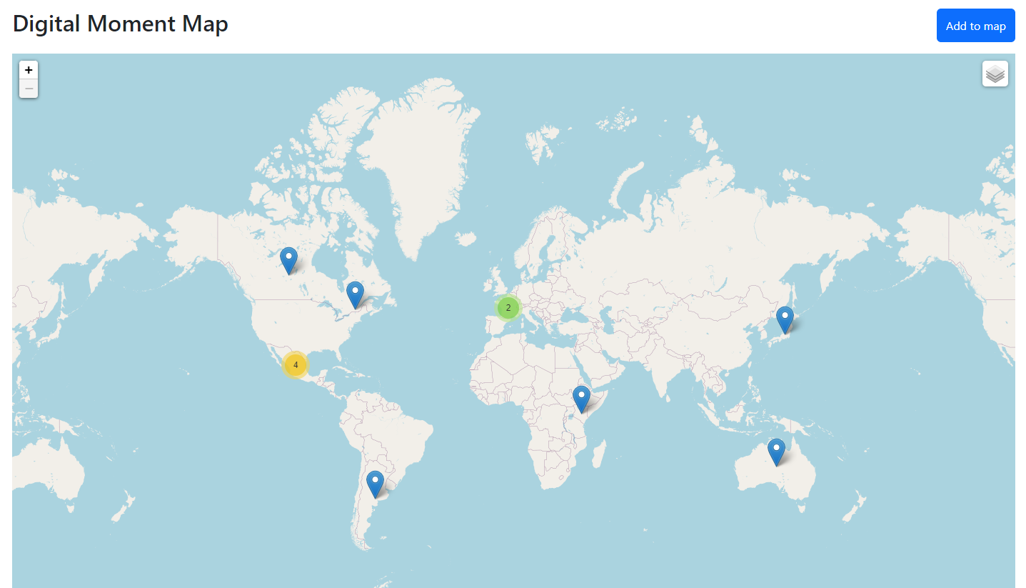
The idea
Interactive world-map that offers clickable location pins that display information and interactions.

Slide 4
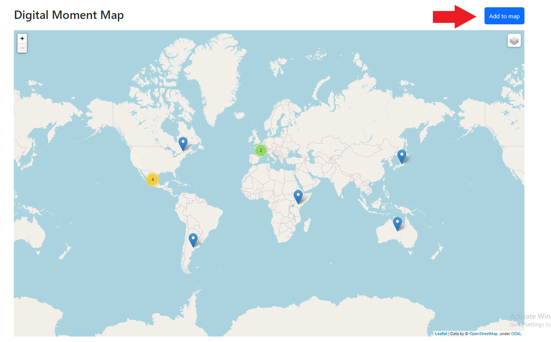
Functionality

Slide 5
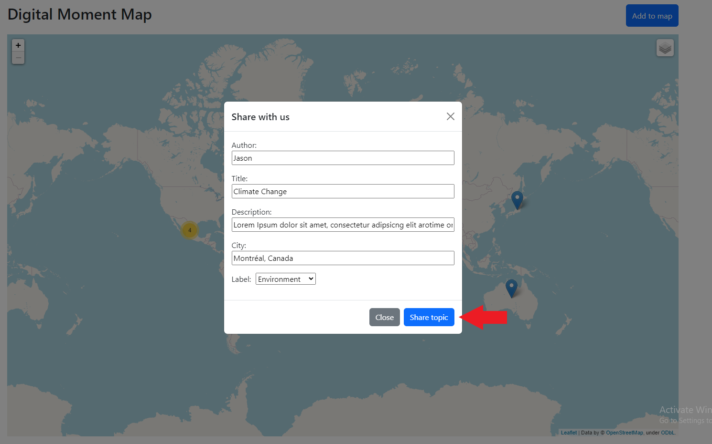
Functionality

Slide 6
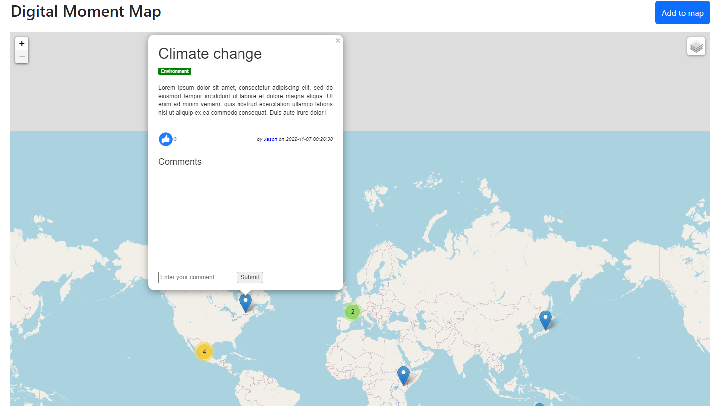
Functionality

Slide 7
The team
Jacob Massih (Team Leader)
Emir Tuncbilek (Python developer)
Jason Owaida (Python developer)
Yusuf Chahal (Java developer)

Slide 8

Technologies used
Python
Django
HTML
Maps API
GitHub

Slide 9
future improvements
Create a direct messaging feature between users
Being able to filter the map through the labels, city and number of likes.

Slide 10


Thank you for listening!

