Slide 1

Digital Moment World Map
Morgan Stanly Code to Give 2022 Hackathon
In collaboration with Digital Moment

Slide 2

The issue
Teens and young adults need a web-based platform to discuss different issues, topics and idea with others all around the world

Slide 3
Features
Adding topics, ideas and issues to the current world map
Adding a label to your topic
Clicking on the pins to see what topics are discussed in the desired areas of the world
As an admin, being able to filter through comments and topics.
As an admin, being able to delete comment and topics

Slide 4
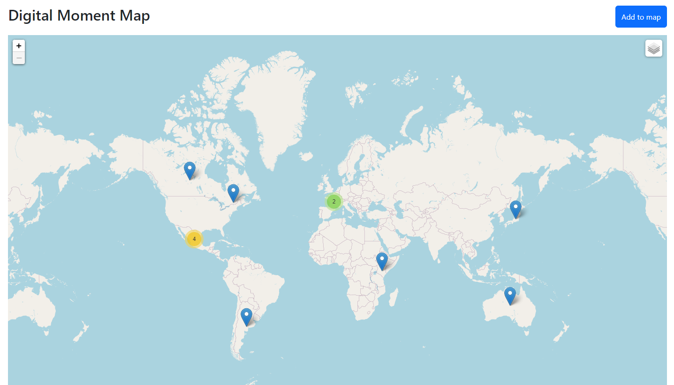
The idea
Interactive world-map that offers clickable location pins that display information and interactions.

Slide 5
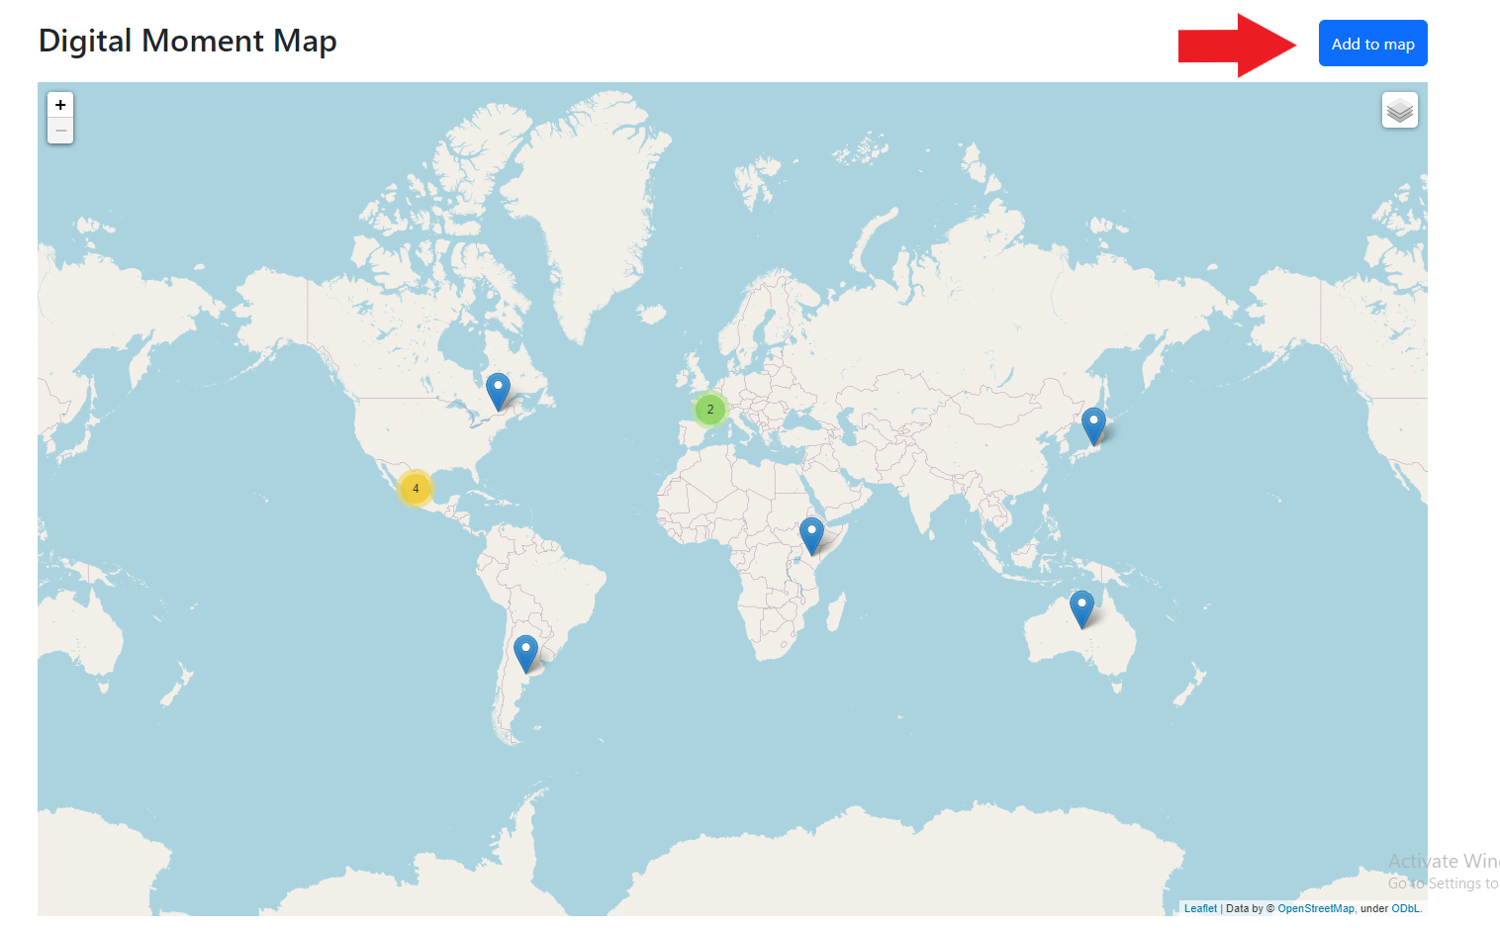
Functionality

Slide 6
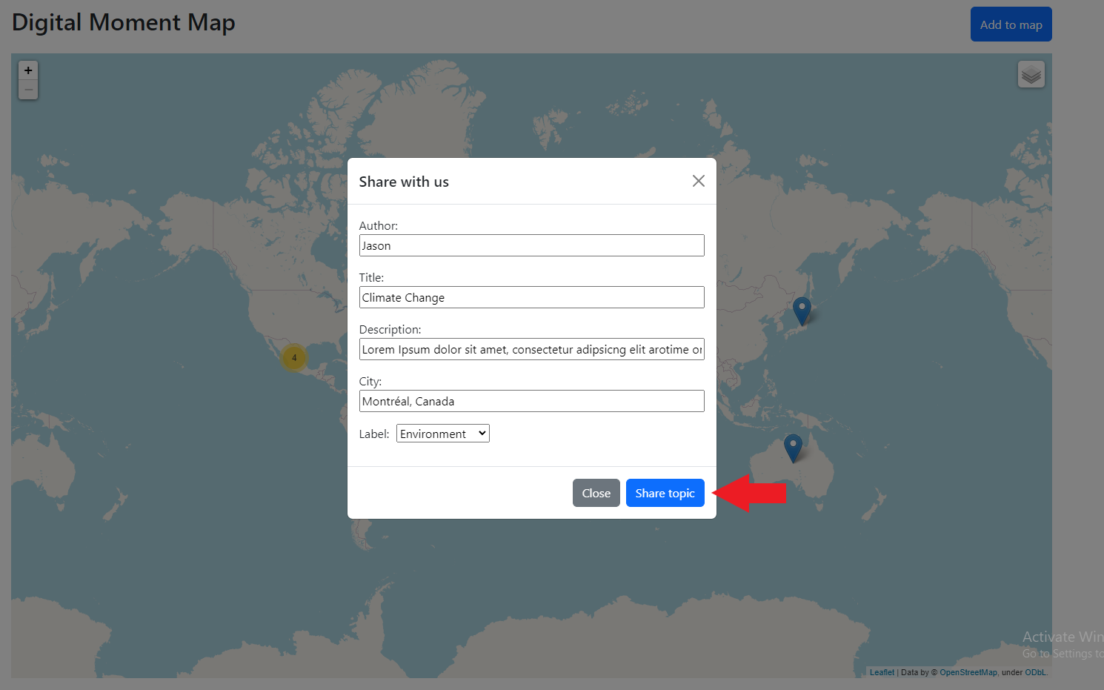
Functionality

Slide 7
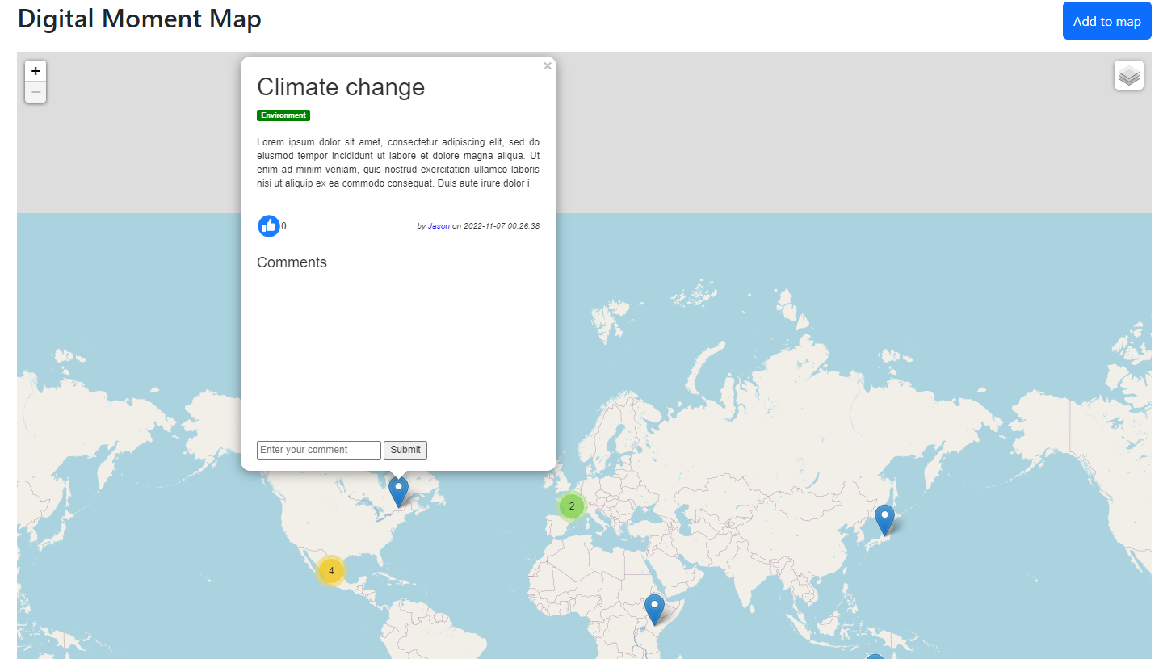
Functionality

Slide 8
The team
Jacob Massih (Team Leader)
Emir Tuncbilek (Python developer)
Jason Owaida (Python developer)
Yusuf Chahal (Java developer)

Slide 9

Technologies used
Python
Django
MySQL
HTML
Maps API
GitHub

Slide 10
future improvements
Create a direct messaging feature between users
Being able to filter the map through the labels, city and number of likes.

Slide 11


Thank you for listening!

