Slide 1
PROJECT PRESENTATION
KRISHNA RESORT BOOKING SYSTEM

Slide 2
ABSTRACT
Resort Booking is a web application that is created for booking rooms for the individuals. This will limit manual work and also make room allocation so much easier for the people and staff off the resort.It manages data in the database and retrieves it whenever required.
We design this system at the request of the resort management, through this they cannot require people to handle and calculate things. The developed system overcomes the drawbacks of manual room management it's said to be more user-friendly.
The modules are Registration, Room Allocation, Report. This software Online Hotel Management is developed using Python,Sqlite. Here, Python and Sqlite as back-end and HTML and CSS as front end. The software tools here is Microsoft SQL Server, here any web browser can be used. The development tool used here is pycharm.

Slide 3
REQUIREMENTS
REGISTRATION AND LOGIN
ADMIN CAN MANAGE ROOMS
ADMIN CAN MANAGE USERS
REPORT MODULES
USER CAN BOOK ROOM
USER CAN CANCEL ROOM

Slide 4
FEATURES AND HIGHLIGHTS
Registration & Login: Users should be able to create an account by providing necessary details.
Admin can manage resort rooms: Admin should be able to add new rooms to the system. Admin should be able to view, update, and delete existing rooms.
Admin can manage students: Admin should have the ability to add new users to the system. Admin should be able to view, update, and delete users.
Report Modules: The system should generate reports for admin and users regarding various aspects such as amount, room allocations, and personal details.
User can book rooms: Users should have the ability to specify their preferences while searching for the rooms.

Slide 5
TECHNICAL ASPECTS
Programming Language
Web Framework
Fronted Framework
Database(SqLite3)
Bootstrap
Jazzmin(DjangoAdmin)
Python Django(Backend)
Html,Css,JavaScript
3rd Part Libraries

Slide 6
Archetecture
Presentation Layer (Frontend): HTML/CSS: Responsible for the user interface and styling.
JavaScript: Handles interactivity and client-side validation
Database Layer:
Database Management System (DBMS): Stores and manages the system's data.
Relational Database (SQLite): Handles structured data related to users, bookings, buses, etc.
Application Layer (Backend):
Web Server: Receives HTTP requests and routes them to the appropriate components.
Authentication and Authorization: Manages user authentication and authorization for secure access to the system.
Business Logic: Implements the core functionalities of the flight booking system.
API: Defines endpoints to expose functionalities for frontend and external integrations.

Slide 7
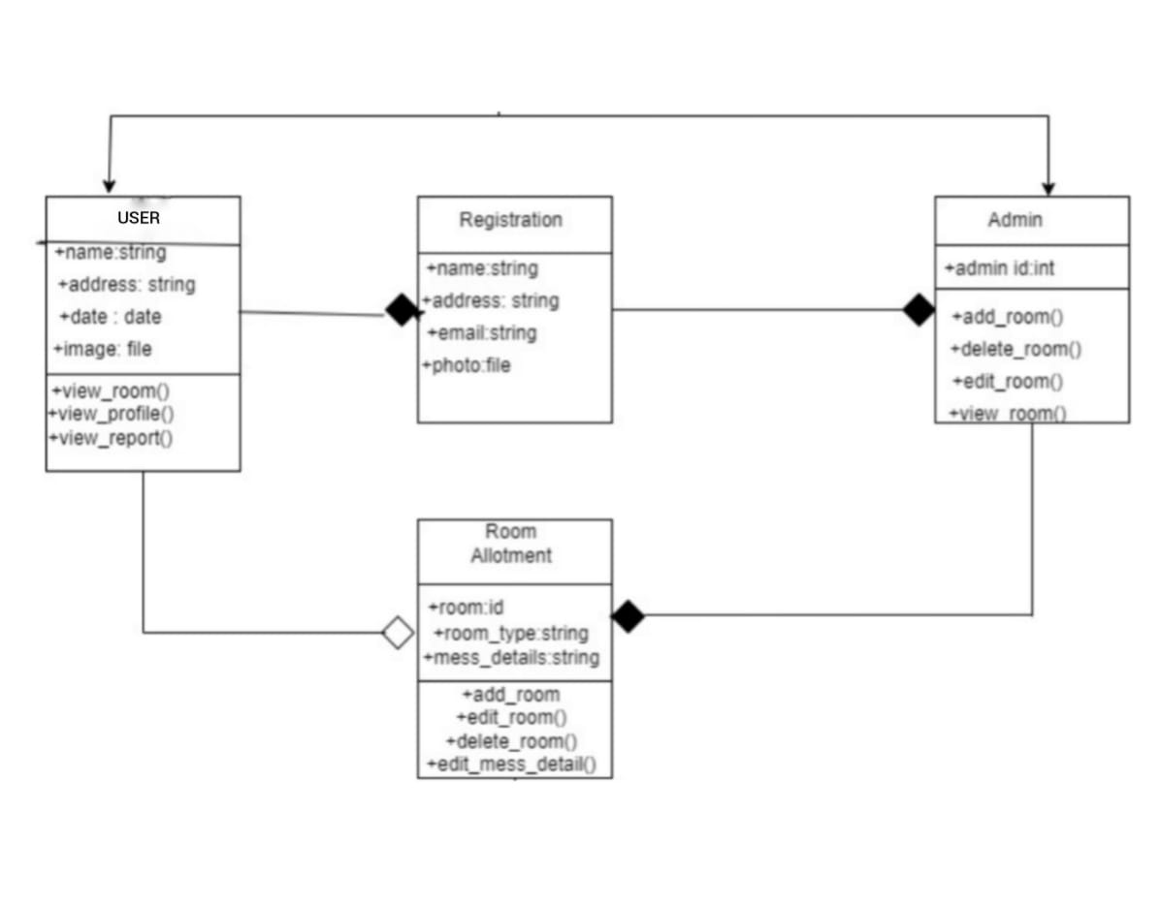
CLASS DIAGRM

Slide 8
CHALLENGES FACED
User Authentication and Security: Implementing a robust user authentication system with appropriate security measures can be a challenging task.
Validation Mechanisms: Implementing validation mechanisms helps ensure that user input is accurate and consistent.
Designing User Interface: Creating an intuitive and user-friendly interface is crucial for a successful bus booking system.
Database Design and Management: Designing an efficient database schema and managing the database operations can be complex.
Testing and Bug Fixing: Thorough testing is essential to identify and fix any bugs or issues in the system.

Slide 9
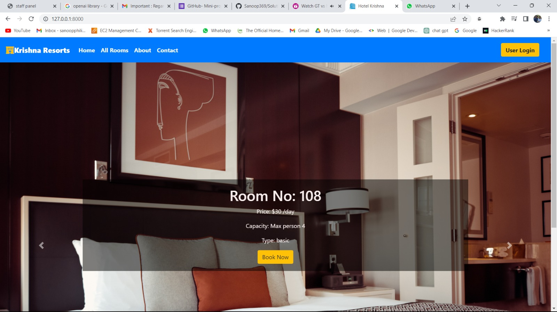
SCREENSHOTS

Slide 10
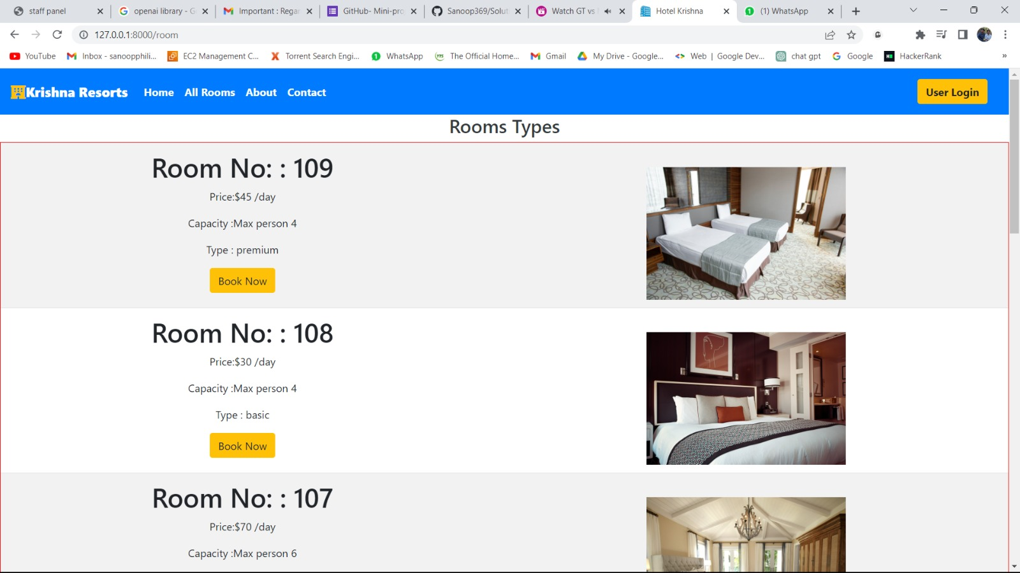

Slide 11
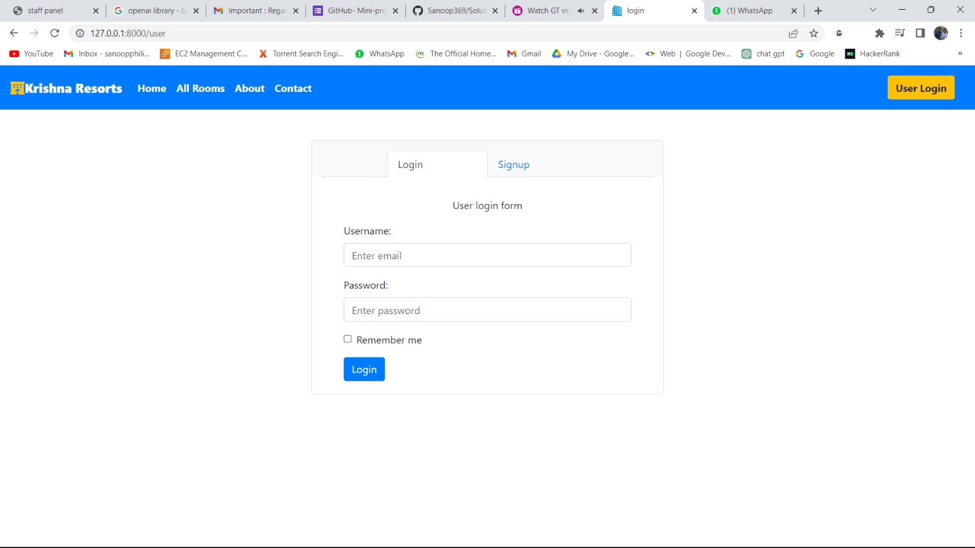

Slide 12
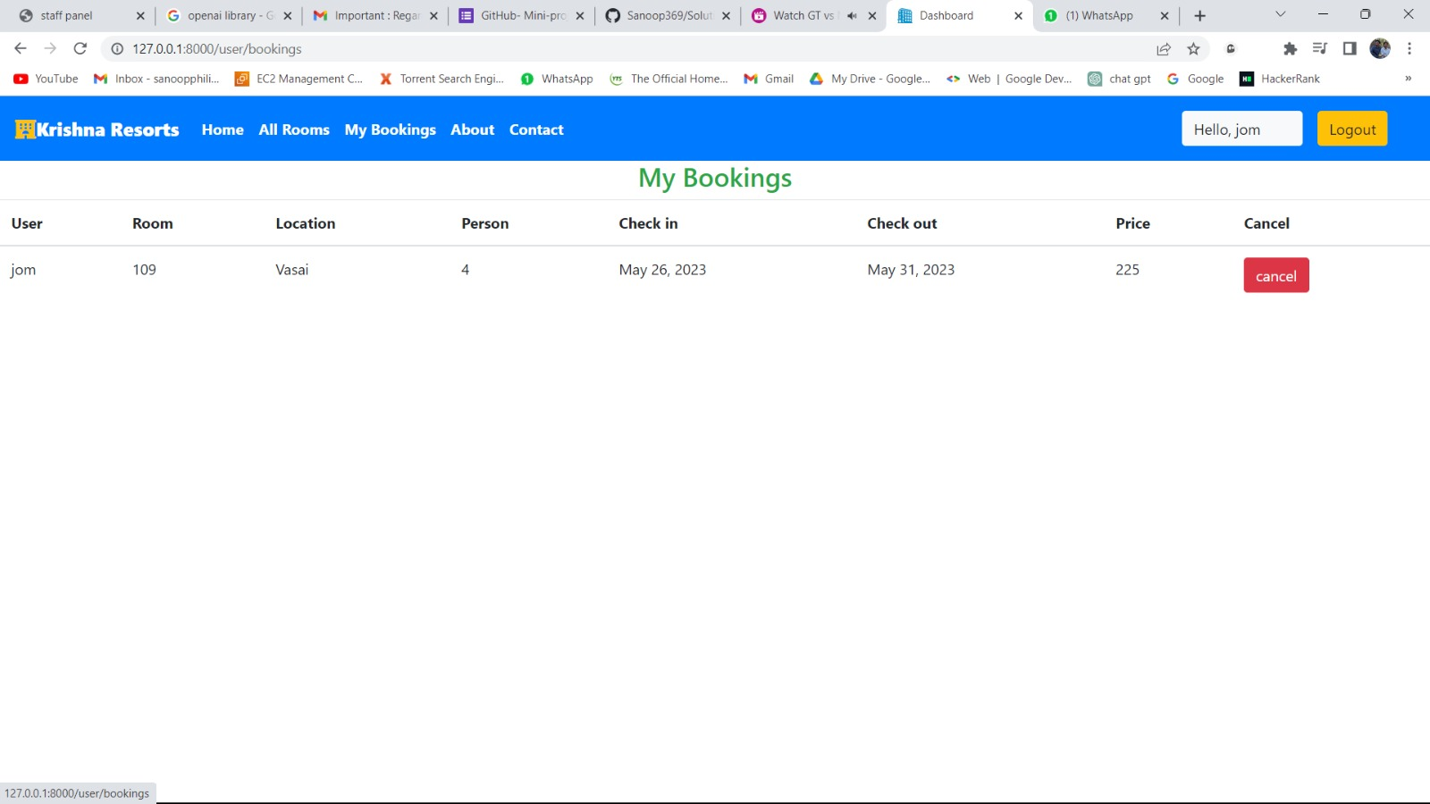

Slide 13
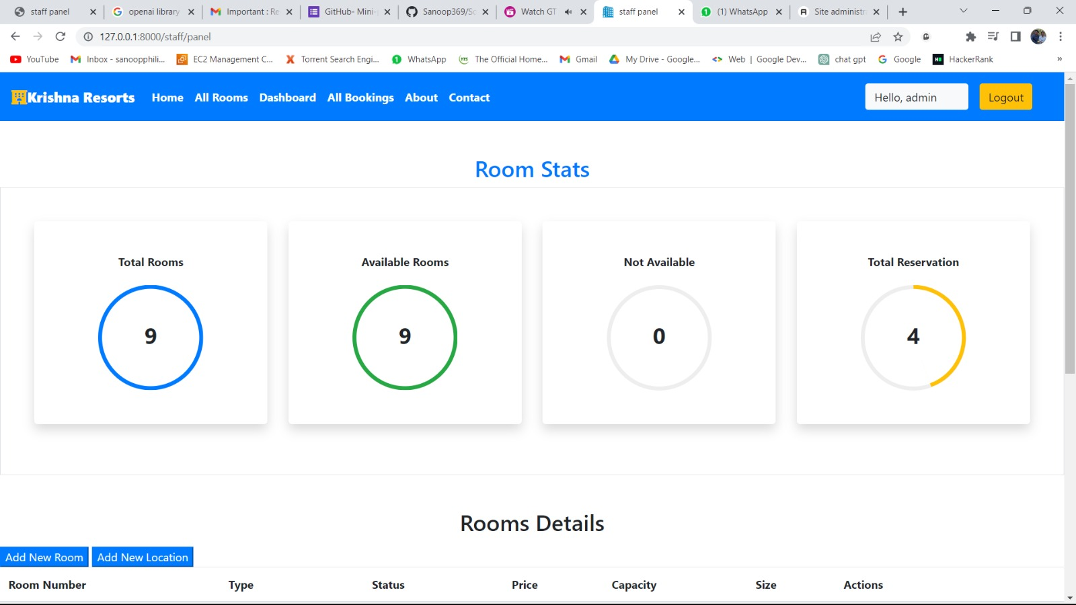

Slide 14
FUTURE ENHANCEMENT
Payment and Billing System:
Integrate a payment and billing system to automate the process of collecting money from users.
Notifications and Reminders:
Implement a notification system to send automated reminders to users for upcoming booking dates, payment, etc.

Slide 15
CONCLUSION
In conclusion, the Resort Management System is a comprehensive solution designed to simplify and automate the management of resorts and their related administrative tasks. It offers a range of features and functionalities to ensure smooth operations and enhance the user experience for both administrators and users.

Slide 16
REFERENCES
.https://youtu.be/YZvRrldjf1Y
.https://youtu.be/tUqUdu0Sjyc
.https://youtube.com/playlist?list=PL-5.1WBLyFTg2vW-
_6XBoUpE7vpmoR3ztO
.https://docs.djangoproject.com/en/4.1/intro/tutorial01/

