Slide 1
Changes in Standardized KIM-1 and NGAL Among AKI and no-AKI Patients

Slide 2
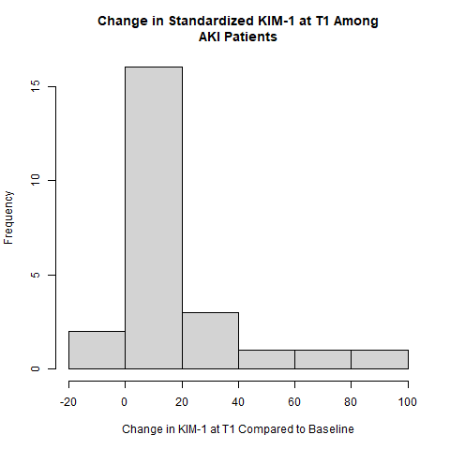
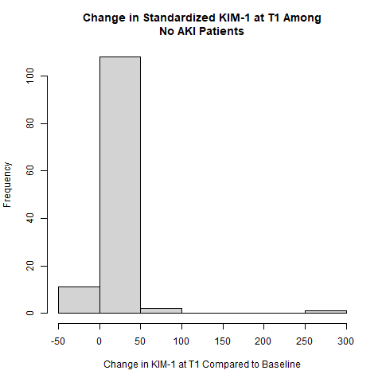
Change in Standardized KIM-1 at T1 for AKI vs. no-AKI Patients

Slide 3
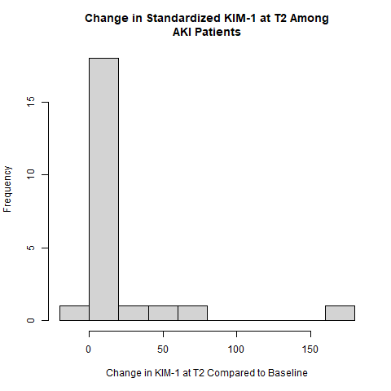
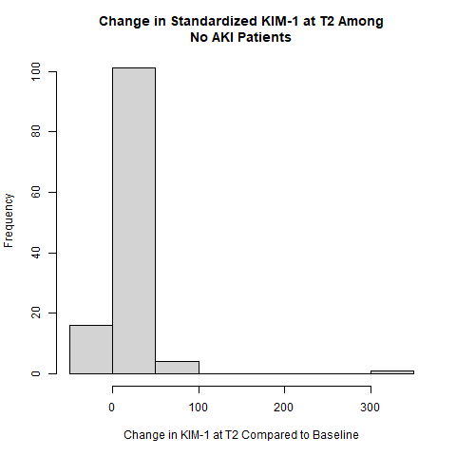
Change in Standardized KIM-1 at T2 for AKI vs. no-AKI Patients

Slide 4
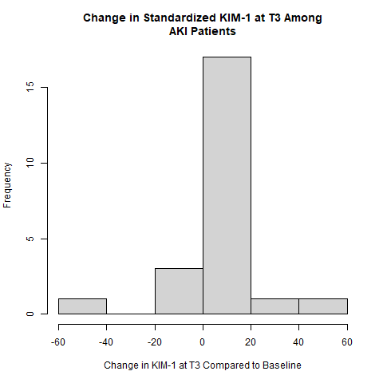
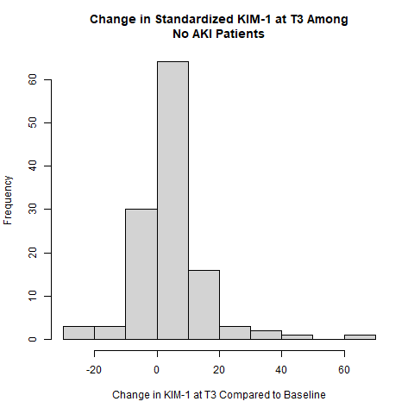
Change in Standardized KIM-1 at T3 for AKI vs. no-AKI Patients

Slide 5
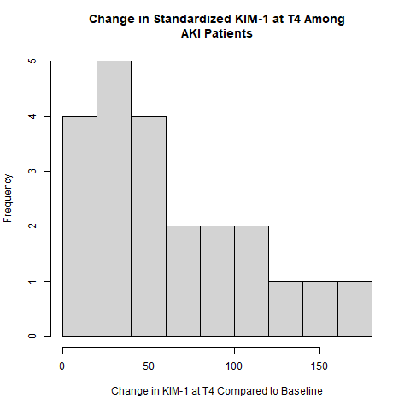
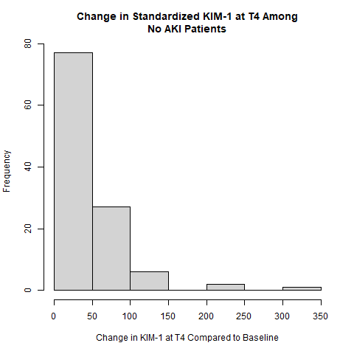
Change in Standardized KIM-1 at T4 for AKI vs. no-AKI Patients

Slide 6
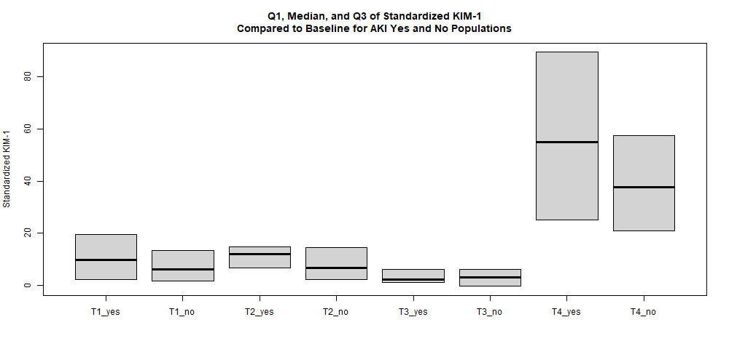
Boxplots for Change in Standardized KIM-1 at T1-T4 for AKI vs. no-AKI Patients

Slide 7
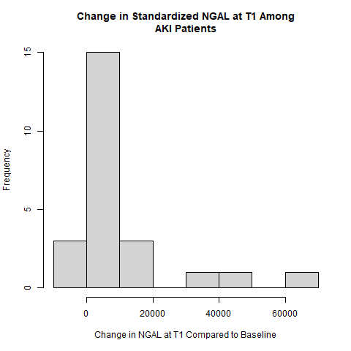
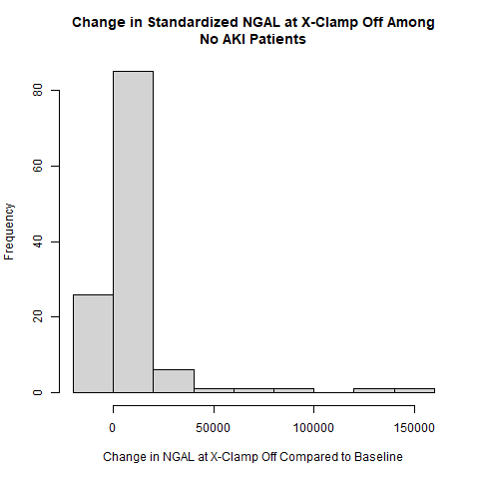
Change in Standardized NGAL at T1 for AKI vs. no-AKI Patients

Slide 8
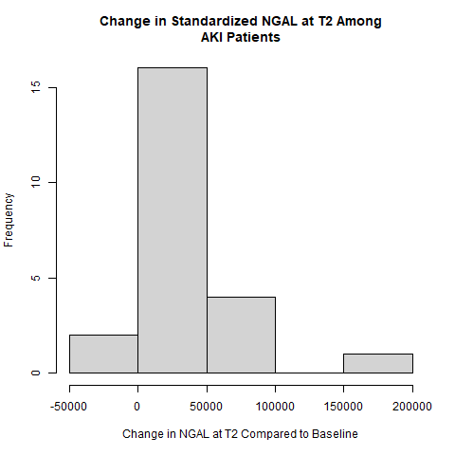
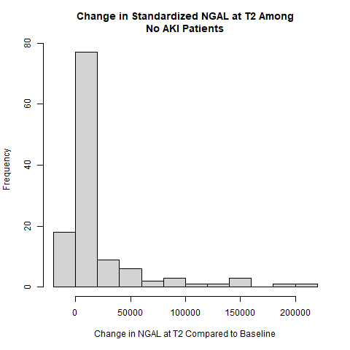
Change in Standardized NGAL at T2 for AKI vs. no-AKI Patients

Slide 9
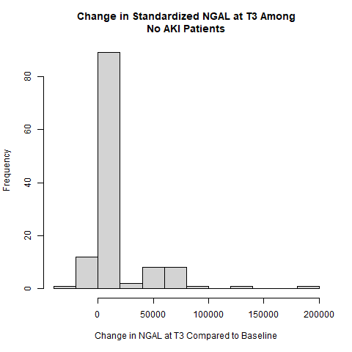
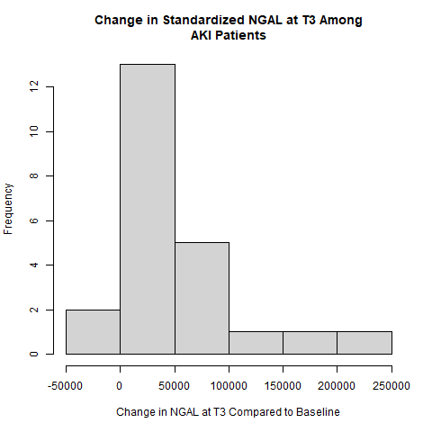
Change in Standardized NGAL at T3 for AKI vs. no-AKI Patients

Slide 10
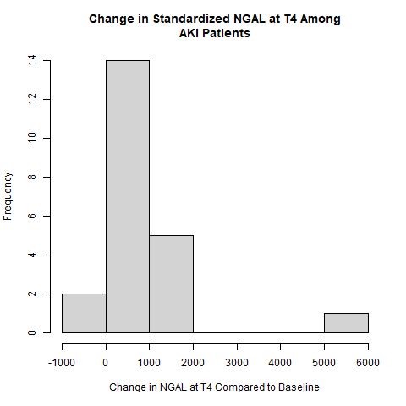
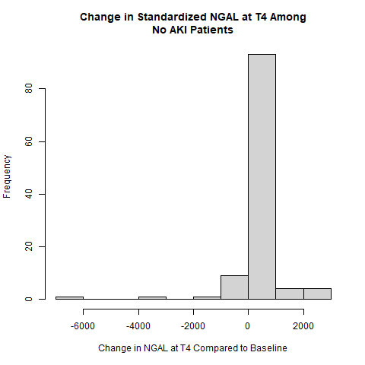
Change in Standardized NGAL at T4 for AKI vs. no-AKI Patients

Slide 11
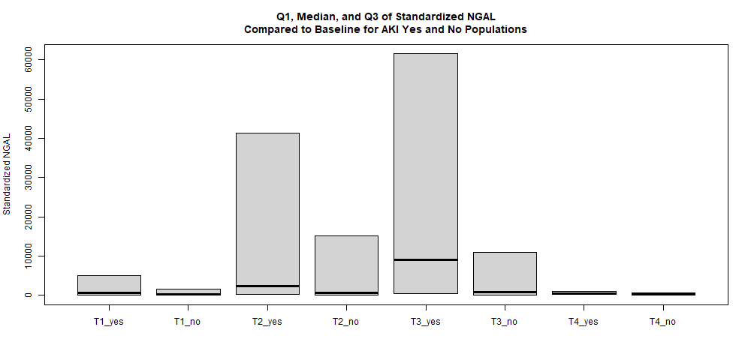
Boxplots for Change in Standardized NGAL at T1-T4 for AKI vs. no-AKI Patients

Slide 12
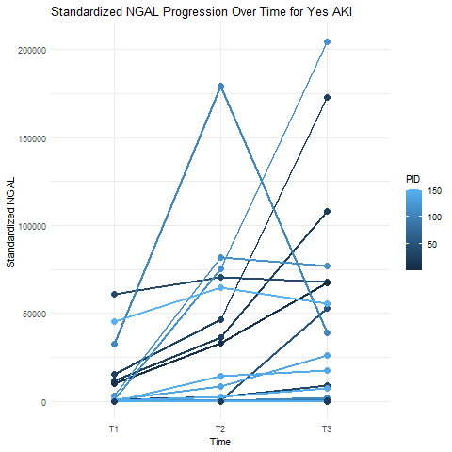
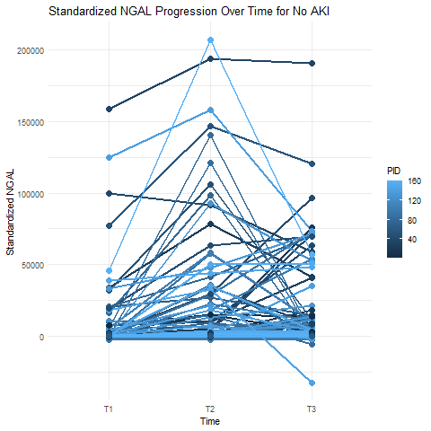
Standardized NGAL from Baseline Over Time for AKI and no AKI populations

Slide 13
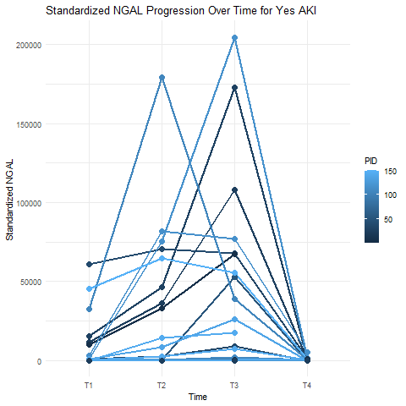
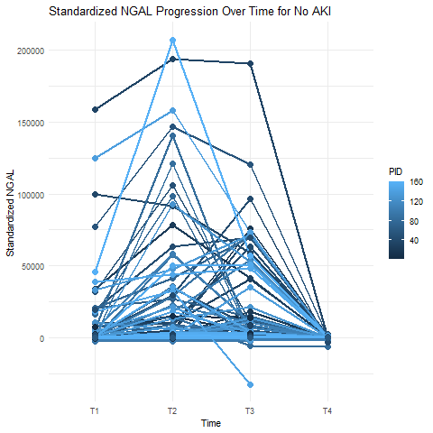
Standardized NGAL from Baseline Over Time for AKI and no AKI populations

Slide 14
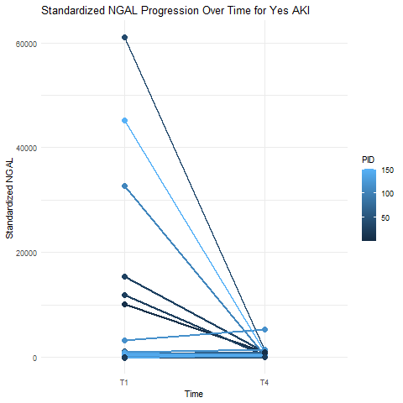
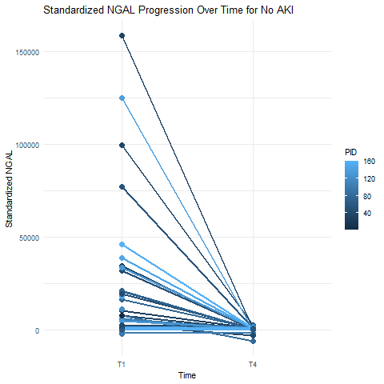
Standardized NGAL from Baseline Over Time for AKI and no AKI populations

Slide 15
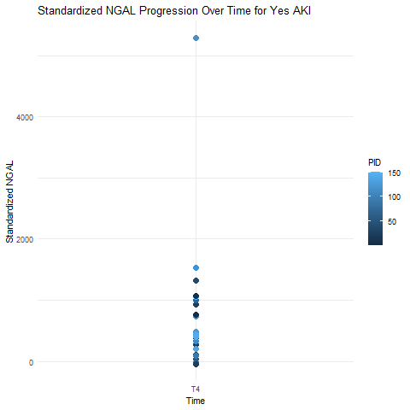
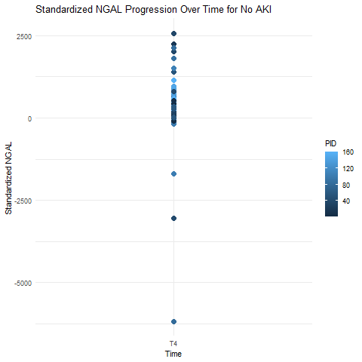
Standardized NGAL at T4 for AKI and no AKI populations

Slide 16
Dictionary of what time points mean
T0: baseline
T1: cross-clamp release
T2: bypass end
T3: arrival at ICU
T4: 24 hours after surgery

Slide 17
T-tests of biomarkers between AKI and no AKI groups at T3
data: aki_yes_data$delta_KIM1_stand_T3 and aki_no_data$delta_KIM1_stand_T3
t = -0.023933, df = 27.143, p-value = 0.5095
data: aki_yes_data$delta_NGAL_stand_T3 and aki_no_data$delta_NGAL_stand_T3
t = 2.1393, df = 24.222, p-value = 0.02134
data: aki_yes_data$delta_MCP1_stand_T3 and aki_no_data$delta_MCP1_stand_T3
t = 1.8316, df = 32.217, p-value = 0.03813
data: aki_yes_data$delta_YKL40_stand_T3 and aki_no_data$delta_YKL40_stand_T3
t = 2.0024, df = 22.619, p-value = 0.02869

Slide 18
Mediation Analysis when using standardized NGAL at T3 as the mediating variable
Analysis of effect of hypoxia on AKI when NGAL is the mediating variable
Total effect: 0.17 (0.00, 0.36)
Indirect effect: 0.00 (-0.19, 0.20)
Direct effect: 0.16 (0.02, 0.32)

Slide 19
Mediation Analysis when using standardized MCP-1 at T3 as the mediating variable
Analysis of effect of hypoxia on AKI when NGAL is the mediating variable
Total effect: 0.17 (0.02, 0.34)
Indirect effect: 0.03 (-0.16, 0.23)
Direct effect: 0.14 (-0.01, 0.30)

Slide 20
Mediation Analysis when using standardized YKL-40 at T3 as the mediating variable
Analysis of effect of hypoxia on AKI when NGAL is the mediating variable
Total effect: 0.16 (0.00, 0.32)
Indirect effect: -0.02 (-0.19, 0.18)
Direct effect: 0.18 (0.03, 0.32)

Slide 21
Mediation Analysis when using standardized NGAL at T4 as the mediating variable
Analysis of effect of hypoxia on AKI when NGAL is the mediating variable
Total effect: 0.16 (0.00, 0.33)
Indirect effect: -0.07 (-0.31, 0.15)
Direct effect: 0.23 (0.06, 0.43)

Slide 22
Reweighted BIC Scores for model selection
[1] "baseline 932.450231041678"
[1] "BIC add XClampDuration 866.288872844058"
[1] "BIC add NadirDO2 862.728010358645"
[1] "BIC add AreaBelow270 869.328983322171"
[1] "BIC add AreaBelow300 864.896283155138"
[1] "BIC add AreaBelow290 866.879828429003"
[1] "BIC add AreaBelow250 867.783166457965"
[1] "BIC add AreaBelow230 867.301535490328"
[1] "BIC add AreaBelow210 867.325222016953"
[1] "BIC add AreaBelow190 867.005919520541"
[1] "BIC add AreaBelow170 866.461712627631"
[1] "BIC add TimesBelow50 864.414237795328"
[1] "BIC add TimesBelow270 868.578796876288"
[1] "BIC add TimesBelow220 865.708189112134"
[1] "BIC add TimesBelow170 869.349063777246"
[1] "BIC add AreaAbove400 867.688547241131"
[1] "BIC add AreaAbove450 867.427006729131"
[1] "BIC add AreaAbove500 866.198254452963"
Final result:
[1] "XClampDuration" "NadirDO2"
862.728

Slide 23
Reweighted regression (MSM) of nadir DO2 and cross-clamp duration on AKI
[1] "estimated reweighted regression coefficients"
Call:
glm(formula = formula_reg, family = binomial, data = dataset,
weights = weights_stand)
Coefficients:
Estimate Std. Error z value Pr(>|z|)
(Intercept) -1.90835 0.50588 -3.772 0.000162 ***
nadirDO2 0.11656 0.20147 0.579 0.562886
xclamp_duration 0.31343 0.18783 1.669 0.095180 .
nadirDO2:xclamp_duration -0.04019 0.08025 -0.501 0.616497

Slide 24
Reweighted regression (MSM) of nadir DO2 and cross-clamp duration on AKI (cont.)
Because we fit a logistic regression, the way to interpret these coefficients is through changes in the odds of developing AKI. Each increase in nadir DO2 of 102 multiplies the odds of developing AKI by exp(0.11)=1.12. Meanwhile, each increase in X-clamp duration of 35 minutes multiplies the odds of developing AKI by exp(0.32)=1.38. When both nadir DO2 and X-clamp duration increase by 102 and 35, the odds of developing AKI is multiplied by 0.96.
A longer X-clamp duration increases the odds of developing AKI, but the way that nadir DO2 affects AKI is more complicated. A higher nadir DO2 can increase or reduce the risk of AKI depending on the length of X-clamp. When X-clamp duration is short, a higher nadir DO2 increases the odds of developing AKI, but, as X-clamp duration increases, a higher nadir DO2 decreases the odds of developing AKI.

Slide 25
More Straightforward Interpretation of coefficients of MSM
At cross-clamp duration of 120 (3.43) minutes each increase in 100 (0.98) scaled of nadir DO2 corresponds to exp(0.98*0.12 – 0.98*3.43*0.04) = 0.98 decrease in odds of AKI.
At nadir DO2 of 240 (2.35), each increase in 35 (1) minutes of cross-clamp duration corresponds to exp(0.31 – 2.35*0.04) = 1.24 increase in odds of AKI.

Slide 26
Reweighted regression (MSM) of nadir DO2 and cross-clamp duration on AKI (cont.)
Mean and standard deviation of treatment variables
"mean of nadirDO2 238.878895655371"
[1] "sample standard deviation of nadirDO2 101.815940489656"
[1] "sample standard deviation of xclamp_duration 34.8356583594392”
[1] "mean of xclamp_duration 79.0277161862528"
[1] "standard deviation of stand NGAL"
[1] 36398.22

Slide 27
Values used to find causal effect of 0.16
First value is nadir DO2, second value is cross-clamp duration
A prime (bad) values: (0.5, 5)
A (good) values: (4, 1.5)
Rescaled to original values…
A prime (bad) values: (50.91 mL/min/m2, 174.2 minutes)
A (good) values: (407.28 mL/min/m2, 52.26 minutes)
Max, min of nadir DO2 is (0, 499)
Max, min of cross-clamp duration is (2, 219)

Slide 28
Table of means and standard deviations for standardized KIM-1
Standardized KIM-1 | Delta-T1 | Delta-T2 | Delta-T3 | Delta-T4
Sample mean for AKI Population | 16.9 | 17.1 | 7.40 | 69.7
Sample standard deviation for AKI Population | 19.3 | 18.4 | 13.3 | 47.2
95% Confidence Interval for Mean of AKI Population | (6.69, 27.21) | (7.25, 26.88) | (0.34, 14.47) | (43.61, 95.86)
Sample mean for no-AKI Population | 12.3 | 14.2 | 4.04 | 47.7
Sample standard deviation for no-AKI Population | 27.0 | 35.61 | 11.79 | 43.8
95% Confidence Interval for Mean of no-AKI Population | (7.59, 16.96) | (8.03, 20.44) | (2.00, 6.08) | (39.82, 55.65)

Slide 29
Table of means and standard deviations for standardized NGAL
Standardized NGAL | Delta-T1 | Delta-T2 | Delta-T3 | Delta-T4
Sample mean for AKI Population | 10,100 | 33,800 | 44,100 | 941
Sample standard deviation for AKI Population | 19,100 | 50,200 | 62,700 | 1,288
95% Confidence Interval for Mean of AKI Population | (0, 20,300) | (7,000, 60,500) | (10,800, 77,500) | (227, 1,650)
Sample mean for no-AKI Population | 6,630 | 18,200 | 14,600 | 297
Sample standard deviation for no-AKI Population | 21,700 | 39,000 | 30,000 | 853
95% Confidence Interval for Mean of no-AKI Population | (2,870, 10,400) | (11,400, 25,000) | (9,350, 19,800) | (143, 452)

Slide 30
Tables of medians, 25th percentiles, and 75th percentiles for standardized KIM-1 and NGAL
Standardized KIM-1 | Delta-T1 | Delta-T2 | Delta-T3 | Delta-T4
Sample median for AKI Population | 12.54 | 12.98 | 2.27 | 58.12
Sample (Q1, Q3) for AKI Population | (2.38, 22.41) | (8.86, 15.29) | (0.92, 9.37) | (32.77, 88.74)
Q3-Q1 for AKI Population | 20.03 | 6.43 | 8.45 | 55.97
Sample median for no-AKI Population | 6.26 | 6.82 | 2.98 | 37.55
Sample (Q1, Q3) for no-AKI Population | (1.68, 13.06) | (2.28, 14.33) | (-0.28, 6.20) | (20.86, 57.80)
Q3-Q1 for no-AKI Population | 11.38 | 12.05 | 6.48 | 36.94
Standardized NGAL | Delta-T1 | Delta-T2 | Delta-T3 | Delta-T4
Sample median for AKI Population | 667 | 2,610 | 13,400 | 482
Sample (Q1, Q3) for AKI Population | (212, 6,330) | (501, 66,000) | (319, 58,500) | (392, 1,030)
Q3-Q1 for AKI Population | 6,118 | 65,499 | 58,181 | 638
Sample median for no-AKI Population | 167 | 632 | 1,110 | 231
Sample (Q1, Q3) for no-AKI Population | (11.0, 1,560) | (85.5, 15,300) | (115, 11,600) | (71.1, 544)
Q3-Q1 for no-AKI Population | 1,549 | 15,215 | 11,485 | 472.9

