Slide 1
Project 1 Creating a Secure Network
By: Jacob Nava

Slide 2
Executive Summary
I was hired by an IT company as an IT subject matter expert. Management has a client who wants to upgrade their IT systems
Virtual machines were successfully installed with proper configuration including Firewall, a PC for the CEO, an internal Webserver, an internal DNS server, and some Linux machines
I then documented configurations of the VM's, used FTP from Webserver to CEO PC, created a new user, scanned for open ports to create a security baseline, verified the network was secure, and used Wireshark to capture username and password used for FTP

Slide 3
Tasks Performed
Installed VirtualBox and extensions
Installed the Router-FW, DNS Server, Webserver, CEO PC, and 3 Kali Linux machines
Using a browser on the CEO PC, opened www.seclab.net after properly configuring IP
Discovered and documented the OS version, IP address, subnet mask, default gateway address, and DNS server address of the CEO PC, Web server, and DNS server
Use FTP to download the “Social-Media-Security-Policy” from the Web server to the CEO PC
Created a new user account on the Web server
Used nmap on Kali Linux to perform port scans on the DNS and Web servers and documented the open ports on each server
Verify that the Trusted network is protected from the Untrusted network
Used Wireshark on Kali Linux to capture an FTP file transfer between the CEO PC and the web server, showing the username and passwords captured by Wireshark

Slide 4
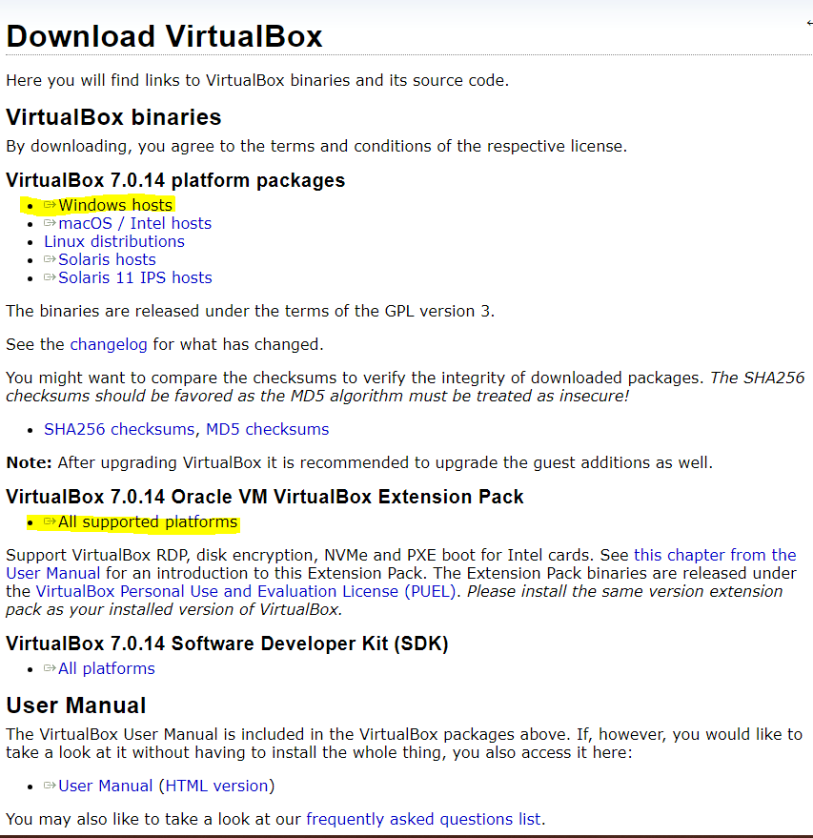
Install of VirtualBox and extensions
VirtualBox and extensions were downloaded from here: https://www.virtualbox.org/wiki/Downloads

Slide 5
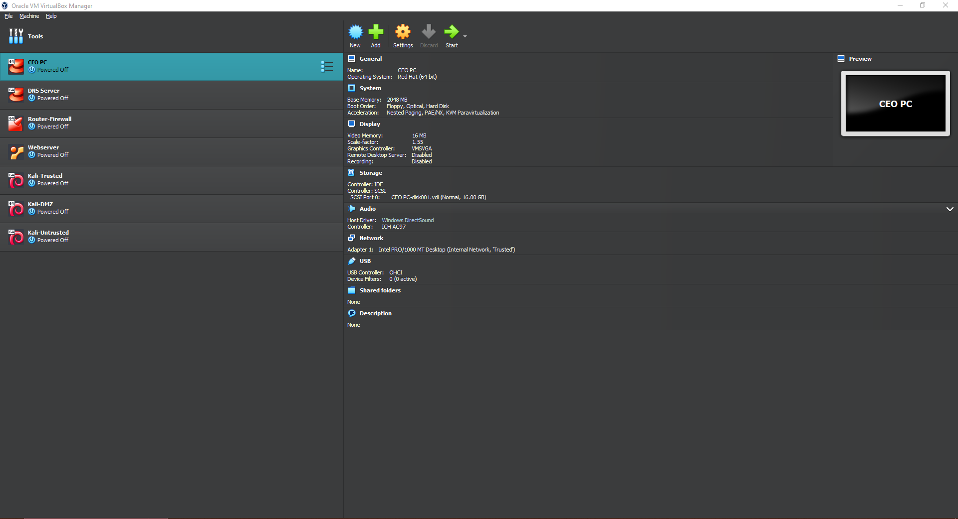
VirtualMachines installed and configured

Slide 6
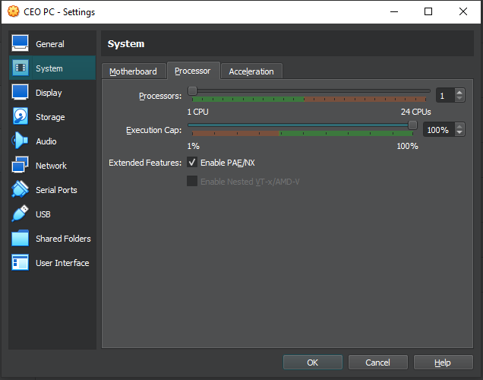
Processor dropped to 1
Changed processor settings to achieve proper performance
CEO PC and Webserver wouldn’t run otherwise

Slide 7
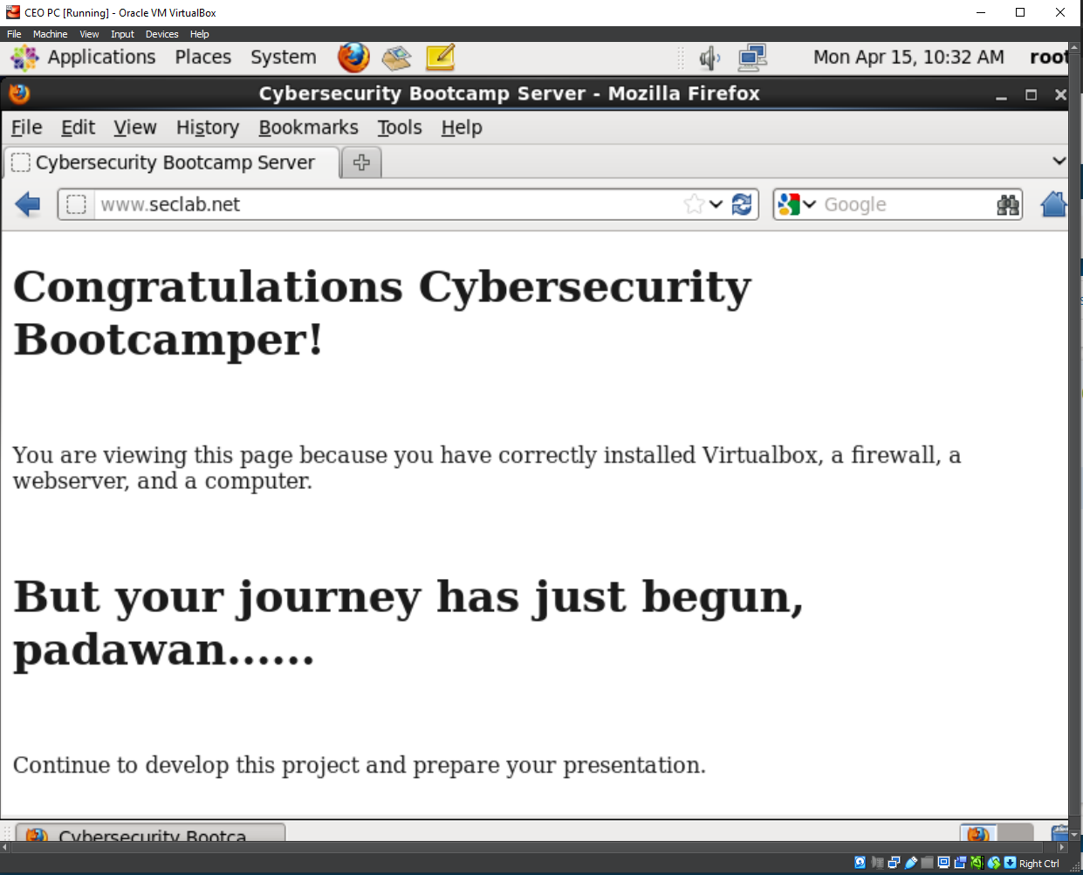
Using a browser on the CEO PC, open www.seclab.net
Properly configured the IP address utilizing Automatic(DCHP)

Slide 8
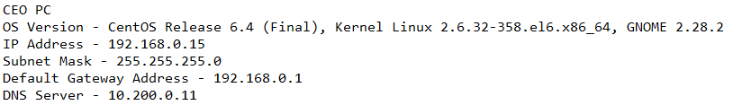
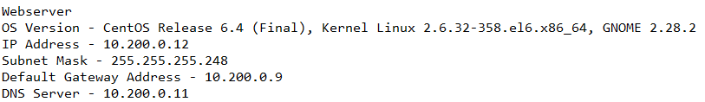
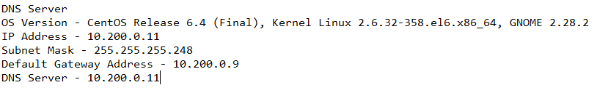
OS version, IP address, subnet mask, default gateway address, and DNS server address
Found this information by using ifconfig and cat /etc/resolv.conf

Slide 9
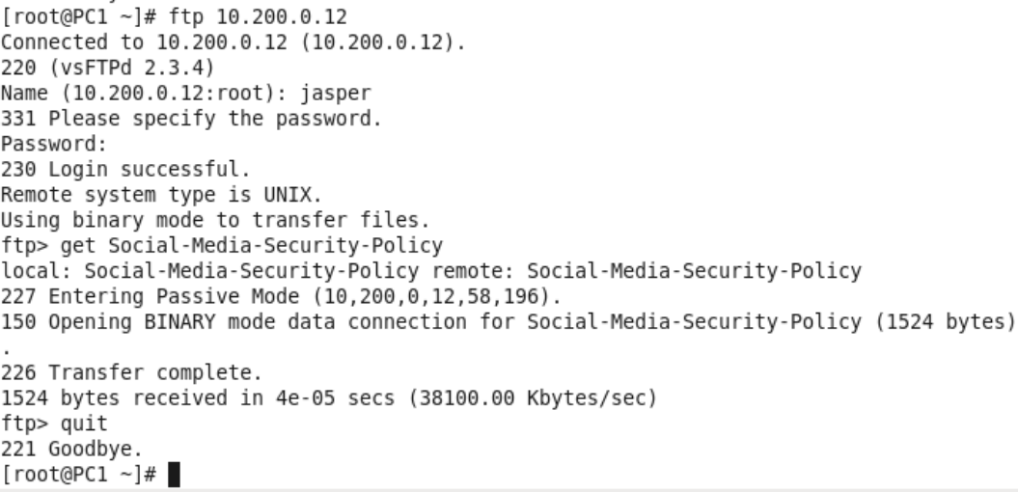
Using FTP to download the “Social-Media-Security-Policy” from the Web server to the CEO PC.

Slide 10
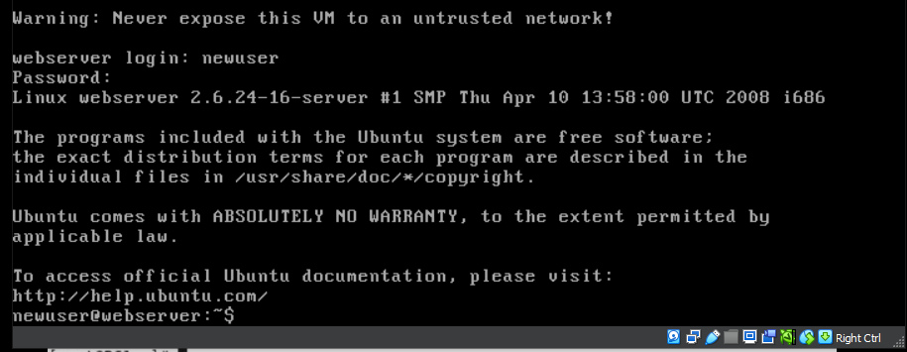
New user for Webserver

Slide 11
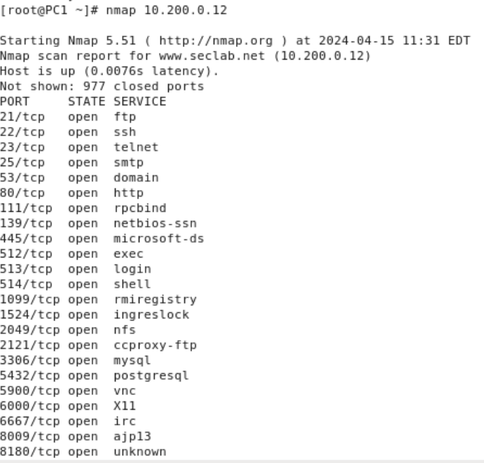
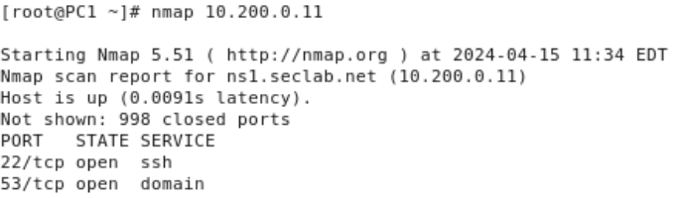
Port scan on the DNS and Webserver

Slide 12
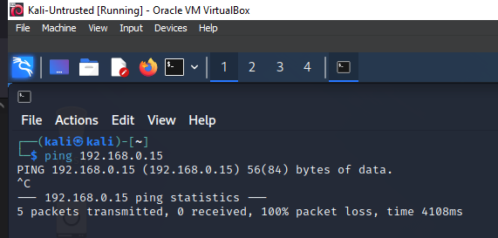
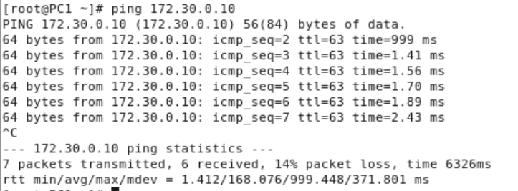
Verification of Trusted and Untrusted Network

Slide 13
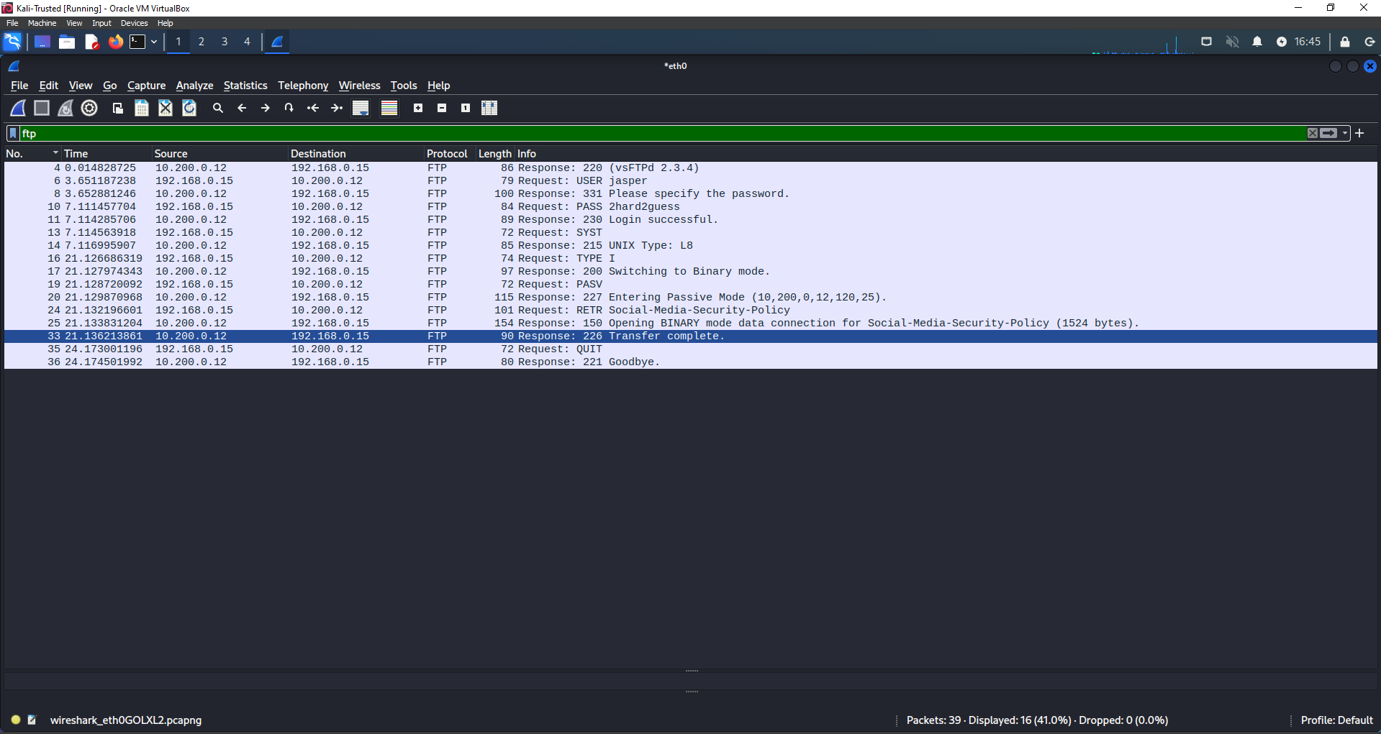
Wireshark capture of FTP

