Slide 1

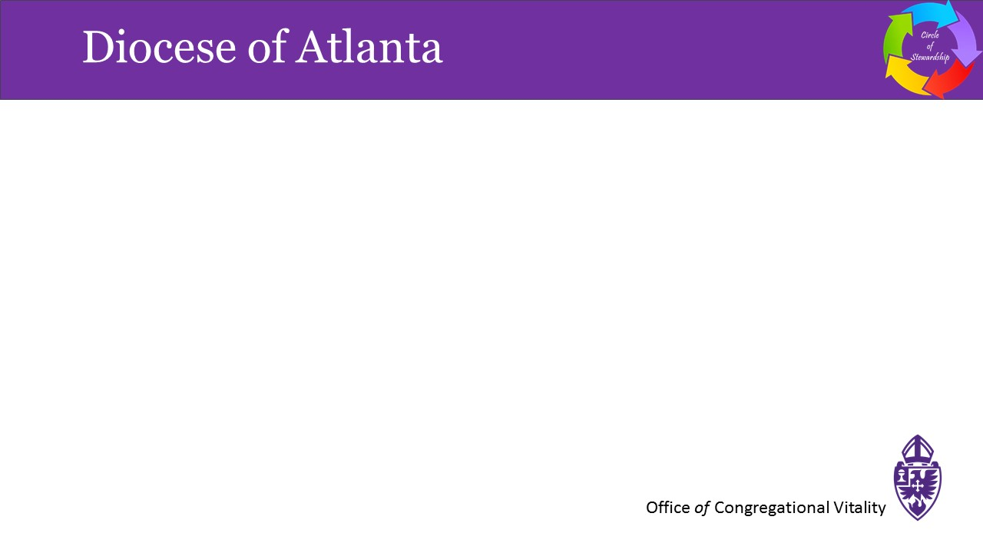

Mal Underwood
Episcopal Diocese of Atlanta
Commission on Stewardship
malvinunderwood@bellsouth.net
404-580-5472

Slide 2
Circle of Stewardship
All scripture is inspired by God
and is useful for teaching, for reproof, for correction,
and for training in righteousness, so that everyone who belongs to God may be proficient,
equipped for every good work.
2 Timothy 3:16-17

Slide 3

















Slide 4
Circle of Stewardship
Thus says the Lord, your Redeemer, who formed you in the womb, I am the Lord, who made all things, who alone stretched out the heavens, who by myself spread out the earth. (Isaiah 44:24)
The God who made the world and everything in it, he who is Lord of heaven and earth, does not live in shrines made by human hands, nor is he served by human hands, as though he needed anything, since he himself gives to all mortals life and breath and all things. (Acts of the Apostles 17:24-25)
For every wild animal of the forest is mine, the cattle on a thousand hills. I know all the birds of the air, and all that moves in the field is mine. If I were hungry, I would not tell you, for the world and all that is in it is mine. (Psalm 50:10-12)
Genesis 1:1 – 2:3

Slide 7
Circle of Stewardship
Building Blocks of Christian Stewardship
1. God created and owns it all

Slide 8
Circle of Stewardship
Every generous act of giving, with every perfect gift, is from above, coming down from the Father of lights, with whom there is no variation or shadow due to change. (James 1:17)
But each of us was given grace according to the measure of Christ’s gift. Therefore it is said, “When he ascended on high he made captivity itself a captive; he gave gifts to his people.” ...The gifts he gave were that some would be apostles, some prophets, some evangelists, some pastors and teachers. (Ephesians 4:7-8,11)
Take care that you do not forget the Lord your God…when you have eaten your fill and have built fine houses…and your silver and gold is multiplied, then do not exalt yourself, forgetting the Lord your God…Do not say to yourself “My power and the might of my own hand have gotten me this wealth.” But remember the Lord your God, for it is he who gives you the power to get wealth. If you do forget the Lord your God…you shall surely perish. (Deuteronomy 8:11-20)

Slide 11
Circle of Stewardship
Building Blocks of Christian Stewardship
1. God created and owns it all
2. Everything we have is gift

Slide 12
Circle of Stewardship
And let the peace of Christ rule in your hearts, to which indeed you were called in the one body. And be thankful. (Colossians 3:15)
Therefore, since we are receiving a kingdom that cannot be shaken, let us give thanks, by which we offer to God an acceptable worship with reverence and awe. (Hebrews 12:28)
Offer to God a sacrifice of thanksgiving and pay your vows to the Most High. Those who bring thanksgiving as their sacrifice honor me. (Psalm 50:14,23a)

Slide 15
Circle of Stewardship
Building Blocks of Christian Stewardship
1. God created and owns it all
2. Everything we have is gift
3. Have a grateful heart

Slide 16
Circle of Stewardship
We want you to know, brothers and sisters, about the grace of God that has been granted to the churches of Macedonia; for during a severe ordeal of affliction, their abundant joy and their extreme poverty have overflowed in a wealth of generosity on their part. (2 Corinthians 8:1-2)
Some give freely, yet grow all the richer; others withhold what is due, and only suffer want. A generous person will be enriched, and one who gives water will get water. (Proverbs 11:24-25)
As for those who in the present age are rich . . . they are to do good, be rich in good works, generous, and ready to share, thus storing up for themselves the treasure of a good foundation for the future, so that they may take hold of the life that really is life. (I Timothy 6:17-19)

Slide 19
Circle of Stewardship
Building Blocks of Christian Stewardship
1. God created and owns it all
2. Everything we have is gift
3. Have a grateful heart
4. Be generous

Slide 20
Circle of Stewardship
Bring the full tithe into my storehouse, so that there may be food in my house, and thus put me to the test, says the Lord of hosts; see if I will not open the windows of heaven for you and pour down for you an overflowing blessing. (Malachi 3:10)
Then the righteous will answer him, “Lord, when was it that we saw you hungry and gave you food, or thirsty and gave you something to drink? And when was it that we saw you a stranger and welcomed you, or naked and gave you clothing? And when was it that we saw you sick or in prison and visited you?” And the king will answer them, “Truly I tell you, just as you did it to one of the least of these who are members of my family, you did it to me.” (Matthew 25:37-40)
Make vows to the Lord your God, and perform them; let all who are around him bring gifts to the one who is awesome. (Psalm 76:11)

Slide 23
Circle of Stewardship
Building Blocks of Christian Stewardship
1. God created and owns it all
2. Everything we have is gift
3. Have a grateful heart
4. Be generous
5. Give back to God

Slide 24
Ultimate Stewardship Scripture
Jesus answered, “The first is, ‘Hear, O Israel:
the Lord our God, the Lord is one;
you shall love the Lord your God with all your heart,
and with all your soul,
and with all your mind,
and with all your strength.’
The second is this,
‘You shall love your neighbor as yourself.’
There is no other commandment greater than these.”
Mark 12:29-31

Slide 25
What Is Stewardship?
Stewardship is our thankful and intentional response to the question, "What is God calling me to do
with the gifts God has entrusted to me?”
Stewardship is everything I do
with everything I have
after I say, “I believe.”
Stewardship is
using the gifts God has given me
to do the work God is calling me to do.

