Slide 1
Commitment Programs

Slide 2
Festive Meal

Slide 3
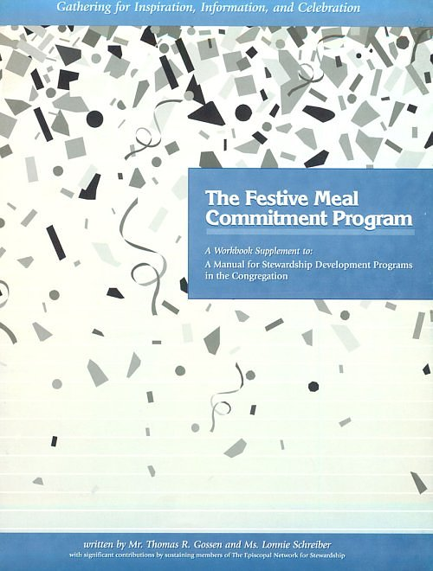
Festive Meal
All energy focused toward one major event.
Table Hosts are recruited and trained and assigned members whom they invite to join their dinner table group.
Discussion Leaders, who are matched with Table Hosts, are also recruited and trained

Slide 4
Festive Meal
A wonderful place for the meal
Joyful, uplifting entertainment
A training session for all table hosts/hostesses
Trained table hosts who personally invite others to sit at their table
Trained discussion leaders
A brief Bible study
A brief lay witness, a personal witness and/or statement of vision by the rector and an inspiring keynote speaker
A signed thank you letter to all pledging households thanking them for their pledge and confirming the amount.

Slide 5


Festive Meal
Strengths
Provides for face-to-face contact with members of the congregation
Educational materials about stewardship and the mission of the church can be distributed easily
Everyone hears the same presentation and message
Strengthens the sense of being the Body of Christ
Limitations
Does not reach the homebound
A large crowd can limit conversation and discussion
Does not reach those members of the congregation who choose not to come

Slide 6
Cottage Meetings

Slide 7

Cottage Meetings
Each member of the congregation is invited to attend one of many small group gatherings in the homes of Hosts who have been recruited
Trained Discussion leaders and Witnesses, who are matched with Hosts, are also recruited and trained

Slide 8
Cottage Meetings
A host home for every 8 to 10 people in the congregation
A training session for all volunteers
A trained host/hostess for each home who will personally invite people to their home and follow up with them
A trained discussion leader for each home
A brief Bible study
A lay witness about stewardship at each home
Dessert
A signed thank you letter to all pledging households thanking them for their pledge and confirming the amount

Slide 9
Cottage Meetings
Strengths
Provides for face-to-face contact with members of the church
Educational materials about stewardship and the mission of the church can be distributed easily
The presentation and message about stewardship as a conversion issue is delivered by well-trained members of the congregation
Strengthens the sense of being the Body of Christ
Limitations
Does not reach the homebound
Does not reach those members of the congregation who choose not to come
May be ineffective if there is conflict within the congregation

Slide 10
Personal Notes

Slide 11

Personal Notes
A group is recruited to write their stewardship witness to use as letters and/or bulletin inserts
These letters should offer personal witness about stewardship and/or highlight a ministry of the parish
Each home receives six pieces of mail, with the final piece being a personal hand-written note.

Slide 12
Personal Notes
The writers attend a training session that includes bible study, prayer and witness with training followed by time to write short personal notes to all other households in the congregation
A letter from the Stewardship Chair with a personal witness
A letter from the Rector offering both a theology of stewardship and a personal witness
Letters from Senior Warden, Junior Warden, Treasurer, and a respected servant leader in the congregation

Slide 13
Personal Notes
Strengths
Includes all members of the congregation
Is non-confrontational
Is great for those for whom speaking about their faith is difficult
Limitations
Resembles secular appeal for funds
May be ineffective if discontent exists in the congregation because of the one-way communication

Slide 14
Journey To Generosity

Slide 15

Journey to Generosity
Available at www.tens.org
Weekly Reflections/Bulletin Inserts
Pledge Cards
Rector’s Letter

Slide 16
Project Resource

Slide 17

Project Resource
Developed by Charles LaFond and provided through the College for Bishops at Project Resource
Resources available at http://www.collegeforbishops.org/project-resource-home
12 month approach to the Annual Stewardship Campaign
Expects Leadership to pledge early to model leadership

Slide 18
Project Resource
January - Hand written thank you notes from team of laity
April/May – Publish article: how the last campaign went and an introduction to the next campaign
June - Planned Giving Sunday and Event
Advance campaign launch (targeting Leadership)
August – End Advanced Campaign and mail Campaign Warm-up Letters to all non-advance campaign prospects
September - Campaign brochure and pledge cards mailed
Sunday or weekday adult formation regarding money, gratitude, and personal budgeting/financial wellness

Slide 19
Project Resource
Mid September - Stewardship Campaign kick-off
Ministry Minutes for 8 weeks with collects and bulletin announcements themed weekly from Ministry Minutes
October - Encouragement Phone-a-Thons
November - Victory Celebration Stewardship Dinner
Pledge Blessing Sunday - Sunday after Victory dinner and before Thanksgiving (seeking all pledges in by this date)
Mid-December - Year-End letter and brochure sent to all donors and donor prospects (members)

Slide 20
Project Resource
Strengths
Continuous – flows from one year to the next
Cycle of recruiting leaders
Reaches all members of the congregation
Emphasizes showing gratitude with frequent thank you notes
Limitations
Resembles secular appeal
Focuses more on obtaining pledges and less on spiritual development
May be ineffective if discontent exists in the congregation because of the one-way communication

Slide 21
New
Consecration Sunday

Slide 22


New Consecration Sunday
4-Week Program
Guest Leader
5 Letters to the Parish
Newsletter Article
3 Speakers
Step Up/Giving Chart
Leadership Meal
Catered Celebration Meal

Slide 23
New Consecration Sunday
7 Weeks Before New Consecration Sunday
Orientation Meeting with Guest Leader
4 Weeks Before New Consecration Sunday
Newsletter Article
Hang Poster
3 Weeks Before New Consecration Sunday
Announcer #1 – Ask for RSVP to Celebration Meal
Letter to Parish from Stewardship Chair

Slide 24
New Consecration Sunday
2 Weeks Before New Consecration Sunday
Announcer #2 – Grow One Step Chart/RSVP

Slide 25
New Consecration Sunday

Slide 26
New Consecration Sunday
2 Weeks Before New Consecration Sunday
Announcer #2 – Grow One Step Chart/RSVP
Letter/Invitation to attend Leadership Dinner
Letter from Rector to Parish
1 Week Before New Consecration Sunday
Announcer # 3 – RSVP
Sermon on Tithe and Percentage Giving
Leadership Dinner with Guest Leader
Follow Up with RSVP

Slide 27
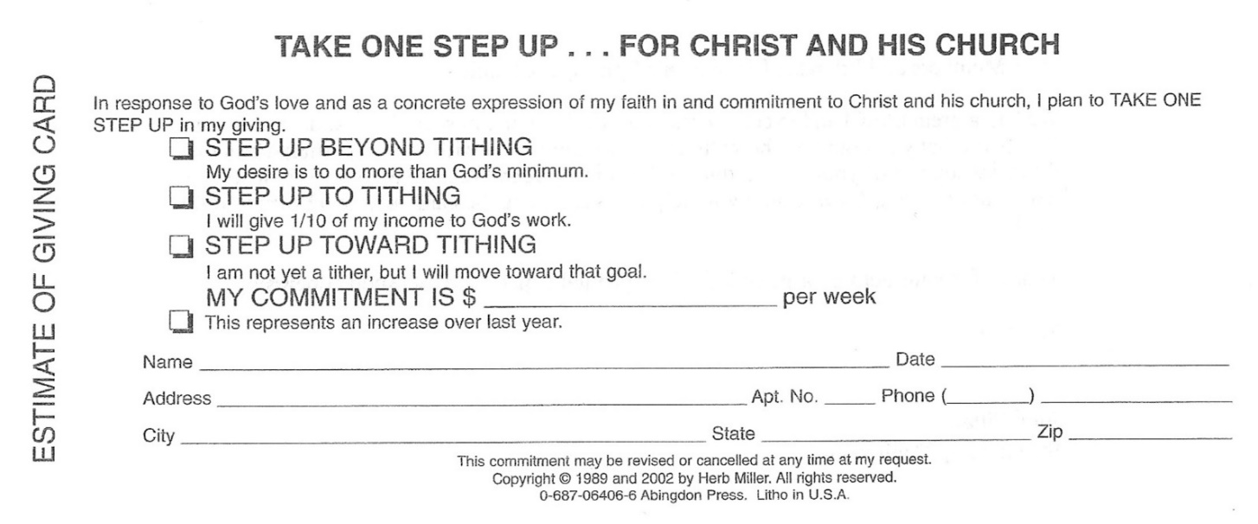
New Consecration Sunday
Sermon by Guest Leader
After announcements: Estimate of Giving Cards Distributed
Each time we celebrate the Lord’s Supper – Holy Communion – we take in our hands a small piece of bread and a cup with ordinary wine. During these moments, these common elements symbolize the deepest meanings of our faith. During the next few minutes when we take an ordinary pencil and a small card, these symbolize the high and holy commitment we make in response to the love God has given each of us.

Slide 28
New Consecration Sunday
After we pray together, we are going to have a few minutes of silence for you to meditate and complete your card. Once you are finished, we ask that you quietly come forward and place your card here in the basket as a worshipful act of dedication. We know that while some cards are from individuals, many are from families. If your card is from the family, we encourage the entire family to come forward together to participate – together – in this worshipful act.
Prayer
Silence While Cards Are Completed
Cards Are Brought to the Altar As Completed
Priests Brings to a Close with Offertory Sentence
Gifts are Consecrated on the Altar
Catered Celebration Meal Following Service

Slide 29
New Consecration Sunday
Results of Giving Announced At Meal
A total of _____ giving units (husbands and wives or single persons) completed Estimate of Giving Cards this year.
A total of _____ of these giving units increased their financial commitment above their last year’s amount.
A total of _____ giving units present to fill out Estimate of Giving Cards today committed a total of $_____.
Based on last year’s giving records, we can expect to receive $_____ during the coming year from people who have consistent giving patterns during the past twelve months but are not present today.

Slide 30
New Consecration Sunday
Results Continued
Based on the average total of loose offerings during the past three years, we can expect to receive $ _____ during the coming year from that source.
Church income from non-donor sources such as interest, rentals, and fees $ _____.
This gives us a grand total of $ _____ anticipated income for the next twelve months.

Slide 31
New Consecration Sunday
Results Continued
The total income for our general operating budget during the last twelve months was $ _____.
Next year, we can expect our operating budget income to increase by $ _____.
This is a _____ percent increase in total giving above last year.

Slide 32
New Consecration Sunday
Day After New Consecration Sunday
Mail Letter and Estimate of Giving Cards to Those Not Present for New Consecration Sunday
1 Week After New Consecration Sunday
Mail Thank You Letter Confirming Pledge Amount

Slide 33
Consecration Sunday
Strengths
Faith-based, not budget-based
Central theme is percentage giving – What is God calling you to do with the gifts entrusted to you?
Participation encouraged
Spiritual growth dimension
Immediate feedback
Easy to execute
Limitations
Does not reach those members of the congregation who choose not to come
Expense of catered meal

Slide 34
Questions

