Slide 1
Legacy Giving Made Easy for Your Parish
Lindsey E. Hardegree, Executive Director
Episcopal Community Foundation for Middle and North Georgia
Notes:
What is planned giving? Why should it be a priority for your parish? And how can ECF help you administer legacy gifts that will benefit both your parish and the poor and oppressed throughout our diocese for years to come?

Slide 2
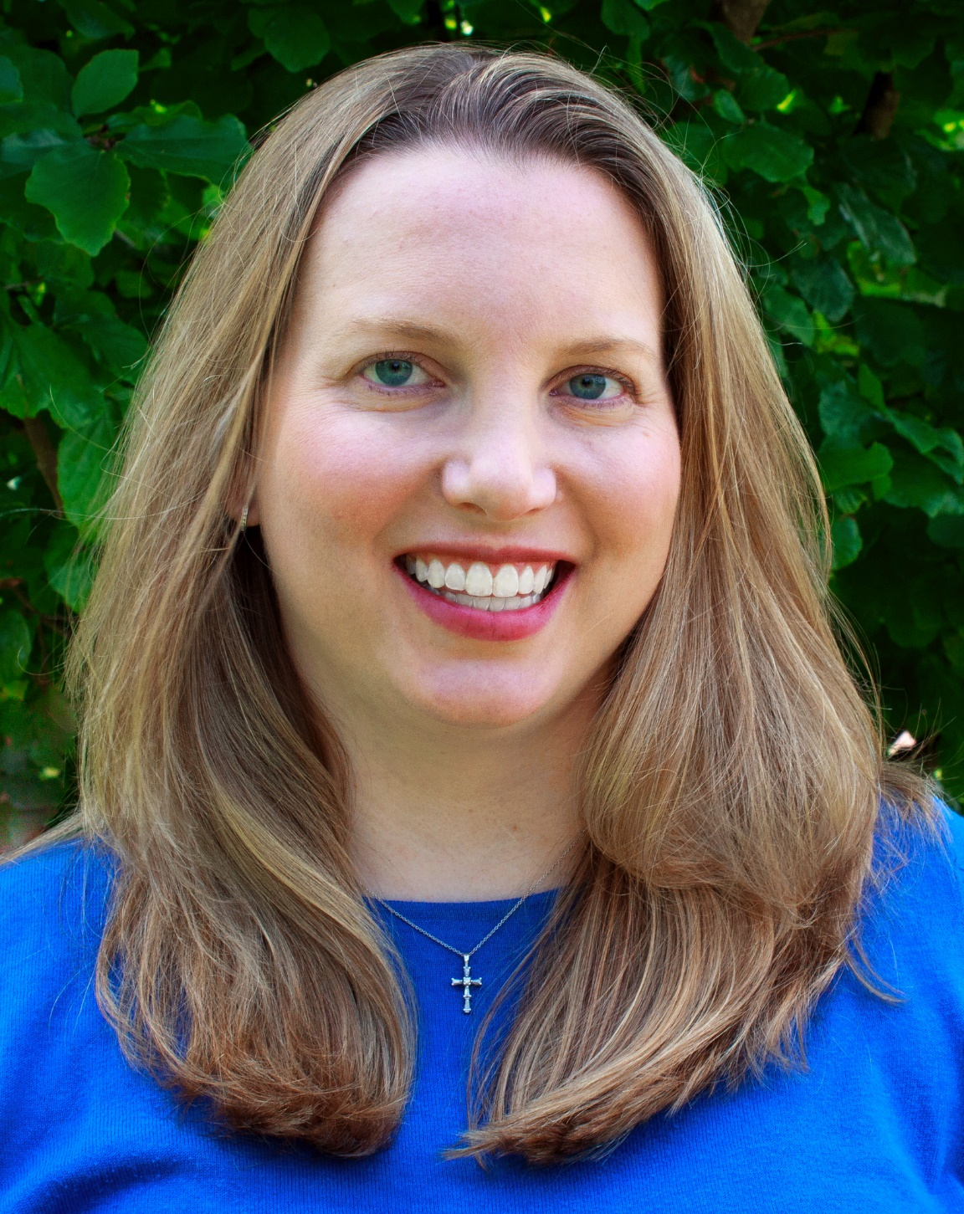
Introduction
Lindsey E. Hardegree
Executive Director
Episcopal Community Foundation
for Middle and North Georgia
ECFimpact.org

Slide 3
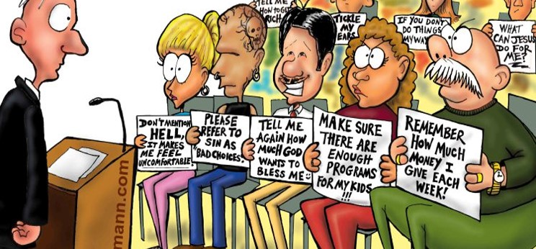
First Church of the Holy Signers

Slide 4
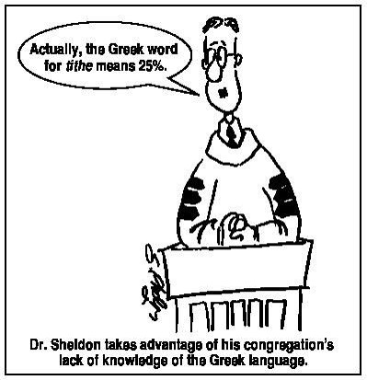
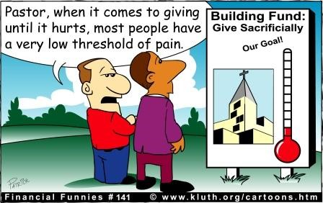
Are we asking parishioners to think about legacy or the annual budget?

Slide 5
What is legacy giving?
Also known as “planned giving” or “testamentary giving”
Legacy giving is a way to support nonprofits and churches through estate wealth:
may include tax tools which are available during a donor’s lifetime
may be gifts given using estate and tax planning techniques after the donor’s death
Legacy gifts are often used to fund an endowment (which ensures that the gifts support the long-term success of the charity) and/or for designated purposes of interest to the donor in their lifetime.
Legacy gifts are the individual’s highest form of praise, and demonstrate their deepest passion.
“In my last words, I leave this for . . . “

Slide 6
Why is legacy giving important?
Future gifts ensure an organization or church’s legacy is secure and sustainable for many years to come, even in future times of economic or other difficulties.
Planned gifts are often the largest contribution that a donor will ever make.
Americans gave $373.25 billion to charitable causes in 2015
$264.58 billion (71%) came from individuals
Of these individual gifts, 12% ($31.76 billion) were charitable bequests (legacy giving)
32% of all donations are to religious organizations (the top category for giving)
Statistics from 2015 Giving USA report, http://givingusa.org

Slide 7
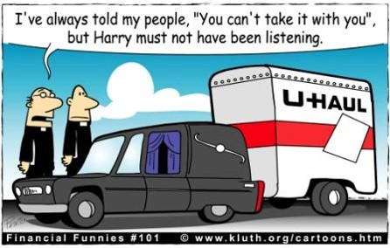
Ye who ask not, receives not!
In just 12 years, more than 20% of the US population will be over the age of 65.*
If we are not asking these individuals for charitable estate gifts, other charities are!
*The Baby Boom Cohort in the United States: 2012 to 2060, US Census Bureau, May 2014

Slide 8
Who are legacy giving donors?
Loyal annual givers (of any amount) have a current ongoing interest in the future success of your parish.
Average age of first bequest: 49*
Individuals and couples with no children
Women (who often live longer than men, and who more often tend to make charitable decisions than male partners)
Life events (death, divorce, retirement, empty-nest) tend to emotionally stir individuals to rethink people/causes they care about and support
*Identification, Death and Bequest Giving, Association of Fundraising Professionals, September 2008

Slide 9
Tools for Legacy Giving
Will Inclusion/Bequests
Endowed Pledges
Retirement Plans
Life Insurance Contributions
Gifts of Property
Life Income Gifts – charitable gift annuities and charitable remainder trusts

Slide 10
How do we secure and administer legacy gifts?
Identifying and assessing prospective donors
Creating an individualized strategy for each prospect
Cultivate the donor through education and relationship building
Develop the proposal
Make the ask
Negotiate and close the gift
Create a specific stewardship plan to continue building that relationship until the gift matures

Slide 11
ECF’s Role in Legacy Giving
ECF is dedicated to serving the poor and oppressed in our Diocese by partnering with our parishes. We do this by:
funding grants which support parishes serving their neighbors in need in their local communities as well as providing leadership and best practices around issues in our communities
providing additional resources to parishes through our new legacy giving program

Slide 12
ECF’s Role in Legacy Giving
ECF is dedicated to help parishes in the Diocese of Atlanta achieve a stream of sustainable funding, for generations to come, by providing:
Administrative and fundraising support for your parishioners to establish a lasting legacy gift that benefits both your parish specifically as well as the poor and oppressed throughout the Diocese.
Planned giving and financial planning experts on our Board of Directors who are specifically charged with creating and managing the tools necessary for legacy giving success.

Slide 13
Community Foundation Model
Community Foundations are:
a tax exempt, non-profit, philanthropic organization with the long term goal of building permanent funds for the broad-based public benefit of the residents in a given area.
designed to pool small and large contributions into a coordinated investment and grant making facility dedicated primarily to the social improvement of a given place.
provides donors with flexible, efficient, and tax-effective ways to ensure their charitable giving achieves the greatest possible impact.
Donors from across the Diocese can contribute their funds to ECF (either in life or upon their passing). When the gift matures, a disbursement(s) will be made back to the donor’s parish based on the donor’s wishes.
Greater participation can provide greater investment opportunities and returns.

Slide 14
Everyone will leave a legacy. Can ECF help your parishioners expand their impact?
Thank you for your time!
Lindsey E. Hardegree
Executive Director
Episcopal Community Foundation for Middle and North Georgia
ECFimpact.org
LHardegree@episcopalatlanta.org
“It takes a noble man to plan a seed for a tree that will someday give shade to people he may never meet.”
D. Elton Trueblood

