Slide 1
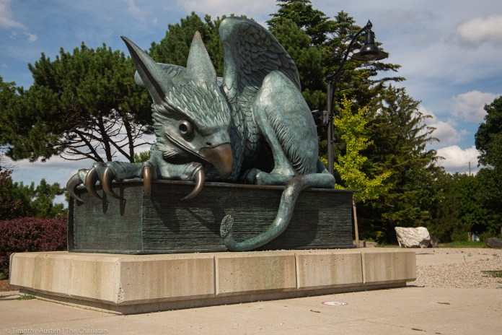
CIS-6520 Dig Forensics & Incident Response School of Computer Science (SOCS)
Data Exfiltration Using TCP Source Port
By Giacomo Nunno & Khaled Nafea
Under the supervision of Dr. Xiaodong Lin

Slide 2
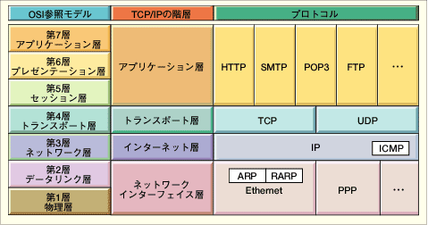
OSI and Protocol Stack
OSI: Open Systems Interconnect
OSI Model
TCP/IP Hierarchy
Protocols
7th
Application Layer
6th
Presentation Layer
Application Layer
5th
Session Layer
4th
Transport Layer
Transport Layer
3rd
Network Layer
Network Layer
2nd
Link Layer
Link Layer
1st
Physical Layer
Link Layer : includes device driver and network interface card
Network Layer : handles the movement of packets, i.e. Routing
Transport Layer : provides a reliable flow of data between two hosts
Application Layer : handles the details of the particular application

Slide 3
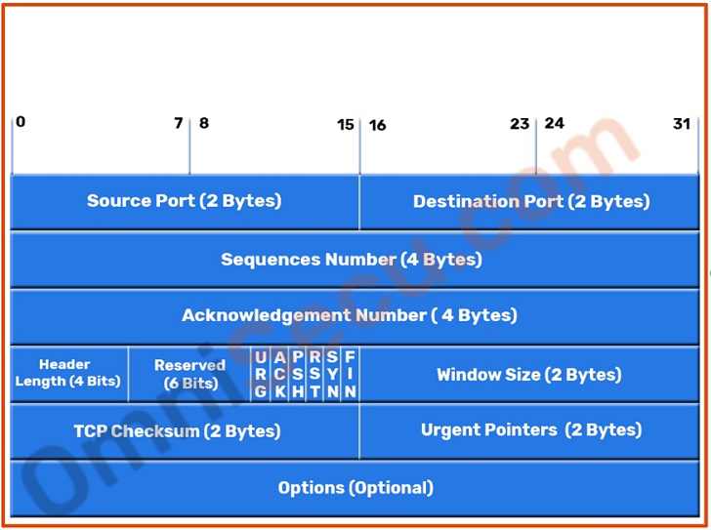
TCP Header
Field Purpose
Source Port Identifies originating application
Destination Port Identifies destination application
Sequence No. Sequence number of first octet in the segment
Ack. No. # Sequence number of the next expected octet (if ACK flag set)
Len Length of TCP header in 4 octet units
Flags TCP flags: SYN, FIN, RST, PSH, ACK, URG
Window Number of octets from ACK that sender will accept
Checksum Checksum of IP pseudo-header + TCP header + data
Urgent Pointer Pointer to end of “urgent data”
Options Special TCP options such as MSS and Window Scale

Slide 4
TCP/IP session
Client
Server
SYN
ISN=X
1
SYN
ISN=Y ACK=X+1
2
ACK=Y+1
3

Slide 5

Divide and Encode
Server
Using ASCII code from 0 to 127
Each Character use 7 or 8 bits
Each packet sends 1 Character (7bits) and (9 bits) for sequence No.
Each packet send two Characters (recommended)
Communication protocol:
One-way communication
Signal the beginning of the transmission use special source port No. 32,768
Next packet send the length of the packets.
Signal the ending of the transmission using the same special port No.
Victim’s PC

Slide 6
Binary to Decimal Coding
Exfiltration Example:
“Password”
“Pa” = “0101 0000 0110 0001” => 20,577
“ss” = “0111 0011 0111 0011” => 29,555
“wo” = “0111 0111 0110 1111” => 30,575
“rd” = “0111 0010 0110 0100” => 29,284
P | a | s | s | w | o | r | d
80 | 97 | 115 | 115 | 119 | 111 | 114 | 100
0101 0000 | 0110 0001 | 0111 0011 | 0111 0011 | 0111 0111 | 0110 1111 | 0111 0010 | 0110 0100

Slide 7

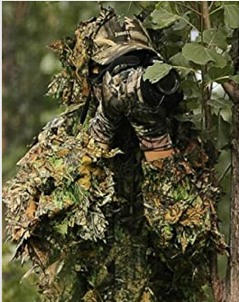
Exfiltration camouflage
Simulate legitimate Processes
Auto Updates
Microsoft Office 365
Linux unattended-upgrades package
Security updates.
Etc.
Auto Connect
VPN Client
Simulate server down situation
One-Way communication
3 tries then 5 min delay
TCP Source port uses random values
Stealth Mode:
3 tries using same source port
Notes:
To understand the operation of these attacks, we need to review the three-way
handshake that TCP uses to establish a connection. This is illustrated in Figure 7.2 .
The client system initiates the request for a TCP connection by sending a SYN packet
to the server. This identifies the client’s address and port number and supplies an
initial sequence number. It may also include a request for other TCP options. The
server records all the details about this request in a table of known TCP connections.
It then responds to the client with a SYN-ACK packet. This includes a sequence
number for the server and increments the client’s sequence number to confirm receipt
of the SYN packet. Once the client receives this, it sends an ACK packet to the server
with an incremented server sequence number and marks the connection as established.
Likewise, when the server receives this ACK packet, it also marks the connection
as established. Either party may then proceed with data transfer. In practice, this
ideal exchange sometimes fails. These packets are transported using IP, which is an
unreliable, though best-effort, network protocol. Any of the packets might be lost in
transit, as a result of congestion, for example. Hence both the client and server keep
track of which packets they have sent and, if no response is received in a reasonable
time, will resend those packets. As a result, TCP is a reliable transport protocol, and
any applications using it need not concern themselves with problems of lost or reordered
packets. This does, however, impose an overhead on the systems in managing
this reliable transfer of packets.

Slide 8
Challenges & Limitations
Devices that changes the source port:
Perimeter Firewall → NATing
Proxy Server
Works when no NAT or Static NAT

Slide 9
Detection
Main characteristics of the traffic flow:
Same source & Destination Ips
TCP source port is changing
Stealth mode:
Has to detect many false positives as well

Slide 10
SNORT advanced Configuration
sfPortscan preprocessor: developed by sourcefire to detect many portscanningtypes :
TCP, UDP, IP port_scanning
Portscan (One->One), Distributed Portscan (Many->One), Decoy (spoofed source address)
Portsweep (One->Many)
Stream5 preprocessor: is a target-based TCP reassembly module, capable of tracking sessions for both TCP and UDP
Maps to OS policy (linux, windows)
TCP protocol anomalies
Detection_filter:
Track by_src, count 30, seconds 60, flow: to_server

Slide 11
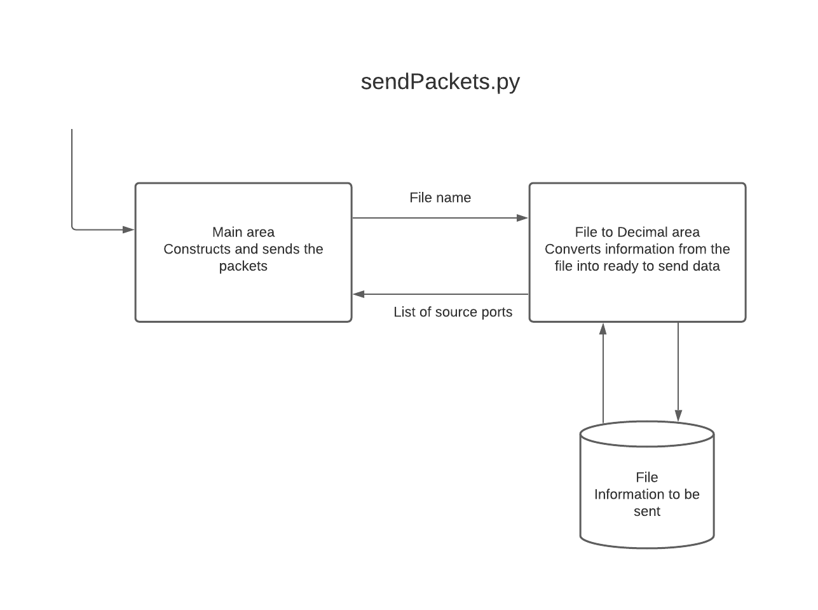
Dataflow Diagram

Slide 12
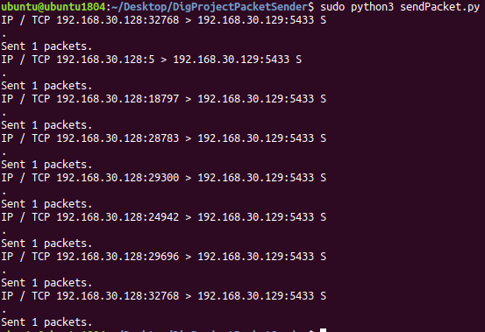

Victim Computer Terminal
Special port number to indicate the start of the transmission
Amount of packets to be sent
Special port number to indicate the end of the transmission
Data sent:

Slide 13
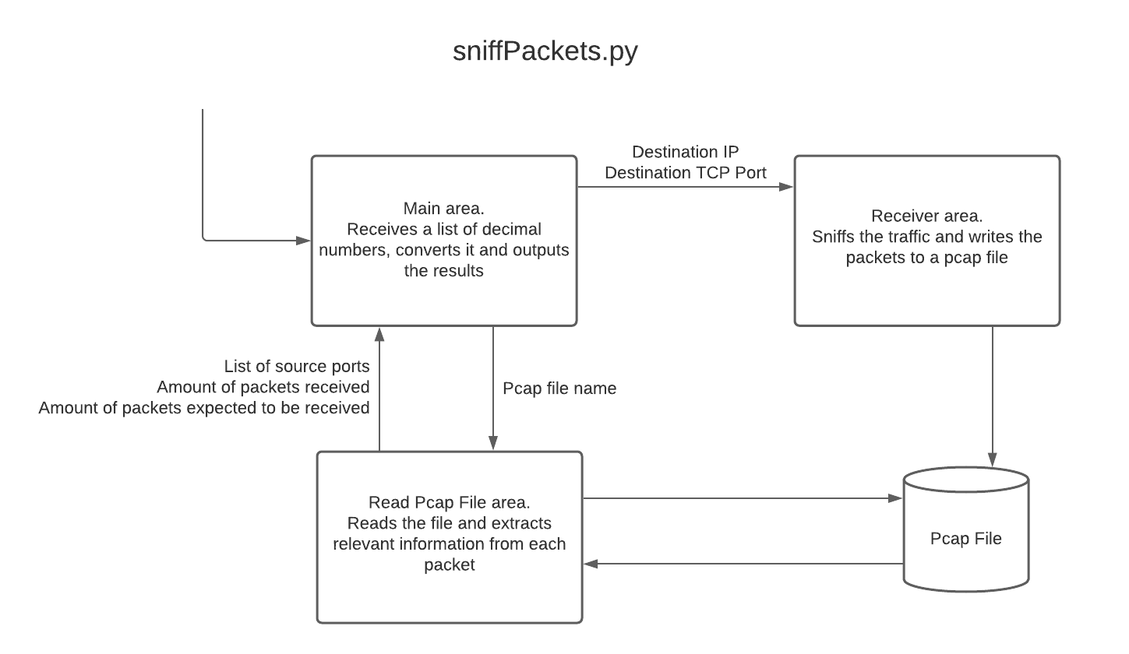
Dataflow Diagram

Slide 14
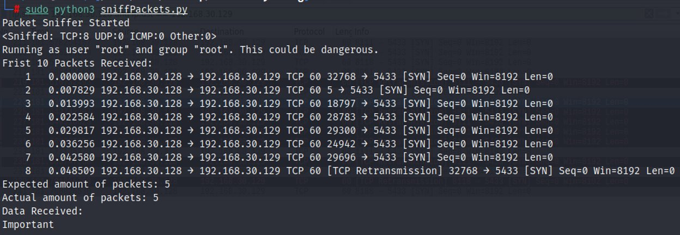
Server Terminal

Slide 15

Demo

Slide 16
Questions & Discussion
Notes:
Possible questions:
1) Are there any ideas on how it would be possible to detect this type of exfiltration?
2)

