Slide 1


The Bookish Butterfly
Priyam Gupta, Sue Boyd, Lawrie Brunswick, Jacob Peterson

Slide 2
Background
Millions of books out there -> hard to find next best book
Book recommenders are quick and convenient
Many different approaches already produced
Our tool:
Multi-modal approach for diverse preferences of users
Optionality of inputs that integrate with different search schemes
Plot and Semantic search novelty
Not advertiser influenced!

Slide 3

Use Cases
Annie Author
Loves Books by Agatha Christie
Wants new book suggestions for books written by Christie OR similar to books that have been written by Christie
Bob Book
Loved the book The Hunger Games
Wants to find new books similar to his favorite book
Choosy Chase
Only wants to read books by her favorite author Agatha Christie
Wants new book suggestions that have been highly rated > 4.5 stars by more than 5 reviewers
Genre Gerry
Only wants to read books in the Genre Mystery.
Patty Plots
Wants to search for books about detectives that solve murders from long ago.

Slide 4
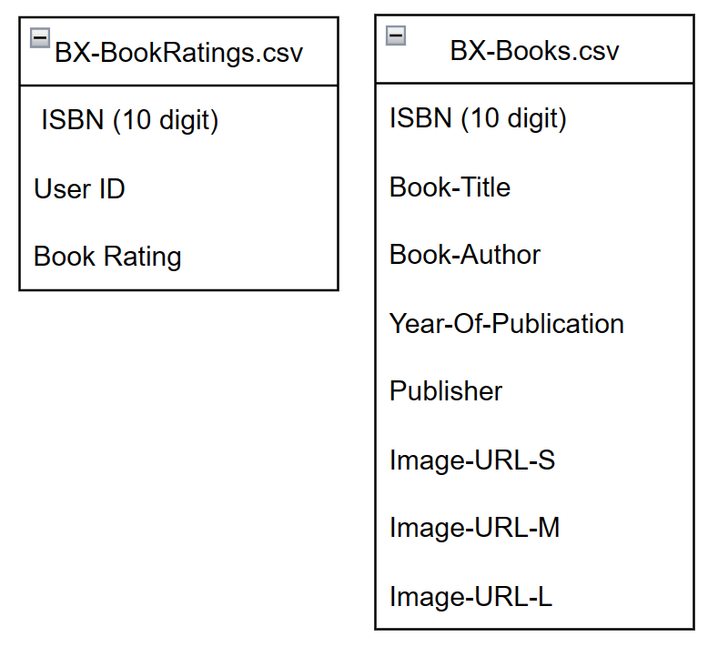
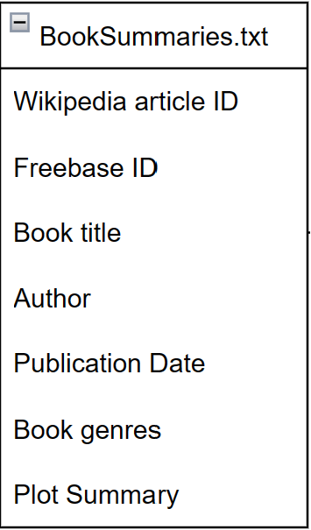
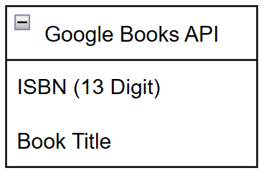
Raw Data Sources
Book Ratings
Plot Summaries
ISBN Matching
Kaggle Book Crossing Dataset
BX-Book-Ratings.csv (1149779 values)
BX-Books.csv (271379 unique values)
Kaggle CMU Book Summary BookSumaries.txt
16,559 unique values
Google Books API
Used to augment CMU data with ISBN Numbers for matching with Book Ratings
Notes:
https://drive.google.com/file/d/1Wdzi1F2S6s2sSNbMeYIAnXekj-EFbaE2/view?usp=sharing (IO Drawing)

Slide 5
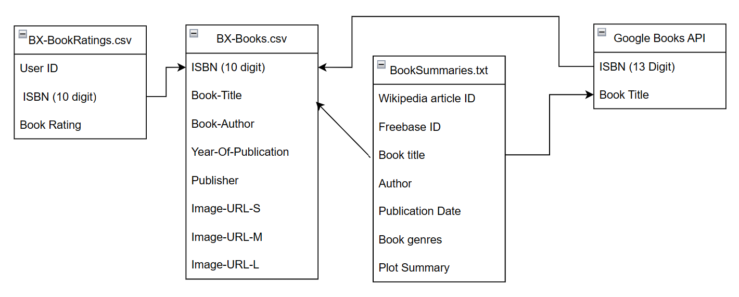
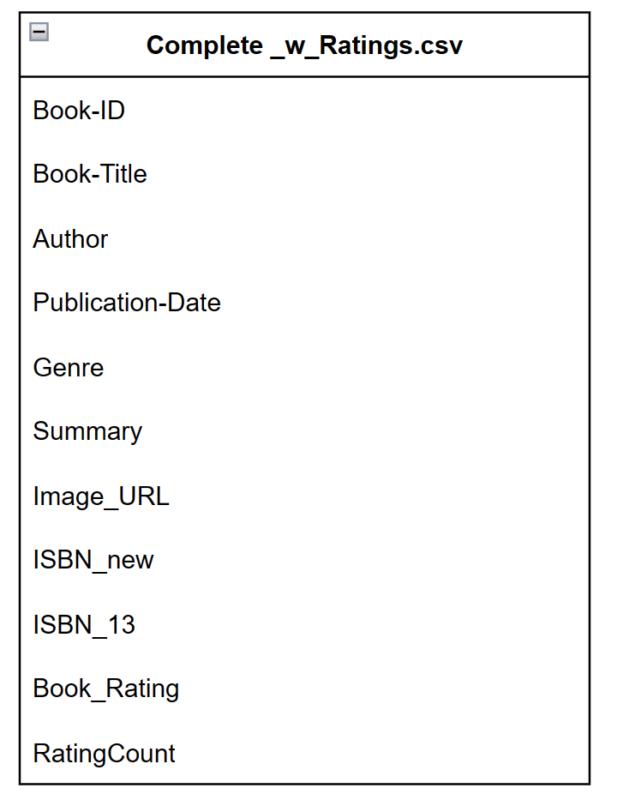
Data Cleaning and Joining
Data Limitations
Small Number of Books can lead to surprising/frustrating results in app (e.g. no results returned for common book or author)
BookSummaries.txt had no ISBN field for hard matching to ratings data
Used fuzzy/best matching on author field between BX-Books.csv and BookSummaries.txt 🡪 6360 matches
Obtained ISBN (13 digit) for 7289 matches using Google API for total of 13649 matches
Sparse Fields
Book genres (11025 of 13649 books had genre marked)
Book Rating (5115 of 13649 books had ratings)
Rating Count is close to 0 for most books
Notes:
https://drive.google.com/file/d/1Wdzi1F2S6s2sSNbMeYIAnXekj-EFbaE2/view?usp=sharing (IO Drawing)

Slide 6
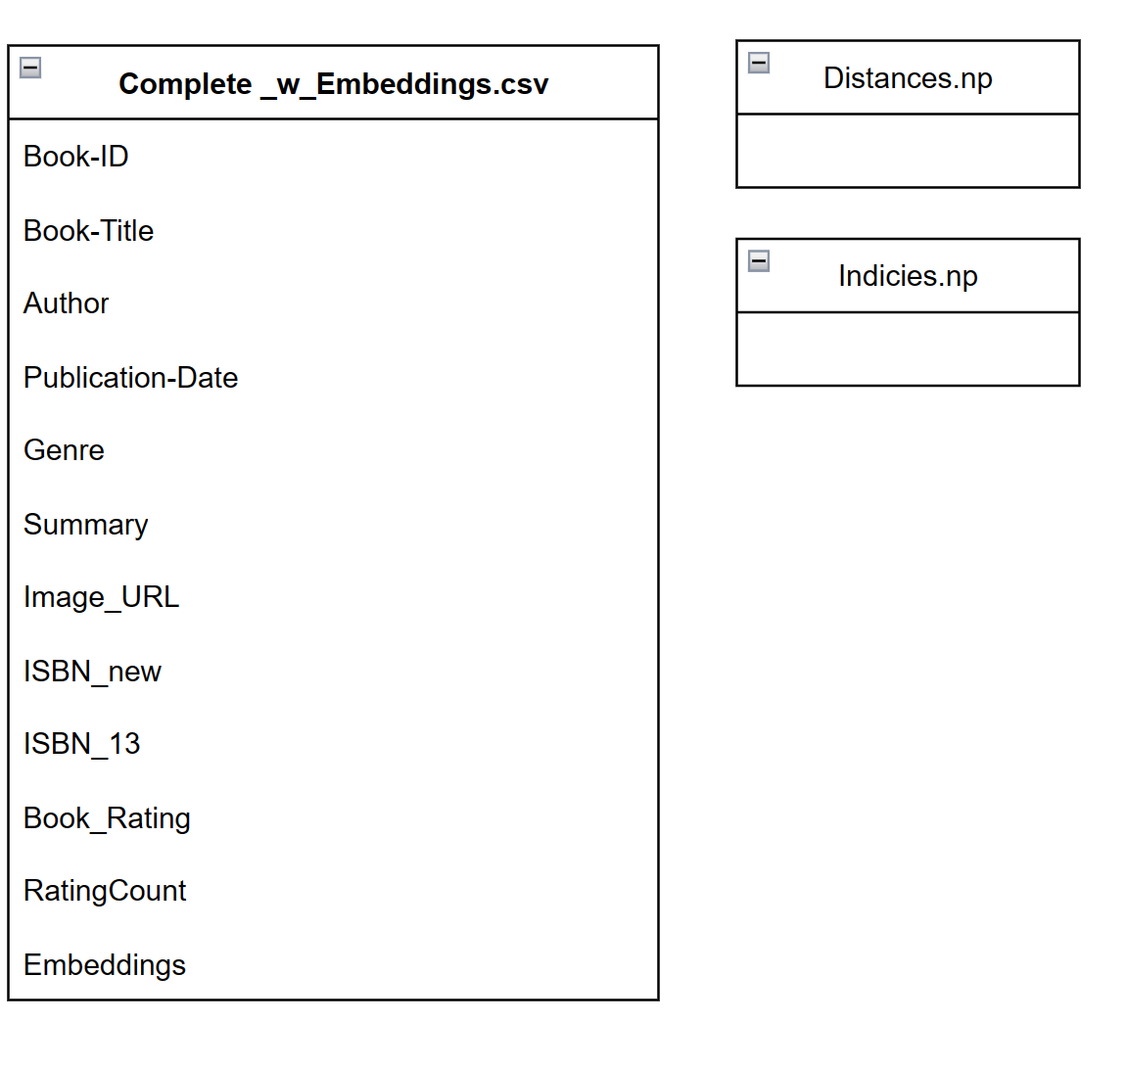
Data Preprocessing - Book Similarity Measures
Voyage-AI-Instruct API
Ranked #1 in MTEB leaderboards on hugging face in Semantic Textual Similarity(STS)
Maps user text query to closest book, for use in Book Title and Plot Search
Calculates “distances” between books based on STS for use in Plot Search
Voyage AI Instruct API

Slide 7
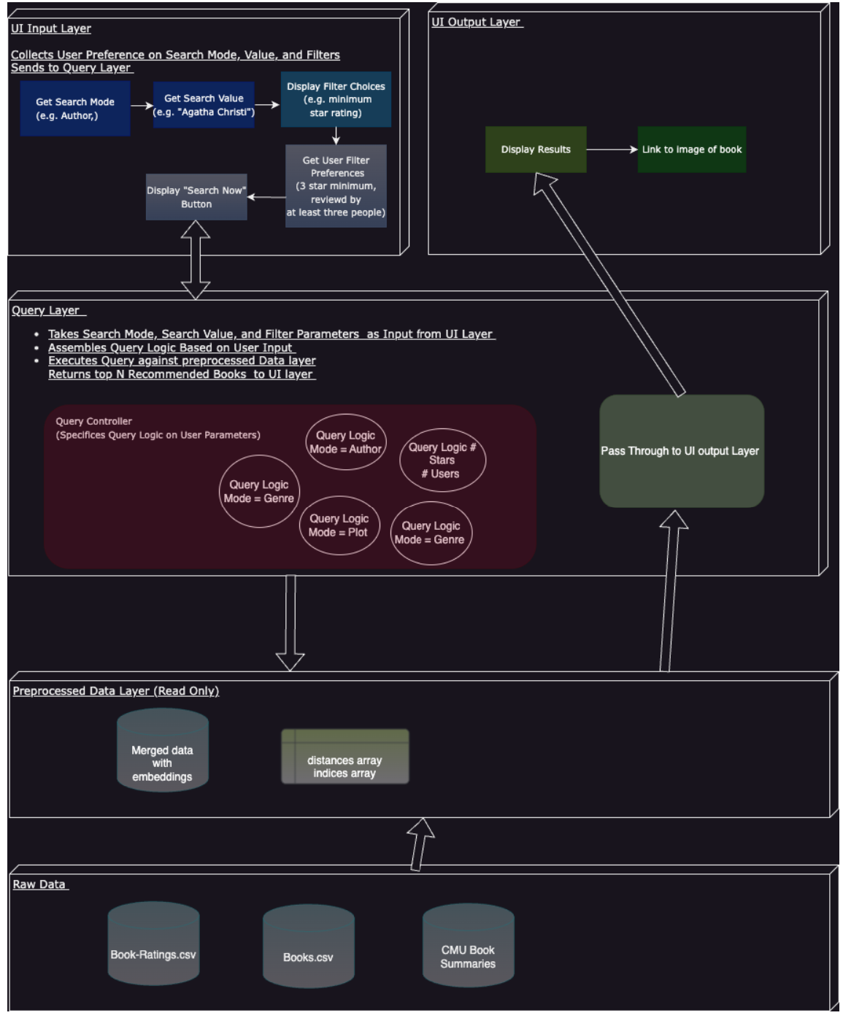
Design

Slide 8
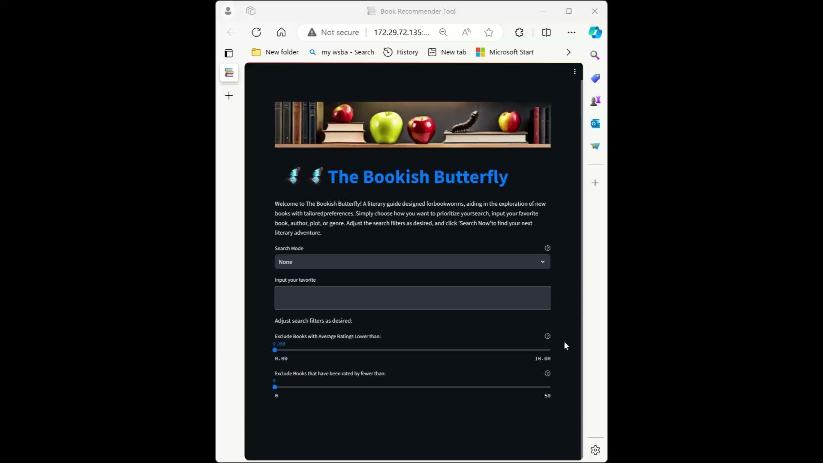
Demo!
Notes:
https://drive.google.com/file/d/1kIl8H_F_tfOOYh9sQEQYU50oWvKYkDrx/view?usp=drive_link

Slide 9
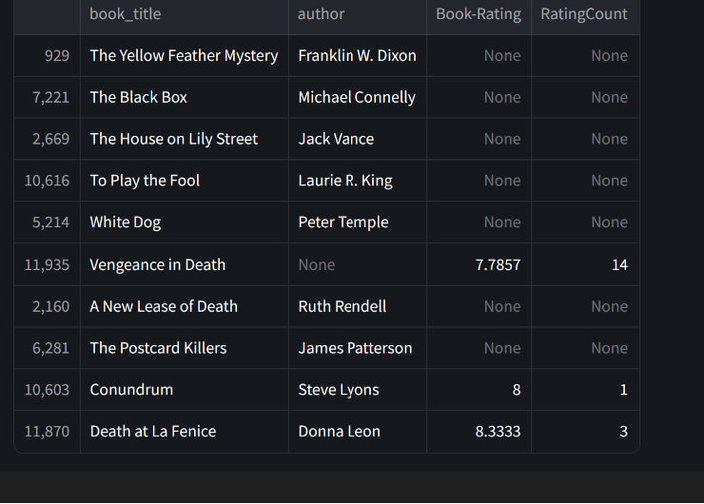
Demo - Plot Search Results
Query:
Detectives that solve murders from long ago.

Slide 10
Lessons Learned
Consider data size and performance limitations early
Leave ample time for testing and CI

Slide 11
APPENDIX / GRAVEYARD

