Slide 1


The Bookish Butterfly
Priyam Gupta, Sue Boyd, Lawrie Brunswick, Jacob Peterson

Slide 2
Background
Millions of books out there -> hard to find next best book
Book recommenders are quick and convenient
Many different approaches already produced
Our tool:
Multi-modal approach for diverse preferences of users
Optionality of inputs that integrate with different search schemes
Plot and Semantic search novelty
Not advertiser influenced!

Slide 3

User Profiles and Use Cases
Annie Author
Running out of books by her favorite authors!
Wants to find new books by the authors she loves and/or new authors that write in a similar style to her favorite authors..
When looking for new books, she cares a lot about how other users have rated them.
Use Case 1: Search for books by Agatha Christie or authors similar to Christie
Use Case 2: Search for only books by Agatha Christie, filtered by ratings.
Use Case 3 (implicit): Wants to search for books by an author but can’t remember author’s first name.
Bob Book
Wants to find new books similar to those he has enjoyed reading in the past.
Use Case 1: Search for books similar to the Hunger Games
Use Case 2: Search for books about detectives solving cold case mysteries
Genre Gerry
Only wants to read books in his favorite Genres.
Use Case 1: Search for books in the Mystery Genre.

Slide 4
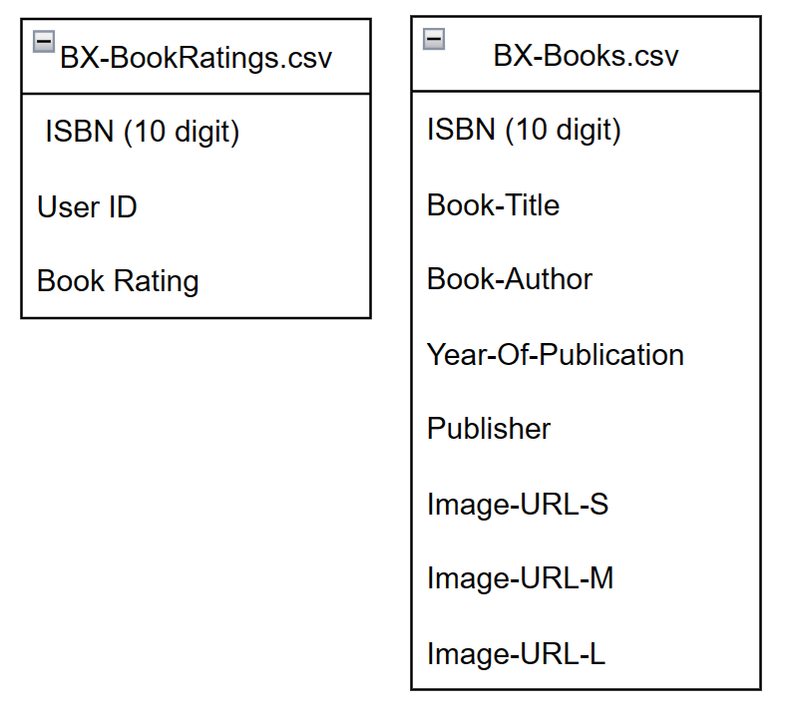
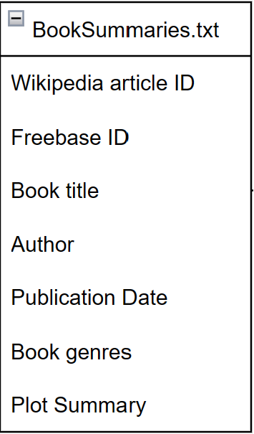
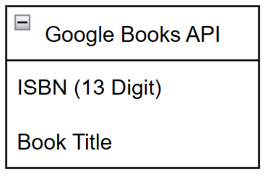
Raw Data Sources
Book Ratings
Plot Summaries
ISBN Matching
Kaggle Book Crossing Dataset
BX-Book-Ratings.csv (1149779 values)
BX-Books.csv (271379 unique values)
Kaggle CMU Book Summary BookSumaries.txt
16,559 unique values
Google Books API
Used to augment CMU data with ISBN Numbers for matching with Book Ratings
Notes:
https://drive.google.com/file/d/1Wdzi1F2S6s2sSNbMeYIAnXekj-EFbaE2/view?usp=sharing (IO Drawing)

Slide 5
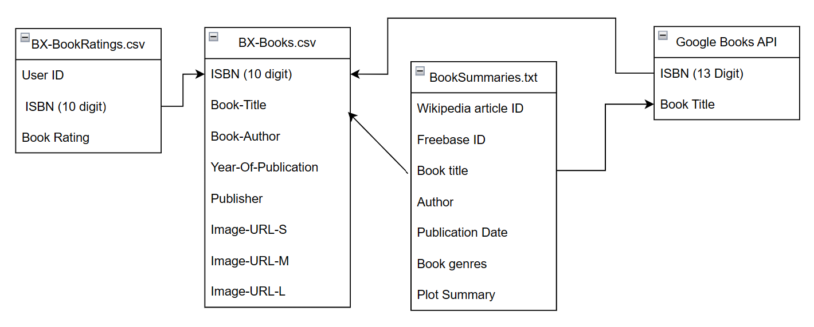
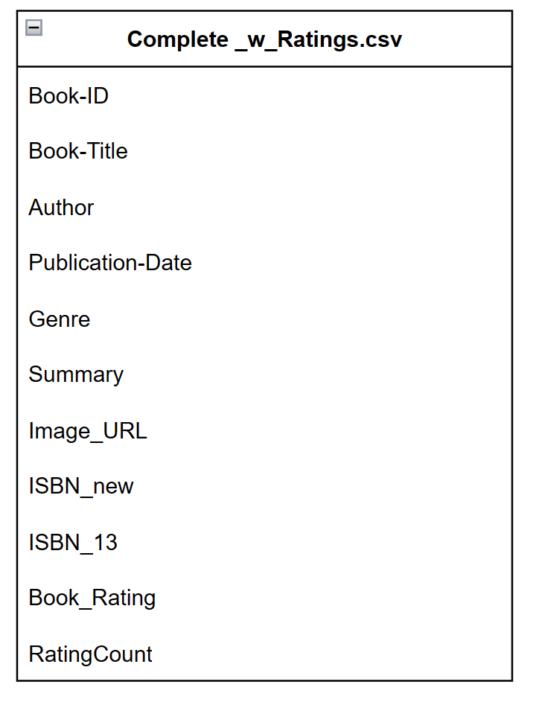
Data Cleaning and Joining
Data Limitations
Small Number of Books can lead to surprising/frustrating results in app (e.g. no results returned for common book or author)
BookSummaries.txt had no ISBN field for hard matching to ratings data
Used fuzzy/best matching on author field between BX-Books.csv and BookSummaries.txt 🡪 6360 matches
Obtained ISBN (13 digit) for 7289 matches using Google API for total of 13649 matches
Sparse Fields
Book genres (11025 of 13649 books had genre marked)
Book Rating (5115 of 13649 books had ratings)
Rating Count is close to 0 for most books
Notes:
https://drive.google.com/file/d/1Wdzi1F2S6s2sSNbMeYIAnXekj-EFbaE2/view?usp=sharing (IO Drawing)

Slide 6
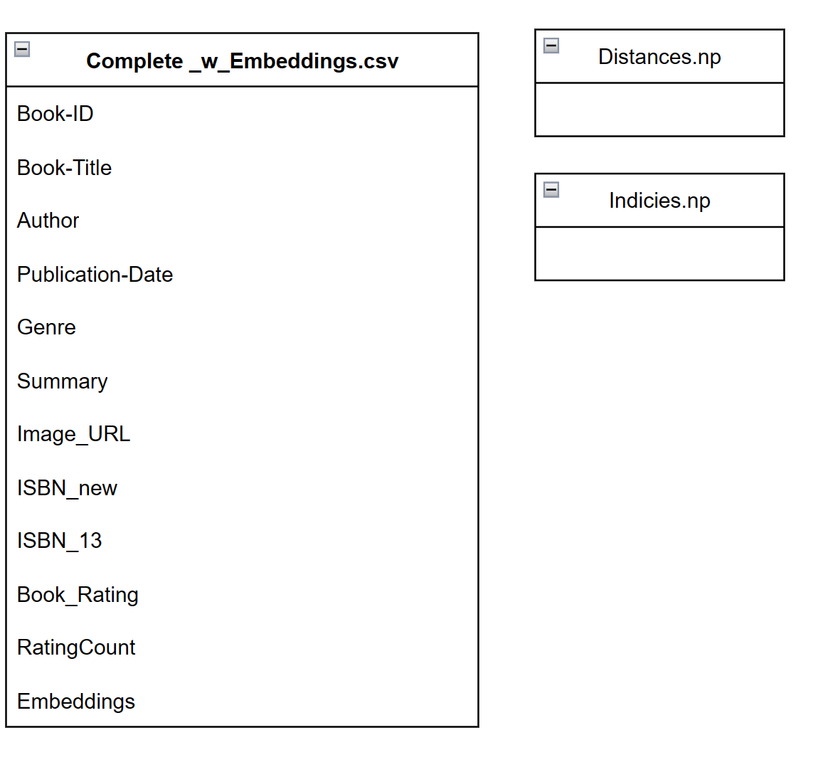
Data Preprocessing - Book Similarity Measures
Voyage-AI-Instruct API
Ranked #1 in MTEB leaderboards on hugging face in Semantic Textual Similarity(STS)
Maps user text query to closest book, for use in Book Title and Plot Search
Calculates “distances” between books based on STS for use in Plot Search
Voyage AI Instruct API

Slide 7
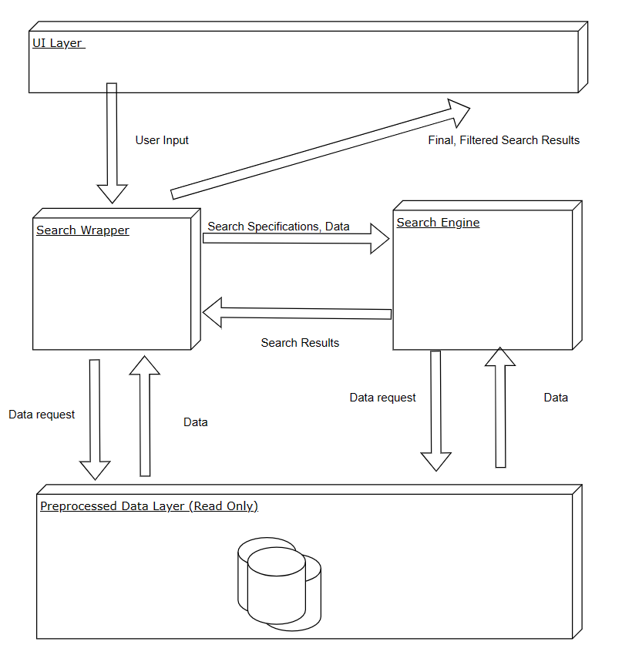
Design

Slide 8
Demo!
bookworm_rec/docs/demo_for_3_13.mp4 at main · jacobp24/bookworm_rec (github.com)
OR
Home - Google Drive

Slide 9
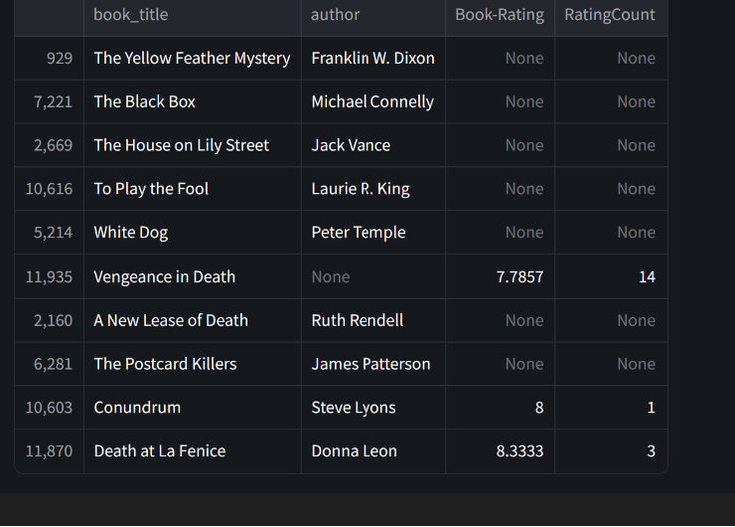
Demo - Plot Search Results
Query:
Detectives that solve murders from long ago.

Slide 10
Lessons Learned
Consider data size and performance limitations early
Leave ample time for testing and CI

