Slide 1

Bookworm Rec
Tech Review
Priyam Gupta, Sue Boyd, Lawrie Brunswick, Jacob Peterson

Slide 2
Background and Use Case
Application: Book Recommender Tool
Use Case: We need to create a graphical user interface to:
Collect user input (type of book they are searching for, filtering requirements) AND
Share recommendations based on user input + our recommendation engine
Package Requirements:
Enables dynamic, interactive UI
Can be run as a Python module
Easy to install and use for all team members

Slide 3
Python Packages Investigated
Flask - Created by Armin Ronacher
A lightweight and flexible micro web framework for Python.
Provides a simple and minimalistic approach to building web applications, allowing developers to have more control over the application structure.
Highly customizable and allows developers to choose their preferred tools and libraries for various components like ORM, templating engines, and authentication.
Well-suited for developers who prefer to have more control over the application architecture and want to build from the ground up.
Dash - Created by Plotly
A Python framework for building analytical web applications.
Built on top of Flask, Plotly, and React, allowing creation of interactive and complex user interfaces.
Allows developers to create interactive dashboards and data visualization tools using Python, HTML, and CSS without requiring knowledge of JavaScript or web development.
Provides a wide range of components and features for building sophisticated web applications, making it suitable for projects that demand high levels of customization and interactivity.
Streamlit - Created by Snowflake Inc.
A python framework for quickly developing and sharing data-driven applications without extensive programming knowledge.
Best for simple apps (e.g single web page)
Allows hosting of apps on Streamlit Community Cloud for easy deployment.

Slide 4
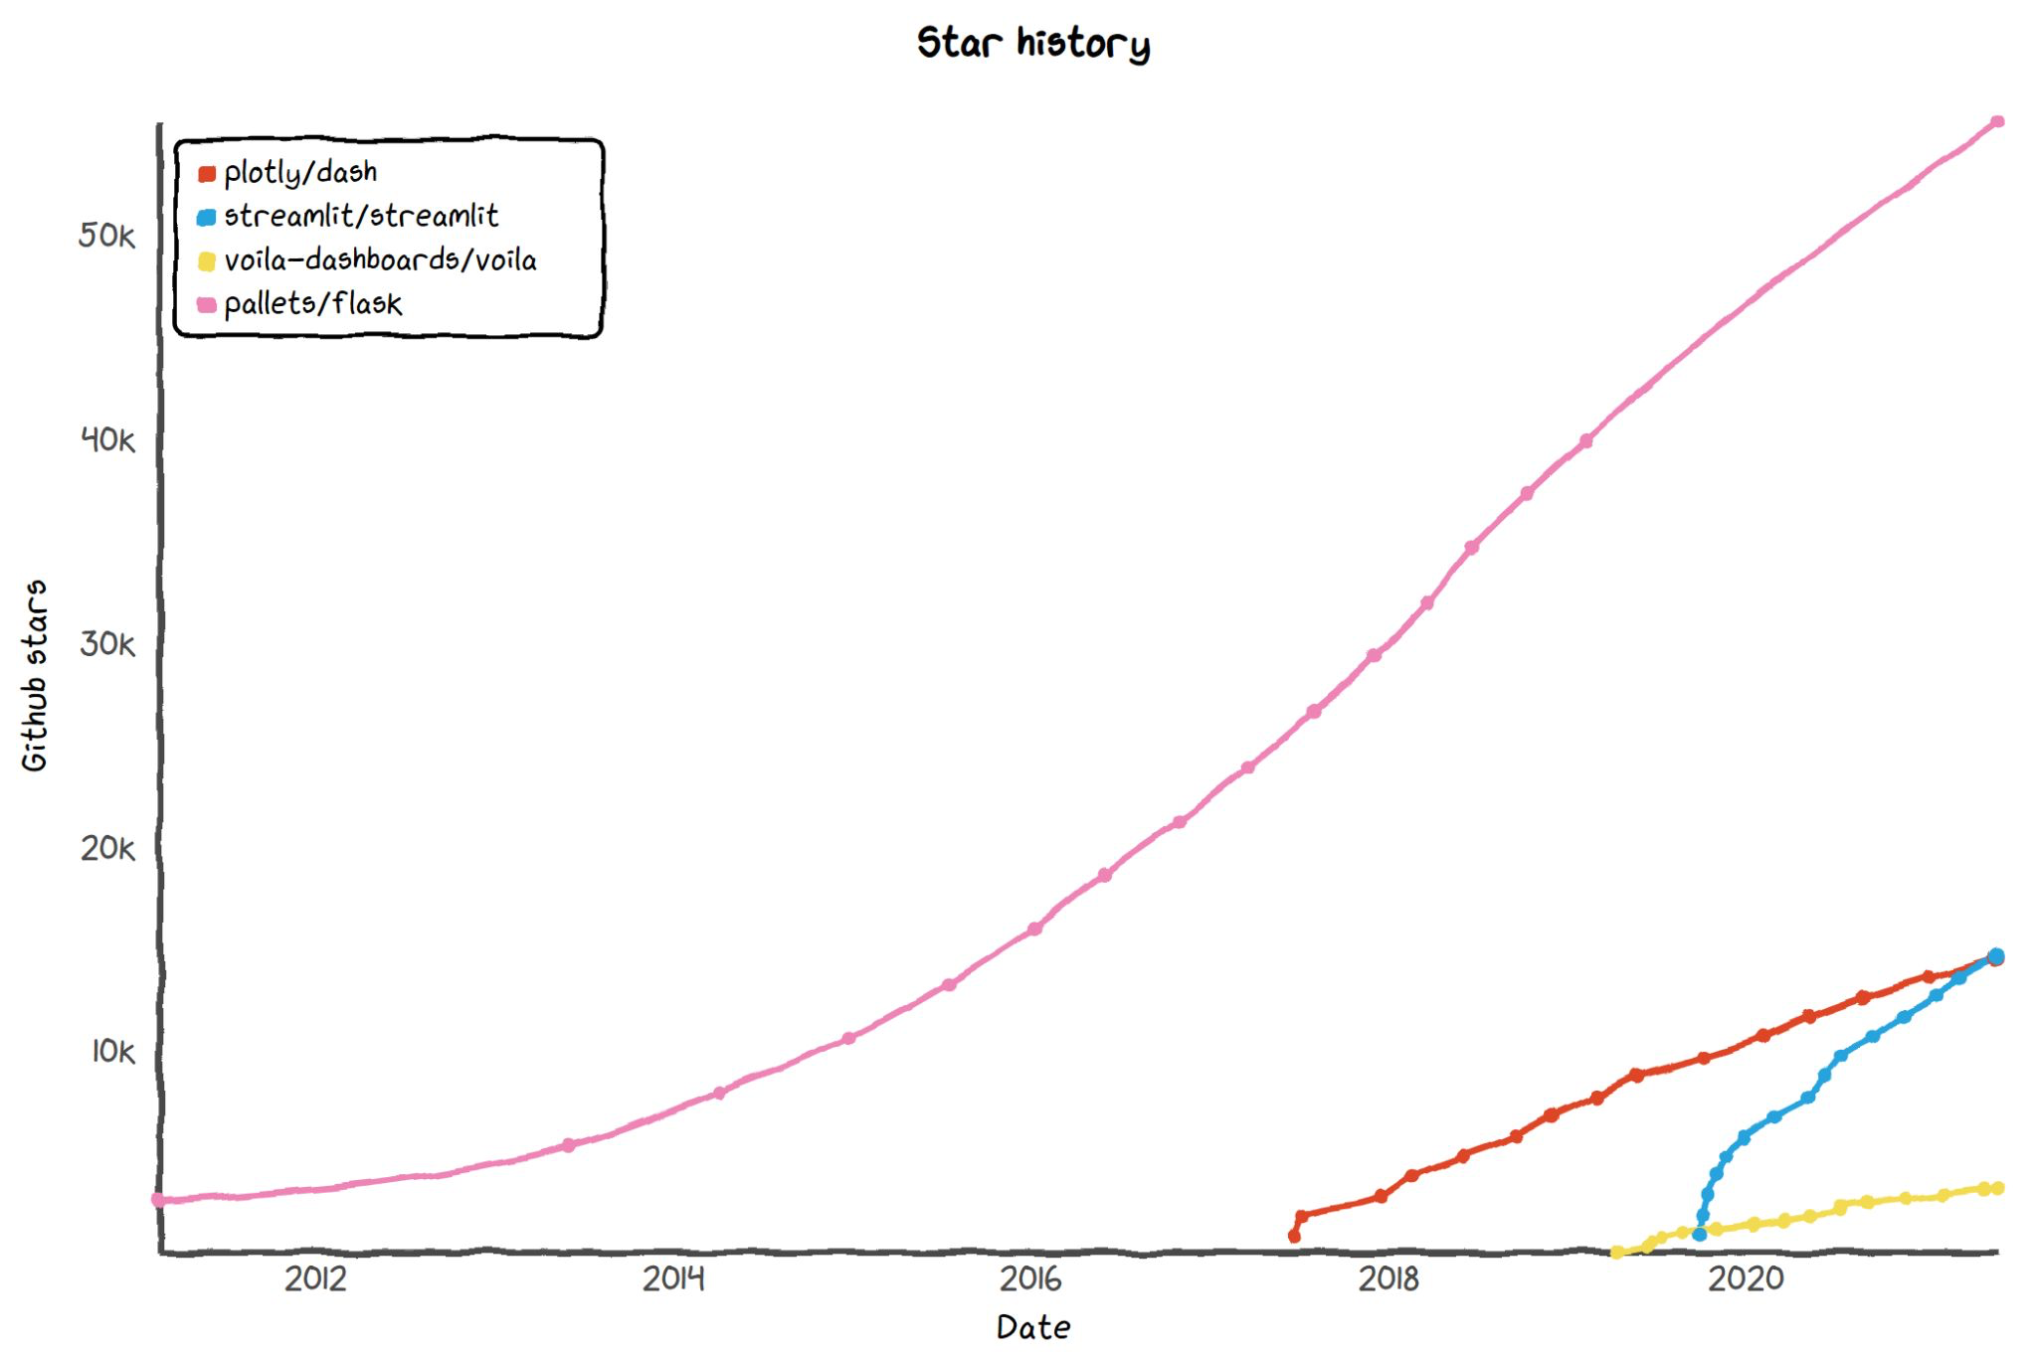
Popularity Comparison: Github Stars

Slide 5
Package Comparison (1 of 2)
 | Dash | Flask | Streamlit
Ease of Use | Easy: Simple to install and use, but has a slightly more complex setup. | Easy/Moderate: Easy for beginners to build small scale projects. | Easiest: Simple to install and use. Standard UI elements (drop down, slider) precoded; no html required.
Flexibility | Good. Dash offers greater customization than Streamlit.. | Good. Core web-dev features with flexibility for external tools | Lowest - but Good enough. Less opportunity for customization, but provides what we need for our project.
Performance | Good. Can use Memoization and Flask Caching. Quick visualization plotly.js | Good. Fast and flexible, Flask-caching library | OK. Inefficient unless caching strategies deployed

Slide 6
Package Comparison (2 of 2)
 | Dash | Flask | Streamlit
Documentation / Examples | Good. Has been around for 9 years. Plenty of support and tutorials. | Good. Has been around since 2010. Most popular micro framework for Python | Good. Newer, but extensive tutorials available
Integration / Compatibility | Good: Integrates well with Python, Docker | Best: Integrates well with Python, Docker, external APIs | Good: Integrates well with Python, Docker
Deployment | Ok: Github Codespaces or Azure Credits | OK: Github Codespaces or Azure Credits | Best: Streamlit Community Cloud

Slide 7
We Choose Streamlit
Has all of the capabilities that we anticipate needing
Easiest to get started with and simple UI
Customizable and moderately flexible for more complicated design
One webpage, one request, no complexities
Data Science focused
Community Cloud hosting for web page

Slide 8
Drawbacks/Remaining Concerns
Not optimized for multiple unique url routings
Will mitigate by keeping design to one page
Difficult to have intricate designs
Potential performance issues
Minimize real time calculations

