Slide 1
Numerical solution to quantum tunneling
Jacob park

Slide 2
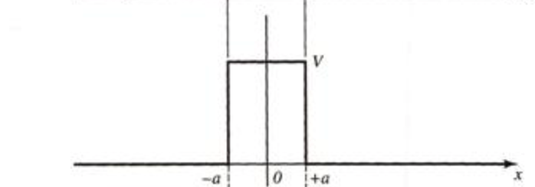

Model: Schrodinger Equation
Differential form of the Schrodinger Equation in the presence of a potential
$\frac{d^{2}ψ}{dx^{2}}=\frac{2m}{ℏ}(V\left(x\right)−E)ψ(x)$
$V\left(x\right)=\left\{\begin{aligned}0, x≤−a, x≥+a \\ V_{o}, −a<x<+a\end{aligned}\right.$

Slide 3



Model: Solution
$ψ\left(x\right)=\left\{\begin{aligned}Ae^{−i\sqrt{2mE/ℏ^{2}}x}+Be^{i\sqrt{2mE/ℏ^{2}}x}, x≤−a \\ Ce^{−\sqrt{2m(V_{o}−E)/ℏ^{2}}x},−a<x<+a \\ De^{−i\sqrt{2mE/ℏ^{2}}x}, x≥+a\end{aligned}\right.$
Solution is sinusoidal wave outside the potential barrier, but is an exponentially decaying function inside.
The full, time dependent solution can be modeled as a Gaussian centered on $x_{o},$ traveling along x and spreading as t increases.
${|ψ\left(x,t\right)\text{|}}^{2}=\frac{1}{\sqrt{2π}σ(t)}e^{\frac{−{(x−x_{o}−ℏk_{o}t)}^{2}}{2σ{(t)}^{2}}}$

Slide 4

Transmission and reflection coefficients
Transmission
$T=\frac{1}{1+\frac{V_{o}^{2}\sinh^{2}(2ka)}{4E(V_{o}−E)}}$
$k=\sqrt{2m(V_{o}−E)/ℏ^{2}}$
Transmission and reflection coefficient are a function of the energy of the incident particle, the potential energy of the barrier and the spatial width of the barrier.
Reflection
R=1-T

Slide 5


Numerical Method
$iℏ\frac{∂}{∂t}ψ\left(x,t\right)=(−\frac{ℏ^{2}}{2m}\frac{∂^{2}}{∂x^{2}})ψ(x,t)$
$\frac{ψ\left(x,t+τ\right)−ψ(x,t) }{τ}=\frac{iℏ}{2m}\frac{ψ\left(x+Δx,t\right)+ψ\left(x−Δx,t\right)−2ψ(x,t)}{Δx}$
$ψ\left(x,t+τ\right)=ψ\left(x,t\right)+\frac{iτℏ}{2m}\frac{ψ\left(x+Δx,t\right)+ψ\left(x−Δx,t\right)−2ψ(x,t)}{Δx}$
Discretize the equation in space and time and solve for the forward time step
Use $ψ\left(x,0\right)$ as initial condition to start off the iterations

Slide 6
results

Slide 7
Conclusion
Produced a method for solving the differential Schrodinger Equation
Used it to calculate the transmission and reflection coefficients of a quantum particle incident on a potential barrier
Plotted the solution as function of space and time
Next steps are to extend the method to solve for different potential configurations, e.g. potential well or spatially varying potential.

