Slide 1
Cheryl Stumbo
Survivor of Gun Violence
Advocate for
Preventing Gun Violence

Slide 2
Friday, July 28, 2006
Almost 4:00pm

Slide 3
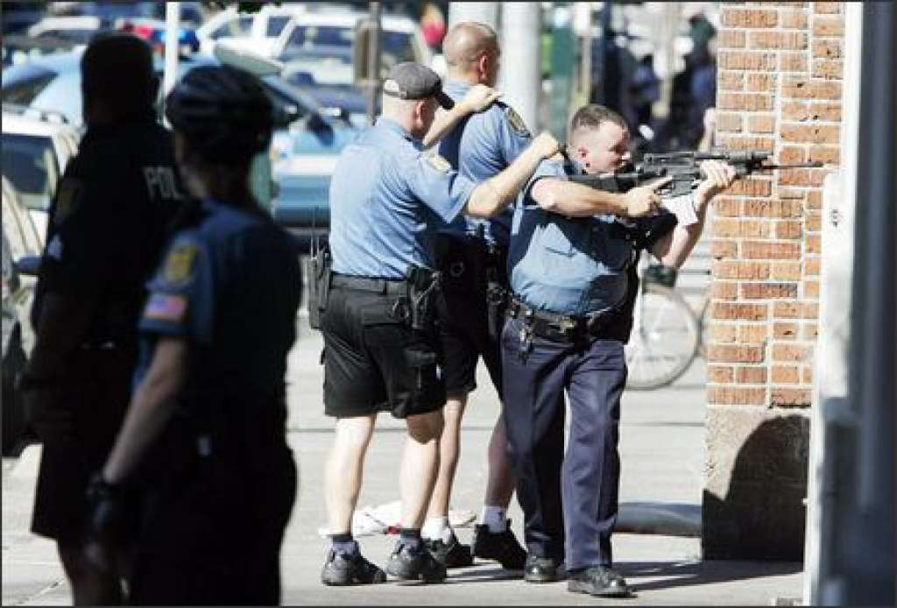

Slide 4
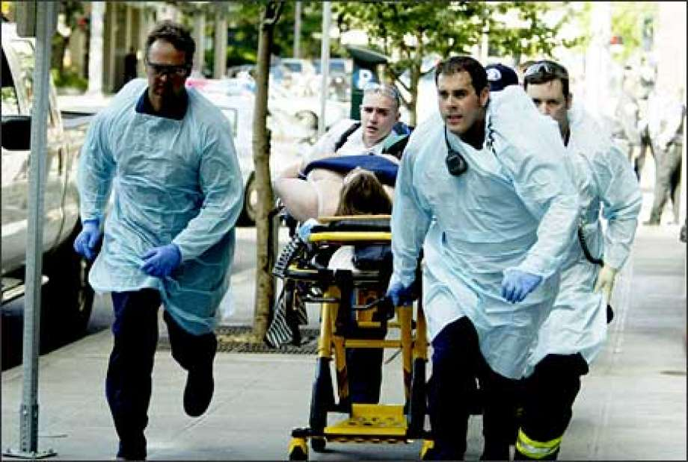

Slide 5
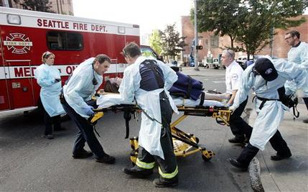

Slide 6
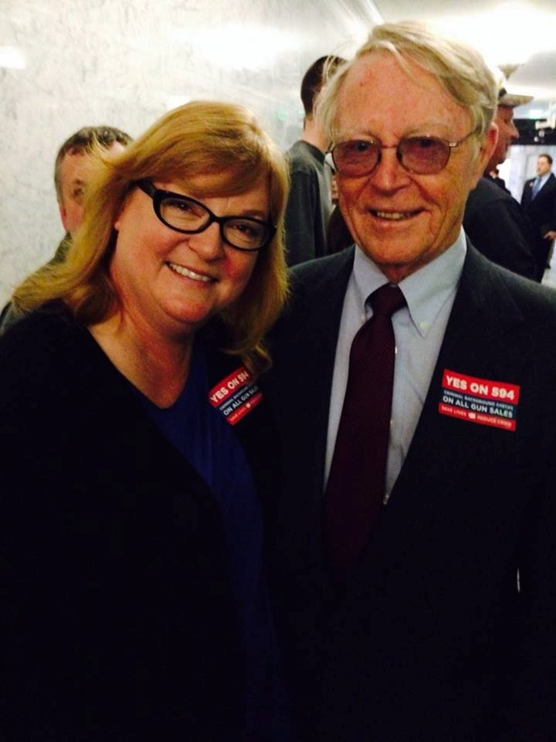

Slide 7
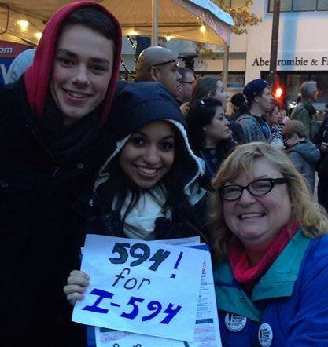

Slide 8
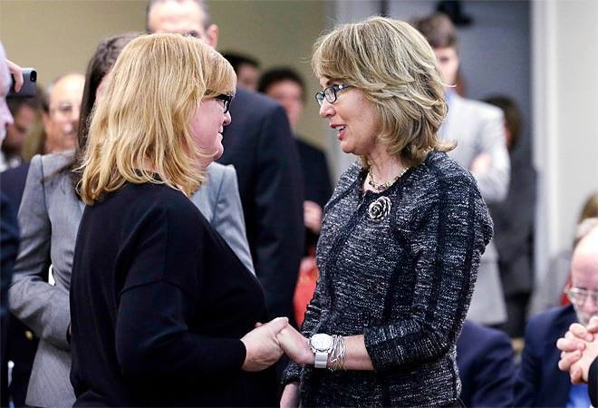

Slide 9
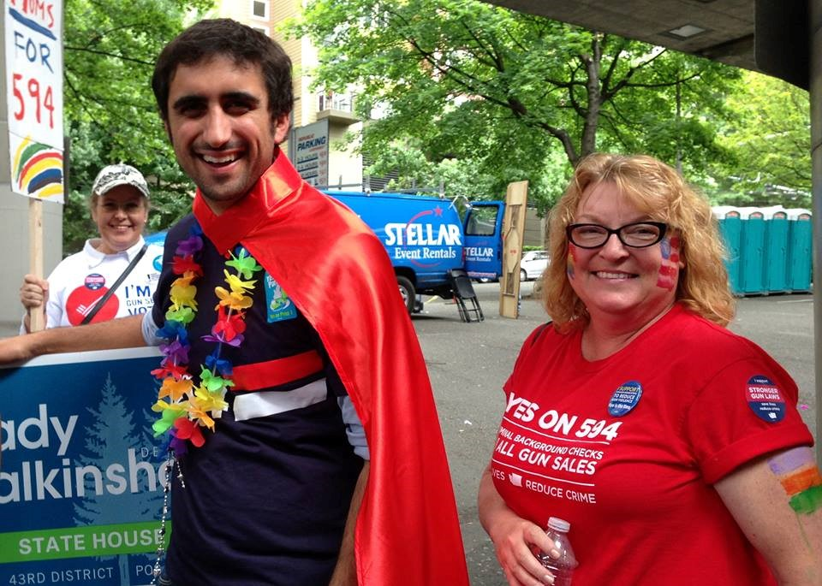

Slide 10
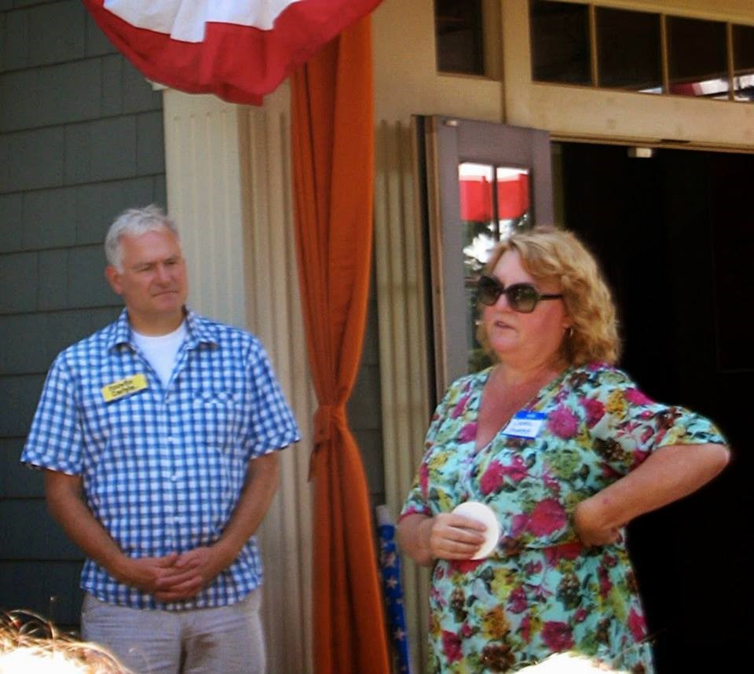

Slide 11
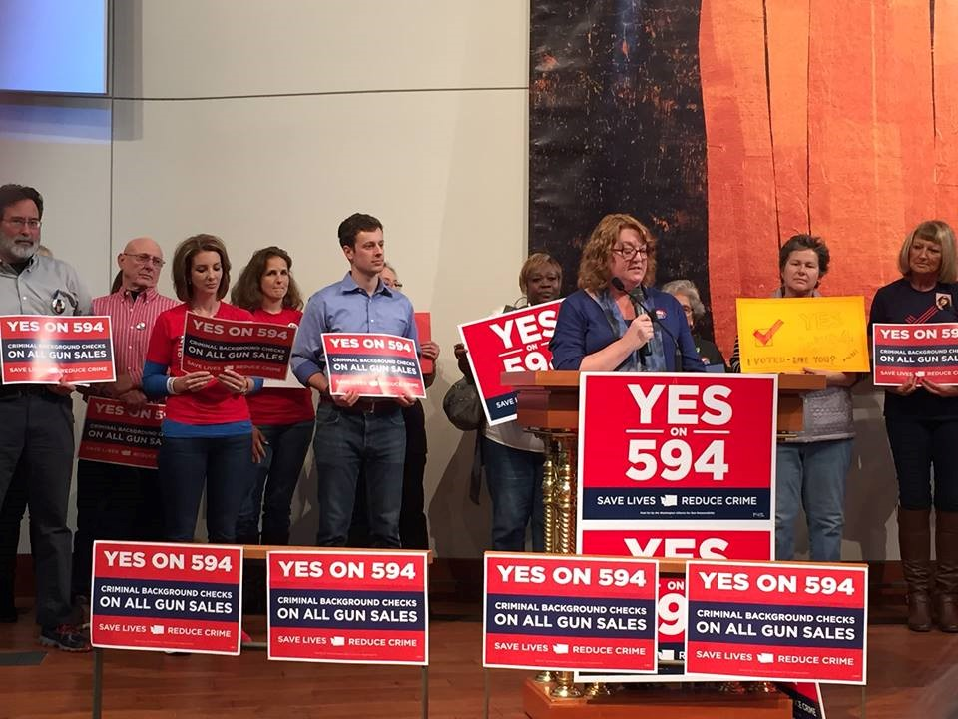

Slide 12
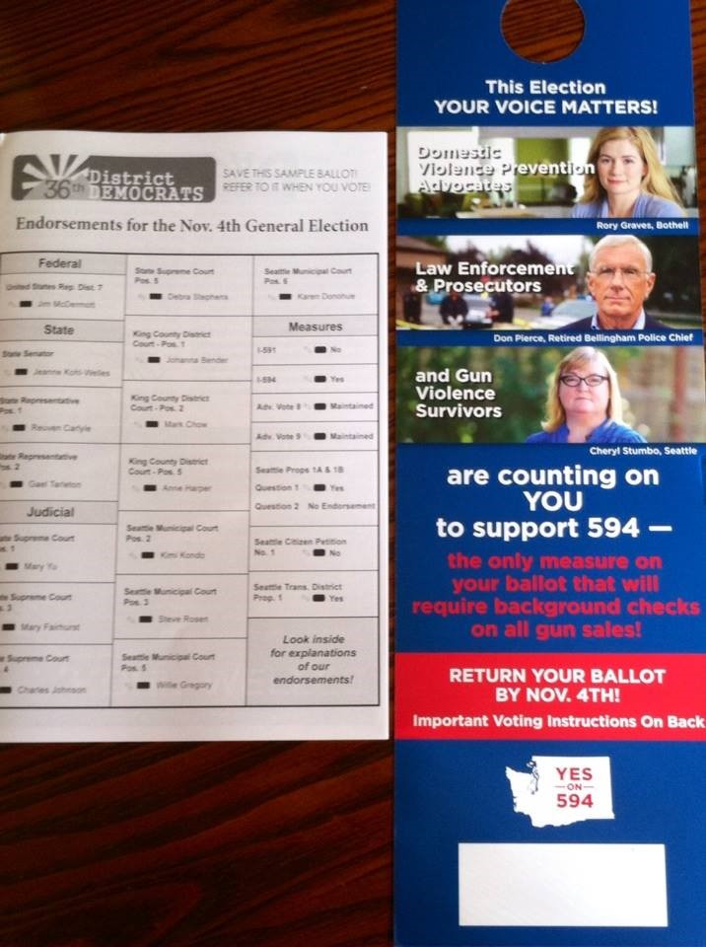

Slide 13
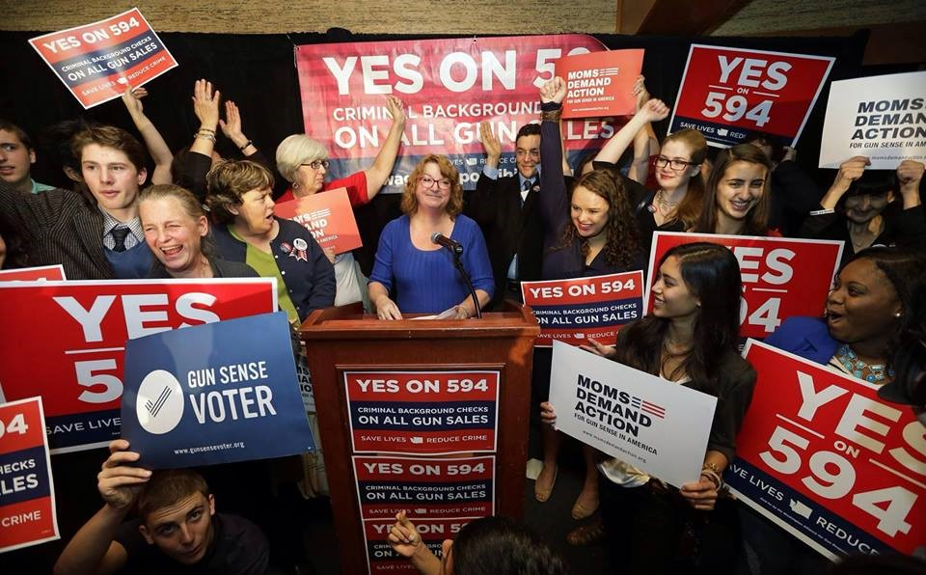

Slide 14
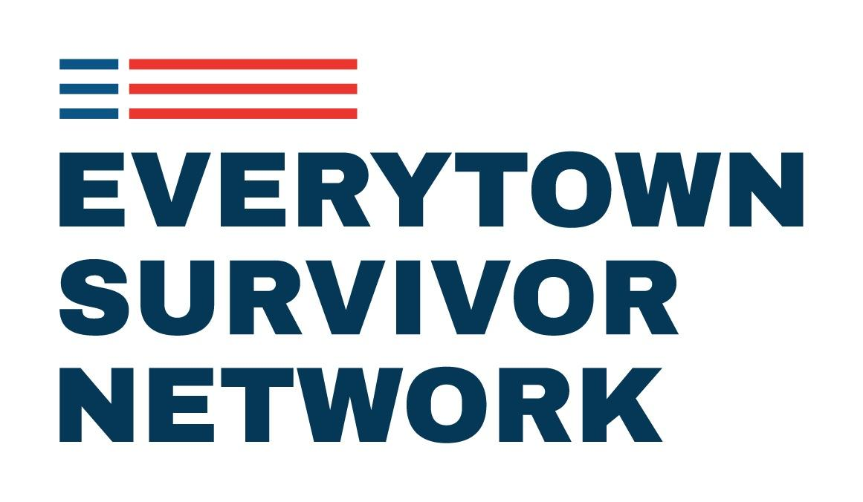

Slide 15
Who is a Survivor?
Anyone who has been personally impacted
by gun violence:
Surviving victims of shootings
Loved ones and close friends of victims/survivors
Witnesses to gun violence
Notes:
[history of the movement and Chris meeting Tucson survivors, and that we’ve now grown into a Network]
[note 11/7/17: update to language from revised brochure, if that’s ready]
So what is the Everytown Survivor Network? We are the largest organized network of gun violence survivors in the country. ESN brings together a network of over 1,500 Americans who have been personally affected by gun violence to build a community of support, empowering survivors who are interested in becoming leaders in the gun violence prevention movement. The ESN empowers survivors by:
Connecting survivors to each other.
Empowering survivors to share their stories (if and when they are ready), to raise awareness about the scale and impact of gun violence in America.
Developing survivors into leaders in the gun violence prevention movement.
Who is a survivor? A survivor is anyone who has been personally impacted by gun violence. This includes loved ones of victims as well as survivors and people who have witnessed an incident of gun violence. The ESN is comprised of individuals who have been affected by many types of gun violence, including but not limited to day-to-day gun violence, suicide, unsolved shootings, unintentional shootings, domestic violence, hate crimes, and mass shootings.
Oftentimes our research and policy focus is referred to as the ‘head’ of the movement, and our work with survivors to elevate their stories is considered the ‘heart’ of the movement.
[Pat Maisch story – survivors sharing their stories made people realize the humanity of the GVP issue – people connected with survivors as humans in a way they don’t with gun violence statistics.]

Slide 16
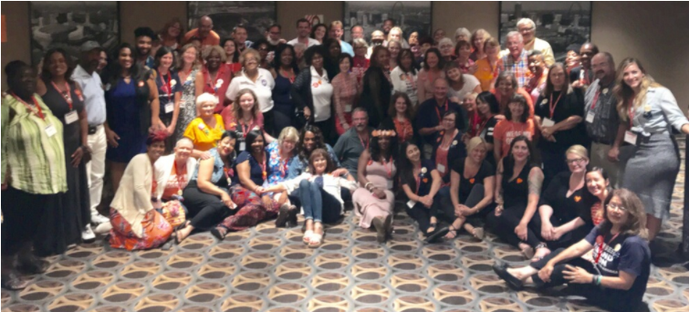
From Survivors to Leaders
Notes:
In 2015, ESN launched two distinct leadership programs focusing on survivors of gun violence; the Survivor Fellowship Program, and Survivor Engagement Leads positions, which are integrated into the Moms volunteer network.

Slide 17
Thank you!
Facebook: Cheryl Stumbo
Everytown for Gun Safety Email: cstumbo@Everytown.org
Personal Email: cherylastumbo@gmail.com
LinkedIn: Cheryl Stumbo

