Slide 1

RESULTS Creating the Political Will to End Poverty
Presented to Enl!ghten By Beth Wilson RESULTS Group Leader & Board Member July 15, 2016

Slide 2
What is RESULTS?
RESULTS is a movement of passionate, committed everyday people.
Together we use our voices to influence political decisions that will bring an end to poverty.

Slide 3
Volunteers receive training, support, and inspiration to become skilled advocates In time they learn to effectively advise policy makers, guiding them to decisions that improve access to health, education and economic opportunity Together we realize the incredible power we possess to use our voices to change the world.

Slide 4
Where is RESULTS?
Started in U.S. in 1980 – organized by chapters
121 Groups in the U.S., 79 focus on Global Poverty, 42 focus on U.S. Poverty
National professional staff in Washington, D.C. led by Dr. Joanne Carter
Spread around the world to Australia, Canada, Japan,
Kenya, Mexico, South Korea, United Kingdom and
Zambia
In Washington State:
Bremerton/Central & North Kitsap (Domestic),
South Kitsap/Gig Harbor, Seattle, Tacoma, Olympia,
Snohomish and Spokane (all Global)
with expansion planned for Tri-Cities
Groups meet once or twice a month to plan their actions to build the political will to end poverty.
An annual International Conference is held each summer in Washington, DC, attended by 500 people from dozens of countries.

Slide 5
What does RESULTS advocate for?
RESULTS started to end hunger around the world. Now works to end poverty at the global level and the domestic (U.S.) level.
Global Poverty: End extreme poverty by 2030
Health – Maternal & Child Health, AIDS, Malaria & TB
Education - for 49 million children without access to education and the 40% of all children whose education is insufficient to ensure literacy
Microfinance for the poorest to lift themselves out of poverty and support their families and communities
U.S.AID and World Bank accountability and effectiveness (Reach Act)

Slide 6
U.S. Poverty, too?
Access to effective healthcare and wellness
services (Advocated for health reform and
funding for community health centers)
Reduction of hunger (SNAP/Food Stamps)
Access to early childhood education (Head
Start)
Poverty reduction through tax policy (EITC &
CTC)

Slide 7
What is Advocacy?
Advocacy is creating political will
Telling decision-makers what their
priorities should be
Building public support through effective engagement in the media
If we want something, we have to ask for it
Every idea must have a voice
Decision-makers are not all knowing
Many times, they need to be educated
just like everyone else

Slide 8
Ultimately…it’s about change
All major changes in social or
economic policy, good or bad,
happened because advocates
did not give up until it happened.
The status quo, inertia, is a
powerful force.

Slide 9
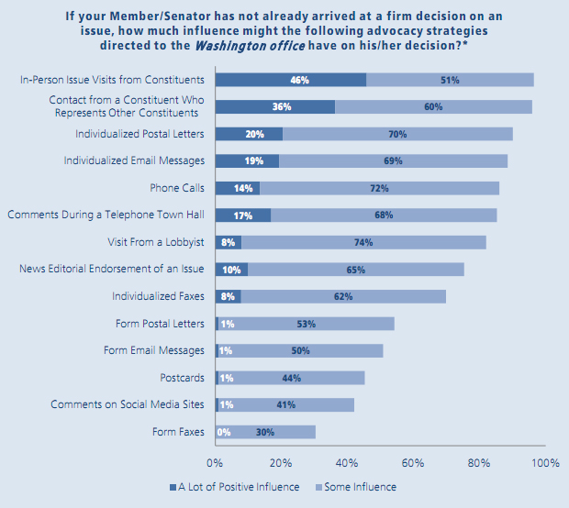
Advocacy Approaches
Constituent visits and individual letters are the most effective way to influence

Slide 10
Advocacy Approaches
Visits from paid lobbyists are only moderately effective

Slide 11
Advocacy Approaches
Form letters, postcards and form faxes are least effective

Slide 12
Advocacy
Never doubt that a small group of thoughtful, committed citizens can change the world. Indeed, it is the only thing that ever has.
— anthropologist Margaret Mead

Slide 13
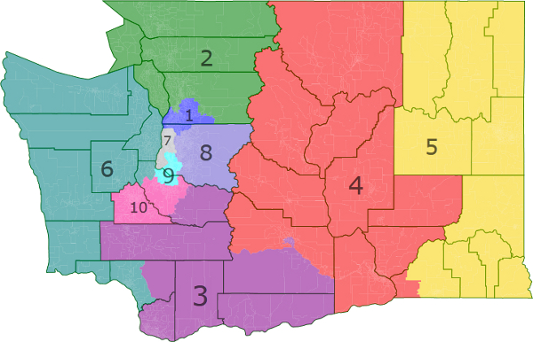
Washington State Congressional Districts
1 – Suzan DelBene, 2 – Rick Larsen, 3 – Jaime Herrera Beutler,
4 – Dan Newhouse, 5 – Cathy McMorris Rogers, 6 – Derek Kilmer,
7-Jim McDermott, 8-David Reichert, 9 – Adam Smith, 10 – Denny Heck

Slide 14
An Example of RESULTS’s Work: The Story of Representative Derek Kilmer’s Letter to the President
Global Fund to Fight AIDS, Tuberculosis and Malaria
Began in 2002 to fight the world’s most deadly diseases
Pledging conference held every three years, next on September 17, 2016 in Montreal, Canada.
While at the 2016 International Conference, RESULTS members asked Congressman Kilmer to sponsor a letter to President Obama urging a $4.3B three-year pledge, signed by all members of the WA State Congressional delegation.
Involved Rep. Kilmer’s Congressional staff, all RESULTS groups, our ONE Campaign Partners. Secured the final signature less than one hour before the deadline on 7/14/16.

Slide 15
Why the Global Fund?
Since 2002 when it began, through its partners, the Global Fund has:
Saved 17 million lives
Provided treatment to 13.2 million Tuberculosis patients
8.1 million people are alive due to ARV treatments for HIV/AIDS
585 million bed nets have been distributed to families at risk for malaria
Leverages $2 additional dollars for every $1 the U.S. contributes
With the next pledge, the Global Fund plans to save 8 million lives and prevent 300 million new infections from HIV, TB and Malaria by 2020.

Slide 16
The Education for All Act (H.R. 4481): Strengthening Impact and Accountability
59 million primary school-aged children around the world have no access to an education (was 100 million in 1999)
Even of those in school, 250 million kids – nearly 40 percent of the world’s children of primary school age – can’t read a single sentence
A well-resourced U.S. global education strategy, increased transparency and accountability is needed to ensure the U.S. government effectively contributes to realizing quality education for children around the world

Slide 17
The Reach Every Mother & Child Act
Develops a U.S. Government strategy to help end preventable child and maternal deaths with ambitious, clear, and measurable goals;
Increases accountability and transparency at all levels;
Focuses on the poorest and most vulnerable populations, and recognizes the unique needs within different countries and communities;
Scales up what is proven to work and save the most lives, while reporting against clear targets;
Codifies a Child and Maternal Survival Coordinator responsible for oversight;
Creates new, innovative funding sources to complement U.S. investment;
Builds the capacity for USAID to meet its goals of saving 15 million child lives and 600,000 women’s lives by 2020.

Slide 18
U.S. Poverty Advocacy: Creating Economic Mobility - Building Ladders out of Poverty
RESULTS volunteers worked to save key provisions of the Earned Income Tax Credit (EITC) and the Child Tax Credit (CTC).
These tax credits are our nation's most successful anti-poverty programs for children – the pro-work tax credits helped to lift 9/8 million Americans out of poverty in 2014, including 5.2 million children.
Because of the outstanding grassroots advocacy work of RESULTS volunteer advocates and others, in 2015 Congress passed tax legislation that saves the key EITC and CTC provisions.
Now RESULTS volunteers are working to expand the EITC to cover families without children who meet the income requirements.

Slide 19
Local RESULTS Groups
Bremerton/North & Central Kitsap Group – Domestic Poverty
Meets on the Wednesday evening following the second Saturday of each month
Contact Grace West at (360) 479-8634 or westgracie@gmail.com or Diana Tyree-Eddy at (360) 434-1158 or autumnguest@hotmail.com for more information.
South Kitsap/Gig Harbor Group – Global Poverty
Meets on the second Tuesday evening and the second Saturday morning of each month.
For more information contact Beth or Paul Wilson at (253) 857-5234
or bethwilson1950@gmail.com.

Slide 20
Questions?

