Slide 1
Are you ready for the big one?
Spoiler alert: No

Slide 2
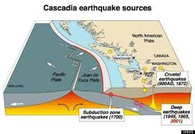
The Big Quake

Slide 3
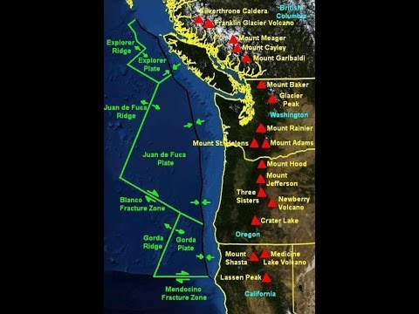
BC to California

Slide 4
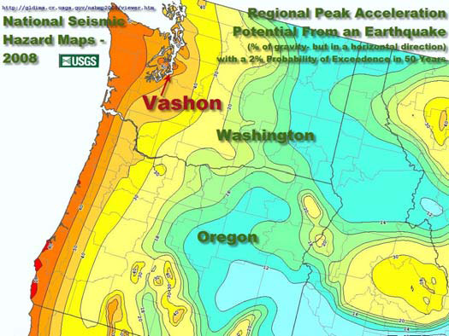
Ground acceleration

Slide 5
More than a shake
Liquefaction
Landslides
Tsunamis

Slide 6
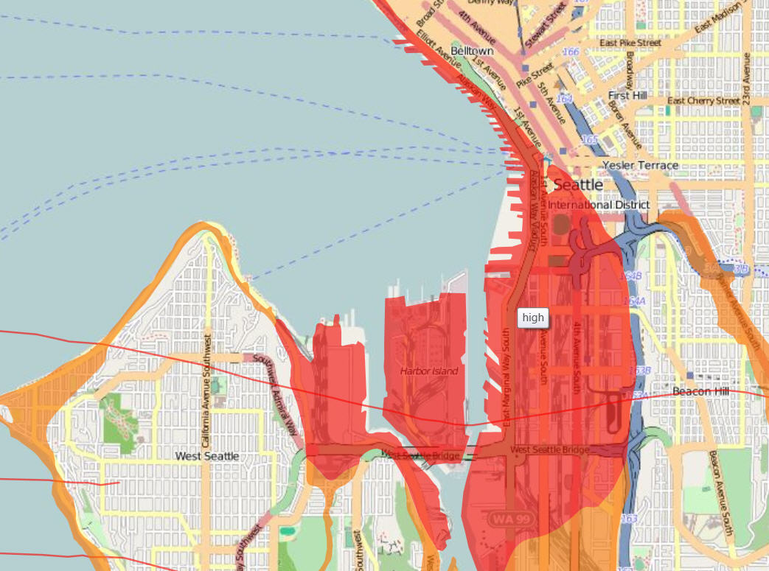
Liquefaction Downtown Seattle

Slide 7

Worst case scenario
Compound disaster
The New Yorker article (http://www.newyorker.com/magazine/2015/07/20/the-really-big-one)
Cascadia Rising exercise 2016
Full Rip book

Slide 8
What you should do
Duck, Cover, and Hold
Take care of yourself first, then family and others

Slide 9
Why and how to prepare
Prepare the sequence of levels-individual, family, neighborhood, community
Make a plan and set about reducing risk and improving survival chances

Slide 10
This talk
Introduction
1 Personal Preparedness
Family Preparedness
Neighborhood Preparedness
Community Preparedness
Communications & Situational Awareness
Dynamic Preparedness

Slide 11
Overflow effects for other disasters
Winter Storms: same except for heating
Wildfires: evacuation same
Tsunami: evacuation same
Tornado: shelter
Disease outbreak: slightly different
Active shooter: slightly different

Slide 12

Why do some people survive?

Slide 13
Who are the most vulnerable?
Elderly
Young people
Homeless

Slide 14

Psych
Chill out
Left of boom: depressing, relentless, never safe, money wasted.
Right of boom: things will never be the same again; PTSD symptoms

Slide 15
Antidotes
Left of boom:
Right of boom:
Do what you can
Step back and pause
Use rational tools for decision making
Make it a game
Talk about it
Trust someone
Don’t allow depression to get rolling
Drugs
Accept that life is meaningless, or at least, not to be taken too seriously

Slide 16
Some tools
Temporal orientation relative to the quake
Prioritization of spending
Risk mitigation
Identify likelihood of location at moment of quake

Slide 17
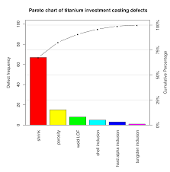
Pareto
Set priorities among a large set of factors
See a solution that is good enough
Not waste effort

Slide 18
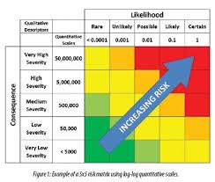
Risk matrices

Slide 19
Where are you at Boom?
Home 60%
Work 15%
Commuting 5%
Restaurant, Class, “Out”
Vacation or Business Travel

Slide 20
Your Emergency Plan
Where are you at Boom?
What do you have to do at boom for individual, family, neighborhood, community?
What are your risks for each?
What is your prioritized purchasing and training plan?
What is your testing plan?
Are you more ready today than you were a month ago? Quantify it.

Slide 21
Fallacies
Dual usage
Living off the grid
Foraging

Slide 22
1: Personal Preparedness
Starts now
The first thing right of boom
All other preparedness depends on this

Slide 23
The bedside 10
Knife
2 Lights
Wallet
Passport
Cell phone w/charger
Medications
Glasses
Machete
Baseball Bat
Whistle

Slide 24
Everyday Carry (EDC)
Knife
Light
Cell phone
Pen
Tools

Slide 25
Good habits
Never let the gas tank drop below 75%
Never go to sleep without charging your phone
Never enter a room or building without considering egress and construction
Never fail to replace anything you borrow from your kits before you go to bed
Rotate food and water through usage

Slide 26
The bed box
Boots
Helmet & Lamp
Gloves
Long Underwear
Pants
Heavy Socks
Rain Jacket
Fleece
Lights
Water Bottle
Sign
FRS Radios
Safety Glasses
Nitrile Gloves
Neck Cover
Gas Shutoff

Slide 27
In the car(s)
Go Bag
CERT Pack
Radios
Sleeping Bags & Pads
Toilet paper
3 meals, 4 quarts water
Warm jacket
Maps/Thomas Guide

Slide 28
The Go-Bag
3 changes of clothes and underclothes
Tolietries
Medications
Glasses
Electronics and Chargers
Boots
Athletics shoes
Socks
2 Flashlights and batteries
Iodine Tablets
4 Energy bars
Blanket
Important papers
Hat
The Bag
Reading
Sunglasses
Hand Crank NOAA radio
Rain Jacket
Fleece
Water Bottle
Water Filter
Moist Towelettes
Plastic Trash Bags
Dust Mask
First Aid Kit
Whistle
Can Opener
Cash
LeathermanTool

Slide 29
At work?
Where is the point of safety?
Do you need to get out of the building after boom?
Is there a shelter?
Are you on your own or part of a team organized by your employer?
Can you go home?
Can you see your Emergency Plan on an electronic device?
Can you begin to implement, or is getting home your priority?

Slide 30
Training
First Aid/CPR
CERT
Amateur Radio license and ARES courses
FEMA courses

Slide 31
What to do individually
Denial-Deliberation-Decision
Duck, Cover, and Hold
Self Assessment-treat injuries
Visual check of surrounding area and structure
Look for interior lights, exterior lights, glare from fire
Listen for human noises, structural noises
Find the bedside ten

Slide 32
Individual risks and mitigations
Training in medical and CERT nonexistent
Pack Go-Bag, EDC, Bedside 10, Bed Box don’t have them
Figure out what to do at work at boom-no idea
Need to practice immediate reaction and thought process-never done that

Slide 33
2: Family Preparedness
When-as soon as your individual safety is taken care of, and probably as soon as you are all reunited.

Slide 34
What to do-2
The Picnic (3-5 days) Rally; find your way together, preferably at home. Assess your survival plan and prepare to execute it. Look at weakest links (water? food? money) and mitigate. Care for animals. Test generator and establish electrical power-on periods. Try to establish situational awareness of roads, credit and cash machine, retail stores, damage to infrastructure. Eat leftovers, contents of refrigerator, thawing freezer food.
The Campout (2-4 months) Establish routines for eating, drinking, cooking, cleaning, hygiene, defense, and electricity. Start the Map Your Neighborhood response once your family is taken care of. Evaluate the option of leaving.

Slide 35
Rally points and notification plans
Assume no phones-establish rally points, one at home, one elsewhere
Send a text message of where you are and what your conditions is immediately after the quake
Call or text your out-of-area/state contact as a virtual rally
Make sure you tell the others what you plan to do

Slide 36
Water
1 gallon/day per person (CDC)
15 liters/day per person (WHO)
4 months/3 people=360 gallons
Rationing could reduce this 30%
This determines how long the campout lasts, period
You have to save bottled water or water in disinfected large containers

Slide 37
Purifying water is all bad choices
Activated charcoal filtration: won’t get all pathogens
Boiling: use fuel; boil for one full minute of roiling
Chemical tablets: expensive and taste bad
In a pinch, 2 drops of bleach per quart
Trying to separate potable from non-potable is not practical
A rainwater catchment system for roof downspouts is a good way to get a lot of water in the the Northwest; but only practical if you have enough fuel for constant boiling

Slide 38
Food
2800 calories men
2200 calories women
1400 calories children under 13
50-30-20 Carbohydrates-Protein-Fats
Canned Meat-Beans-Fish every day
120 days equals approximately 600-700 cans of food
On the picnic, eat leftovers, refrigerated food, frozen food as it thaws; stretch this as long as possible; it doesn’t come out of your long term stash
Most of us can afford to eat slightly too few calories for two weeks to get the weight loss benefit, so long as the balance and vitamin content are maintained. After that, weigh yourselves once a week to track weight loss and reestablish caloric steady state.

Slide 39
Know the Signs of Malnutrition
Listlessness or depression
Ketones on breath
Skin color change
Infections more frequent and heal slowly
Difficulty concentrating
Difficulty keeping warm

Slide 40
Medical treatment
You may have to go beyond your comfort zone: have a couple of advanced outdoor medicine text around
Robust first aid kit, including medications the family is currently prescribed
Be prepared to suture, clean wounds, deal with compound fractures
First Aid/CPR really isn’t enough; you need one family member with First Responder training at least

Slide 41
Electrical power
Generator
Fuel: the weakness; it runs out.
You must test your generator once a month most of the year and once a week November through April
Use dewatering agent in fuel
Cycle fuel through your car every six months
Even a built in system with a large gas tank will run out of fuel.
Establish a daily schedule to run the house, charge electronics, cook food. Do not run the refrigerator or freezer on generator. If you run the heater, be conservative.

Slide 42
Fuel for heating and cooking
Besides heating the house, you must boil water and cook food. You should heat the house before you cook the food.
You must calculate your consumption of fuel each day in order to calculate the point of evacuation if you get no resupply.
If you are confident of resupply then you should schedule one hot shower day. Make it a Navy shower. If not, cold sponge baths. Your call: comfort vs. survival

Slide 43
Light and Fire
Candles-more light leans more fire risk
You can’t live on batteries
You need about four candles per day, or 480 small candles; also five oil lamps, with about 10 gallons of kerosene
You need ventilation
Fire starter for fireplace, propane stove, lamps. Matches and five other backups

Slide 44
Hygiene
Sponge baths
Quick daily bathing
Wash hands after urinating or defecating-more chance of infection, and no medical treatment available
Less water and no vacuuming means more dirt and dust accumulates over time. Also, wood heating spreads more ash and smoke. Requires more frequent mechanical cleaning
This begins to be a problem after a week.

Slide 45
Cleaning home spaces and laundry
Washing tubs
Clothespins
Scrub brushes and rags
Brooms and mops
Tubs for washing dishes and pots

Slide 46
Solid waste
Double trash bags
Shovels
Pre-dig trenches
Separate trenches for feces
Dry garbage out if possible
Deep enough trenches to keep animals out: three feet
Farthest extent of property but accessible in rain

Slide 47
Heat
Firewood
Axe, wedges, saw, sharpener
A chainsaw is not for cutting firewood
Wood needs to be dried; cutting a cord just after the quake isn’t going to do much good
Propane refills likely won’t be available
If you shut off your gas you may not be able to get it back on without the gas company
If you have no electricity you probably have no heat unless you have a mechanical valve that bypasses the solenoid and sends gas to a fireplace flame
Depending on the type of wood, your discipline, and the weather, you may need two cords of wood

Slide 48
Security: theory of overlapping defenses
Nothing can stop determined invaders; multiple layers can stop most of them
Layers should overlap
Detection and sensors are more important than weapons
A large dog is the single best investment in home security you can make (despite the downside of care, food, training, etc.)

Slide 49
Security: layers
Sensors: gravel tracks
Passive weapons: thorn bushes
Passive defense: padlocked gates
Passive weapon: dead bolted front, side, rear doors
Sensor/Active weapon: working dog
Active weapon: machete
Active weapon: baseball bat
Active weapon: knife

Slide 50
Security: no one wants to talk about this
Guns require licenses, training, ammunition, regular cleaning, target practice, safe and secure storage. All of this is the minimum.
Ideal mix is one 12 gauge shotgun, one M4 assault rifle, one .45 ACP pistol, and one 9mm automatic pistol. This is the ideal combination of long, medium, and close-in ranges and rates-of-fire.
Invaders don’t necessarily know you have guns, so deterence is limited.
In the extremely unlikely event that you need a gun, you will be glad you have one (or four)

Slide 51
False Security
One or two weapons without frequent disassembly and cleaning, regular target practice, training in proper methods of shooting, use of a modern locking system, and appropriate licensing is worse than no guns at all.
Very few people are killed with machetes and baseball bats each year, and almost none accidentally

Slide 52
Time to leave?
Issues
Needs
When: 30-90 days right of Boom
What: Refugee or Emigrant?
Drivers: Cash, Fuel, Employment
Situational Awareness: Roads, Gas, Credit Cards
True Costs of Staying vs. Going
Clear destination and route
Pets?
Fuel for trip
Food-Water-Cooking
Tent
Clothes
Personal electronics
Toilet
Valuables & papers

Slide 53
Simulation & training
Based on your Emergency Plan
Semiannually at least; monthly is ideal
Specify simulated date, time, weather
Part rehearsal, part test, part exploration
One person brings one unexpected variable
One person reads the plan/narrative
Introduce more variables each time
Without a critique, performance measures, and feedback, this is a waste of time

Slide 54
Pets
Pet stores will be closed
Food, medication, water
Birds, fish, small mammals have specialized diets; how long are you stocked to support them?
Animals suffer after a natural disaster, too: disorientation, grief, depression

Slide 55
Family risks
No evacuation plan thought out
No pet supplies laid away
Never thought about home security systematically
Haven’t really quantified each kind of supplies
Don’t have enough wood, fuel, or water put away
Haven’t establish contact plan or conducted a simulation

Slide 56
3: Neighborhood preparedness
When? As soon as your family is reassembled and cared for

Slide 57
The Question
Are you going to share your preparations and supplies with your neighbors whom you know or don’t know if they haven’t prepared themselves?
Make this decision now rather than in real time

Slide 58
Map Your Neighborhood
Map Your Neighborhood (MYN) was developed by Dr LuAn Johnson, first in Sunnyvale, CA and then in Seattle, WA. The program was implemented state-wide by the State of Washington’s Emergency Management Division (EMD) in 2006. This award-winning program has proven its effectiveness. During the Nisqually (Seattle) Earthquake on February 28, 2001, 92% of 460 organized neighborhoods effectively responded utilizing the 9-Step Neighborhood Disaster Response Plan. More than 50 counties and cities in Washington State are in various stages of implementing MYN. States which have adopted MYN include Alaska, Oregon, California, Montana, Idaho, Kansas, Pennsylvania and South Carolina.

Slide 59
What to do-3
THE NINE STEPS TO TAKE IMMEDIATELY FOLLOWING A DISASTER: 1. Take care of your loved ones. 2. Protect your head, feet and hands. 3. Check the propane at your home. 4. Shut off water at the house main. 5. Place the HELP or OK sign on your front door or window. 6. Put your fire extinguisher in front of house. 7. Go to the Neighborhood Gathering Site. 8. Form teams to listen to the radio for alerts; check on elderly, disabled and children; check propane; check homes with HELP cards and those with no card. 9. Return to Neighborhood Gathering Site to share what has been done.
The Picnic (3-5 days) Reassemble the teams every other day
The Campout (2-4 months) Reassemble the teams weekly or biweekly

Slide 60
3 MYN teams
Care (children, elderly, disabled)
Search-based on maps and phone trees and knowledge of who’s out of town; also consider pets
Control-listen to radios, any other media still operable, serve as message center, centralize neighborhood supplies

Slide 61
Neighborhood team supplies and equipment
Stretchers
Tools (pry bars, 4x4 blocks, shovels, chainsaws)
Food and water
Blankets
First aid kits

Slide 62
Fuel and chainsaws
Do you know what it takes to cut apart and move a 100 foot pine tree blocking a street? Chainsaws, replacement blades, chain oil, 2 cycle fuel, people, vehicles, rigging?
Multiply this by several hundred trees and you will see the potential problem after a 9.0 earthquake
Who will fix a chainsaw if one of the neighbors breaks theirs?

Slide 63
Simulation & training
Walkthrough-not a real test
Callout/Walkaround
Assembly at Neighborhood center
Break into Search, Daycare, Operations teams
Each team sets up and discusses its function
Simulated search, simulated lost child, simulated intermittent communications

Slide 64
Neighborhood risk matrix
Never heard of MYN-need to investigate and get a presentation
Do not know half my neighbors, nor what skills we have around us
Ought to get one of those HELP signs

Slide 65
4: Community preparedness
When? As soon as family and neighborhood are taken care of; CERT members call into to team leads or show up at EOC. The earthquake is considered the callout.

Slide 66
What to do-4
The Picnic (3-5 days)
Report to CERT when you are free of neighborhood and family issues; Divide your time and the commitments you make so that you can continue to collect fuel, water, food.
Rapid Impact Survey comes first
Assisting police and fire & rescue as needed
Coping with aftershocks may means another RIS or more rescue work
The Campout (2-4 months)
More of the same, dividing time between home and neighborhood and community; at some point you will have to choose between using dwindling gas supplies to help at CERT vs. conserving.
Lord of the Flies

Slide 67
Community Emergency Response Team (CERT) Training
Unit 1: Disaster Preparedness (2.5 hrs). Topics include (in part) identifying local disaster threats, disaster impact, mitigation and preparedness concepts, and an overview of Citizen Corps and CERT. Hands on skills include team-building exercises, and shutting off utilities.
Unit 2: Fire Safety (2.5 hrs). Students learn about fire chemistry, mitigation practices, hazardous materials identification, suppression options, and are introduced to the concept of size-up. Hands-on skills include using a fire extinguisher to suppress a live flame, and wearing basic protective gear.
Unit 3: Disaster Medical Operations part 1 (2.5 hrs). Students learn to identify and treat certain life-threatening conditions in a disaster setting, as well as START triage. Hands-on skills include performing head-tilt/chin-lift, practicing bleeding control techniques, and performing triage as an exercise.
Unit 4: Disaster Medical Operations part 2 (2.5 hrs). Topics cover mass casualty operations, public health, assessing patients, and treating injuries. Students practice patient assessment, and various treatment techniques.

Slide 68
CERT Training
Unit 5: Light Search and Rescue Operations (2.5 hrs). Size-up is expanded as students learn about assessing structural damage, marking structures that have been searched, search techniques, as well as rescue techniques and cribbing. Hands-on activities include lifting and cribbing an object, and practicing rescue carries
Unit 6: CERT Organization (1.5 hrs). Students are introduced to several concepts from the Incident Command System, and local team organization and communication is explained. Hands-on skills include a table-top exercise focusing on incident command and control
Unit 7: Disaster Psychology (1 hr). Responder well-being and dealing with victim trauma are the topics of this unit
Unit 8: Terrorism and CERT (2.5 hrs). Students learn how terrorists may choose targets, what weapons they may use, and identifying when chemical, biological, radiological, nuclear, or explosive weapons may have been deployed.
Unit 9: Course Review and Disaster Simulation (2.5 hrs)

Slide 69
Rapid Impact Survey
Issaquah divided into 14 districts, with house by house maps; many municipalities have something similar.
RIS is a windshield survey, undertaken as soon after boom as it is safe to drive.
CERT survey personnel follow prescribed routes, looking for downed trees, fires, hazards to life, broken water mains or other utilities, road outages, power lines down, etc.
Results are returned to the City EOC on forms; emergency issues are radioed in to the EOC
The object is to get a quick view of the city before Fires & Rescue, Police, and Public Works can get to a site

Slide 70
Building Inspections
(not a CERT function)
Performed by civil engineers and building inspectors organized through the State of California
Based on ATC 20-1 and ATC-45 from the private non-profit Applied Technology Council
Focused on safely getting people access to their homes after earthquakes or windstorms/floods
It is anticipated that after a 9.0 event we will have an acute shortage of qualified building inspectors

Slide 71
Emergency Operations Centers
Most medium sized cites and all counties have some version of an EOC.
Most CERTs work out of an EOC.
Kitsap County EOC 911 Carver St. Bremerton, WA 98312

Slide 72
Community Shelters
Ad Hoc
No clear listing is available
Sometimes Red Cross creates them, sometimes churches
If you search for them, you will get homeless shelters

Slide 73
Other levels of response
Counties
State OEM
National Guard
FEMA
Other Federal agencies
Red Cross
Other NGOs

Slide 74
Community Risk Matrix
Never heard of CERT; I need to find the time (just 20 hours) to at least get the training
Need to know the community a little better from walking it
I need to know where the shelters are in my community

Slide 75
5: Communications & situational awareness
Cellular networks will likely be at 20% or less effectiveness within 3 minutes of a regional subduction zone quake
Local commercial television and radio is likely to be completely inoperative within 1 minute (Some satellite television may be available)
Internet Service Providers are likely to be 100% inoperative within 3 minutes
Restoration of service will be spotty and irregular and may take 3 to six months

Slide 76
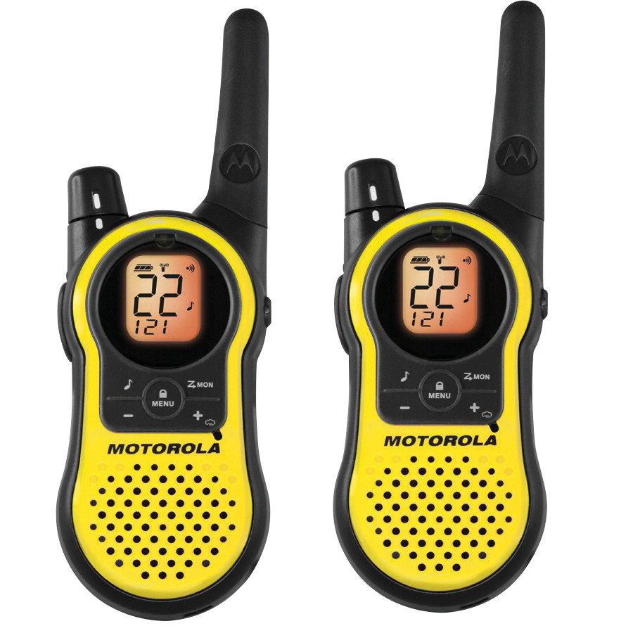

The spectrum of options
FRS/GMRS Radios
Dual Band Handheld amateur radios

Slide 77
FRS/GMRS
No license required for FRS
Limited range (5-10 miles line of sight)
Useful in a neighborhood or for a CERT team
Will get very crowded in an emergency
Channel Frequency (MHz) Notes
1 462.5625 Shared with GMRS
2 462.5875 Shared with GMRS
3 462.6125 Shared with GMRS
4 462.6375 Shared with GMRS
5 462.6625 Shared with GMRS
6 462.6875 Shared with GMRS
7 462.7125 Shared with GMRS
8 467.5625 FRS use only
9 467.5875 FRS use only
10 467.6125 FRS use only
11 467.6375 FRS use only
12 467.6625 FRS use only
13 467.6875 FRS use only
14 467.7125 FRS use only

Slide 78
The three amateur radio licenses
Technician: easy; test requires 8 hours study
General: moderately difficult, perhaps 40 hours study
Extra: probably not necessary, requires additional 40 hours of study
95% of all people are intimidated by the testing
General is the minimum license for self-sufficiency

Slide 79
Amateur radio equipment
Dual-band or Tri-band handheld transceivers
Headphones and microphones
Car-mounted mobile transceivers and antennas
Home base station transceivers and large antennas (separate mobile generators and battery banks)

Slide 80
Local Amateur Radio
Mike and Key is an umbrella organization of Puget Sound networks and clubs http://www.mikeandkey.org/aboutus.htm
Puget Sound Repeater Group maintains repeaters across the region http://web.psrg.org
The Amateur Radio Relay League is the national non-profit umbrella organization for hams. Washington clubs are listed at http://wwa.arrl.org/clubs.html
Clubs provide classes for licenses and many conduct license testing
The national ARRL site lists testing each month (http://www.arrl.org/licensing-education-training)

Slide 81
Amateur radio networks of Puget Sound-1
Day Time Freq Call Net
Daily 900 146.86 W7AVM Island County ARC (except Sunday, at 1930)
900 146.96 WW7 PSRG Nine O’clock Net (also at 2100)
1730 146.82 K7LED Puget Sound NTS Net
2000 28.43 (HF SSB) Chief Seattle Chapter of 10X Intl. (also Tues. at 0930)
M - F 545 145.33 K7NWS Northwest Weather Net (also at 1645)
SUN 1000 3.915 (HF SSB) 75 Meter Ham Swap Net
1900 147.24 K7SYE Auburn Area Emergency Communications Team
1900 146.84 WA7FW Federal Way D-STAR/D-RATS Practice Net
1900 145.39 W7EOC Grays Harbor Co. Aux. Emerg. Comm. (& BeachNet rptrs.)
1900 28.33 (HF SSB) Kitsap County ACS (also 6-meter FM net on 52.430)
1900 147.34 K6RFK NW Washington LDS Stakes ERC Net
1900 442.3 N9VW City of Sammamish ARES/RACES
1900 146.74 K7SKW Whatcom County ARES Emergency Services Net
1915 145.47 K7CPR Region 3 ARES/RACES (& BeachNet repeaters)
1930 147.04 WA7FW Federal Way Amateur Radio Club
1930 145.49 K7LWH Kirkland Emergency Comm. Team (KECT) / ARES
1930 145.43 KD7WDG Kitsap County Alt. Comm. System (ACS)
1930 443.5 W7VMI Vashon-Maury I. RC - ARES (1st Sun. 28.385 MHz SSB)

Slide 82
Amateur radio networks of Puget Sound-2
MON 1830 3.985 (HF SSB) WA State Emerg. Net (Winter at 1730) (alt. 3.990, 7.245)
1830 441.8 W7AW West Seattle ARC (also 145.130 & 53.290)
1845 147.32 WB7DOB Kent Communications Support Team (KCST)
1900 146.96 WW7PSR Seattle Auxiliary Communications Service (ACS)
1930 146.96 WW7PSR Puget Sound Repeater Group (PSRG)
1930 442.825 W7AUX Shoreline ACS (City of Shoreline)
2000 147.26 W7DG Cowlitz County Auxiliary Communications Service
2000 444.55 WW7SEA Puget Sound Digital Hams Practice Net
2000 147.57 (simplex) Stanwood-Camano ARES
2015 147.36 W7PIG Stanwood-Camano Amateur Radio Club
TUE 1000 145.19 N7GDE Region 1 EmComm Net (then QSY 444.5, 53.09, 223.86)
1900 146.66 WA7ST SeaTac Amateur Radio (STAR)
1900 441.4 NT7H Thurston County ARES/RACES (also 147.36 & 224.46)
1930 147.28 W7DK Radio Club of Tacoma
1930 441.4 NT7H Olympia Amateur Radio Society (also 147.36 & 224.46)
2000 441.55 W7WWI American Red Cross - King & Kitsap (alt. 440.525)
2000 147.26 KF7NPL Maple Valley Amateur Radio Club (146.54 simplex after)
2000 146.92 WA7DEM Snohomish County ACS/ARES

Slide 83
Amateur radio networks of Puget Sound-3
WED 800 28.37 (HF SSB) Stanwood-Camano ARC (informal net, also Mon.)
900 145.15 W7JCR Jefferson County ARES/RACES (formal net)
1900 145.19 N7GDE Skagit County ARES
1930 146.72 N7SK Mason County Amateur Radio Club (also Sun.)
1930 146.82 K7LED Mike & Key Technical Net
2000 146.7 N7JN San Juan County Amateur Radio Society
THU 1900 147.34 K6RFK Bothell-area Amateur Radio Emergency Communications
1900 443.55 W7SRZ West. WA Med. Svcs. (also 444.825, 443.675, 440.550)
1900 443.6 K7FDF Renton Emergency Communication Service
SAT 900 3.985 (HF SSB) WA State Emerg. Net (WSEN) (secondary 3.990, 7.245)
2000 147.08 W7WWI Western WA Amateur TV Society (also Wed.)

Slide 84
Other sources: frequencies
Worldwide short wave/SSB
NOAA Weather radio
Community emergency radio
Commercial AM/FM radio
[Citizens Band is not a viable option]

Slide 85

Weather learning
https://www.meted.ucar.edu

Slide 86
NOAA Weather Station Broadcasts
Site Name Transmitter Name Call Sign Frequency Power WFO
H Street - Blaine Area H Street - Blaine Area KAD93 162.525 100 Seattle, WA
Astoria Naselle Ridge KEC91 162.400 300 Portland, OR
Seattle Couger Mtn. KHB60 162.550 100 Seattle, WA
Yakima Ahtanum R KIG75 162.550 300 Pendleton, OR
Neah Bay Bohokus Peak KIH36 162.550 300 Seattle, WA
Forks Clearwater KXI27 162.425 330 Seattle, WA
Dayton Patit KZZ73 162.525 300 Pendleton, OR
Davis Peak Longview WNG604 162.525 100 Portland, OR
Okanogan Tunk Mtn. WWF49 162.525 50 Spokane, WA
Richland Richland WWF56 162.450 300 Pendleton, OR
Puget Sound Marine Miller Peak WWG24 162.425 90 Seattle, WA
Spokane Spokane Mtn. WXL86 162.400 100 Spokane, WA
Wenatchee Eagle Rock WXM48 162.475 100 Spokane, WA
Capitol Peak Olympia WXM62 162.475 300 Seattle, WA
Cle Elum Sky Meadows WXN21 162.400 75 Pendleton, OR
Randle Bennett Road WZ2502 162.425 100 Seattle, WA

Slide 87
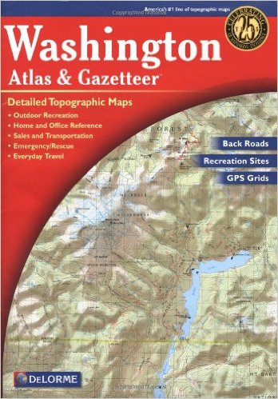
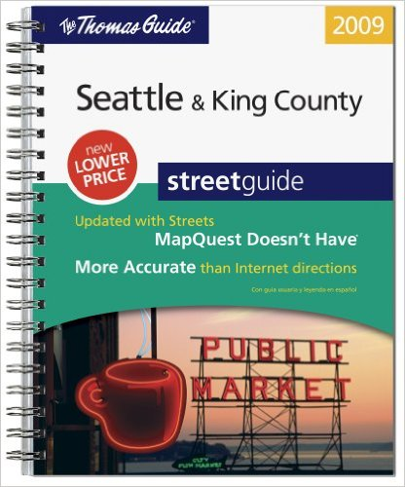
Maps

Slide 88
Situational Awareness Test
Are the weather, road conditions, and availability of food and lodging good enough to drive to Yakima?
To drive to Portland?
Is gasoline available in Kitsap county? Cash or credit? How much per gallon?
Is CostCo open? Hours? Cash or credit?
What pharmacies are open in Kitsap county?
Where is the nearest hospital? Will they take my insurance in this post earthquake world?

Slide 89
Situational Awareness Risk
I need to get a full set of current maps
I should get an FRS radio for short range
I should get a hand-crank NOAA radio
I should think about an amateur radio license
I should take a look at MetEd

Slide 90
6: Dynamic preparedness
Think of preparedness as a continuous process, not something you achieve
Have an outsider look critically at your preparedness and planning
Be systematic-use Pareto principles to spend money where most effective, use Risk Matrix to mitigate

Slide 91
Continuous training and practice
Personal practice all the time: where’s the egress, how would I make contact/rally,
Family practice/simulation twice a year minimum, monthly ideally-doesn’t have to be onerous
Map Your Neighborhood practice once a year if you’re lucky-at least meet your neighbors and trade phone numbers

Slide 92
Escalating stressors during simulations
Separate the family in space
Posit structural damage rendering your home uninhabitable
Posit a small fire in the trees near your house caused by a shorted transformer
A floor of your house collapsed, burying all your survival supplies
Posit one family member severely injured requiring medical treatment

Slide 93
Working at risk mitigation: driving towards green
Each month take a look at your risk matrices and try to drive some of the risks toward green.
This can be procedural, by purchasing supplies, getting some training, or practicing

Slide 94
Learn from Government simulations
The Great Shakeout 1020am October 20, 2016: participate and read debriefs and watch videos. (http://shakeout.org/washington/) also in California, Oregon, Southeast US, etc.
Cascadia Rising Regional Simulation June 7-10, 2016. Look for debriefs and exercise planning documents in WA, OR, CA, and British Columbia

Slide 95
Teaching as learning
Teach First Aid for the Red Cross
Teach or assist at CERT training
Teach or assist at local Ham radio club license courses

Slide 96
Improve situational awareness
Hard Copy Maps of Puget Sound, Washington State, Northwestern US, West Coast, your city
Thomas guides
List of weather station frequencies on short wave radios; NOAA stations
WASHDOT web page and radios
Build library of phone numbers of gas stations in Snoqualmie Pass, South on I-5 to California

Slide 97
Inventories
Bedside 10
Under-bed Box
Go Bag
Valuables Strongbox
CERT Pack
Home Stores
MYN Supplies
CERT Team Supplies
Camping Supplies
Firewood
Fuel
Plywood
Tarps
Duct Tape
Batteries
[Revisit rally points and notification plans]

Slide 98
The effect of Winter
No one wants to train
Rain attenuates RF
Mold gets on survival supplies
Practicing functioning in the rain is not fun
Short days and extended darkness make training, working on risks, and attending meetings impossible
We are less prepared in Winter

Slide 99
Formal Emergency Plan
Risks Matrices and Mitigations
Inventories
Training Plan (Needed vs Achieved)
Updated Where Am I at Boom? pie chart
Simulation Plan/Checklist/Record
Boom Timeline

Slide 100
What if you did nothing?
Chances are you’d be OK
You’d save a lot of money and hassle
If the big quake happens in our lifetime, if you’re within 50 miles of the epicenter, if the weather is bad or you’re at the wrong place at the wrong time…
No one really knows

Slide 101
Aftershocks…
Do a little every month
Don’t stress
Don’t stop
Don’t believe everything anything you read or hear about preparedness, including this presentation; make up your own mind; know why you are doing something.

Slide 102
Disclaimer
Nothing herein represents the official position of any organization; it is offered as one person’s opinion.

