Slide 1
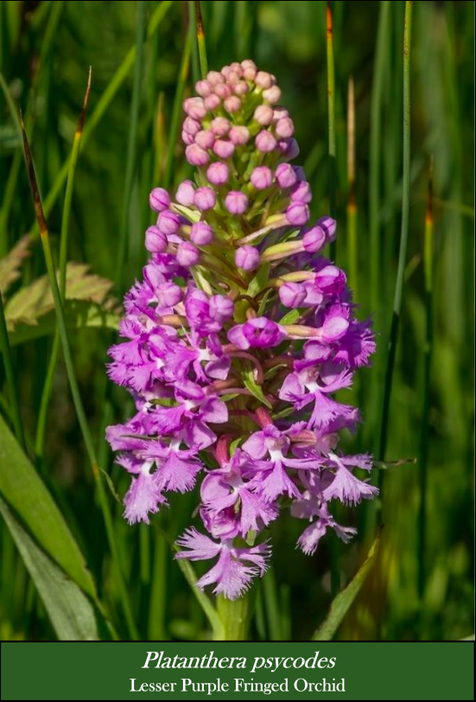
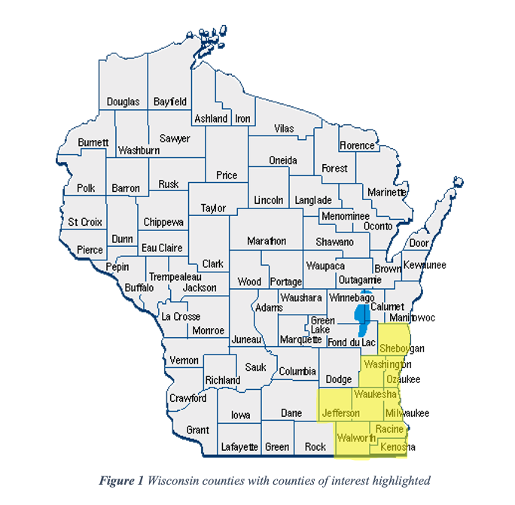
Intro Tab General Analysis Tab Species-Specific Analysis Tab
Introduction
Datasets
References
Study area

Slide 2
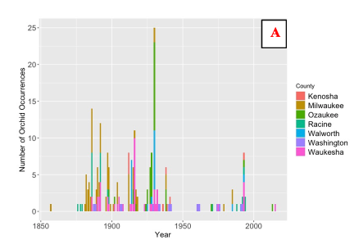
Intro Tab Dataset Overview Tab Species-Specific Analysis Tab
Histogram of orchid occurrences over time

