Slide 1
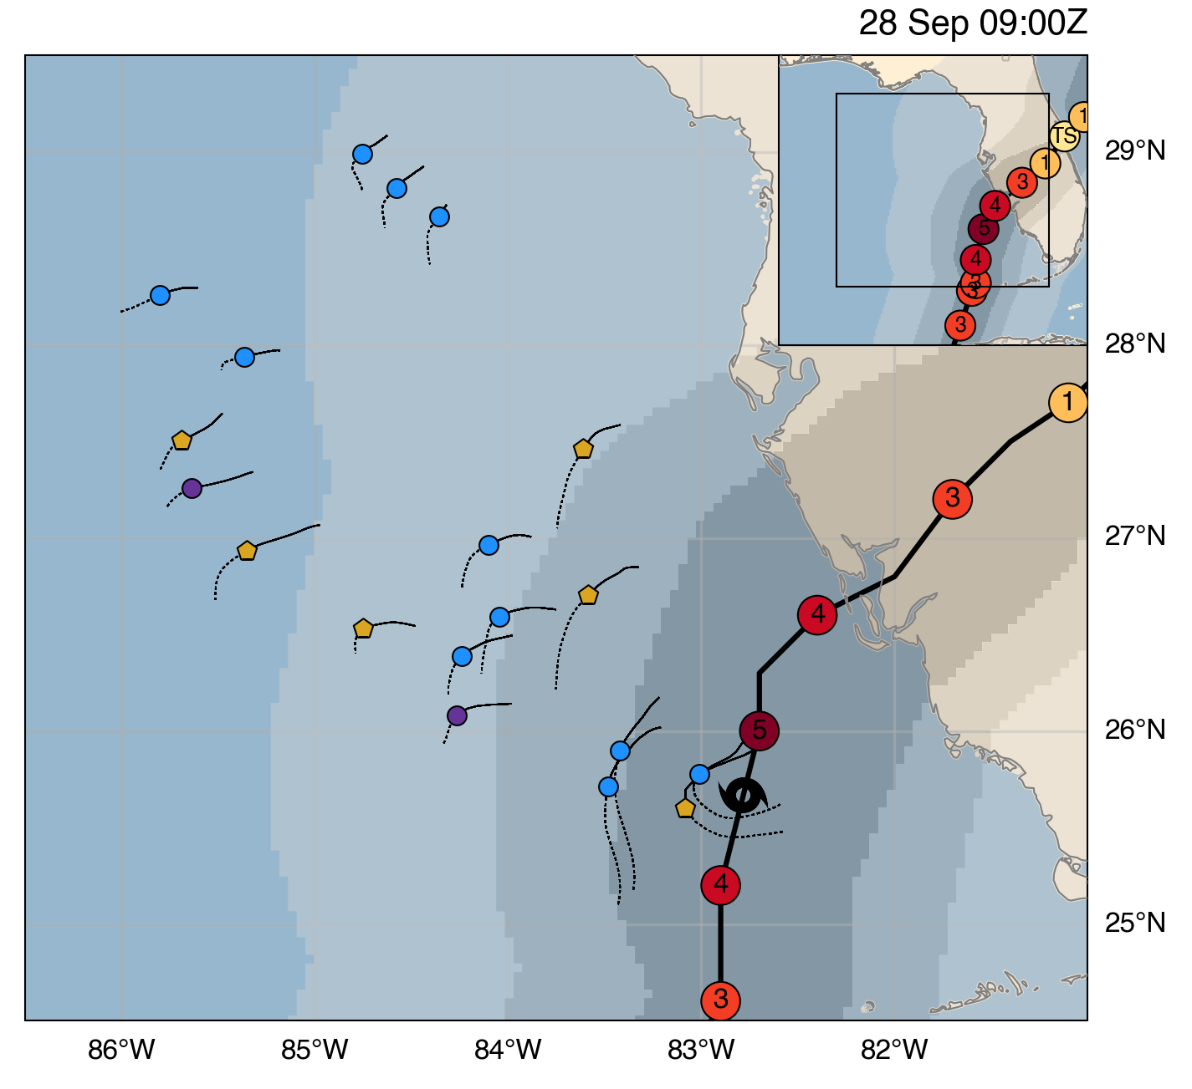
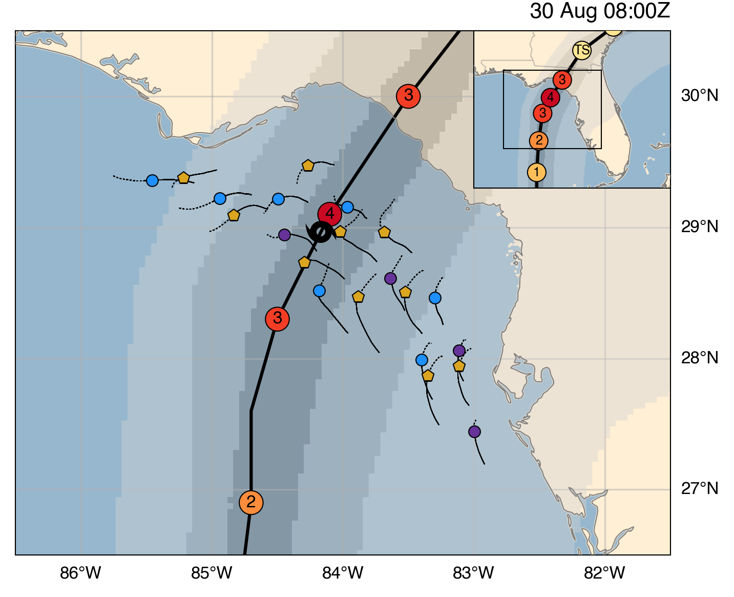
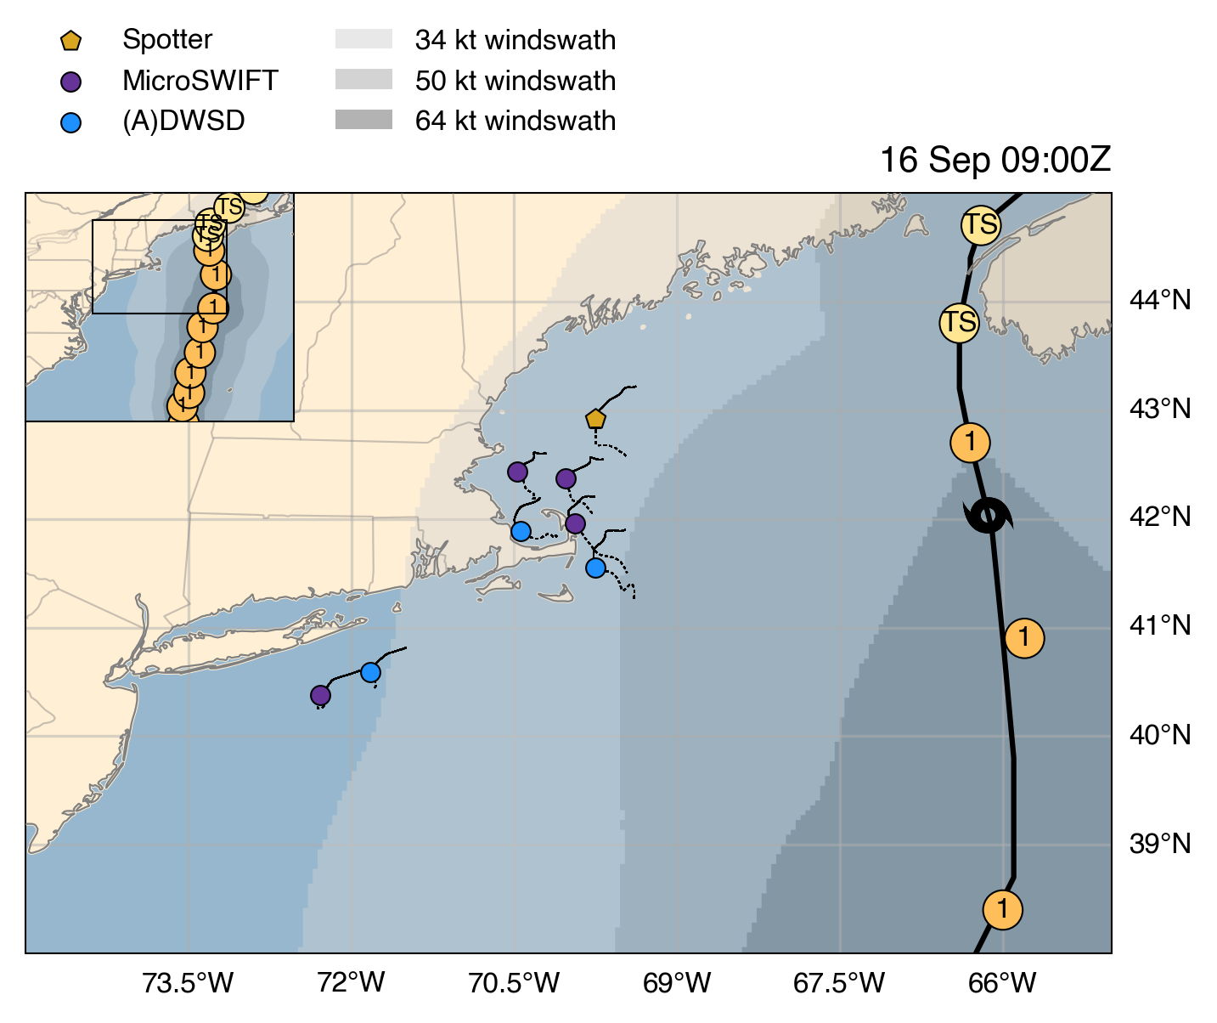
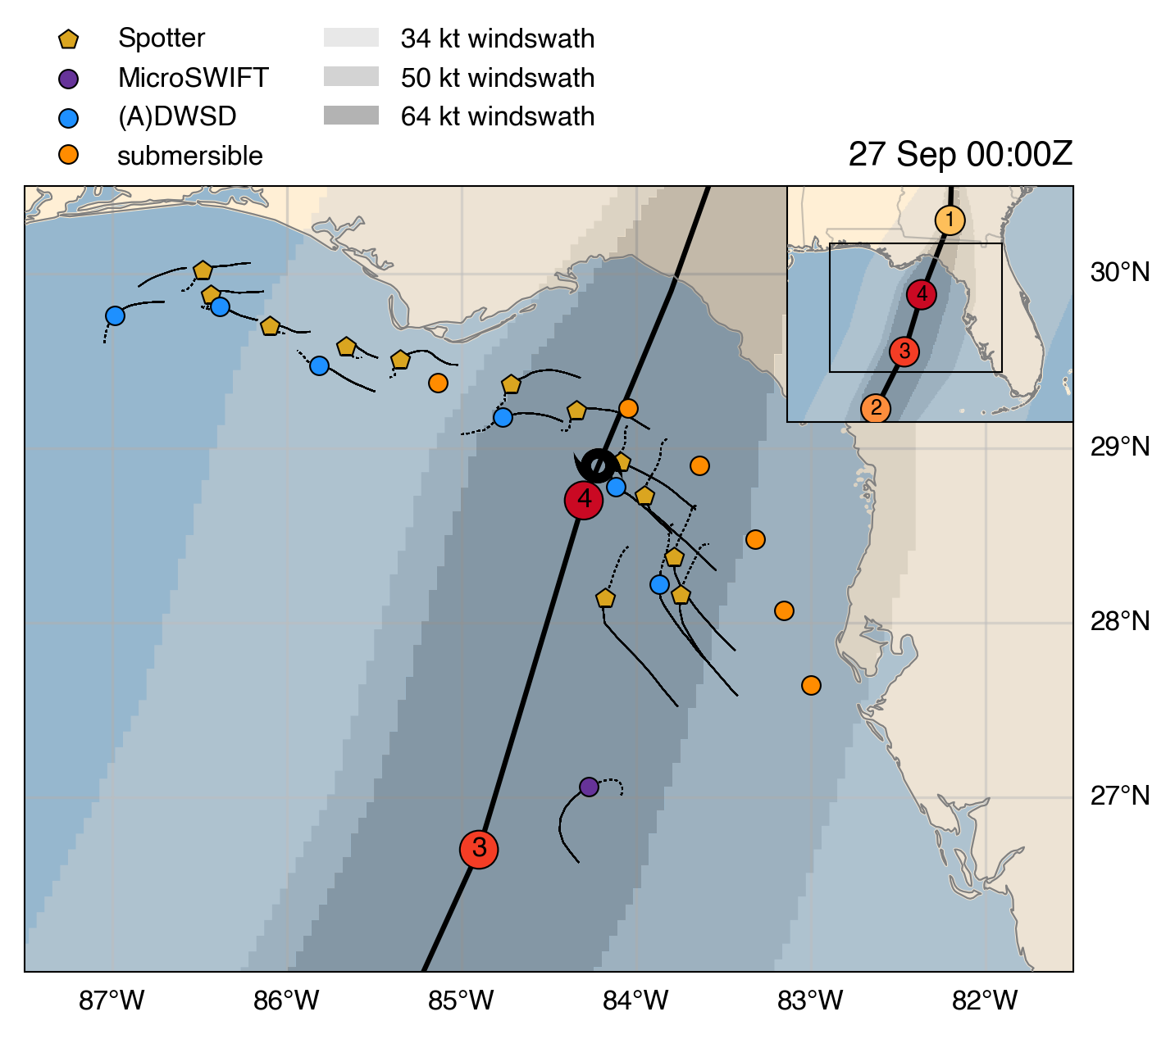
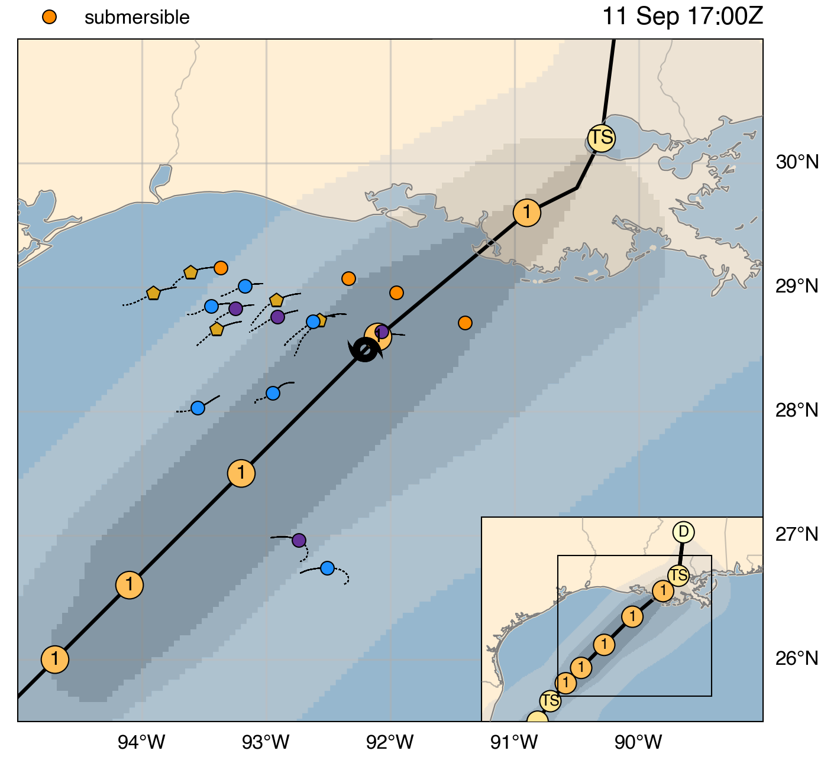
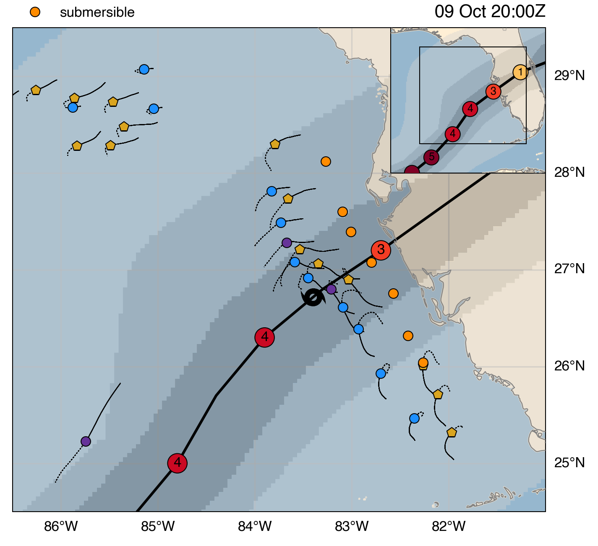
Ian (2022)
Idalia (2023)
Lee (2023)
Replace with Jenna’s
legend items
Francine (2024)
Helene (2024)
Milton (2024)
“Shaded contours represent extent of NHC wind swaths (34 kt, 50 kt, 64 kt with increasing tone/opacity/greyness/darkness)”.
OR could label wind speed in italicized contour lines
TODO:
- Add Jenna’s points
- Bathymetry? (similar to paper)
- Need to make Lee a square aspect
- Set same scales across all (same latitude)
- Add scale bar?

