Slide 1
pandas.qcut
28. April 2023
Präsentator: Jacob Ruhnau (Matrikelnr. 2441453, WWI22A)
Erarbeitet im Rahmen der Vorlesung „Programmierung 2“ bei Kai Bernecker

Slide 2

pandas.qcut – Introduction
© pandas.pydata.org
DESCRIPTION Quantile-based discretization function.
Discretize variable into equal-sized buckets based on rank or based on sample quantiles.
METHOD CALL & PARAMETERS
pandas.qcut( x, q, labels=None, retbins=False, Precision=3, duplicates=´raise´ )
1d ndarray
or series
int
or list-like of float
array or False
default None
bool
default False
Int
default 3
{‘raise’, ‘drop’}
default ‘raise‘
Pandas array
or series
Used as labels for the resulting bins. Must be of the same length as the resulting bins.
If False, return only integer indicators of the bins.
If True, raises an error.
Whether to return the (bins, labels) or not.
Can be useful if bins is given as a scalar.
optional
optional
Number of quantiles.
10 for deciles, 4 for quartiles etc
Alternately array of quantiles, ie. [0, .25, .5, .75, 1] for quartiles
optional
The precision at which to store and display the bins labels.
If bin edges are not unique, raise ValueError or drop non-uniques.
RETURNS Categorical or Series or array of integers if labels is False
The return type (Categorical or Series) depends on the input: a Series of type category if input is a Series else Categorical. Bins are represented as categories when categorical data is returned.

Slide 3
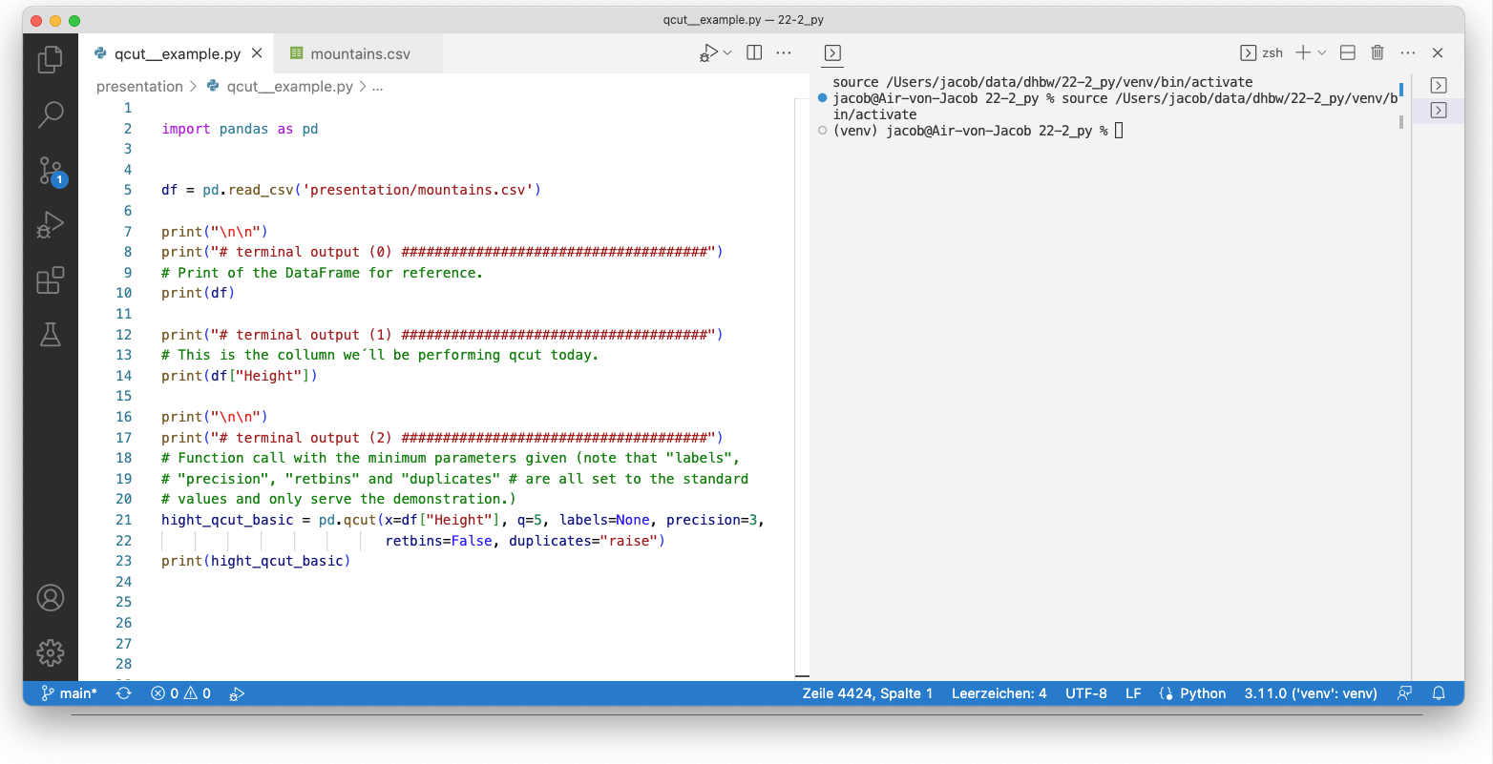
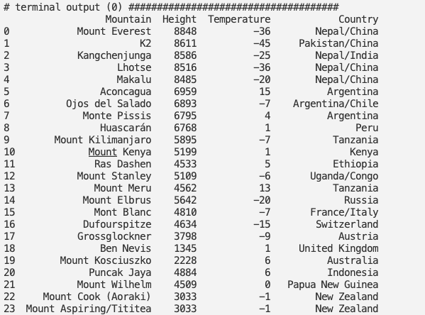

Slide 4
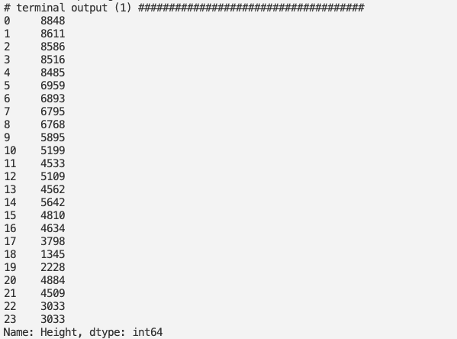

Slide 5
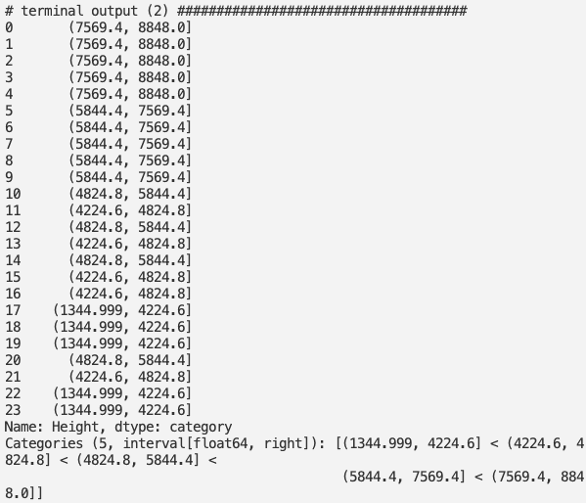

Slide 6
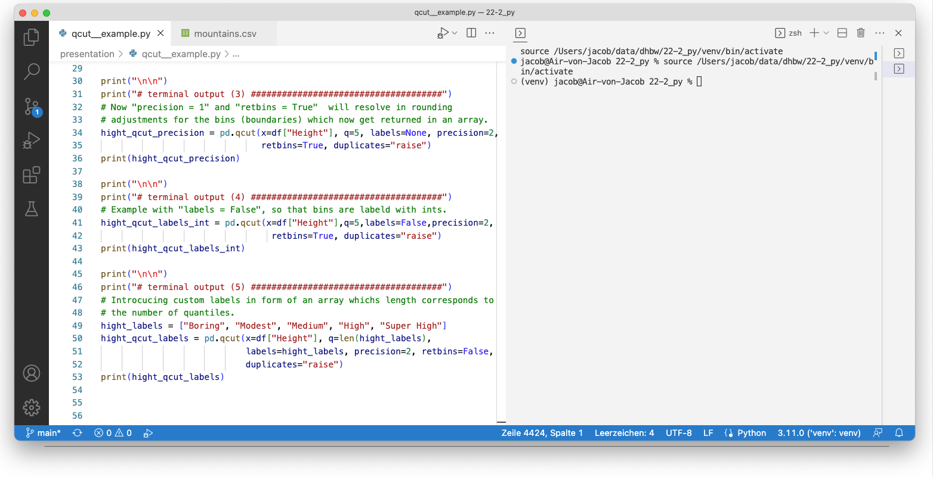
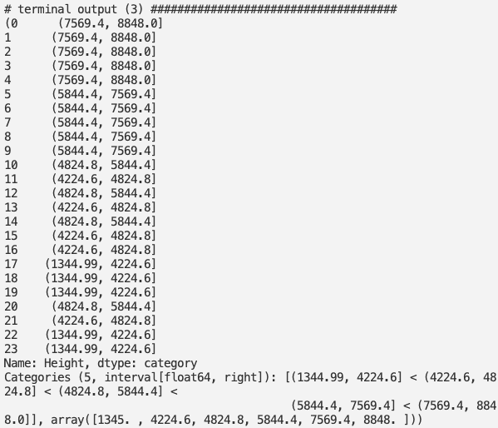

Slide 7
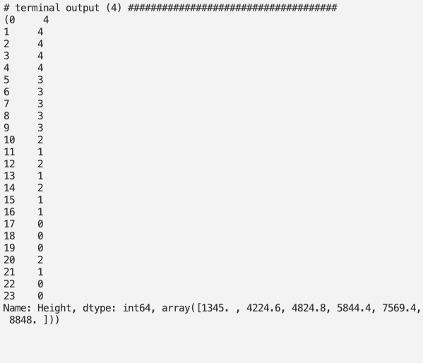

Slide 8
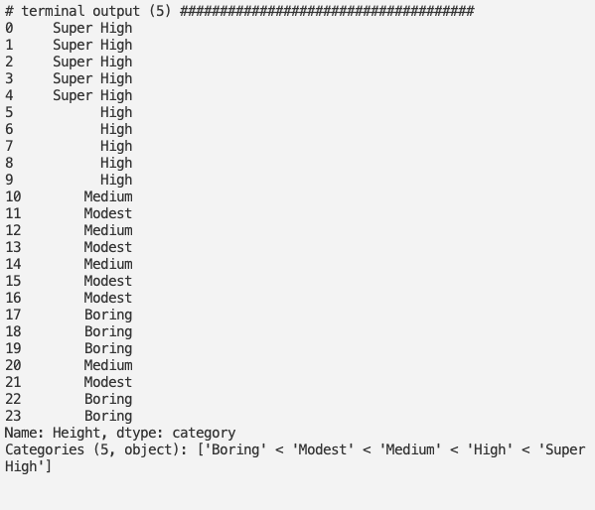

Slide 9
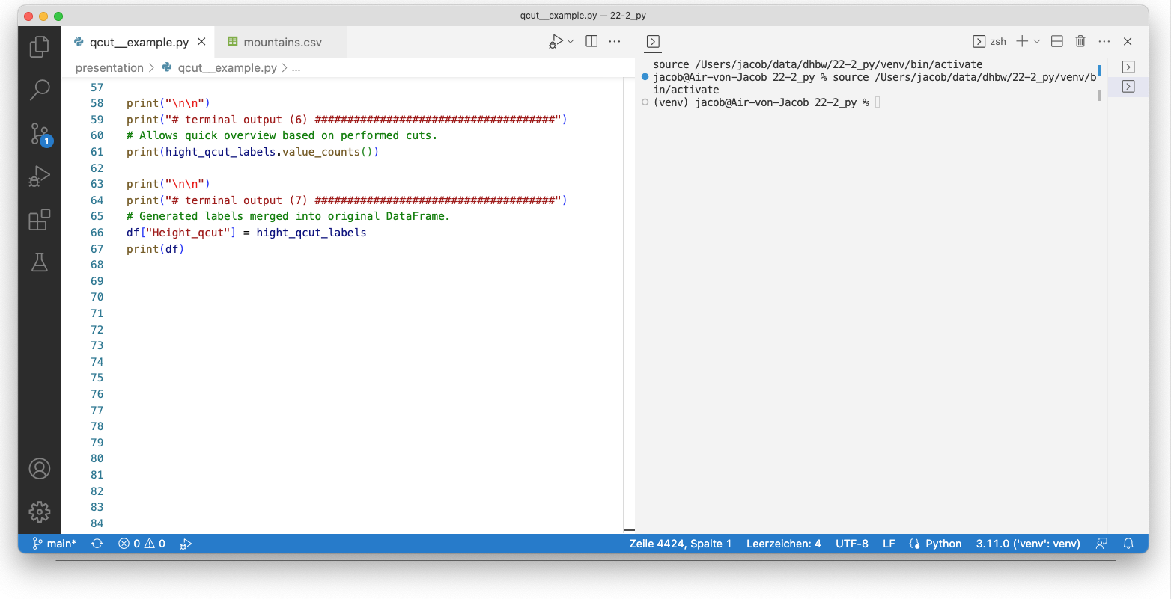
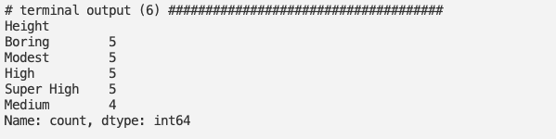

Slide 10
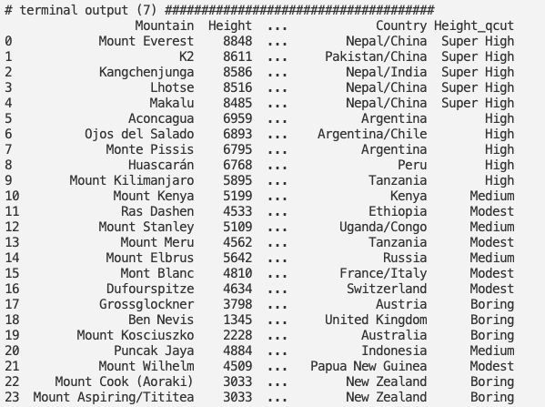

Slide 11

pandas.qcut – Exercise
Make mountains.csv available as pandas DataFrame from this repository
Perform qcut fuction on „Temperature“-column:
Provide correct amount of quintiles
bins should be denotaded with „Super Freezing“, „Freezing“, „Cold“, Medium“, „Warm“
How many mountains are in each bin?
2) What are the lower boundaries for the bins?

Slide 12
pandas.qcut – Exercise (Solution)
Make mountains.csv available as pandas DataFrame from this repository
Perform qcut fuction on „Temperature“-column:
Provide correct amount of quintiles
bins should be denotaded with „Super Freezing“, „Freezing“, „Cold“, Medium“, „Warm“
How many mountains are in each bin?
2) What are the lower boundaries for the bins?
Super Freezing 6
Freezing 5
Medium 5
Warm 5
Cold 3
array([-45. , -20. , -7. , -0.2, 4.4, 15. ]

Slide 13



pandas.qcut – Documentation & Links
https://github.com/jacobrhn/pandas_qcut_presentation
[repo with all information of this presentation]
https://pandas.pydata.org/docs/reference/api/pandas.qcut.html
[pandas documentation on qcut]
https://www.geeksforgeeks.org/how-to-use-pandas-cut-and-qcut
[GeeksforGeeks on pandas cut and qcut]
https://stackoverflow.com/search?q=pandas+qcut
[questions and answers to all the topics
you could think of concerning qcut]

