Slide 1
Natural language processing Term Project1 Fine-Grained Sentiment Analysis on Financial Microblogs
Project1_team_5
湯忠憲、劉宏國、陳奎伯

Slide 2
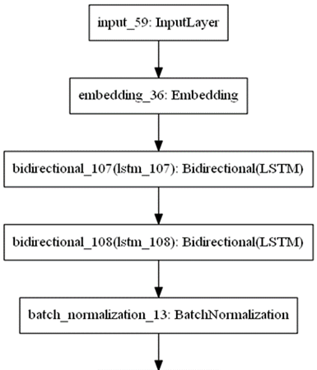
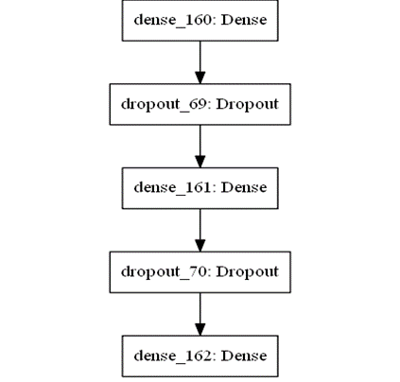
Methodology - Sentiment Analysis F1 3-class
Model: RNN (Bi-LSTM) with an Embedding layer
Parameters：
lstm1-units(128)
lstm2-units(64)
lstm-dropout(0.2)
dense-dropout(0.5)
batch-size(64)
epoch(10)
optimizer(adam)
loss(categorical_crossentropy)

Slide 3

Methodology - Sentiment Analysis F1 3-class
Preprocessing
Gensim Word2Vec
(1) Word Level
1. 原始文字先用 space 進行斷詞
2. 去除內含「http」、「$」、「@」的詞
3. 去除包含在 stopword 列表的詞
(2) Char Level
1. 去除包含在 stopword 列表的字元
2. 轉換為小寫字元
(1) Vector dimension = 300
(2) Window = 5
(3) Vocabulary = 2464
(4) Longest sentence = 22
Labeling
No | Class Name | Sentiment Score
1 | Bullish | >0
2 | Bearish | <0
3 | Neutral | =0

Slide 4
Evaluation - Sentiment Analysis F1 3-class
The first category accounts for more than 60%
No | Class Name | # of Records
1 | Bullish | 878
2 | Bearish | 422
3 | Neutral | 96
→ Shouldn't give disadvantages to big classes.
→ Micro-F1 is more suitable.
Avg. Micro-F1
0.7071
Preprocessing | Micro-F1
Word Level + Char Level | 0.7071
Only Word Level | 0.6536
Only Char Level | 0.6643
None | 0.6214
Avg. Macro-F1
0.2626

Slide 5
Methodology - Sentiment Analysis MSE
Intuitively, Deep learning may not outperform some classic approaches with small training data.
Sentiment dictionary plays a crucial role in both dictionary-based and machine learning approaches.
Our approach combines the sentiment dictionary and machine learning algorithm to predict a sentiment score of financial microblogs.

Slide 6
Methodology - Sentiment Analysis MSE
1. Remove stop words
Filter out redundant words.
2. Sentiment dictionaries
NTUSD-Fin [source]
AFINN [source]
VADER (Valence Aware Dictionary and sEntiment Reasoner) [source]
SentiWordNet [source]
3. Average sentiment score
Average the output score for each word in a sentence with respect to different dictionaries.
4. Approach
Linear -> Linear regression.
Non-linear -> XGboost
5. Performance measurement
Mean square error.

Slide 7
Evaluation - Sentiment Analysis MSE
Approach | only NTUSD-Fin dictionary | Linear regression | XGboost
MSE | 0.2615 | 0.1045 | 0.0832
Feature importance：
Feature | NTUSD-Fin | Senti pos | Senti neg | VADER pos | AFINN | VADER neg
Info gain | 0.3256 | 0.2545 | 0.1810 | 0.093 | 0.077 | 0.067
Experiment results：
Word | Senti pos | Senti neg | NTUSD-Fin | AFINN | VADER neg | VADER pos
buy | 0 | 0 | 0.596 | 0 | 0 | 0
downgrade | 0 | 0 | -1.071 | 0 | 0 | 0
competition | 0 | 0 | -1.095 | 0 | 0 | 0

Slide 8
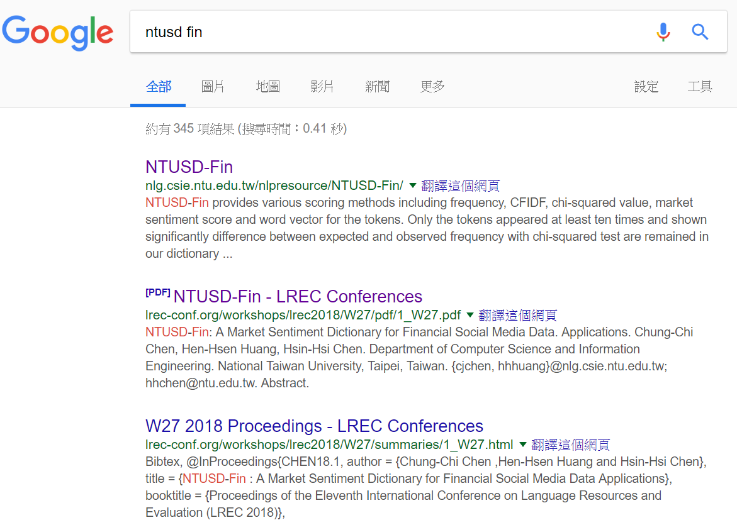

Conclusion
We also tried to use pre-trained sentiment classifier (LSTM), but there’s no significant improvement.
A customized dictionary would be helpful on Financial tweets sentiment analysis.
And NTUSD-Fin (Chung-Chi Chen, 2018) did a great job.

