Slide 1
CSS

Slide 2
Different way to add css
There are three ways of inserting a style sheet:
External CSS
Internal CSS
Inline CSS

Slide 3
Internal css:in this we will add style on the head section
<head>
<style>
body {
background-color: linen;
}
</style>
</head>

Slide 4
Inline css:An inline style may be used to apply a unique style for a single element.
<h1 style="color:blue;text-align:center;">This is a heading</h1>
External css:in this we will add an external style sheet in the head section.
<link rel="stylesheet" href="style.css">

Slide 5
Different css selectors
There are 3 ways to add css
Element selector
Id selector
Class seclector

Slide 6
Element selector
In this we used html elements for styling
Eg:
p {
text-align: center;
color: red;
}

Slide 7
Id selecor:The id selector uses the id attribute of an HTML element to select a specific element.
Eg:<h1 id="heading">hey here</h1>
#heading {
color: blueviolet
}

Slide 8
Class selctor:The class selector selects HTML elements with a specific class attribute.
Eg: <h1 class="main">new demo</h1>
<p class="main">new demo</p>
.main {
color: coral;
text-align: center;
text-shadow: 5px 5px 5px red;}

Slide 9
Color:Css color property are used to give text color.
We can give color value in different ways HEX,RGB,HSL
color:rgb(255, 0, 0)//rgb
color:#ff6347 //hex
color:hsl(0, 100%, 50%)//hsl

Slide 10
background
Background-color:
eg:
  background-color: beige;
Background image
eg:
  background-image: url('./background.jpg');

Slide 11
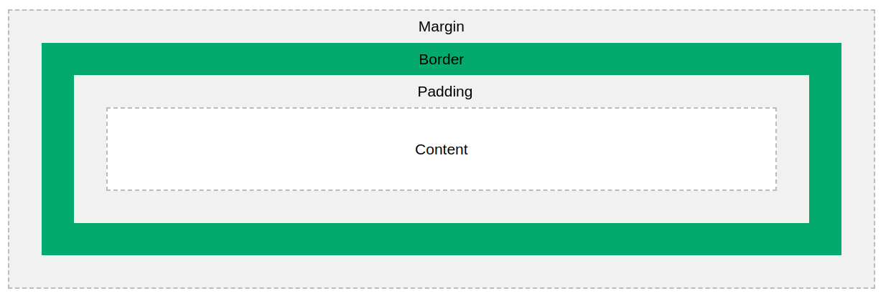
box-model

Slide 12
Margin:Clears an area outside the border. The margin is transparent
Border - A border that goes around the padding and content
Padding - Clears an area around the content. The padding is transparent
Content - The content of the box, where text and images appear

Slide 13
position
Position:they are used to specify the position of an element.
There are 5 position
static
relative
fixed
Absolute
sticky

Slide 14
Static:default position of an element.it does not affect any bottom,left,right properties
Fixed:the element remain in its position even if page is scrolled. The top, right, bottom, and left properties are used to position the element.
Absolute:position relative to ancestor

Slide 15
display
They are used to control the layout.
Blcok:A block-level element always starts on a new line and takes up the full width available
inline:An inline element does not start on a new line and only takes up as much width as necessary.
None:used to hide an element

Slide 16
Flex Box
The Flexible Box Layout Module, makes it easier to design flexible responsive layout structure without using float or positioning.
Flex-direction:is used to specify the direction of flex
Justify-content:they are used to align element horizontally.
Space-around,space-between,space-evenely
Align-items:used to align items vertically

Slide 17
Media query
Media query are mainly used to make page resposive.
They are used to change the style when certain resolution(px size) are reached.

Slide 18
Text-shadow:used to give shadow to text
text-shadow: 5px 5px 5px red;
x offset,y offset,spread,color
Box-shadow:
box-shadow: 15px 15px 15px cyan;

Slide 19
Animation
An animation lets an element gradually change from one style to another.
You can change as many CSS properties you want, as many times as you want.
For this it uses keyframe

Slide 20
Transition
CSS transitions allows you to change property values smoothly, over a given duration.
transition
transition-delay
transition-duration
transition-property
transition-timing-function

Slide 21
Transform
CSS transforms allow you to move, rotate, scale, and skew elements.
Rotate:they are used to rotate html elements
Skew: skews an element along the X-axis by the given angle.

