Slide 1

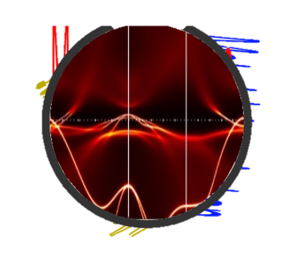

Revolution of Quantum Technology: Qubit Engineering Guided by Theory and Computation
Christopher Jacobs
Department Of Physics and Astronomy, West Virginia University, Morgantown, WV, USA
CQMG@WVU

Slide 2
Interesting Physics Ahead
Motivation
This is Important
What we plan to learn

Slide 3
Background
Motivation
This is Important
What we plan to learn

Slide 4
What do we need?
Motivation
This is Important
What we plan to learn

Slide 5
What I plan to do
Computation
How this relates to Experiment

