Slide 1
Exploring the Many-Body Physics of strongly correlated topological materials with Dynamical Mean Field Theory (DMFT) in 30 minutes
Christopher Jacobs
Collective Phenomena
4/18/2024 - 4/25/2024

Slide 2
In 30 Minutes:
What is Many body physics?
What is DMFT?
What are topological materials?
How are the last two related?

Slide 3

Tall Task! Please Ask Questions! Note: slide numbers below
Notes:
https://fineartamerica.com/featured/scylla-attacking-the-ship-of-odysseus-roger-payne.html

Slide 4

First: what is many body physics in solids?
From “The Theory of Everything” by Lauglin and Pines “...the ultimate theory
of the universe-(is) a set of equations capable of describing all phenomena
that have been oberserved or that will ever be”
They claim we need two equations:
1. time-dependent Shrodinger’s equation
2. Hamiltonian for particles in a solid
Lots of particles in a solid

Slide 5


Solution: ignore the slow physics
Aside: molecular dynamics or coupled electron-nuclear dynamics
2 Approximations:
1. Born-Oppenheimer Approximation
2. Only the valence electrons dominate electronic properties
Notes:
Figure from https://www.mycutegraphics.com/graphics/cow/cow-in-the-mud-with-flies.html

Slide 6
Historical approximations and why we need DMFT
So far: electronic Hamiltonian (ignore slow physics and focus on valence electrons)
Now: how do we deal with the wave function and pesky interaction term?
1920s Hartree theory – wave-function is separable, mean-field approximation of potential
1940s Hartree-Fock Theory – wave-function is slater determinant (exchange potential)
Problem: Expensive computationally or not good enough
1960s Density Function Theory - Hohenberg-Kohn Theorems allow us to reformulate QM in terms of density
Problem: Assumes “Kohn-sham” basis for electrons (noninteracting electons)
If you want more, slides in supplement!, ask during questions!!!
Notes:
Figure from https://www.mycutegraphics.com/graphics/cow/cow-in-the-mud-with-flies.html

Slide 7
What is Many body physics?
What is DMFT?
What are topological materials?
How are these related?

Slide 8
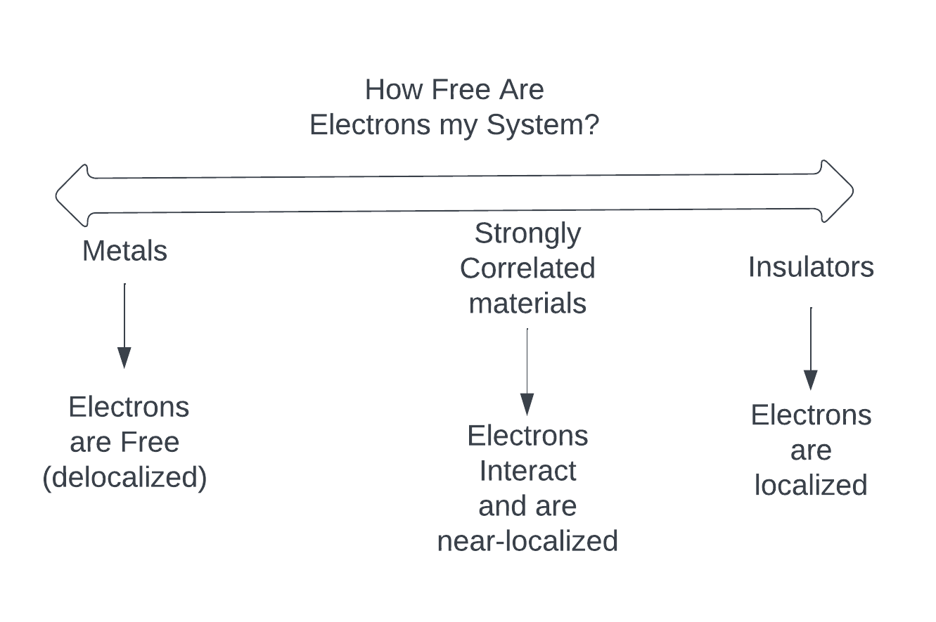
What are strongly correlated electrons? Review!
Notes:
Figure from https://www.mycutegraphics.com/graphics/cow/cow-in-the-mud-with-flies.html

Slide 9
Methods for Dealing with Strongly Correlated Electrons and Flavors of Dynamical Mean Field Theory
Methods for dealing with strongly correlated electrons:
1. Exact Diagonalization (subspace of hamiltonian)
2. Quantum Monte Carlo Methods
3. DFT + Hubbard U correction
4. Iterative Perturbation Theory
5. Slave-boson Mean Field Theory
Extentions of DMFT:
1. Dynamical Mean Field Theory
2. Cluster Dynamical Mean Field Theory
3. Multi-orbital extensions
4. Long-range correlations
5. Non-equilibrium
Notes:
Figure from https://www.mycutegraphics.com/graphics/cow/cow-in-the-mud-with-flies.html

Slide 10
Mean Field Theory (Ned spoke about Weiss Model): example Ising Model
Notes:
Figure from https://www.mycutegraphics.com/graphics/cow/cow-in-the-mud-with-flies.html

Slide 11
Historical Motivation for DMFT
So far: electronic Hamilonians
Now: how do we deal with the wavefunction?
Problem: Expensive computationally or not good enough
Notes:
Figure from https://www.mycutegraphics.com/graphics/cow/cow-in-the-mud-with-flies.html

Slide 12
What is Many body physics?
What is DMFT?
What are topological materials?
How are these related?

Slide 13
Topological Materials: Introduction
So far: electronic Hamilonians
Now: how do we deal with the wavefunction?
Problem: Expensive computationally or not good enough
Notes:
Figure from https://www.mycutegraphics.com/graphics/cow/cow-in-the-mud-with-flies.html

Slide 14
What is Many body physics?
What is DMFT?
What are topological materials?
How are these related?

Slide 15
Strongly Correlated Topolgical Materials: Bi2Se3
So far: electronic Hamilonians
Now: how do we deal with the wavefunction?
Problem: Expensive computationally or not good enough
Notes:
Figure from https://www.mycutegraphics.com/graphics/cow/cow-in-the-mud-with-flies.html

Slide 16
Flat Bands???
So far: electronic Hamilonians
Now: how do we deal with the wavefunction?
Problem: Expensive computationally or not good enough
Notes:
Figure from https://www.mycutegraphics.com/graphics/cow/cow-in-the-mud-with-flies.html

Slide 17
Flat Bands???
So far: electronic Hamilonians
Now: how do we deal with the wavefunction?
Problem: Expensive computationally or not good enough
Notes:
Figure from https://www.mycutegraphics.com/graphics/cow/cow-in-the-mud-with-flies.html

Slide 18
How are these related?

Slide 19
If you got nothing get this: 1.DMFT is a method of exactly mapping your lattice Hamiltonian to another solvable problem which involves a impurity, bath, and coupling aspect 2. “Topological” in topological materials is referring to “some quality” of the electronic band structure (also the robust surface state)

Slide 20
Supplement

