Slide 1
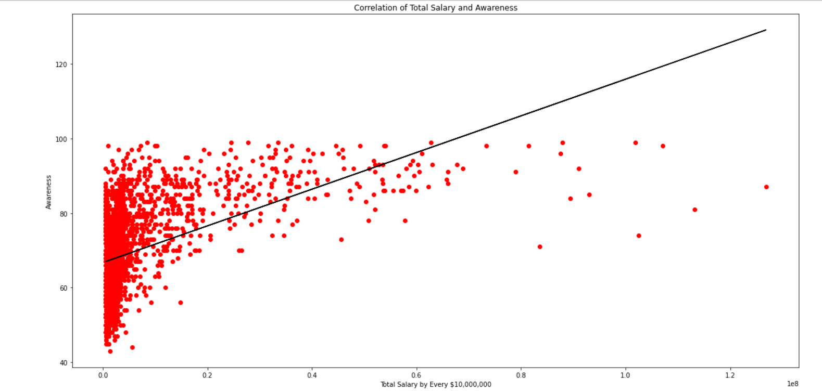
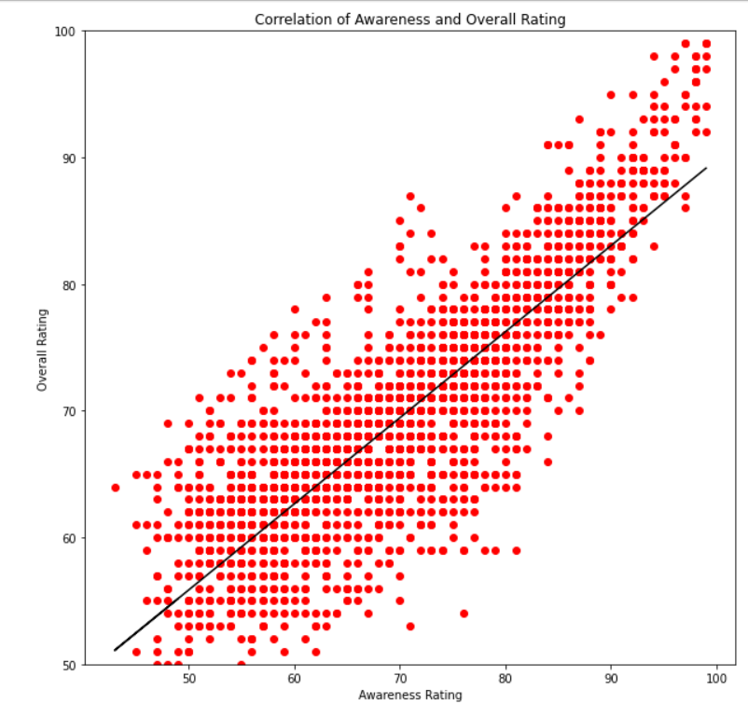
What Influences Madden Overall?

Slide 2
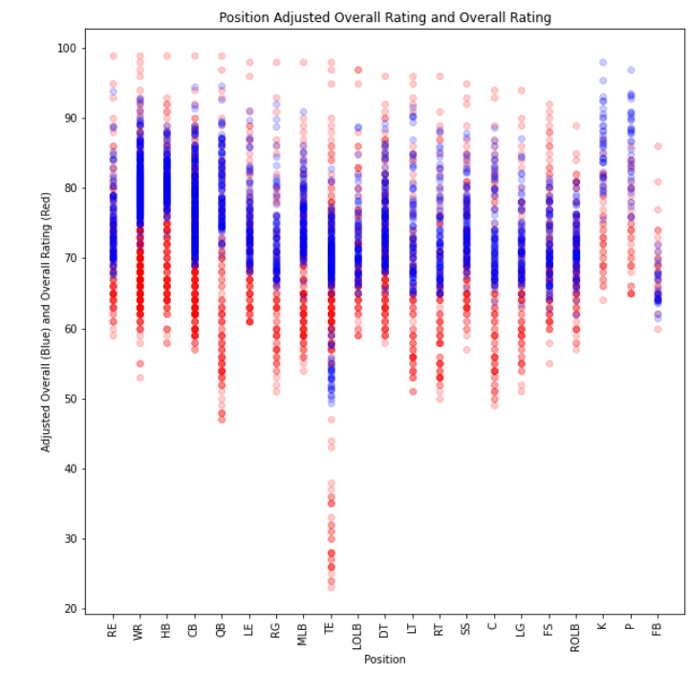
Positional Spread
More spread among real overalls.
Adjusted overalls do not normally exceed 90.
Kickers and Punters finally get recognition!

Slide 3
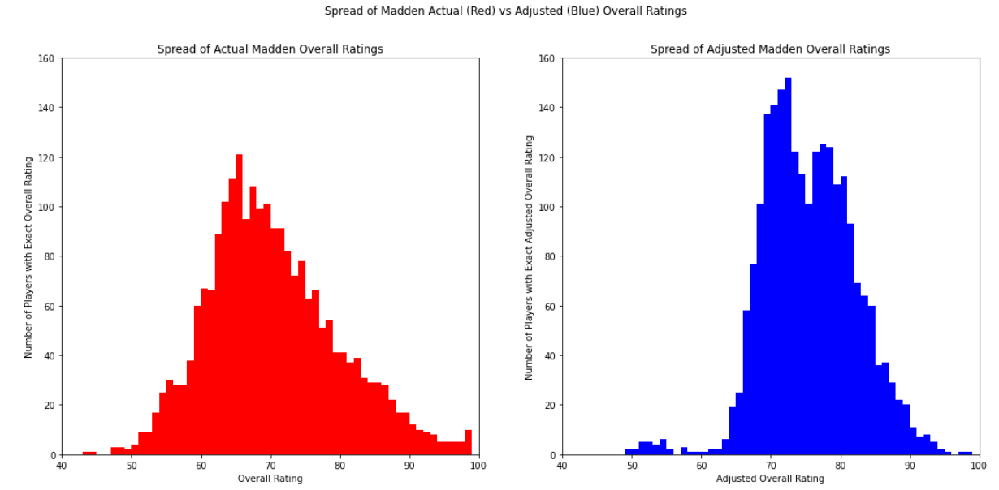
Histograms of Real Overall (Left) vs Adjusted Overall (Right)

