Slide 1

Motivating f_{esc} During Reionzation Using Semi-Analytic Models
Jacob Seiler
Anne Hutter, Darren Croton, Emma Ryan-Weber

Slide 2

What is f_{esc}?
𝜸
𝜸
IGM
ISM
𝜸
𝜸
ISM
IGM
𝜸
𝜸
ISM
𝜸
𝜸
ISM
𝜸
ISM
IGM
f_{esc} = Number of HI Ionizing Photons Produced /
Number of Photons that Escape Into IGM

Slide 3
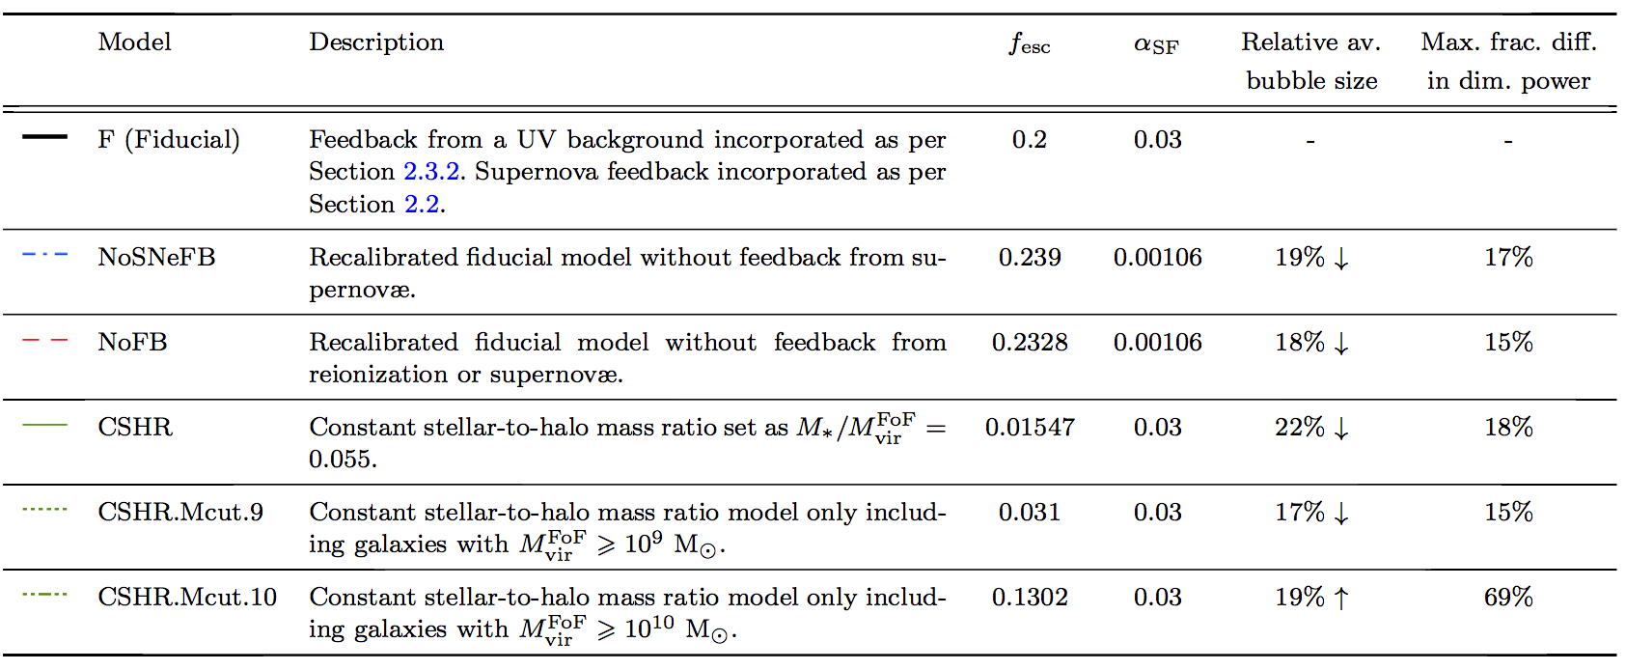
Uncertainty in f_{esc}
Observational limits place f_{esc} at 0-5% for z < 1.5 (Cowie+ 2009, Grimes+ 2009), and < 10-20% at z ~ 3 (Guaita+ 2016, Grazian+ 2017). But also measurements of f_{esc} > 20%! (Vanzella+ 2016, Bian+ in prep)
As a first step often assume f_{esc} is a constant.
See Also: Kuhlen & Faucher-Giguere (2012)
Sobacchi & Mesinger (2014)
Yajima et al. (2017)
(Geil et al., 2016)
Notes:
Paper is the DRAGONS paper III that studied the morphology of reionization under different scenarios. “Reionization morphology at fixed neutral fraction is not uniquely determined by details of galaxy formation but is sensitive to the mass of haloes hosting the bulk of the ionizing photons.”
Also mention that current observations place fesc at levels from abount 0-10% for about z < 1.5. At higher redshift these then range from 10-20%.

Slide 4
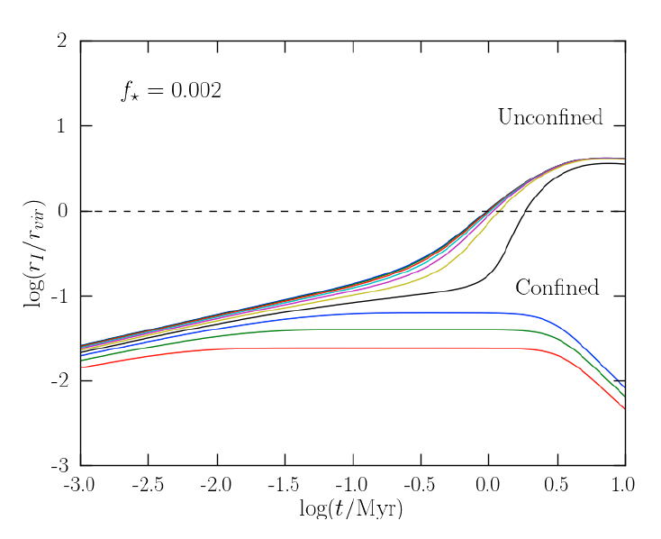
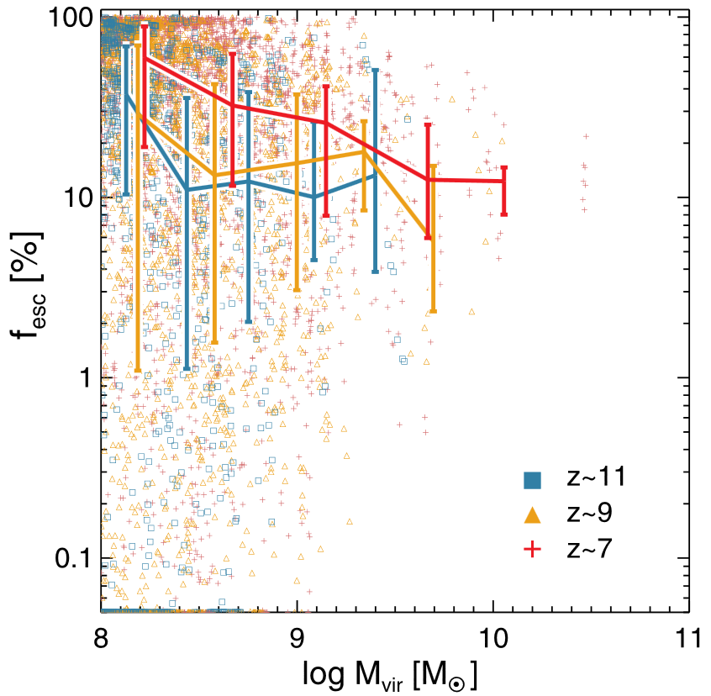
Is f_{esc} A Function of Halo Mass?
As halo mass decreases gas becomes less dense.
Lower recombination rate so higher escape fraction?
10⁸M☉
10¹¹M☉
(Ferarra & Loeb, 2013)
(Kimm & Cen, 2014)
Notes:
Left one: Performed cosmological zoom in simulations from 9 halos between masses of 6 < log(Msun) < 8.
M_part = 90msun. L = 2 h^-1Mpc. Identifies halos with > 10,000 DM particles. Spatial Res = 0.7pc.
Right one: Performed two zoomed-in radiation-hydrodynamic simulations to investigate the effect of SN on fesc.
M_part = 1.6e5 Msun. L = 3.8 * 4.8 * 9.5 cMpc. N_part = 2048^3. Spatial res = 4.2pc
Highlights the recent paradigm shift that the escape fraction is inversely proportional to halo mass. This is a results of low mass halos being less dense than higher mass halos allowing photons to escape easier.

Slide 5
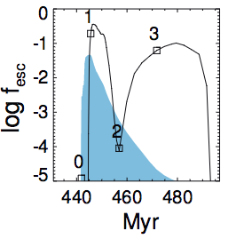
Is f_{esc} A Function of the Individual Galaxy?
Stellar feedback + Supernovae blowouts move gas to outskirts.
Photons can more easily escape into the IGM?
SN Blowout
Radiation Feedback
(Kimm et al., 2016)
Notes:
From zoom-in simulations that also included a sub-grid model of SFR.
M_Part approx 1000 Msun, L approx 4 h^-1Mpc. Spatial res approx 10pc.
These images show the most massive galaxy from a number of different runs. Highlights that there is significant variation in the escape fraction over time and that there is a slight delay between the peaks in SFR and the peaks in fesc.

Slide 6
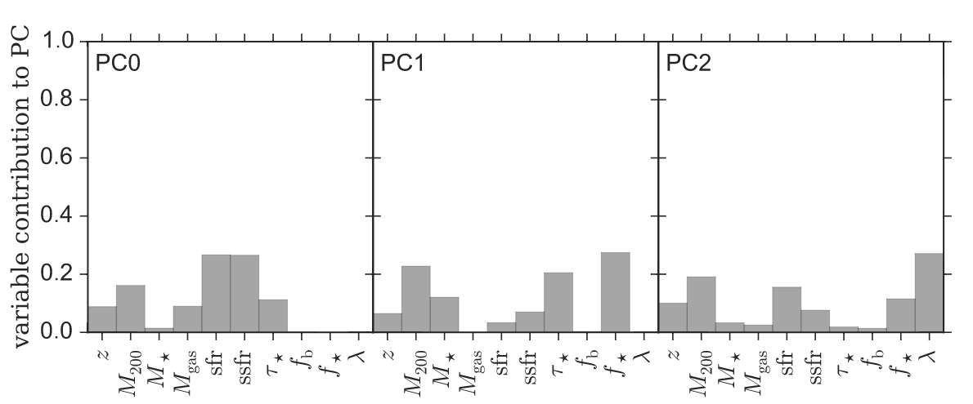
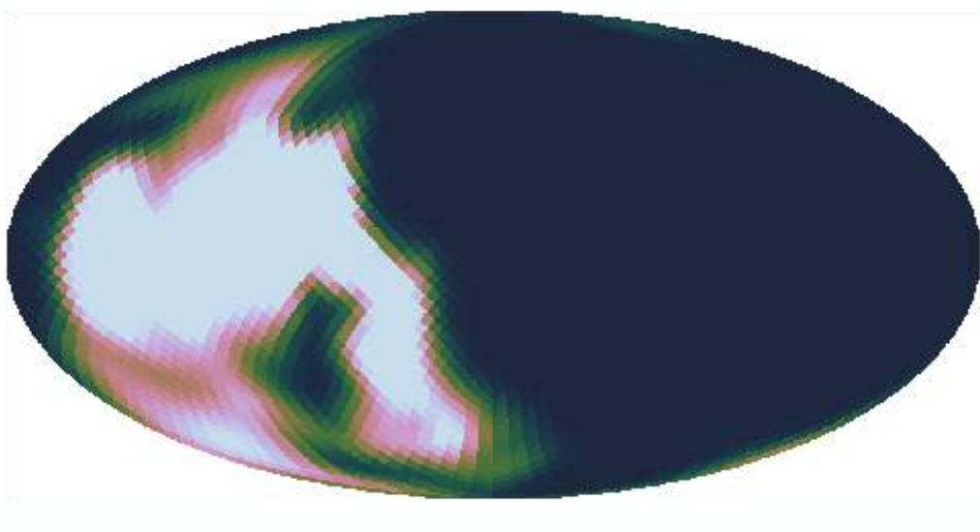
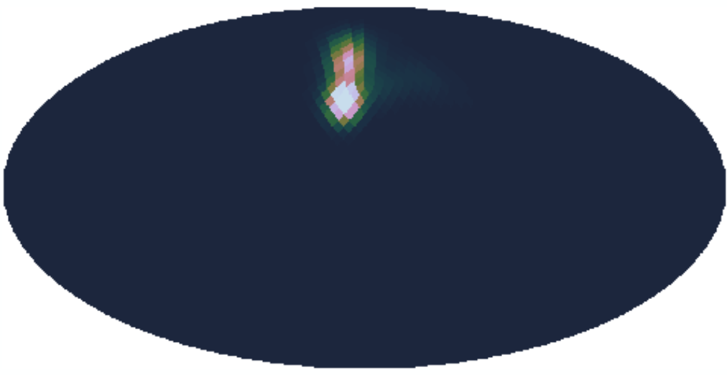
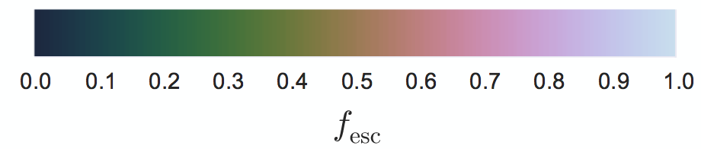
f_{esc} Is Complex
f_{esc} is a complex combination of many parameters. Choosing a constant fraction is a result of this complexity.
(Paardekooper 2015)
Notes:
Results from ‘The First Billion Years project’ which used cosmological hydrodynamical sims to model reionization from redshift 27 and 6.
M_part = 1253.6 Msun, L = 8 cMpc, N = 2*1368^3. Identified halos with > 1000 DM parts.
This figure uses PCA in an attempt to explain the scatter in the escape fraction measurements from the simulation. It’s done by diagionaliizing the covariance matrix of the data with the eigenvectors of this matrix forming the principal components. PC0 explains the most amount of scatter in the data, with PC1 doing the next etc. PC0 accounts for 18% of the uncertainty with 3 components being required for 50%; 90% requires at least 7 PCs.
This plot and explanation highlights that its ridculously difficult to analytically describe the escape fraction of an individual galaxy. Image on the right is for halos with similar stellar mass, sSFR and mean stellar lifetime. Despite this the top one has fesc = 0.3 whilst the bottom one has fesc = 0.01 solely due to how gas is distributed.

Slide 7
f_{esc} Is Complex
“Couldn’t we just choose any escape fraction?”
f_{esc} is a complex combination of many parameters. Choosing a constant fraction is a result of this complexity.
(Paardekooper 2015)
Notes:
Results from ‘The First Billion Years project’ which used cosmological hydrodynamical sims to model reionization from redshift 27 and 6.
M_part = 1253.6 Msun, L = 8 cMpc, N = 2*1368^3. Identified halos with > 1000 DM parts.
This figure uses PCA in an attempt to explain the scatter in the escape fraction measurements from the simulation. It’s done by diagionaliizing the covariance matrix of the data with the eigenvectors of this matrix forming the principal components. PC0 explains the most amount of scatter in the data, with PC1 doing the next etc. PC0 accounts for 18% of the uncertainty with 3 components being required for 50%; 90% requires at least 7 PCs.
This plot and explanation highlights that its ridculously difficult to analytically describe the escape fraction of an individual galaxy. Image on the right is for halos with similar stellar mass, sSFR and mean stellar lifetime. Despite this the top one has fesc = 0.3 whilst the bottom one has fesc = 0.01 solely due to how gas is distributed.

Slide 8
f_{esc} Is Complex
“Couldn’t we just choose any escape fraction?”
f_{esc} is a complex combination of many parameters. Choosing a constant fraction is a result of this complexity.
Well, yeah.
(Paardekooper 2015)
Notes:
Results from ‘The First Billion Years project’ which used cosmological hydrodynamical sims to model reionization from redshift 27 and 6.
M_part = 1253.6 Msun, L = 8 cMpc, N = 2*1368^3. Identified halos with > 1000 DM parts.
This figure uses PCA in an attempt to explain the scatter in the escape fraction measurements from the simulation. It’s done by diagionaliizing the covariance matrix of the data with the eigenvectors of this matrix forming the principal components. PC0 explains the most amount of scatter in the data, with PC1 doing the next etc. PC0 accounts for 18% of the uncertainty with 3 components being required for 50%; 90% requires at least 7 PCs.
This plot and explanation highlights that its ridculously difficult to analytically describe the escape fraction of an individual galaxy. Image on the right is for halos with similar stellar mass, sSFR and mean stellar lifetime. Despite this the top one has fesc = 0.3 whilst the bottom one has fesc = 0.01 solely due to how gas is distributed.

Slide 9
Our Aim
Is it possible to model the Epoch of Reionization using a more physically motivated escape fraction parameterization?
What are the `key’ observations/measurements/results that we have to match?
Notes:
Normally people just assume constant escape fraction, however this simiplifies a lot of things (as we just saw). As a consequence, are we able to determine a more physical form of the escape fraction that still agrees with general EoR things?

Slide 10
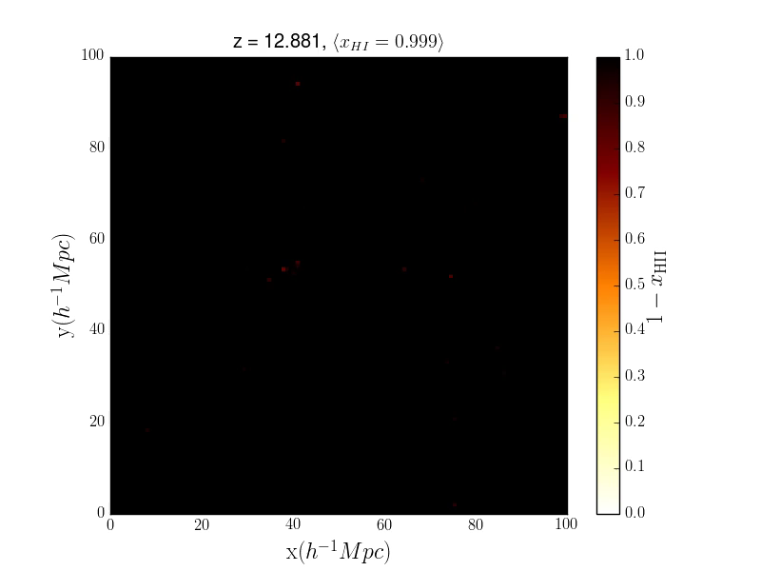
Galaxy Properties + Photons
Use Semi-Analytic Galaxy Evolution model to generate galaxy properties.
Model reionization in a post-processing step.
Use SFR to calculate number of ionizing photons.
Draw spheres and count the number of ionizing photons + neutral H + recombinations.
Notes:
A previous talk has hopefully talked about SAMs; if they haven’t give a brief description. On the left is the SMF which we can see agrees to an acceptable level with the observations. On the right we see that the rate of ionizing photons reaches a plateau after ~5 Myr. This is a linear relationship that depends upon the SFR which is how we determine the number of ionizing photons emitted by each galaxy.
Finally highlight that SAMs take a short amount of time to run; easy to explore parameter space!

Slide 11


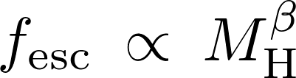




Escape Fraction Parameterization
Sample Text
Notes:
Final ingredient is the escape fraction. In this work we focus on 3 different parameterizations. As we saw the halo mass is thought to affect the escape fraction so we use a power law. We fix the escape fraction for the least and most massive halos that then defines our slope + intercept. The ejected mass is an attempt to model how SN are seen to affect the escape fraction. Fix the smallest and largest escape fraction and then define a linear relationship.
But because of the power of the SAM we can really be crazy and parameterize the escape fraction however we want. These are just a few examples.

Slide 12
Preliminary Results

Slide 13
Summary
f_{esc} is not a constant but is a complex combination of parameters.
Using galaxies evolved from a Semi-Analytic Model, we attempt to implement a more physical prescription for f_{esc}.
Our key assumption is that f_{esc} depends strongly on the density of the galaxy gas.
Attempt to capture this by using halo mass and ejected fraction.
Important consequence is that since these parameters evolve, the escape fraction will evolve as well.
Notes:
It’s a summary slide, do I really need to summarize the summary?

