Slide 1



Capstone - Model Building for Fraud Detection
Retaining high profitable customers is the number one business goal for many banks. Banking fraud, however, poses a significant threat to this goal for different banks. In terms of substantial financial losses, trust, and credibility, this is a concerning issue for both banks and customers alike. In the banking industry, credit card fraud detection using machine learning is not just a trend. It is necessary for players in the industry to put proactive monitoring and fraud prevention mechanisms in place.
by Jacob Simon Areickal

Slide 2

Exploratory Data Analysis (EDA)
Data Overview
Missing Values
Outlier Detection
Analyze the structure, size, and basic statistics of the dataset
Identify, understand, and handle missing data appropriately
Detect and analyze outliers that may impact the model

Slide 3
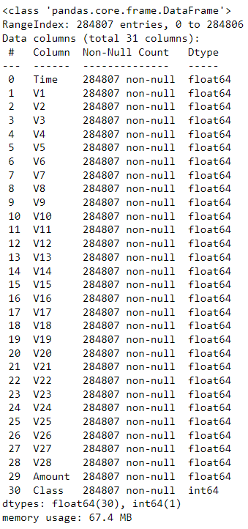
Data Overview
1
Null Values
There are no null values detected for any of the columns in the dataset
2
Datatypes
Apart from the label column which is an integer, all the other columns are floats
3
Columns
Apart from “time” and “amount,” all the other features (V1, V2, V3, up to V28)
are the principal components obtained using PCA.

Slide 4
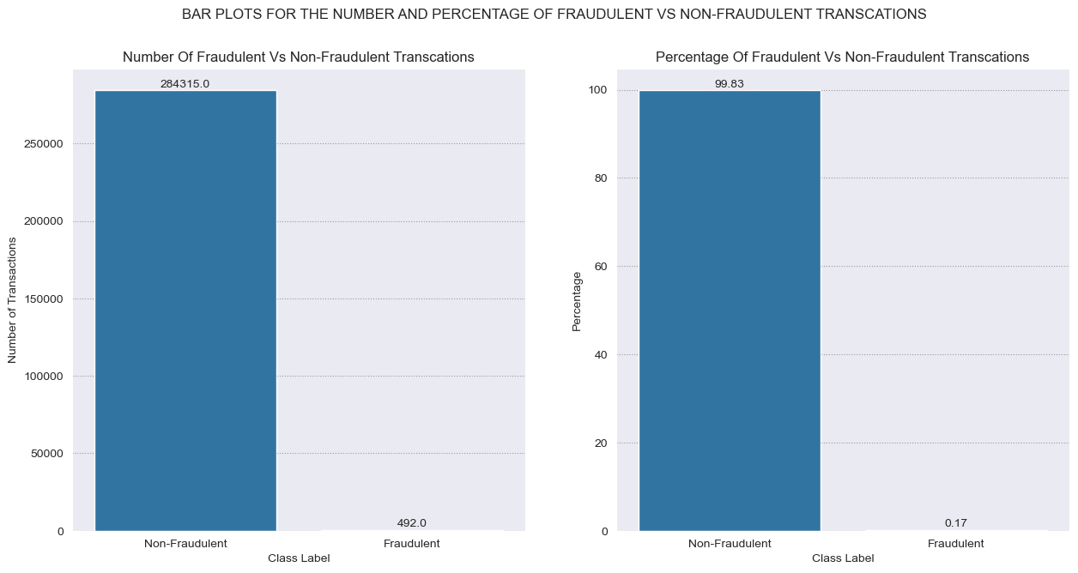
Fraudulent vs non-fraudulent transactions
The percentage of fraudulent transactions is 99.83% while the non fraud fraudulent transactions is a meagre 0.17%
This leads to extreme imbalance in the distribution of the classes
This can lead to biased models that perform poorly on the minority class. Here are some techniques to address class imbalance:
Under sampling: Randomly remove instances from the majority class to balance the class distribution.
Oversampling: Replicate instances from the minority class or generate synthetic instances to balance the class distribution.
SMOTE (Synthetic Minority Over-sampling Technique): Generate synthetic samples for the minority class by interpolating
between existing instances.

Slide 5
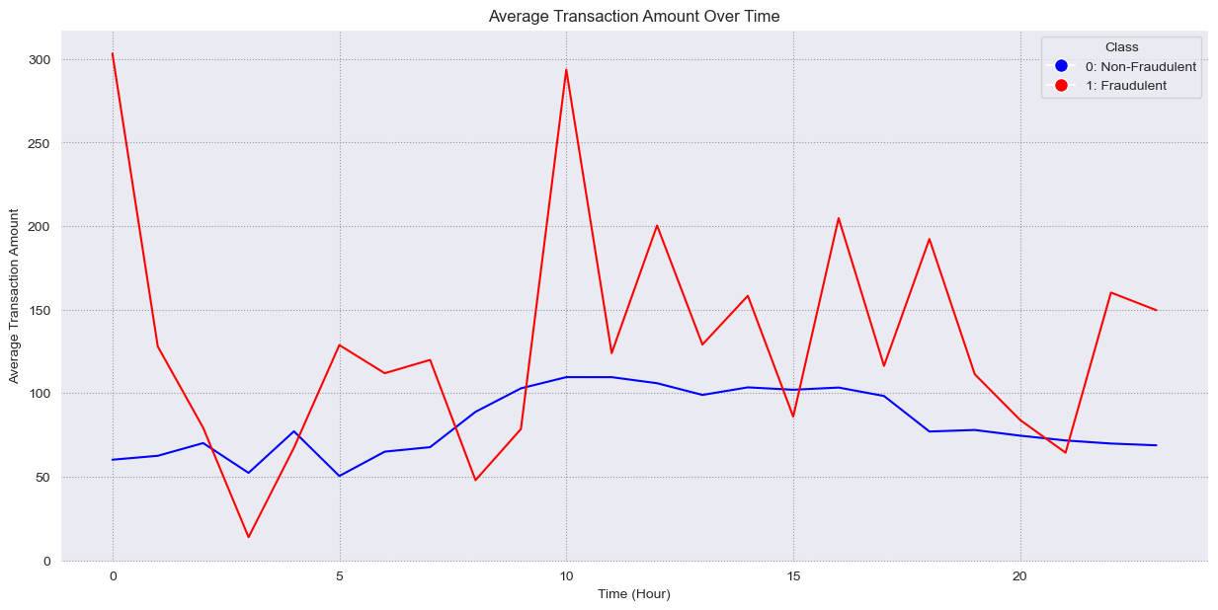
Average Transaction Amount Over Time
Unusual spikes in the graph representing fraudulent transactions suggests that there are specific time
periods where the occurrence of fraudulent activities deviates significantly from the expected or normal behavior.
The non fraudulent transactions have much lesser average transaction amount compared to fraudulent transactions
There is a huge spike in the average transaction amount for fraudulent transactions, mainly in early and late mornings

Slide 6
Data Preprocessing
Data Cleaning: Removed duplicates, handled missing values, and corrected inconsistencies in the dataset
Power Transformer: Power transformer is a type of preprocessing transformer that applies a
power transformation to the input data. The purpose of power transformations
is to make the data more Gaussian-like, which can be beneficial for certain
machine learning algorithms that assume normality or perform better with
more symmetric distributions.
Scaling: ‘StandardScaler’ is a preprocessing technique used to standardize or normalize the features
of a dataset. Scaling has been applied to the ‘Amount’ column in the dataset.

Slide 7
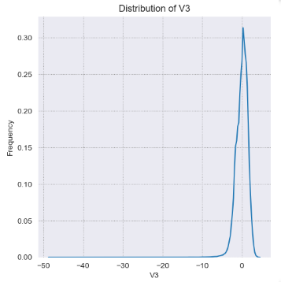
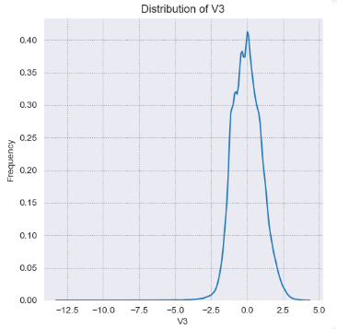
Power Transformer
Using the skew function in SciPy, we found all columns which are skewed in the dataset.
Features with skewness greater than 1 or less than -1 were 'V1', 'V2', 'V3', 'V5', 'V6', 'V7', 'V8', 'V10', 'V12', 'V14', 'V16', 'V17', 'V20', 'V21', 'V23', 'V28', 'Amount’.
Power Transformer has been applied to the above columns to make the distribution less skewed and more Gaussian. An example of ‘V3’ column before and after applying Power Transformer is shown below:
Power Transformer

Slide 8
Model Selection
Logistic Regression
Random Forest
A classic and interpretable model for binary classification tasks.
An ensemble model known for handling complex relationships in data.
Support Vector Machines
XGBoost
Effective in high-dimensional spaces, using a kernel trick to map data.
Scalable and efficient ML algorithm that belongs to the ensemble learning family, specifically designed for boosting decision trees.
KNN
ML algorithm used for classification and regression, making predictions based on mean of the k-nearest data points
Decision Trees
Interpretable ML algorithm that recursively partitions the feature space to make predictions based on a series of binary decisions.

Slide 9
Evaluation Approach
AUC Score: AUC score will be given the first priority when it comes to choosing the best model.
Higher the AUC score, better is the decision making capacity of the model. If the AUC of models are similar to a degree, then recall/sensitivity is used to decide the best model.
Recall/Sensitivity: False negatives occur when a fraudulent transaction is incorrectly classified as non-fraudulent. In the context of fraud detection, missing a fraudulent transaction can have severe consequences, leading to financial losses for both the individuals and the financial institution. Recall, also known as sensitivity or true positive rate, specifically measures the ability of the model to capture all instances of the positive class (fraudulent transactions).

Slide 10



Considerations
Data Security
Probability Estimation
Statistical Analysis
Proper measures needs to be taken to ensure secure handling of sensitive data in fraud detection.
ML models calculate the probability of a certain event. Proper measures and analysis needs to be performed to select the best threshold for each model
Crucial and statistical analysis need to be performed to gather insights into the relationships between variables and their impact.

Slide 11
Model Results
S No | Model | Dataset Balance Technique | Recall/Sensitivity | Specificity | Precision | F1 Score | AUC
1 | LogisticRegression | Imbalanced | 0.9184 | 0.9843 | 0.0915 | 0.1664 | 0.9513
2 | SVC | Imbalanced | 0.898 | 0.9822 | 0.0798 | 0.1465 | 0.9401
3 | DecisionTreeClassifier | Imbalanced | 0.8163 | 0.9976 | 0.367 | 0.5063 | 0.9069
4 | RandomForestClassifier | Imbalanced | 0.9184 | 0.9849 | 0.0948 | 0.1719 | 0.9516
5 | KNeighborsClassifier | Imbalanced | 0.8673 | 0.9991 | 0.6296 | 0.7296 | 0.9332
6 | XGBClassifier | Imbalanced | 0.898 | 0.9984 | 0.4862 | 0.6308 | 0.9482
7 | LogisticRegression | Random Oversampling | 0.898 | 0.9909 | 0.145 | 0.2496 | 0.9444
8 | DecisionTreeClassifier | Random Oversampling | 0.8776 | 0.9942 | 0.2067 | 0.3346 | 0.9359
9 | RandomForestClassifier | Random Oversampling | 0.9388 | 0.9699 | 0.0509 | 0.0966 | 0.9543
10 | KNeighborsClassifier | Random Oversampling | 0.8776 | 0.9988 | 0.5584 | 0.6825 | 0.9382
11 | XGBClassifier | Random Oversampling | 0.9286 | 0.983 | 0.0858 | 0.1572 | 0.9558
12 | LogisticRegression | SMOTE | 0.9082 | 0.9885 | 0.1196 | 0.2114 | 0.9483
13 | DecisionTreeClassifier | SMOTE | 0.8367 | 0.9736 | 0.0517 | 0.0974 | 0.9052
14 | RandomForestClassifier | SMOTE | 0.9388 | 0.9748 | 0.0602 | 0.1132 | 0.9568
15 | KNeighborsClassifier | SMOTE | 0.898 | 0.9948 | 0.2304 | 0.3667 | 0.9464
16 | XGBClassifier | SMOTE | 0.9286 | 0.9836 | 0.0889 | 0.1622 | 0.9561
17 | LogisticRegression | ADASYN | 0.9082 | 0.9908 | 0.1452 | 0.2504 | 0.9495
18 | DecisionTreeClassifier | ADASYN | 0.8776 | 0.967 | 0.0438 | 0.0835 | 0.9223
19 | RandomForestClassifier | ADASYN | 0.9388 | 0.98 | 0.0749 | 0.1388 | 0.9594
20 | KNeighborsClassifier | ADASYN | 0.898 | 0.992 | 0.1624 | 0.275 | 0.945
21 | XGBClassifier | ADASYN | 0.9286 | 0.9848 | 0.0951 | 0.1725 | 0.9567

Slide 12
Best Model for Imbalanced Data
Although the model with the highest AUC and recall is the random forest classifier, we need the model to be easily explainable to business
Hence in this case, Logistic Regression is the best model with a recall of 0.91 and AUC score of 0.95
Reasons for choosing Logistic Regression:
Interpretability: Logistic Regression is a simple and interpretable model. The coefficients of the features can be easily interpreted in terms of the impact on the log-odds of the outcome.
Advantages: It is easy to understand and explain to business stakeholders.

Slide 13
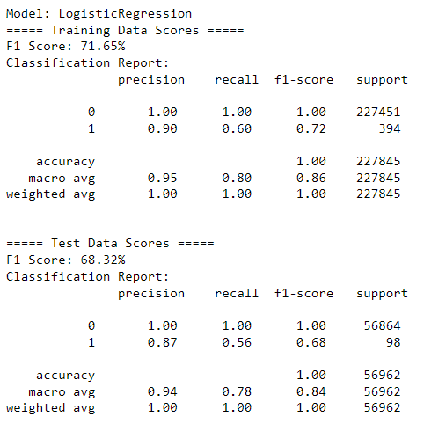
Continued..
Below is the classification report of the Logistic Regression model:
Classification Report Analysis:
The model achieves perfect accuracy on both the training and test datasets, indicating that it correctly classifies all instances.
However, the key focus should be on the evaluation of the minority class (Class 1 - fraud cases).
The model shows good precision (87%) for fraud cases on the test data, meaning that when it predicts a transaction as fraud, it is correct 87% of the time.
The recall for fraud cases (56%) on the test data is moderate, indicating that the model captures 56% of actual fraud cases.

Slide 14
Best Model for Random Oversampled Data
XGBoost Classifier is the best model with a recall of 0.928 and AUC score of 0.9558
Depending on the specific context and considerations, both XGBoost and Random Forest Classifier can be reasonable choices as both the models show almost similar AUC and recall. It's essential to take into account business objectives.
Reasons for choosing XGBoost Classifier :
Scalability:
XGBoost: Designed to handle large datasets and distributed computing, making it scalable for big data applications.
Random Forest: Can become computationally expensive and less scalable as the dataset size increases.
Parallelization:
XGBoost: Optimized for parallel computing, which can significantly speed up the training process.
Random Forest: Parallelization is limited as each tree is grown independently.

Slide 15
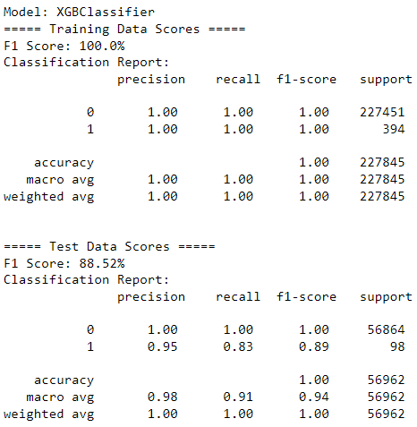
Continued..
Below is the classification report of the XGBoost Classifier model:
Classification Report Analysis:
Training Data:
The model achieves perfect F1 score, precision, recall, and accuracy on the training data.
Test Data:
The model maintains high performance on the test data, with an F1 score of 88.52%.
While the precision for Class 1 (fraud cases) is 95%, the recall is 83%. This indicates that the model correctly identifies a high proportion of actual fraud cases, but there is still room for improvement in terms of capturing all fraud cases.

Slide 16
Best Model for SMOTE Data
Random Forest Classifier is the best model with a recall of 0.9388 and AUC score of 0.9568
Considering both AUC and recall for SMOTE data, the Random Forest Classifier stands out with the highest recall and a strong AUC. It captures a higher proportion of actual fraud cases while maintaining good discrimination between classes. However, XGB Classifier is also a competitive choice with slightly lower recall but a comparable AUC.
Reasons for choosing Random Forest Classifier :
Interpretability:
Feature Importance Interpretation: While not as interpretable as a single decision tree, Random Forest can still provide insights into feature importance, aiding in the interpretability of the model.
Robustness to Noisy Data:
Handling Outliers: Random Forest is less sensitive to noisy data and outliers compared to individual decision trees, making it more robust in the presence of potential anomalies in the dataset.

Slide 17
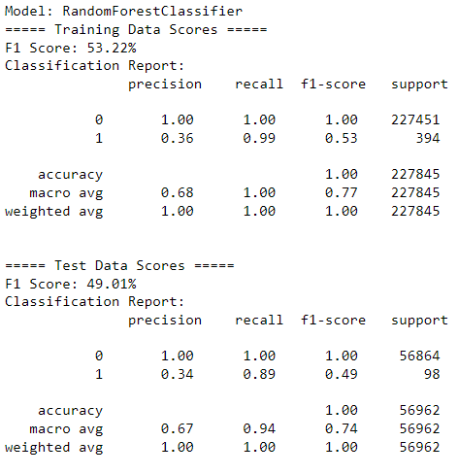
Continued..
Below is the classification report of the Random Forest Classifier model:
Classification Report Analysis:
Training Data:
The model achieves a high F1 score on the training data, but there is a significant imbalance between precision and recall for Class 1 (fraud cases).
While precision for Class 0 is 100%, indicating no false positives, the recall for Class 1 is exceptionally high at 99%.
Test Data:
The model maintains high accuracy but has a lower F1 score on the test data.
There is a similar imbalance in precision and recall for Class 1, with a relatively high recall (89%) and lower precision (34%).

Slide 18
Best Model for ADASYN Data
XGBoost Classifier is the best model with a recall of 0.9286 and AUC score of 0.9567
Considering both AUC and recall for ADASYN data, the Random Forest Classifier stands out with the highest recall and a strong AUC.
It captures a higher proportion of actual fraud cases while maintaining good discrimination between classes.
However, I chose XGB Classifier for this case considering the vast benefits of the XGBoost model.

Slide 19
Continued..
From the above results , the XGB Classifier with the ADASYN (Adaptive Synthetic Sampling) balance technique performs well across multiple metrics. XGB ADASYN will be considered the best model overall for credit card fraud detection as inferred below:
High Sensitivity (Recall):
The XGB Classifier with ADASYN consistently shows high sensitivity, suggesting that it is effective in identifying instances of the minority class (fraudulent transactions). High sensitivity is crucial in fraud detection because it minimizes the number of false negatives, ensuring that actual fraudulent transactions are not overlooked.
Balanced Specificity:
While focusing on sensitivity, XGB ADASYN maintains a reasonable level of specificity. Balanced specificity is important to avoid classifying too many non-fraudulent transactions as fraudulent (minimizing false positives), which is critical in real-world applications to prevent inconveniencing legitimate users.
Trade-off Between Precision and Recall:
Credit card fraud detection often involves a trade-off between precision and recall. XGB ADASYN might strike a balance by achieving high recall while still maintaining a reasonable level of precision. This is essential to minimize both false negatives and false positives.

Slide 20
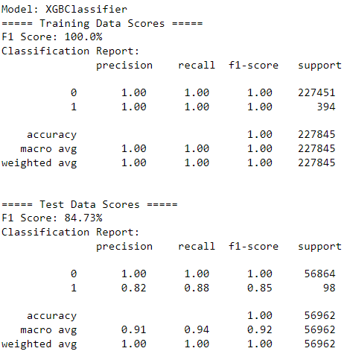
Continued..
Below is the classification report of the XGBoost Classifier model:
Classification Report Analysis:
Test Data F1 Score: 84.73%
The F1 score on the test data is still relatively high, suggesting a strong overall performance. It combines precision and recall, providing a balanced assessment of the model's ability to correctly classify both positive and negative instances.
Test Data Recall: 88%
The recall on the test data is 88%, indicating that the model is able to capture a high percentage of actual positive cases (fraudulent transactions).
Key Observations:
High Training F1 Score: The perfect F1 score on the training data suggests that the model has learned the patterns in the training set well.
High Test Data Recall: The high recall on the test data indicates the model's ability to effectively identify fraudulent transactions.

Slide 21



Cost Benefit Analysis
Below are important considerations that should be taken into account when choosing the best model:
Interpretability
If interpretability is a critical requirement, Logistic Regression may be preferred due to its simplicity.
Random Forest and XGBoost are more complex and harder to interpret.
1
Predictive Performance
2
XGBoost and Random Forest typically outperform Logistic Regression in terms of predictive
accuracy, especially when dealing with complex patterns.
Resource Constraints
3
If computational resources are limited, Logistic Regression might be a more
practical choice. Random Forest and XGBoost require more computational power.
Model Complexity
Consider the trade-off between model complexity and performance.
Logistic Regression is simpler but may sacrifice some predictive power.
4

Slide 22
THANK YOU!!!
In case of any queries, please feel free to write to me at:
jareickal@arizona.edu

