Slide 1
SLC-DSS Experiment
4-3-2020

Slide 2
overview
Het—6/Mut—8/Wt—5
Only Male
4 mice dead（2 Het/1 Mut/1 Wt）
item | D₀ | D₁ | D₂ | D₃ | D₄ | D₅ | D₆ | D₇ | D₈ | D₉ | D₁₀
DSS |  | √ | √ | √ | √ | √ | √ | √
Weight | √ | √ | √ | √ | √ | √ | √ | √ | √ | √ | √
Stool Score | √ |  | √ |  | √ |  | √ |  | √ |  | √
Blood test | √ |  | √ |  | √ |  | √ |  | √ |  | √
Bodyweight Loss |  | √ | √ | √ | √ | √ | √ | √ | √ | √ | √

Slide 3
Body Weight
On day 3 WT was more affected than het and mutant but from next day they are equal again.
The bodyweight of mutant is larger than others

Slide 4
Stool Score
The stool score shows that WT are more sensitivity than other genotype by the DSS

Slide 5
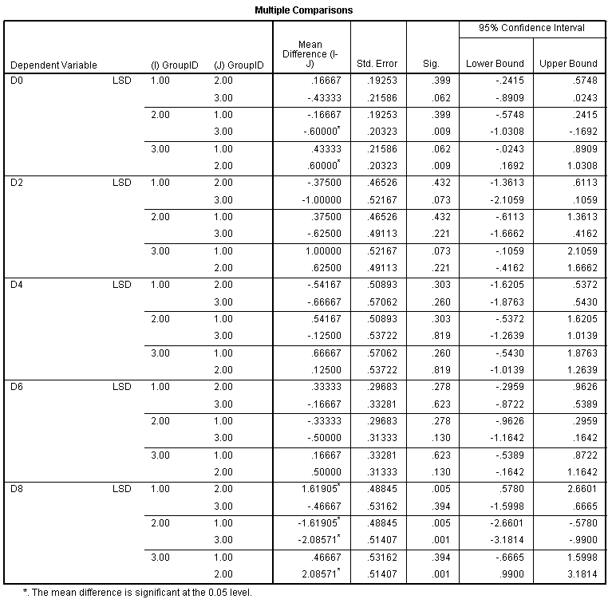
Occult Blood Score
no differences when drinking DSS. However, the mutant may recover better from this

Slide 6
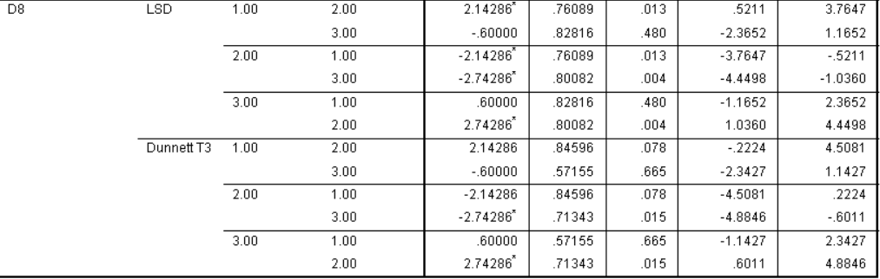
All Score
The Total Score indicated that the WTs were more affected than others.
The Mutant recover better from others.

Slide 7
Spleen & Colon
No significant difference.
colon length of the mutant is larger than the others may be related to a better recovery of mutant.

