Slide 1
TNBS 1 & 2

Slide 2
Technical detail
Presensitization solution
64% Acetone + 16% Olive oil + 1%TNBS
Shave the mice on the back between the shoulders.
Apply 150 pre-solution (we don’t have the negative control mice)
Weight the mice every two days.
TNBS injection solution
40% ethanol + 2.5% TNBS
Inject 100 μL TNBS-solution, keep the mice under anesthesia, and hang the mice head down vertically for 1 min
Weight the mice every day and collect the sample on day 3 after TNBS injection

Slide 3
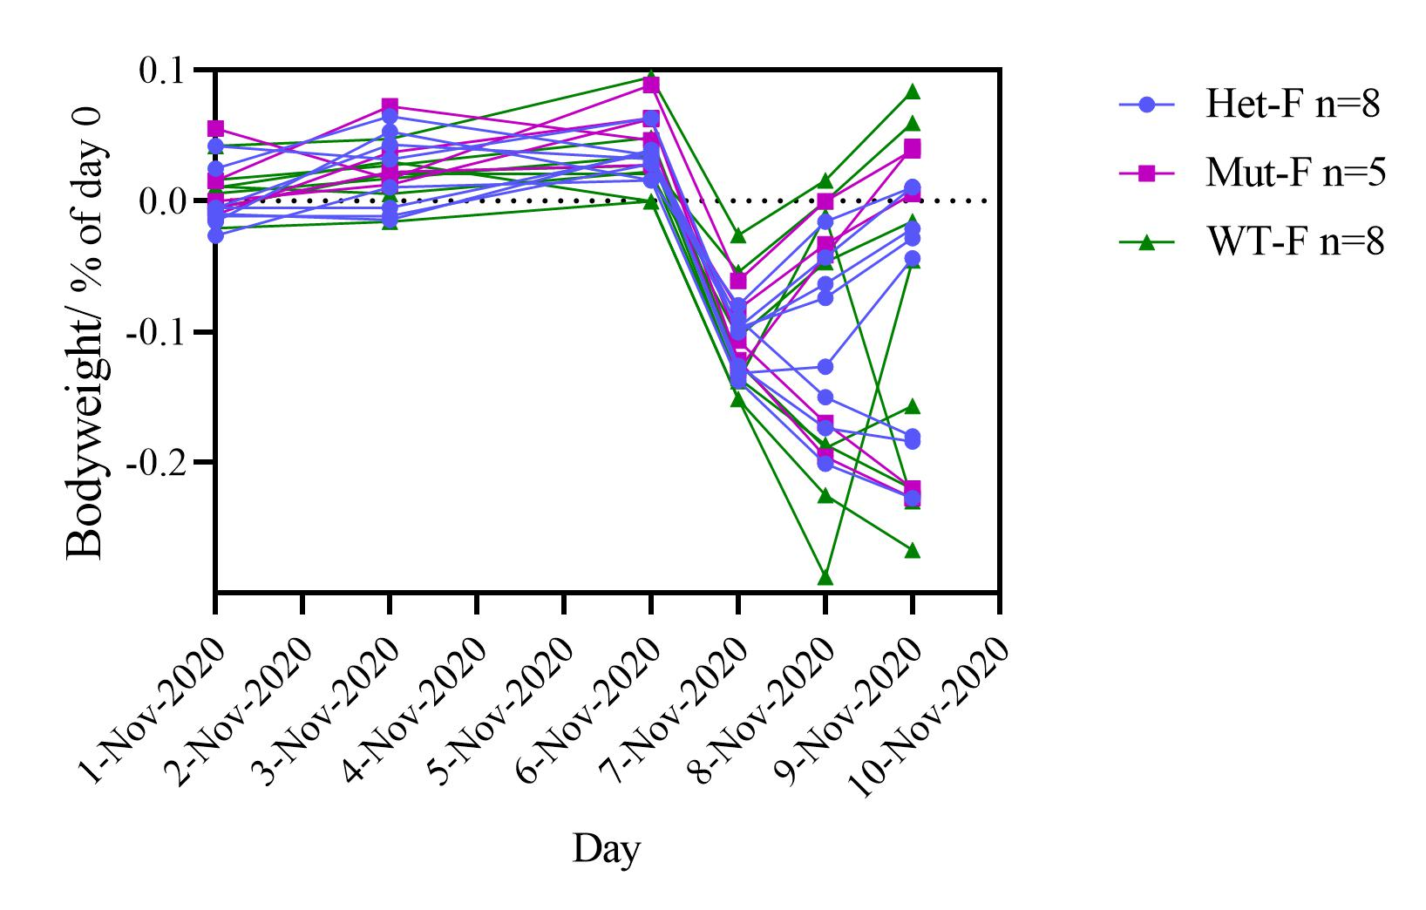
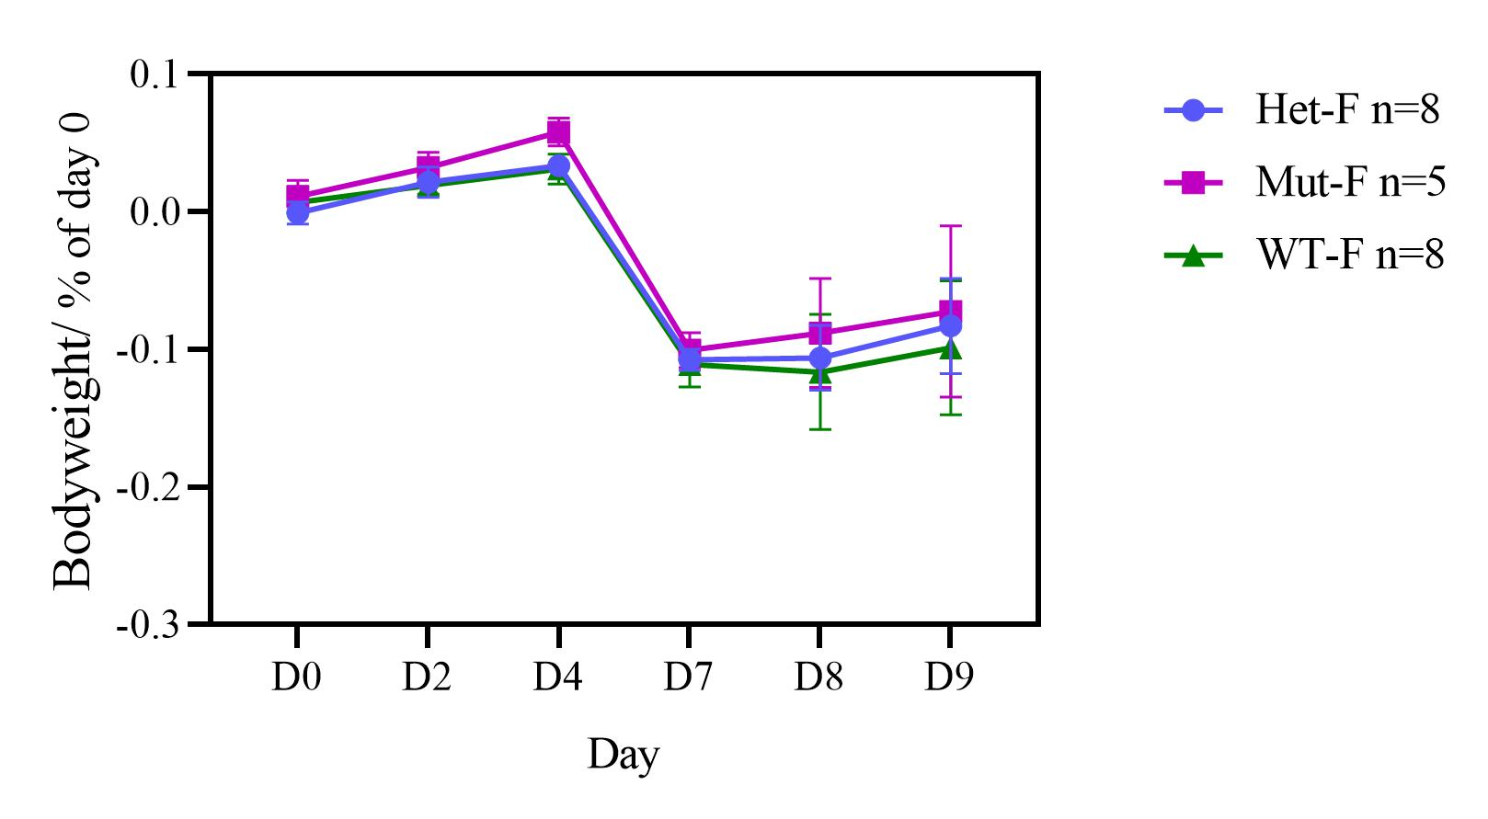
The bodyweight loss curve

Slide 4
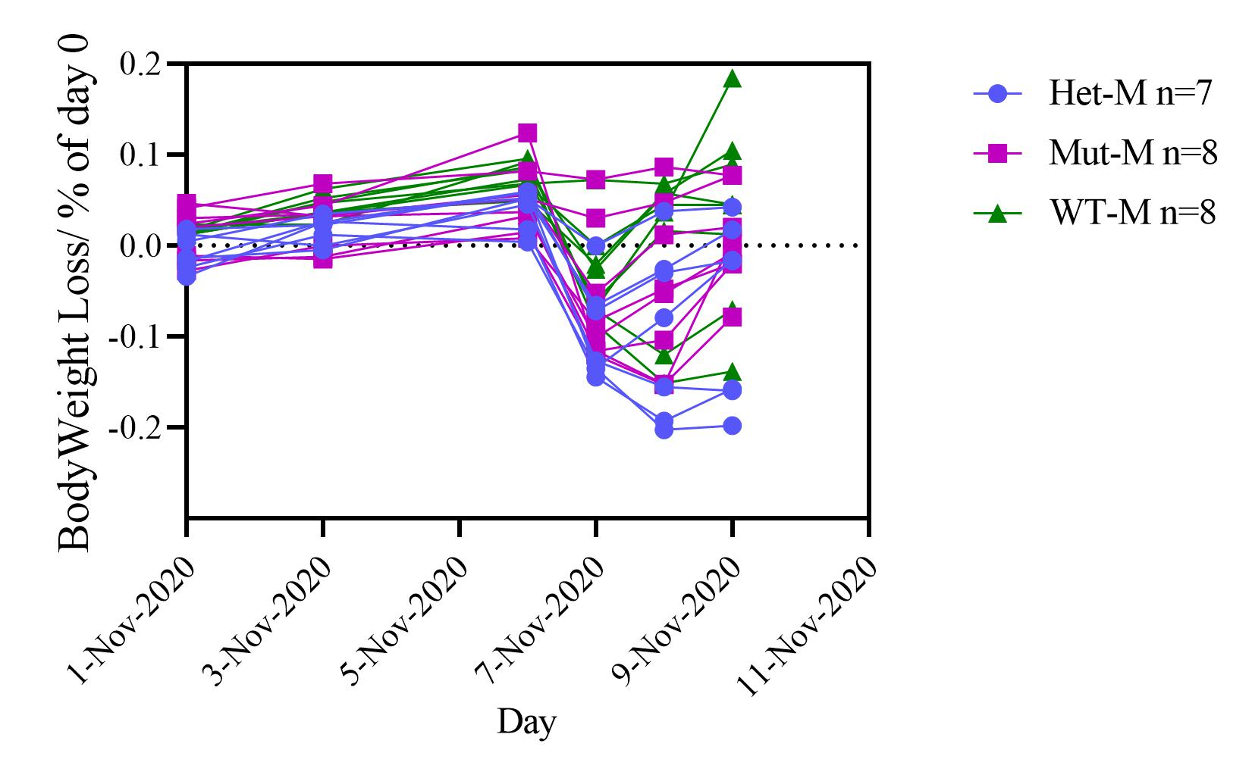
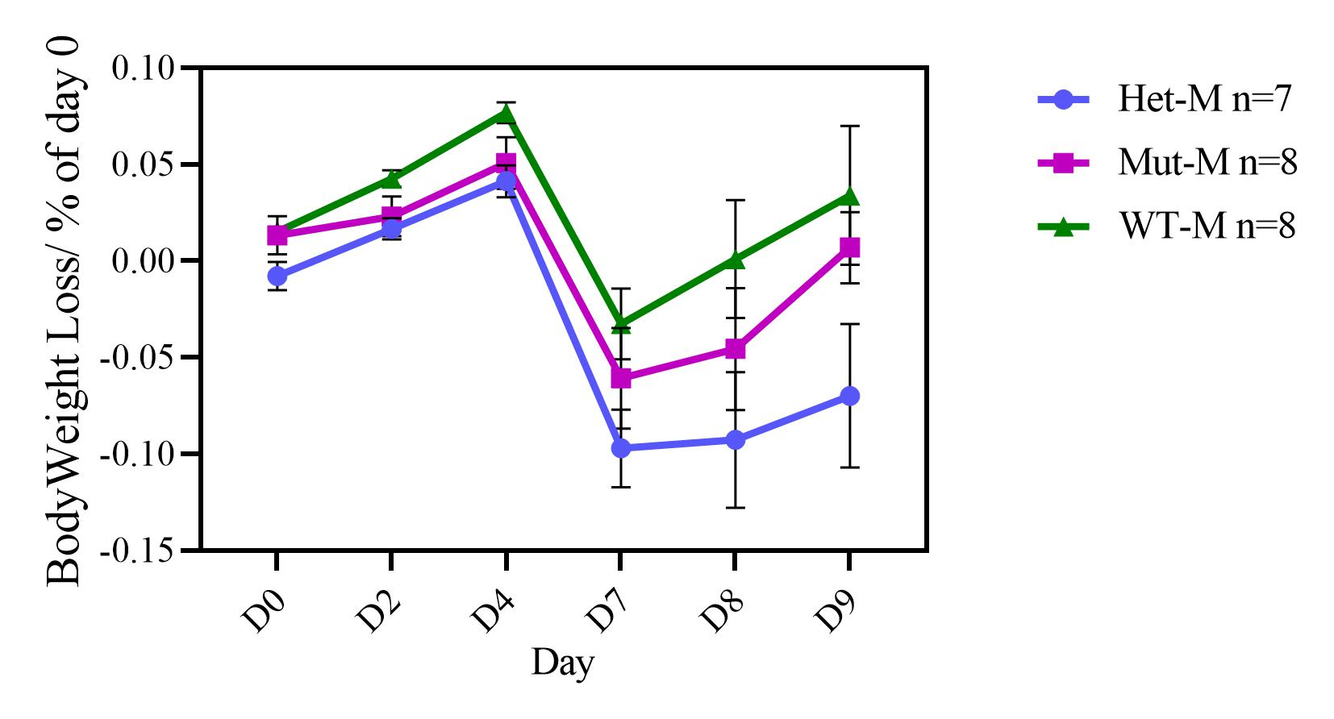
The bodyweight loss curve

Slide 5
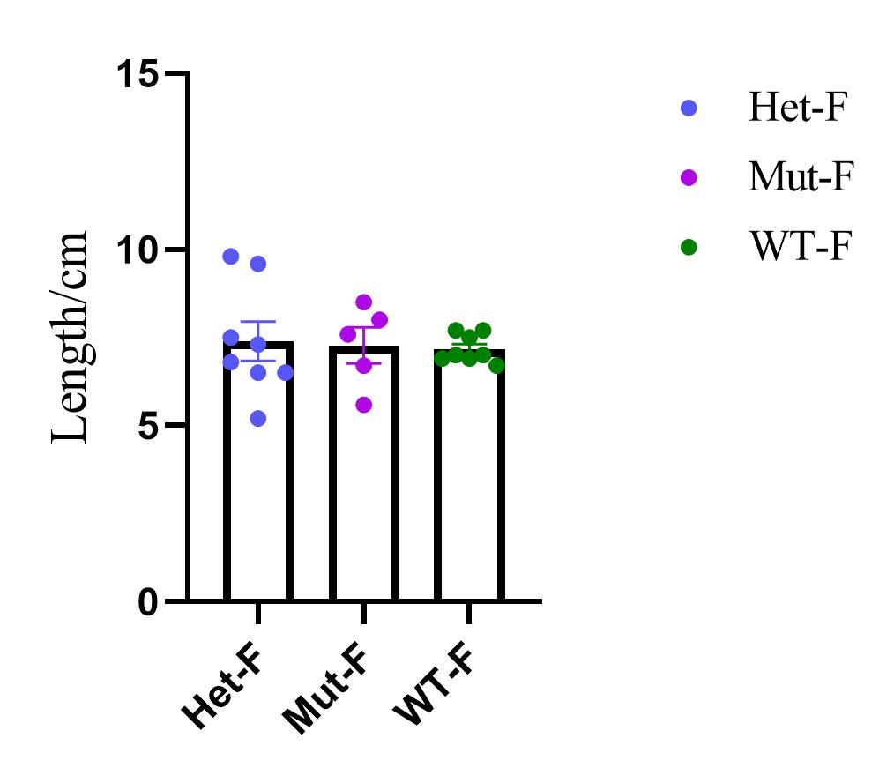
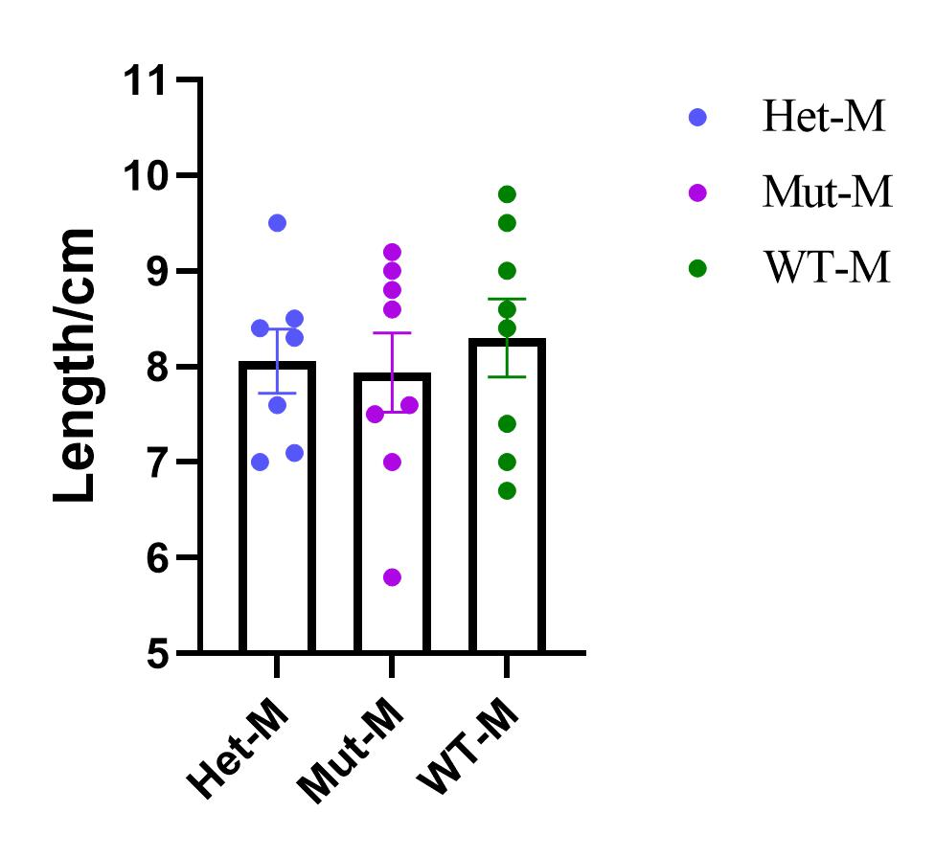
The colon length

Slide 6
Decision on Histology sample
All samples are ready to send to the Histology core
Colon only？(total number of colon is 44)

Slide 7
Next TNBS experiment
Genotype | Male | Male | Male | Total (including B1&2)
Het | 3 | 5 |  | 15
Mut | 3 | 2 | 2 | 15
Wt | 6 | 1 |  | 15
 | Batch3 (1 week later) | Batch4 (3 weeks later) | Batch5(4 weeks later)

