Slide 1
Credit Risk Analysis
By : Jacob Stallone

Slide 2
ABOUT ME
JACOB STALLONE
BACKGROUND IN ELECTRONICS ENGINEERING
DATA SCIENCE ETHUSIAST

Slide 3
Introduction
German Credit Risk.
Credit Scoring Rule.
If a new applicant is a good credit risk or a bad credit risk.

Slide 4
TARGET AUDIENCE
BORROWER
01
LENDER
02
BANK ANALYSTS
03
DATA SCIENCE ETHUSIAST
04

Slide 5
DATA
The German Credit data set
From UC Irvine Machine Learning Repository.
Contains observations on 30 variables for 1000 past applicants for credit.
Each applicant was rated as “good credit” (700 cases) or “bad credit” (300 cases).

Slide 6
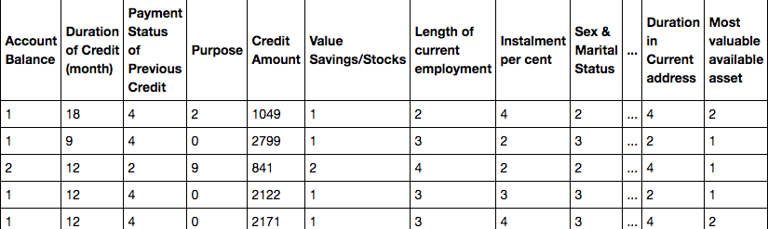
DATA OVERVIEW

Slide 7
METHODS
DATA CLEANING
DATA FEATURE ENGINEERING
DATA VISUALISATION
FEATURE SELECTION
MACHINE LEARNING MODELS FOR PREDICTION

Slide 8
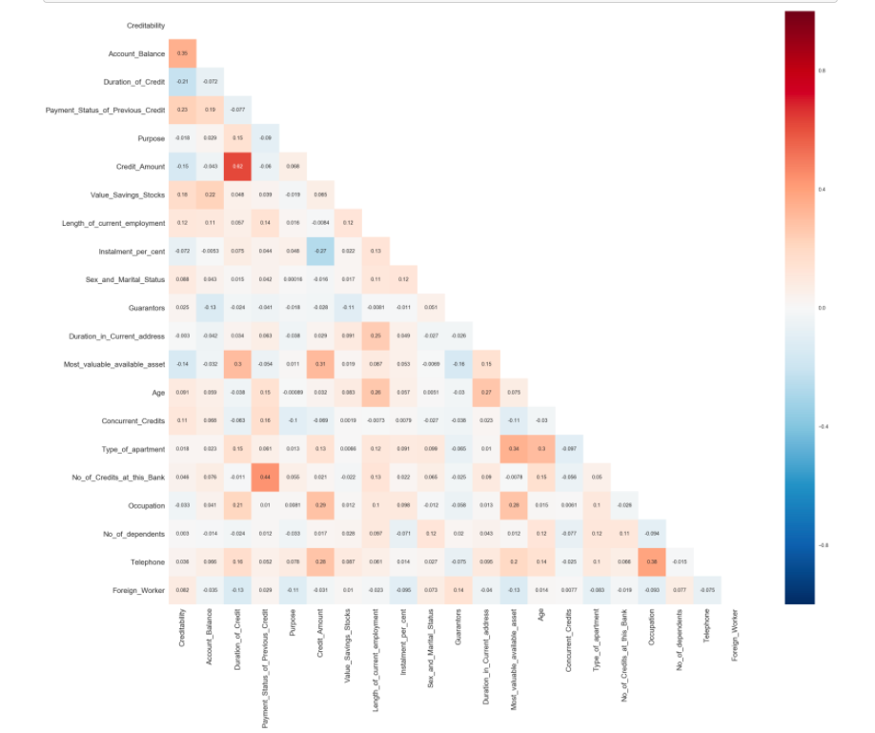
DATA VISUALISATION
Correlation
Not Lot of strong correlation
Categorical data

Slide 9
DATA VISUALISATION
Credit Amount vs Occupation

Slide 10
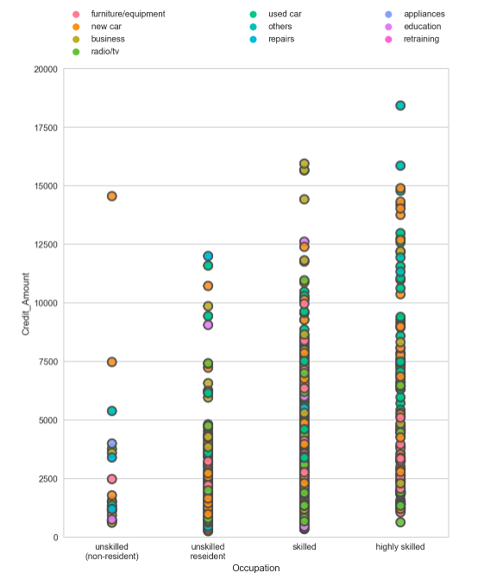
DATA VISUALISATION
Credit Amount vs Occupation
Purpose

Slide 11
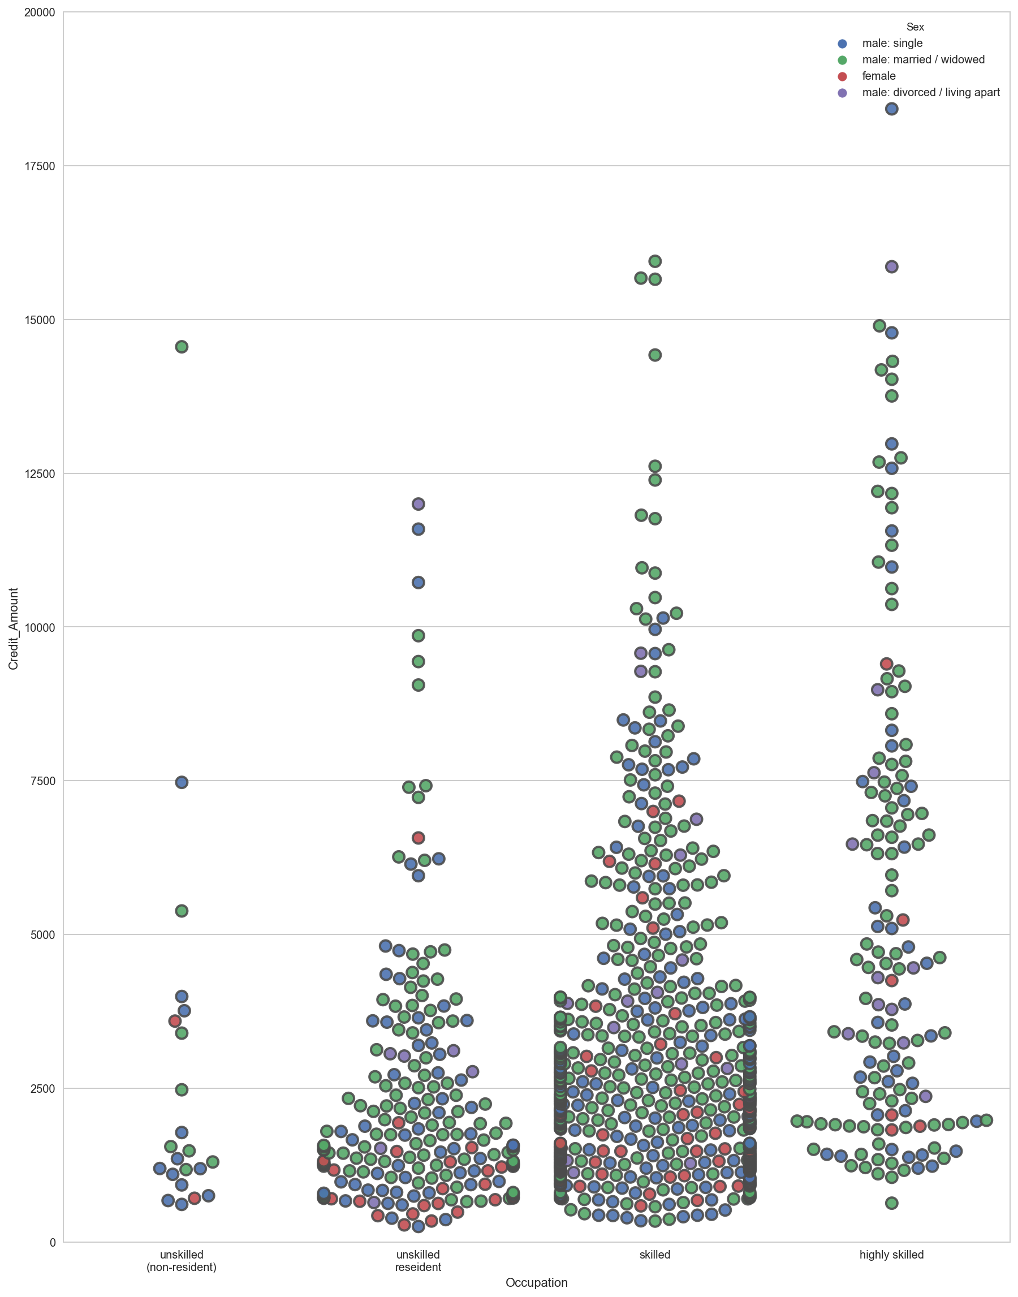
DATA VISUALISATION
Credit Amount vs Occupation
Gender

Slide 12
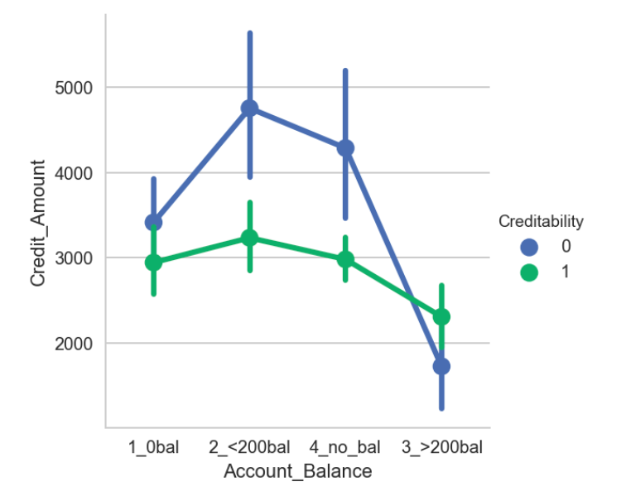
DATA VISUALISTAION
Credit Amount vs Account Balance.
Creditability

Slide 13
Machine learning Models
Ridge ,Lasso
1
Random forest , decision tree ,Xgboost, AdaBoost
2
KNN, Logistic regression , Support Vector Machine
3

Slide 14
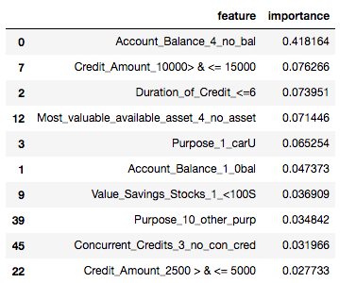
Decision Tree
Account Balance
Credit amount : 1000 > & <=15000
Duration of credit : <=6
Purpose : Used cars

Slide 15
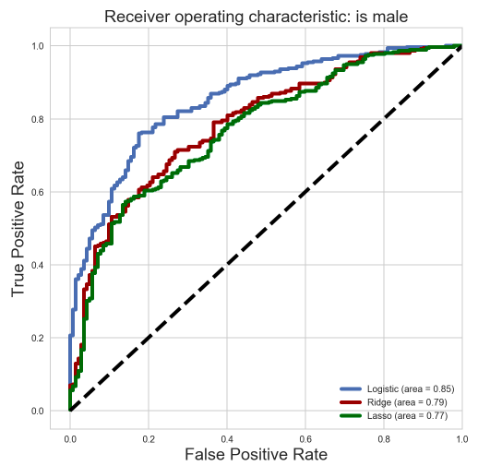
Model Accuracy

Slide 16
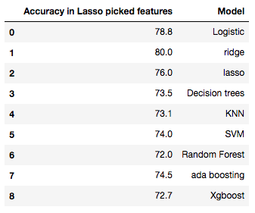
Model Accuracy
Best scores Between 78 to 85

Slide 17
INFERENCE AND IMPROVEMENT
Try other feature selection methods like PCA , ANOVA , CHI2
Model parameter tuning
A credit scoring model is just one of the factors used in evaluating a credit application. Assessment by a credit expert remains the decisive factor.

Slide 18
CONCLUSION & SUMMARY
DATA Mining
DATA Wrangling
EDA- Exploratory data analysis
Machine Learning Models

Slide 19
THANK YOU

