Slide 1
ANALYSIS OF THE DRUG DATA-SET
JACOB .S

Slide 2
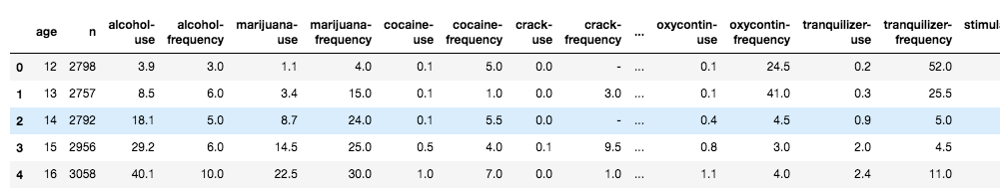
A VIEW OF THE DATA

Slide 3
DATA DESCRIPTION
AGE
DRUG-USE
DRUG-FREQUENCY

Slide 4
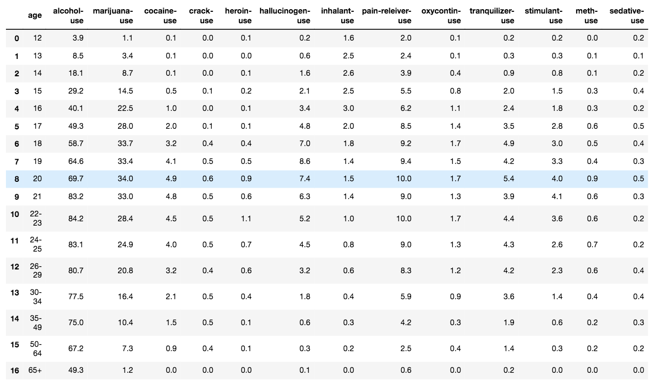
SEPERATING DRUG-USE

Slide 5
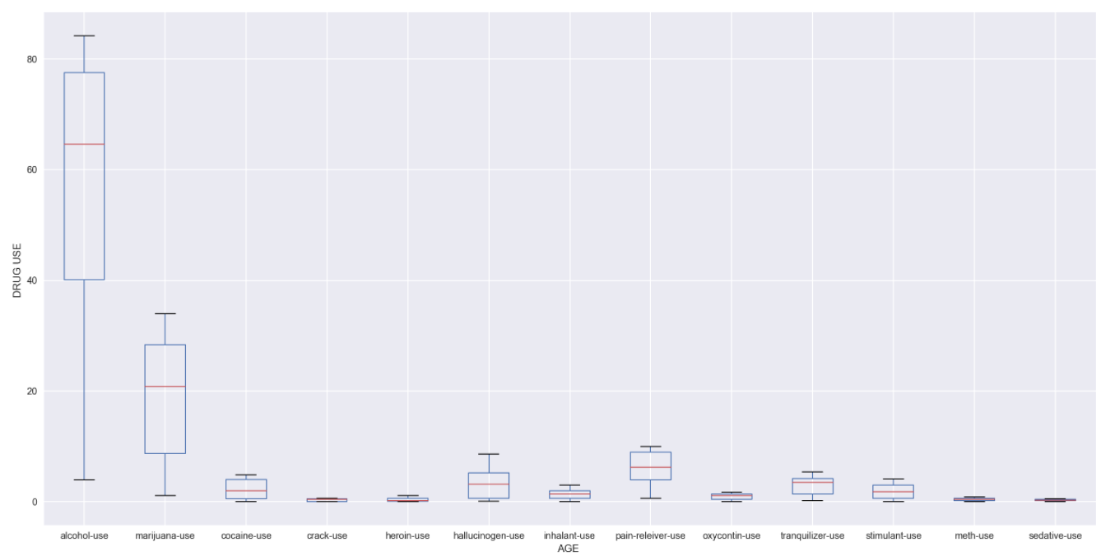
BOXPLOT-DRUG USE

Slide 6
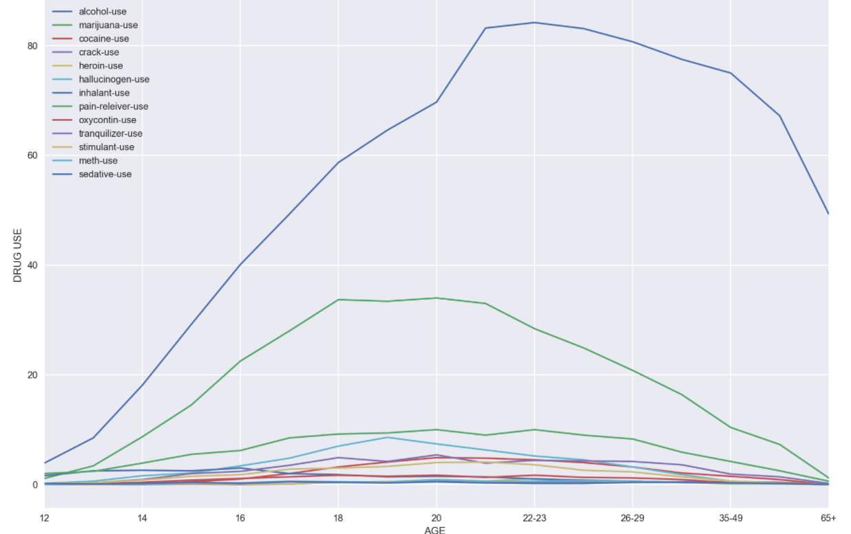
LINE PLOT – DRUG USE

Slide 7
FROM THE PLOTS :
Its clear that there is very high usage of alcohol & marijuana which increases with age .
There is an increase of overall drug usage from age 16 on-wards and starts to reduce at the group age 35-49

Slide 8
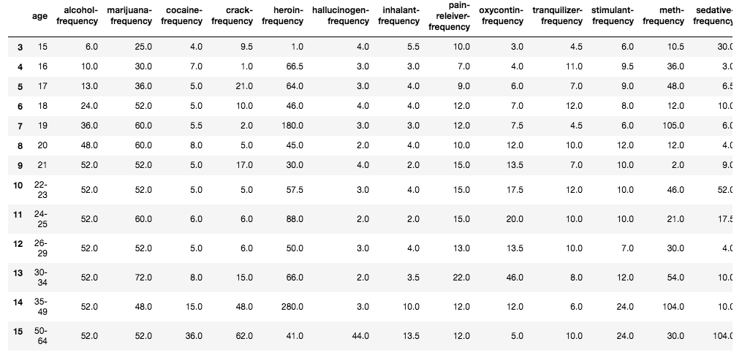
SEPERATING DRUG-FREQUENCY

Slide 9
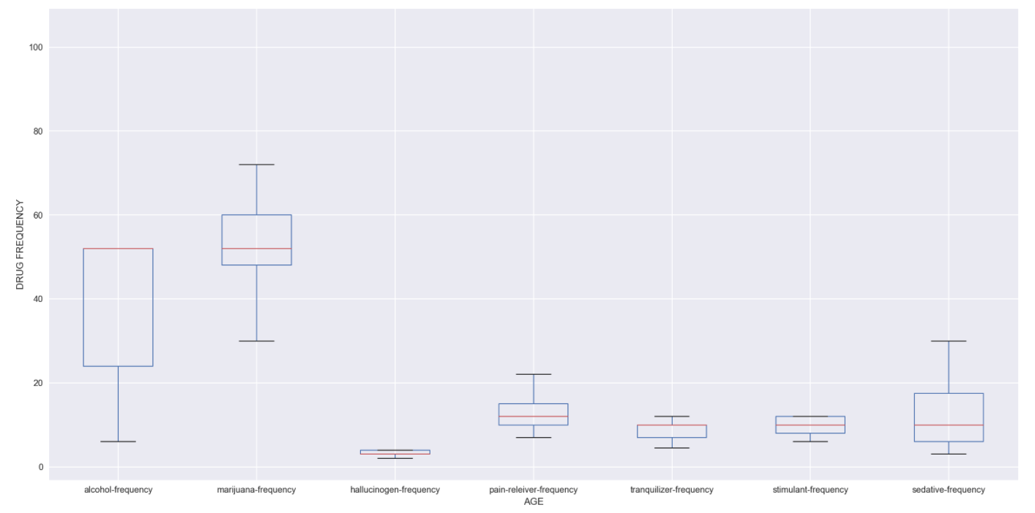
BOXPLOT-DRUG FREQUENCY

Slide 10
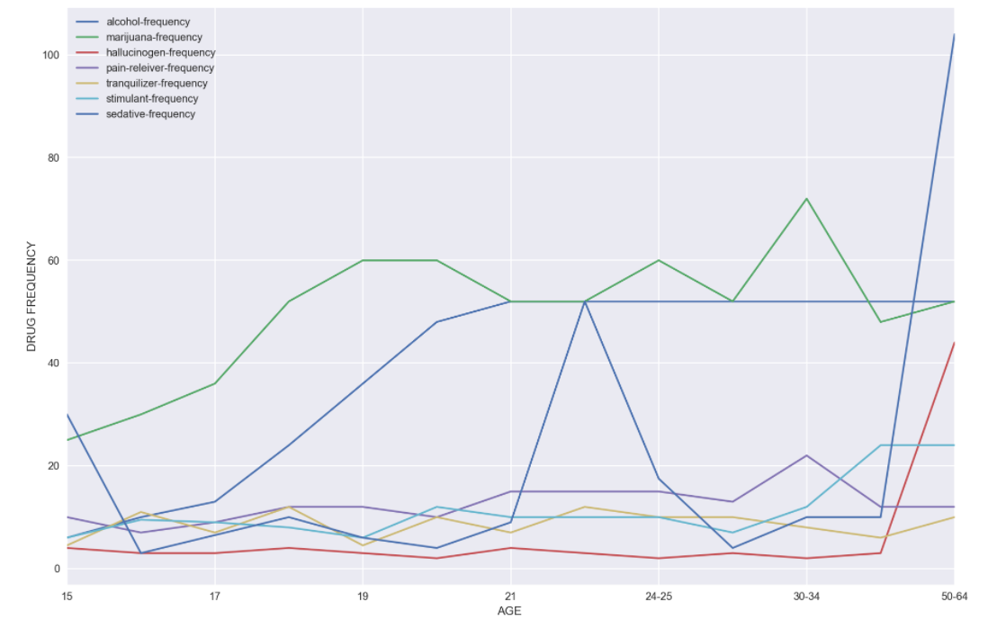
LINE PLOT – DRUG FREQUENCY

Slide 11
FROM THE PLOT :
There is a drastic increase in sedative-frequency and hallucinogen-frequency between the age 34 and 50.
Steady increase of frequency of drugs from age 17.
There is a drastic increase in the use of sedative-frequency from the age of 21.

Slide 12
HYPOTHESIS
The increase in the average use of a certain drug category can decrease the average use of another drug category
If there is a negative correlation between two drug category (use/frequency )

Slide 13
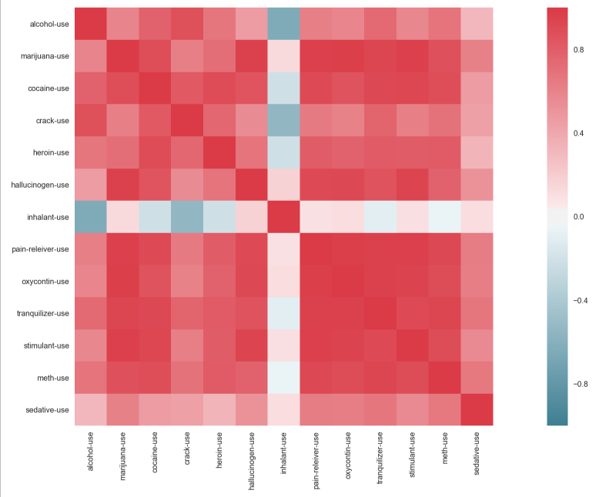
CORRELATION IN DRUG-USE IN HEATMAP

Slide 14
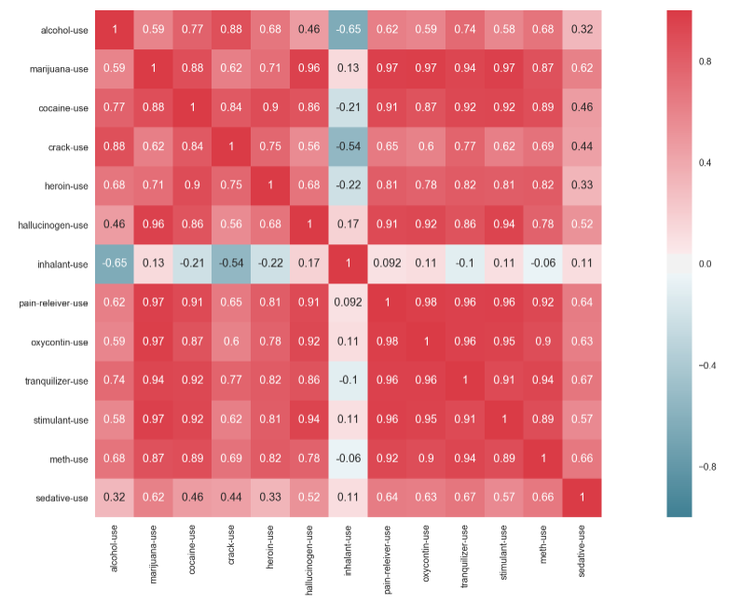
CORRELATION IN DRUG-USE IN HEATMAP

Slide 15
FROM THE PLOT:
There is a negative correlation between alcohol-use and inhalant-use of -0.65
The increase in the average use of a alcohol category can decrease the average use of another inhalant category
The increase in the average use of a inhalant category can decrease the average use of another alcohol category

Slide 16
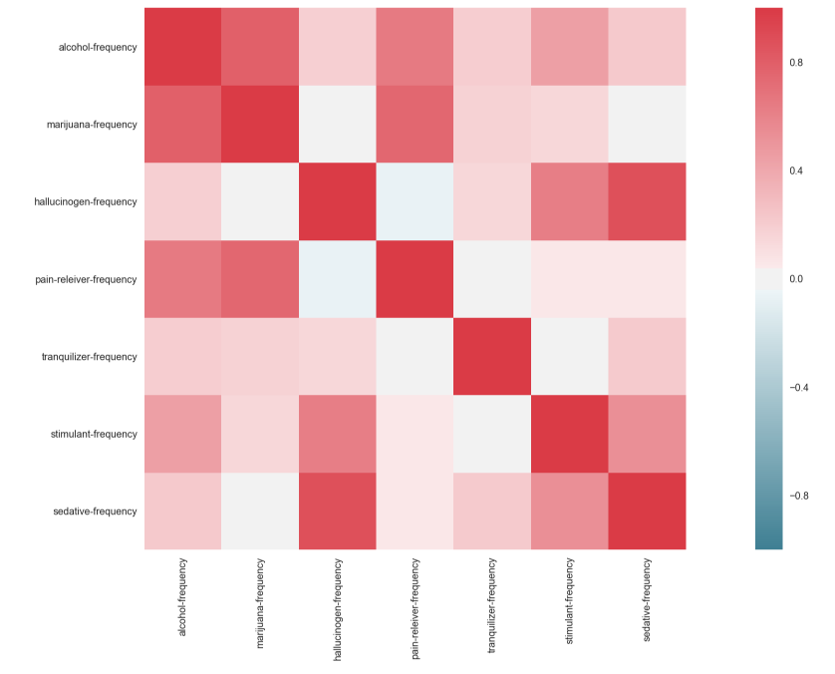
CORRELATION IN DRUG-FREQUENCY IN HEATMAP

Slide 17

CORRELATION IN DRUG-FREQUENCY IN HEATMAP

Slide 18
FROM THE PLOT:
No much negative correlation
Not much inferred.

Slide 19
COMBINING DRUG-USE AND DRUG-FREQUENCY
The original data

Slide 20
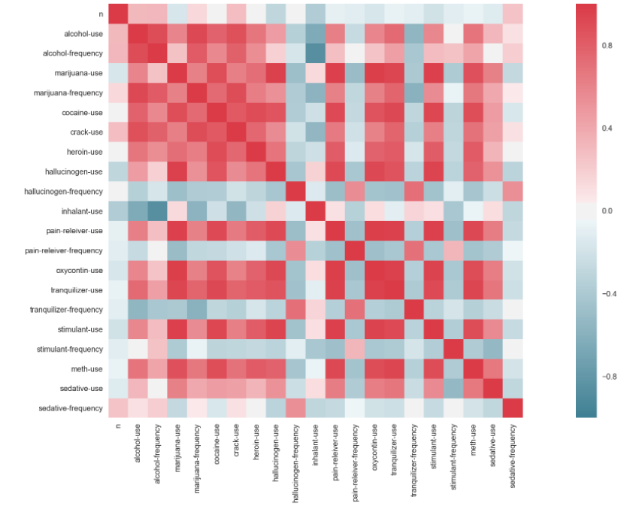
CORRELATION FOR THE DATA IN HEATMAP

Slide 21
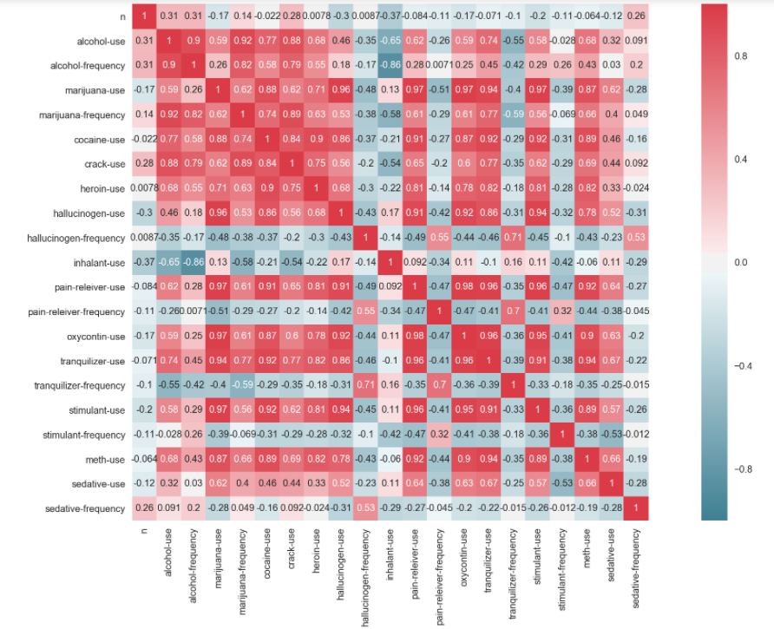
CORRELATION FOR THE DATA IN HEATMAP

Slide 22
FINAL RESULT ON THE HYPOTHESIS
There is strong negative correlation between inhalant-use and alcohol-frequency of -0.86
There is also a negative correlation between inhalant-use and alcohol-use of -0.65
The increase in the average use of a alcohol can reduce the average use of inhalant.
The increase in the average use of a inhalant can reduce the average use of alcohol.
The hypothesis is not rejected :The increase in the average use of a certain drug category can reduce the average use of another drug category.

Slide 23
Thank You

