Slide 1
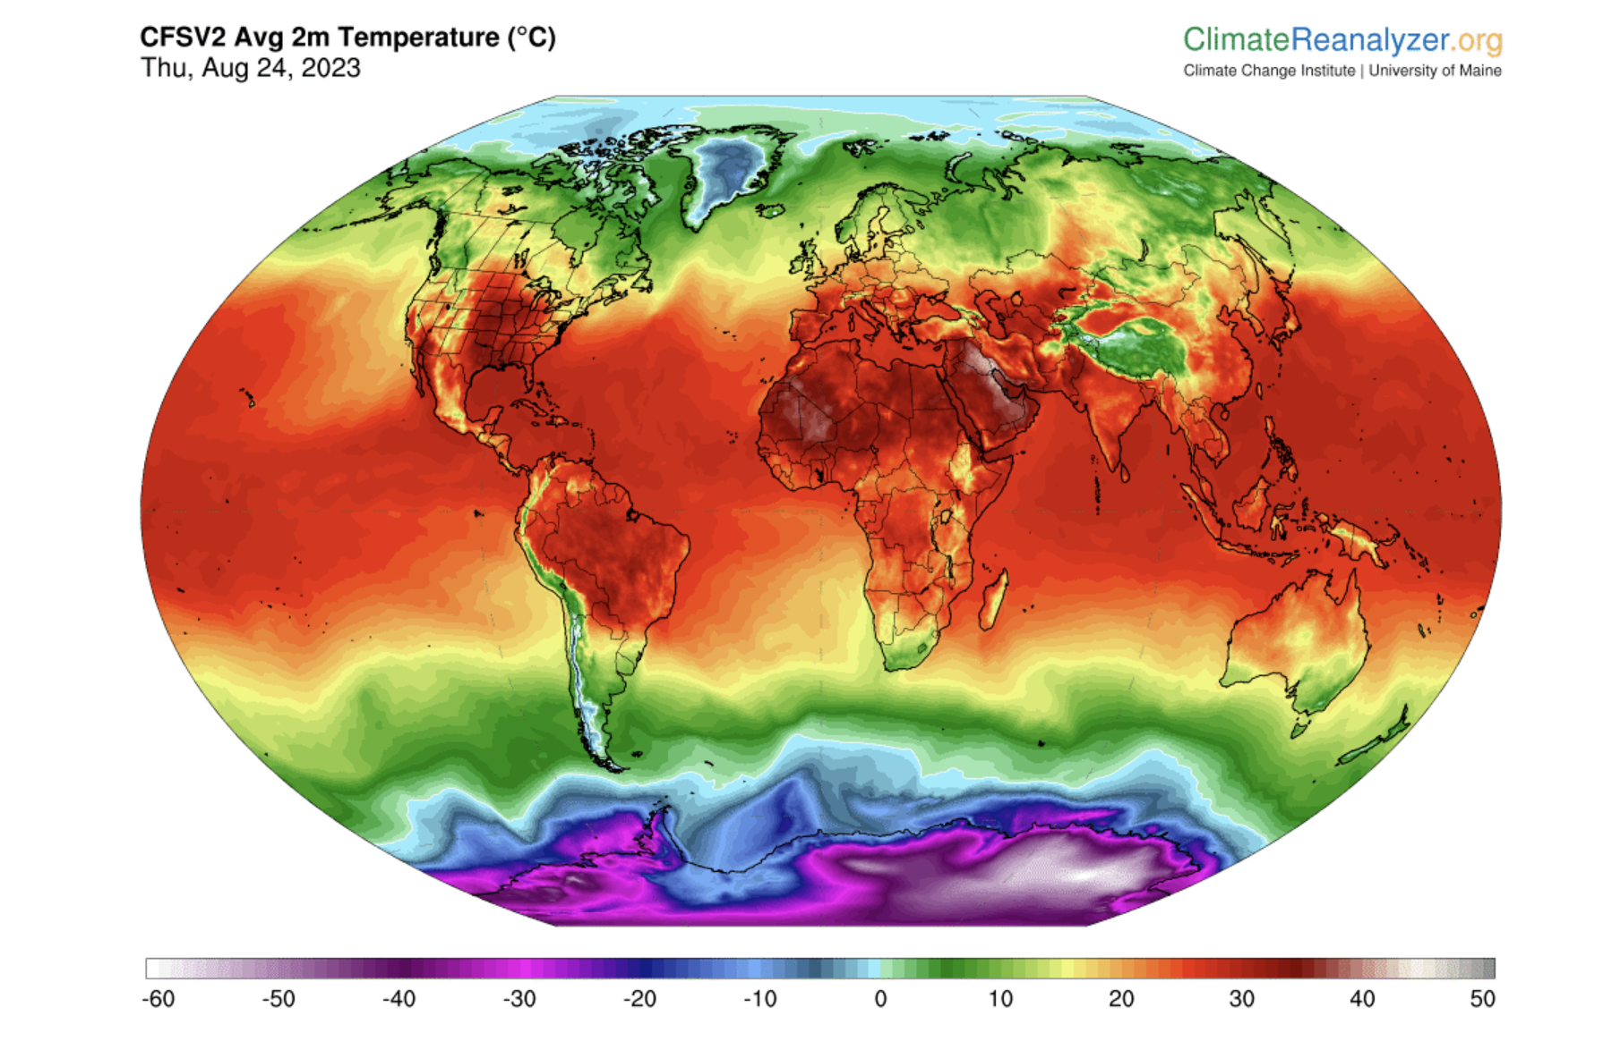
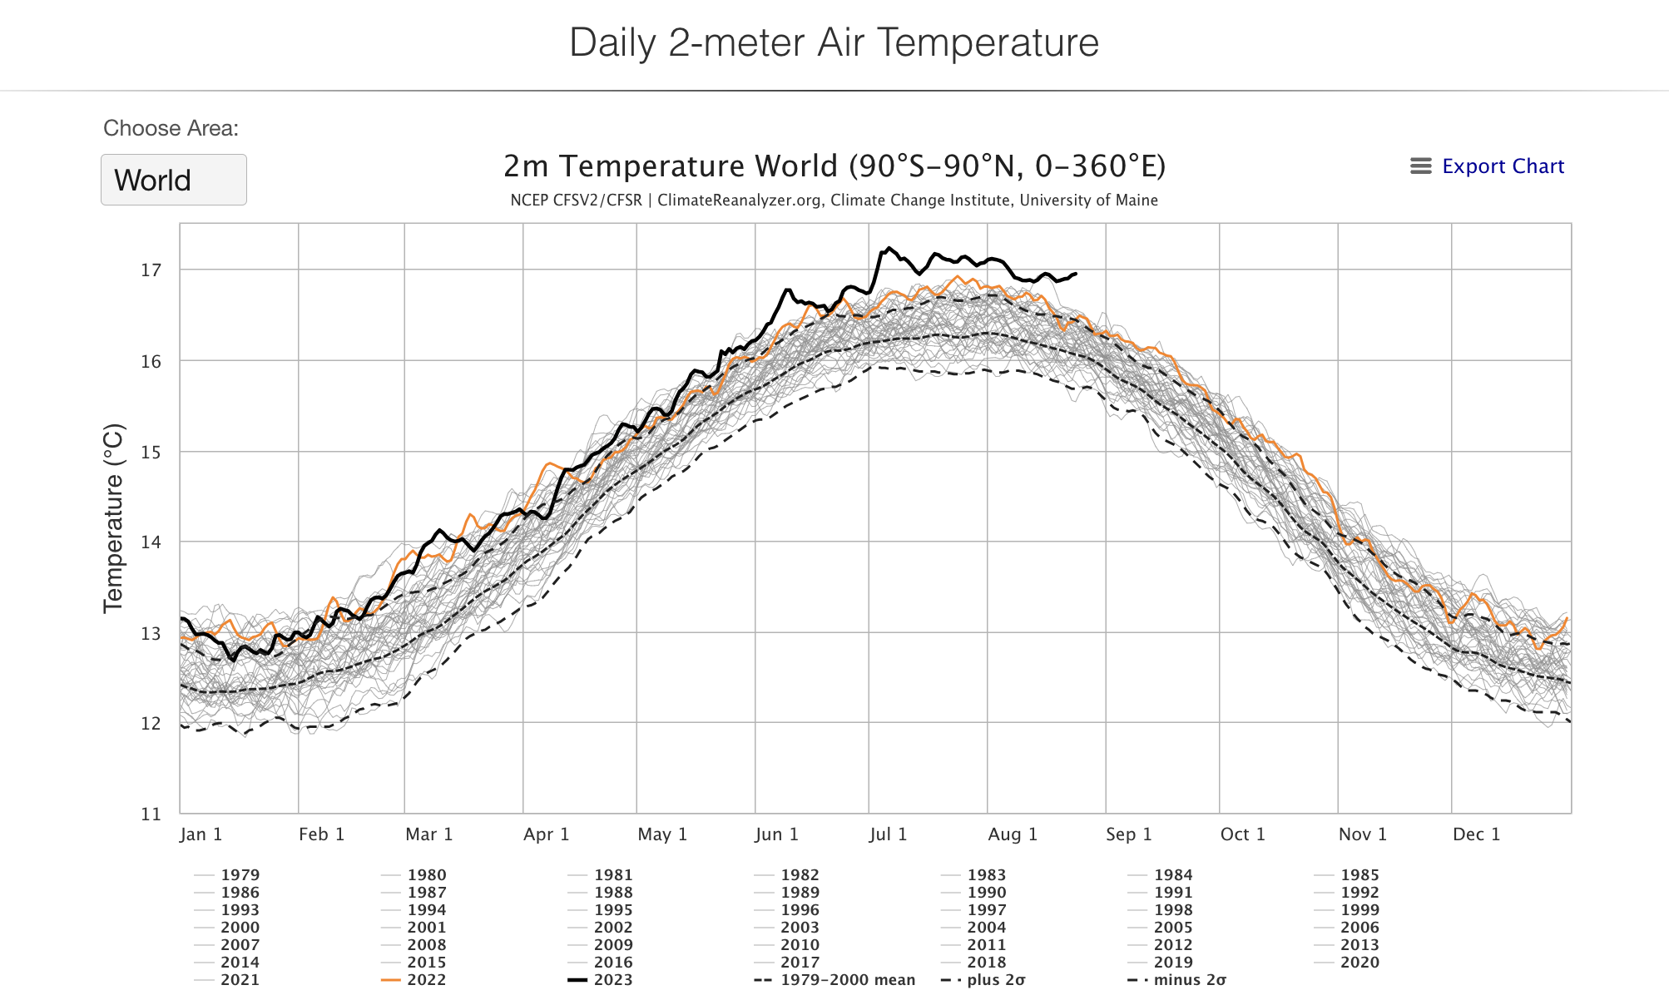
Data sources:
SST
Daily T2M Anomaly (
Monitoring

