Slide 1
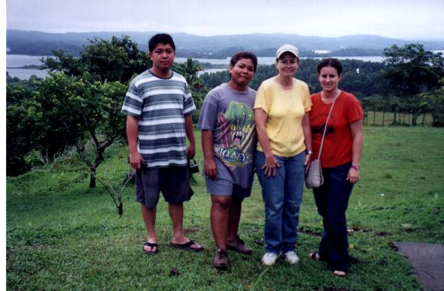
Maurine’s spot - Philippines, Pagsanjan Falls

Slide 2
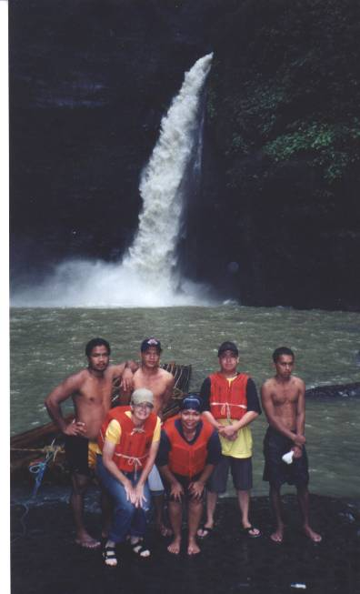
Pagsanjan Falls
Island of Luzon
Laguna Province
Pagsanjan City

Slide 3
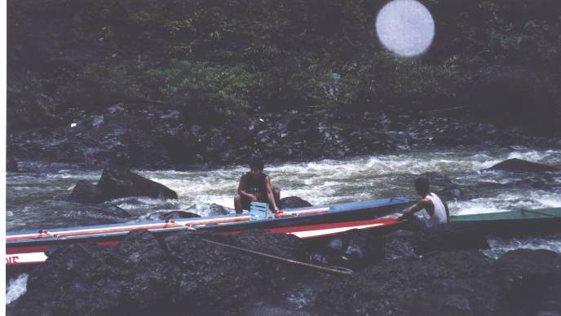
$20 per person for 2 hour boat ride to the falls – upstream
Four persons per banka (boat), 2 boatmen, 2 passengers.

