Slide 1
Our Favorite Vacation Spot
Jacob – Great Basin National Park
Maurine - Philippines, Pagsanjan Falls
Monica – Hampton Court London

Slide 2
Great Basin National Park
Jacob’s Camping Place

Slide 3
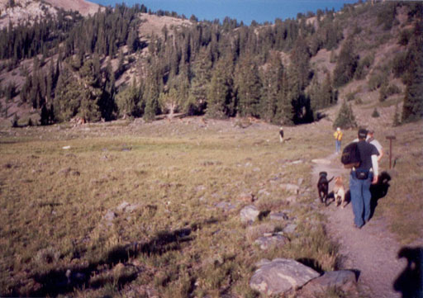
Great Basin National Park
Hiking
  Wheeler Peak
  Bristlecone Forest
  Glacier
  3 Lakes

Slide 4
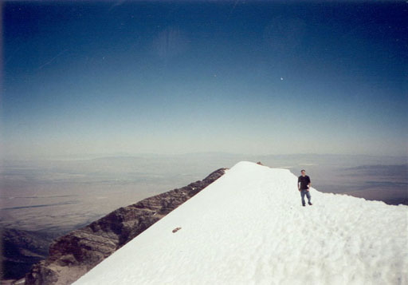
Great Basin National Park
Beautiful Scenery
Lehman Caves

Slide 5
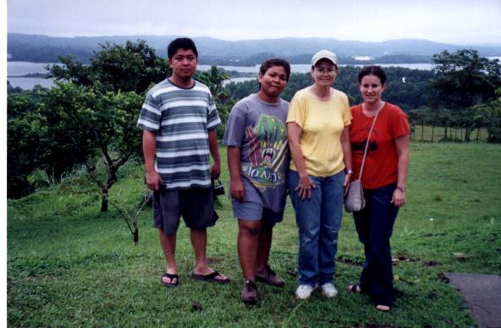
Maurine’s spot - Philippines, Pagsanjan Falls

Slide 6
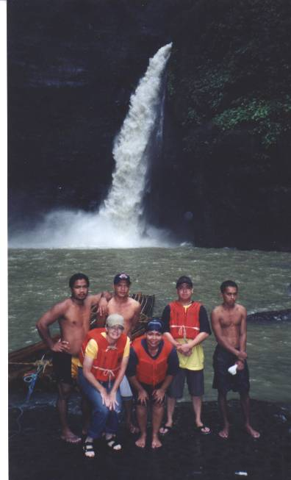
Pagsanjan Falls
Island of Luzon
Laguna Province
Pagsanjan City

Slide 7
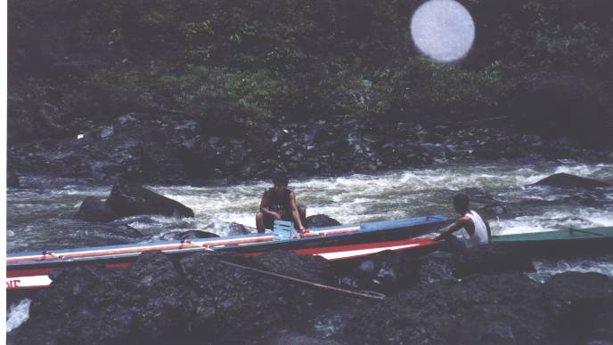
$20 per person for 2 hour boat ride to the falls – upstream
Four persons per banka (boat), 2 boatmen, 2 passengers.

Slide 8
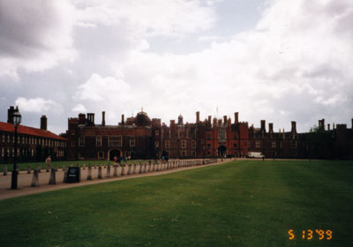
Hampton Court Palace
This beautiful palace is one of the few distractions London has to offer.
Hampton Court Palace has over 500 yrs of royal history. And it was once owned by Henry VIII and William III.
This beautiful place has a lot to offer visitors with its customed guides and audio tours it makes you feel like royalty.

Slide 9
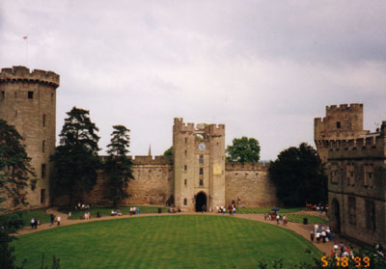
The Gardens
Hampton court Palaca also has the largest collection of art in the world.
The royal collection which now belongs to Queen Elizabeth II.
Its romantic towers will make you feel like you’re part of this enchanted world.

Slide 10
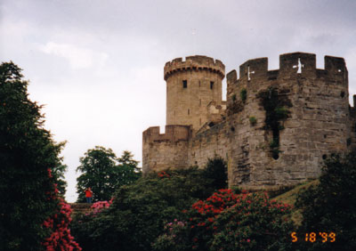
Romantic Towers
For more information to go www.hrp.org.uk
Tues.-Sun. 9:30-16:30 Last admission at 15:45
Adult 10.80 pounds Children under 5 yrs free
Students & seniors 8.30 pounds

