Slide 1

Chapter 2 Primitive Data Types and Operations
Basic computer skills such as using Windows,
Internet Explorer, and Microsoft
Word
Chapter 1 Introduction to Computers, Programs,
and Java
Chapter 2 Primitive Data Types and Operations
Chapter 3 Control Statements
Chapter 4 Methods
Chapter 5 Arrays

Slide 2
Objectives
To write Java programs to perform simple calculations (§2.2).
To use identifiers to name variables, constants, methods, and classes (§2.3).
To use variables to store data (§2.4-2.5).
To program with assignment statements and assignment expressions (§2.5).
To use constants to store permanent data (§2.6).
To declare Java primitive data types: byte, short, int, long, float, double, char, and boolean (§2.7 – 2.10).
To use Java operators to write expressions (§2.7 – 2.10).
To know the rules governing operand evaluation order, operator precedence, and operator associativity (§2.11 – 2.12).
To represent a string using the String type. (§2.13)
To obtain input using the JOptionPane input dialog boxes (§2.14).
To become familiar with Java documentation, programming style, and naming conventions (§2.18).
To distinguish syntax errors, runtime errors, and logic errors (§2.19).

Slide 3
Introducing Programming with an Example
Example 2.1 Computing the Area of a Circle
This program computes the area of the circle.

Slide 4
Identifiers
An identifier is a sequence of characters that consist of letters, digits, underscores (_), and dollar signs ($).
An identifier must start with a letter, an underscore (_), or a dollar sign ($). It cannot start with a digit.
  An identifier cannot be a reserved word. (See Appendix A, “Java Keywords,” for a list of reserved words).
An identifier cannot be true, false, or
null.
An identifier can be of any length.

Slide 5
Variables
// Compute the first area
radius = 1.0;
area = radius * radius * 3.14159;
System.out.println("The area is “ + area + " for radius "+radius);
// Compute the second area
radius = 2.0;
area = radius * radius * 3.14159;
System.out.println("The area is “ + area + " for radius "+radius);

Slide 6
Declaring Variables
int x; // Declare x to be an
// integer variable;
double radius; // Declare radius to
// be a double variable;
char a; // Declare a to be a
// character variable;

Slide 7
Assignment Statements
x = 1; // Assign 1 to x;
radius = 1.0; // Assign 1.0 to radius;
a = 'A'; // Assign 'A' to a;

Slide 8
Declaring and Initializing in One Step
int x = 1;
double d = 1.4;
float f = 1.4;
Is this statement correct?

Slide 9
Constants
final datatype CONSTANTNAME = VALUE;
final double PI = 3.14159;
final int SIZE = 3;

Slide 10
Primitive Data
There are exactly eight primitive data types in Java
Four of them represent integers:
  byte, short, int, long
Two of them represent floating point numbers:
  float, double
One of them represents characters:
  char
And one of them represents boolean values:
  boolean

Slide 11
Numeric Primitive Data
The difference between the various numeric primitive types is their size, and therefore the values they can store:
Type
byte
short
int
long
float
double
Storage
8 bits
16 bits
32 bits
64 bits
32 bits
64 bits
Min Value
-128
-32,768
-2,147,483,648
< -9 x 10¹⁸
+/- 3.4 x 10³⁸ with 7 significant digits
+/- 1.7 x 10³⁰⁸ with 15 significant digits
Max Value
127
32,767
2,147,483,647
> 9 x 10¹⁸

Slide 12
Operators
+, -, *, /, and %
5 / 2 yields an integer 2.
5.0 / 2 yields a double value 2.5
5 % 2 yields 1 (the remainder of the division)

Slide 13
Remainder Operator
Remainder is very useful in programming. For example, an even number % 2 is always 0 and an odd number % 2 is always 1. So you can use this property to determine whether a number is even or odd.

Slide 14
Integer Values
An integer value can be assigned to an integer variable as long as it can fit into the variable. A compilation error would occur if the value were too large for the variable to hold. For example, the statement byte b = 1000 would cause a compilation error, because 1000 cannot be stored in a variable of the byte type.
An integer value is assumed to be of the int type, whose value is between -2³¹ (-2147483648) to 2³¹–1 (2147483647). To denote an integer value of the long type, append it with the letter L or l. L is preferred because l (lowercase L) can easily be confused with 1 (the digit one).

Slide 15
Floating-Point Values
Floating-point values are written with a decimal point. By default, a floating-point value is treated as a double type value. For example, 5.0 is considered a double value, not a float value. You can make a number a float by appending the letter f or F, and make a number a double by appending the letter d or D. For example, you can use 100.2f or 100.2F for a float number, and 100.2d or 100.2D for a double number.

Slide 16
Scientific Notation
Floating-point literals can also be specified in scientific notation, for example, 1.23456e+2, same as 1.23456e2, is equivalent to 123.456, and 1.23456e-2 is equivalent to 0.0123456. E (or e) represents an exponent and it can be either in lowercase or uppercase.

Slide 17

Arithmetic Expressions
is translated to
(3+4*x)/5 – 10*(y-5)*(a+b+c)/x + 9*(4/x + (9+x)/y)

Slide 18
Shortcut Assignment Operators
Operator Example Equivalent
+= i+=8 i = i+8
-= f-=8.0 f = f-8.0
*= i*=8 i = i*8
/= i/=8 i = i/8
%= i%=8 i = i%8

Slide 19
Increment and
Decrement Operators
Operator Name Description
++var preincrement The expression (++var) increments var by 1 and evaluates
to the new value in var after the increment.
var++ postincrement The expression (var++) evaluates to the original value
in var and increments var by 1.
--var predecrement The expression (--var) decrements var by 1 and evaluates
to the new value in var after the decrement.
var-- postdecrement The expression (var--) evaluates to the original value
in var and decrements var by 1.

Slide 20
Increment and Decrement
When used alone in a statement, the prefix and postfix forms are functionally equivalent. That is,
count++;
is equivalent to
++count;
When used in a larger expression, the prefix and postfix forms have different effects
In both cases the variable is incremented (decremented)
But the value used in the larger expression depends on the form used:

Slide 21
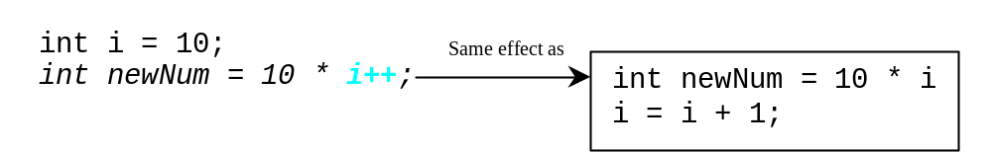
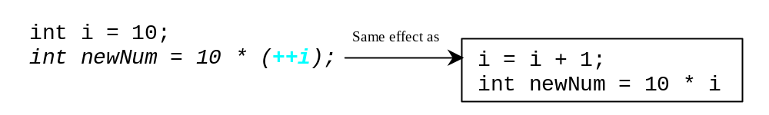
Increment and
Decrement Operators, cont.

Slide 22
Numeric Type Conversion
Consider the following statements:
byte i = 100;
long k = i * 3 + 4;
double d = i * 3.1 + k / 2;

Slide 23
Conversion Rules
When performing a binary operation involving two operands of different types, Java automatically converts the operand based on the following rules:
1. If one of the operands is double, the other is converted into double.
2. Otherwise, if one of the operands is float, the other is converted into float.
3. Otherwise, if one of the operands is long, the other is converted into long.
4. Otherwise, both operands are converted into int.

Slide 24
Type Casting
Implicit casting
double d = 3; (type widening)
Explicit casting
int i = (int)3.0; (type narrowing)
int i = (int)3.9; (Fraction part is truncated)
What is wrong? int x = 5 / 2.0;

Slide 25
Data Conversions
double a = 189.66;
float b = a/4;
float b = (float) a/4;
int c = b;
int c = (int) b;
int a = 8/4;
int b = 8/3;
float c = 8/3;
float d = (float) 8/3;
int a = 200;
byte c = (byte) a;
© 2004 Ted Han

Slide 26
Character Data Type
Four hexadecimal digits.
char letter = 'A'; (ASCII)
char numChar = '4'; (ASCII)
char letter = '\u0041'; (Unicode)
char numChar = '\u0034'; (Unicode)
NOTE: The increment and decrement operators can also be used on char variables to get the next or preceding Unicode character. For example, the following statements display character b.
  char ch = 'a';
  System.out.println(++ch);

Slide 27

Unicode Format
Java characters use Unicode, a 16-bit encoding scheme established by the Unicode Consortium to support the interchange, processing, and display of written texts in the world’s diverse languages. Unicode takes two bytes, preceded by \u, expressed in four hexadecimal numbers that run from '\u0000' to '\uFFFF'. So, Unicode can represent 65535 + 1 characters.
Unicode \u03b1 \u03b2 \u03b3 for three Greek letters

Slide 28
Escape Sequences for Special Characters
Description Escape Sequence Unicode
Backspace \b \u0008
Tab \t \u0009
Linefeed \n \u000A
Carriage return \r \u000D
Backslash \\ \u005C
Single Quote \' \u0027
Double Quote \" \u0022

Slide 29

Appendix B: ASCII Character Set
ASCII Character Set is a subset of the Unicode from \u0000 to \u007f

Slide 30

ASCII Character Set, cont.
ASCII Character Set is a subset of the Unicode from \u0000 to \u007f

Slide 31
Casting between char and Numeric Types
int i = 'a'; // Same as int i = (int)'a';
char c = 97; // Same as char c = (char)97;

Slide 32
The boolean Type and Operators
Often in a program you need to compare two values, such as whether i is greater than j. Java provides six comparison operators (also known as relational operators) in Table 2.5 that can be used to compare two values. The result of the comparison is a Boolean value: true or false.
boolean b = (1 > 2);

Slide 33
Comparison Operators
Operator Name
< less than
<= less than or equal to
> greater than
>= greater than or equal to
== equal to
!= not equal to

Slide 34
Boolean Operators
Operator Name
! not
&& and
|| or

Slide 35
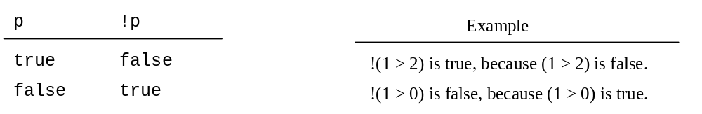
Truth Table for Operator !

Slide 36
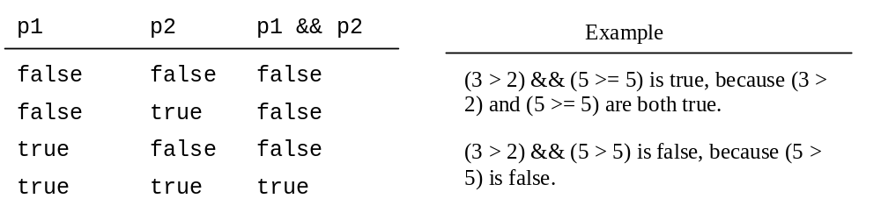
Truth Table for Operator &&

Slide 37
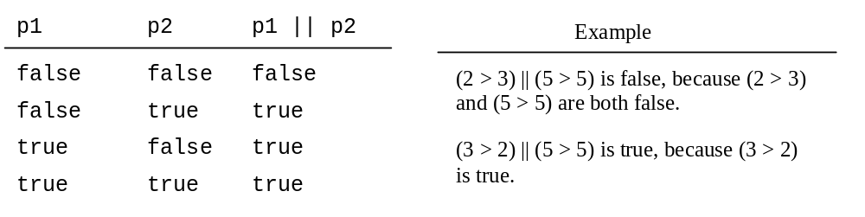
Truth Table for Operator ||

Slide 38
Examples
System.out.println("Is " + num + " divisible by 2 and 3? " +
((num % 2 == 0) && (num % 3 == 0)));
System.out.println("Is " + num + " divisible by 2 or 3? " +
((num % 2 == 0) || (num % 3 == 0)));

Slide 39
Operator Precedence
How to evaluate 3 + 4 * 4 > 5 * (4 + 3) – 1?
Multiplication, division, and remainder are evaluated prior to addition, subtraction, and string concatenation
Arithmetic operators with the same precedence are evaluated from left to right
Comparison operators have a lower precedence than arithmetic operators
Parentheses can be used to force the evaluation order

Slide 40
Assignment Revisited
The assignment operator has a lower precedence than the arithmetic operators or the comparison operators
First the expression on the right hand
side of the = operator is evaluated
answer = sum / 4 + MAX * lowest;
4
1
3
2
Then the result is stored in the
variable on the left hand side

Slide 41

Example
Applying the operator precedence and associativity rule, the expression 3 + 4 * 4 > 5 * (4 + 3) - 1 is evaluated as follows:

Slide 42
The String Type
The char type only represents one character. To represent a string of characters, use the data type called String. For example,
String message = "Welcome to Java";
String is actually a predefined class in the Java library just like the System class and JOptionPane class. The String type is not a primitive type. It is known as a reference type. Any Java class can be used as a reference type for a variable. Reference data types will be thoroughly discussed in Chapter 6, “Classes and Objects.” For the time being, you just need to know how to declare a String variable, how to assign a string to the variable, and how to concatenate strings.

Slide 43
String Concatenation
// Three strings are concatenated
String message = "Welcome " + "to " + "Java";
// String Chapter is concatenated with number 2
String s = "Chapter" + 2; // s becomes Chapter2
// String Supplement is concatenated with character B
String s1 = "Supplement" + 'B'; // s becomes SupplementB

Slide 44
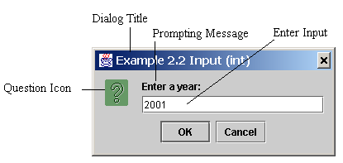
Getting Input from Input Dialog Boxes
String string = JOptionPane.showInputDialog(
null, “Prompting Message”, “Dialog Title”,
JOptionPane.QUESTION_MESSAGE));

Slide 45
Two Ways to Invoke the Method
There are several ways to use the showInputDialog method. For the time being, you only need to know two ways to invoke it.
One is to use a statement as shown in the example:
  String string = JOptionPane.showInputDialog(null, x,
  y, JOptionPane.QUESTION_MESSAGE));
where x is a string for the prompting message, and y is a string for the title of the input dialog box.
The other is to use a statement like this:
  JOptionPane.showMessageDialog(x);
where x is a string for the prompting message.

Slide 46
Converting Strings to Integers
The input returned from the input dialog box is a string. If you enter a numeric value such as 123, it returns “123”. To obtain the input as a number, you have to convert a string into a number.
To convert a string into an int value, you can use the static parseInt method in the Integer class as follows:
int intValue = Integer.parseInt(intString);
where intString is a numeric string such as “123”.

Slide 47
Converting Strings to Doubles
To convert a string into a double value, you can use the static parseDouble method in the Double class as follows:
double doubleValue =Double.parseDouble(doubleString);
where doubleString is a numeric string such as “123.45”.

Slide 48
Example 2.2
Entering Input from Dialog Boxes
This program first prompts the user to enter a year as an int value and checks if it is a leap year, it then prompts you to enter a double value and checks if it is positive.
A year is a leap year if it is divisible by 4 but not by 100, or it is divisible by 400.
((year % 4 == 0) && (year % 100 != 0)) || (year % 400 == 0)

Slide 49
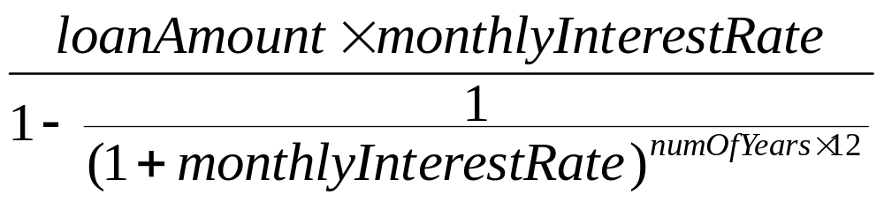
Example 2.3
Computing Loan Payments
This program lets the user enter the interest rate, number of years, and loan amount and computes monthly payment and total payment.

Slide 50
Example 2.4 Monetary Units
This program lets the user enter the amount in decimal representing dollars and cents and output a report listing the monetary equivalent in single dollars, quarters, dimes, nickels, and pennies. Your program should report maximum number of dollars, then the maximum number of quarters, and so on, in this order.

Slide 51
Example 2.5
Displaying Current Time
Write a program that displays current time in GMT in the format hour:minute:second such as 1:45:19.
The currentTimeMillis method in the System class returns the current time in milliseconds since the midnight, January 1, 1970 GMT. (1970 was the year when the Unix operating system was formally introduced.) You can use this method to obtain the current time, and then compute the current second, minute, and hour as follows.

Slide 52
Programming Style and Documentation
Appropriate Comments
Naming Conventions
Proper Indentation and Spacing Lines
Block Styles

Slide 53
Appropriate Comments
Include a summary at the beginning of the program to explain what the program does, its key features, its supporting data structures, and any unique techniques it uses.
Include your name, class section, instructor, date, and a brief description at the beginning of the program.

Slide 54
Naming Conventions
Choose meaningful and descriptive names.
Variables and method names:
  Use lowercase. If the name consists of several words, concatenate all in one, use lowercase for the first word, and capitalize the first letter of each subsequent word in the name. For example, the variables radius and area, and the method computeArea.

Slide 55
Naming Conventions, cont.
Class names:
  Capitalize the first letter of each word in the name. For example, the class name ComputeArea.
Constants:
  Capitalize all letters in constants, and use underscores to connect words. For example, the constant PI and MAX_VALUE

Slide 56
Proper Indentation and Spacing
Indentation
  Indent two spaces.
Spacing
  Use blank line to separate segments of the code.

Slide 57

Block Styles
Use end-of-line style for braces.

Slide 58
Programming Errors
Syntax Errors
  Detected by the compiler
Runtime Errors
  Causes the program to abort
Logic Errors
  Produces incorrect result

Slide 59
Syntax Errors
public class ShowSyntaxErrors {
public static void main(String[] args) {
i = 30;
System.out.println(i + 4);
}
}

Slide 60
Runtime Errors
public class ShowRuntimeErrors {
public static void main(String[] args) {
int i = 1 / 0;
}
}

Slide 61
Logic Errors
public class ShowLogicErrors {
// Determine if a number is between 1 and 100 inclusively
public static void main(String[] args) {
// Prompt the user to enter a number
String input = JOptionPane.showInputDialog(null,
"Please enter an integer:",
"ShowLogicErrors", JOptionPane.QUESTION_MESSAGE);
int number = Integer.parseInt(input);
// Display the result
System.out.println("The number is between 1 and 100, " +
"inclusively? " + ((1 < number) && (number < 100)));
System.exit(0);
}
}

