Slide 1

Chapter 4 Methods
Basic computer skills such as using Windows,
Internet Explorer, and Microsoft
Word
Chapter 1 Introduction to Computers, Programs,
and Java
Chapter 2 Primitive Data Types and Operations
Chapter 3 Control Statements
Chapter 4 Methods
Chapter 5 Arrays

Slide 2
Objectives
To create methods, invoke methods, and pass arguments to a method (§4.2-4.4).
To use method overloading and know ambiguous overloading (§4.5).
To determine the scope of local variables (§4.6).
To know how to use the methods in the Math class (§4.8-4.9).

Slide 3
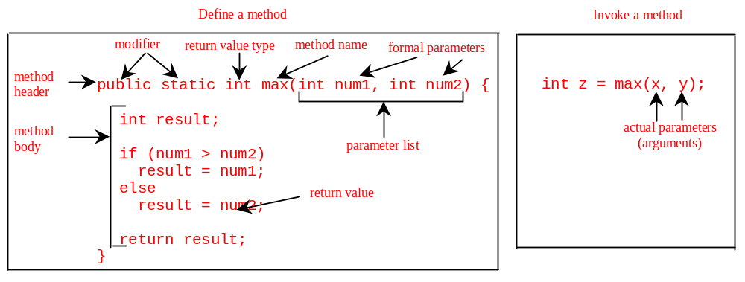
Introducing Methods
A method is a collection of statements that are grouped together to perform an operation.

Slide 4
Introducing Methods, cont.
Method signature is the combination of the method name and the parameter list.
The variables defined in the method header are known as formal parameters.
When a method is invoked, you pass a value to the parameter. This value is referred to as actual parameter or argument.

Slide 5
Introducing Methods, cont.
A method may return a value. The returnValueType is the data type of the value the method returns. If the method does not return a value, the returnValueType is the keyword void. For example, the returnValueType in the main method is void.

Slide 6
Calling Methods
Example 4.1 Testing the max method
This program demonstrates calling a method max to return the largest of the int values

Slide 7
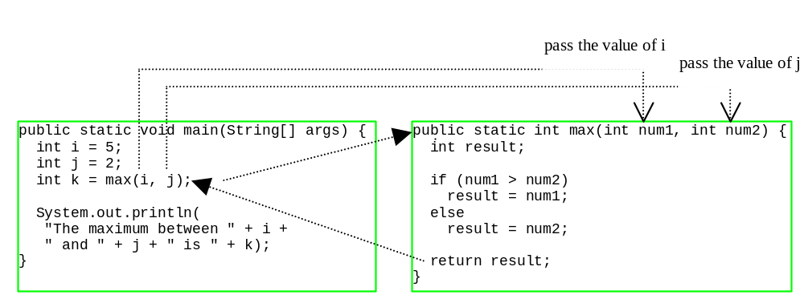
Calling Methods, cont.

Slide 8
CAUTION
A return statement is required for a nonvoid method. The following method is logically correct, but it has a compilation error, because the Java compiler thinks it possible that this method does not return any value.
public static int sign(int n) {
if (n > 0) return 1;
else if (n == 0) return 0;
else if (n < 0) return –1;
}
To fix this problem, delete if (n<0) in the code.

Slide 9
Reuse Methods from Other Classes
NOTE: One of the benefits of methods is for reuse. The max method can be invoked from any class besides TestMax. If you create a new class Test, you can invoke the max method using ClassName.methodName (i.e., TestMax.max).

Slide 10
Passing Parameters
public static void nPrintln(String message, int n) {
for (int i = 0; i < n; i++)
System.out.println(message);
}
Suppose you invoke the method using
  nPrintln(“Welcome to Java”, 5);
What is the output?
Suppose you invoke the method using
  nPrintln(“Computer Science”, 15);
What is the output?

Slide 11
Overloading Methods
Example 4.3 Overloading the max Method
public static double max(double num1, double num2) {
if (num1 > num2)
return num1;
else
return num2;
}

Slide 12
Ambiguous Invocation
Sometimes there may be two or more possible matches for an invocation of a method, but the compiler cannot determine the most specific match. This is referred to as ambiguous invocation. Ambiguous invocation is a compilation error.

Slide 13
Ambiguous Invocation
public class AmbiguousOverloading {
public static void main(String[] args) {
System.out.println(max(1, 2));
}
public static double max(int num1, double num2) {
if (num1 > num2)
return num1;
else
return num2;
}
public static double max(double num1, int num2) {
if (num1 > num2)
return num1;
else
return num2;
}
}

Slide 14
Example 4.4 Computing Taxes with Methods
Example 3.1, “Computing Taxes,” uses if statements to check the filing status and computes the tax based on the filing status. Simplify Example 3.1 using methods. Each filing status has six brackets.
The code for computing taxes is nearly same for each filing status except that each filing status has different bracket ranges. For example, the single filer status has six brackets [0, 6000], (6000, 27950], (27950, 67700], (67700, 141250], (141250, 307050], (307050, ∞), and the married file jointly status has six brackets [0, 12000], (12000, 46700], (46700, 112850], (112850, 171950], (171950, 307050], (307050, ∞).

Slide 15
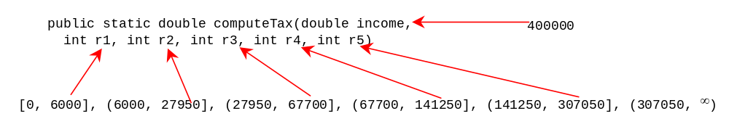
Example 4.4 cont.
The first bracket of each filing status is taxed at 10%, the second 15%, the third 27%, the fourth 30%, the fifth 35%, and the sixth 38.6%. So you can write a method with the brackets as arguments to compute the tax for the filing status. The signature of the method is:
For example, you can invoke computeTax(400000, 6000, 27950, 67700, 141250, 307050) to compute the tax for single filers with $400,000 of taxable income:

Slide 16
Scope of Local Variables
A local variable: a variable defined inside a method.
Scope: the part of the program where the variable can be referenced.
The scope of a local variable starts from its declaration and continues to the end of the block that contains the variable. A local variable must be declared before it can be used.

Slide 17
Scope of Local Variables, cont.
You can declare a local variable with the same name multiple times in different non-nesting blocks in a method, but you cannot declare a local variable twice in nested blocks.

Slide 18

Scope of Local Variables, cont.
A variable declared in the initial action part of a for loop header has its scope in the entire loop. But a variable declared inside a for loop body has its scope limited in the loop body from its declaration and to the end of the block that contains the variable.

Slide 19
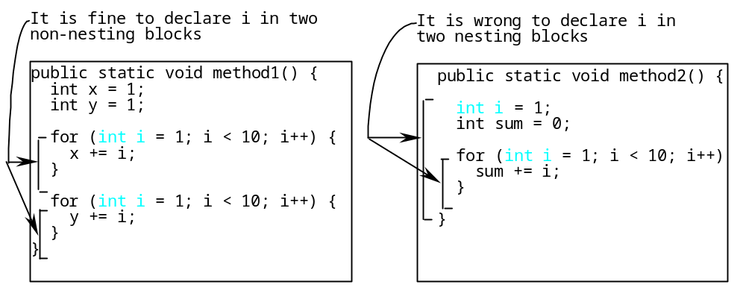
Scope of Local Variables, cont.

Slide 20
Scope of Local Variables, cont.
// Fine with no errors
public static void correctMethod() {
int x = 1;
int y = 1;
// i is declared
for (int i = 1; i < 10; i++) {
x += i;
}
// i is declared again
for (int i = 1; i < 10; i++) {
y += i;
}
}

Slide 21
Scope of Local Variables, cont.
// With no errors
public static void incorrectMethod() {
int x = 1;
int y = 1;
for (int i = 1; i < 10; i++) {
int x = 0;
x += i;
}
}

Slide 22
The Math Class
Class constants:
  PI
  E
Class methods:
  Trigonometric Methods
  Exponent Methods
  Rounding Methods
  min, max, abs, and random Methods

Slide 23
Trigonometric Methods
sin(double a)
cos(double a)
tan(double a)
acos(double a)
asin(double a)
atan(double a)
Examples:
Math.sin(0) returns 0.0
Math.sin(Math.PI / 6) returns 0.5
Math.sin(Math.PI / 2) returns 1.0
Math.cos(0) returns 1.0
Math.cos(Math.PI / 6) returns 0.866
Math.cos(Math.PI / 2) returns 0
Radians
toRadians(90)

Slide 24
Exponent Methods
exp(double a)
  Returns e raised to the power of a.
log(double a)
  Returns the natural logarithm of a.
pow(double a, double b)
  Returns a raised to the power of b.
sqrt(double a)
  Returns the square root of a.
Examples:
Math.pow(2, 3) returns 8.0
Math.pow(3, 2) returns 9.0
Math.pow(3.5, 2.5) returns 22.91765
Math.sqrt(4) returns 2.0
Math.sqrt(10.5) returns 3.24

Slide 25
Rounding Methods
double ceil(double x)
  x rounded up to its nearest integer. This integer is returned as a double value.
double floor(double x)
  x is rounded down to its nearest integer. This integer is returned as a double value.
double rint(double x)
  x is rounded to its nearest integer. If x is equally close to two integers, the even one is returned as a double.
int round(float x)
  Return (int)Math.floor(x+0.5).
long round(double x)
  Return (long)Math.floor(x+0.5).

Slide 26
Rounding Methods Examples
Math.ceil(2.1) returns 3.0
Math.ceil(2.0) returns 2.0
Math.ceil(-2.0) returns –2.0
Math.ceil(-2.1) returns -2.0
Math.floor(2.1) returns 2.0
Math.floor(2.0) returns 2.0
Math.floor(-2.0) returns –2.0
Math.floor(-2.1) returns -3.0
Math.rint(2.1) returns 2.0
Math.rint(2.0) returns 2.0
Math.rint(-2.0) returns –2.0
Math.rint(-2.1) returns -2.0
Math.rint(2.5) returns 2.0
Math.rint(-2.5) returns -2.0
Math.round(2.6f) returns 3
Math.round(2.0) returns 2
Math.round(-2.0f) returns -2
Math.round(-2.6) returns -3

Slide 27
min, max, and abs
max(a, b)and min(a, b)
  Returns the maximum or minimum of two parameters.
abs(a)
  Returns the absolute value of the parameter.
random()
  Returns a random double value
  in the range [0.0, 1.0).
Examples:
Math.max(2, 3) returns 3
Math.max(2.5, 3) returns 3.0
Math.min(2.5, 3.6) returns 2.5
Math.abs(-2) returns 2
Math.abs(-2.1) returns 2.1

Slide 28

The random Methods
Generates a random double value greater than or equal to 0.0 and less than 1.0 (0 <= Math.random() < 1.0).
Examples:
In general,

Slide 29
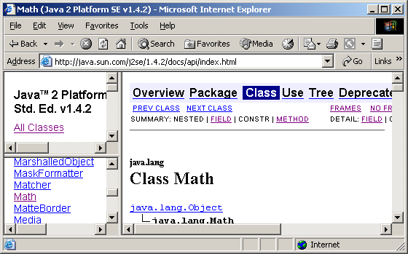
View java.lang.Math Documentation
You can view the complete documentation for the Math class online from http://java.sun.com/j2se/1.4.2/docs/api/index.htm.

Slide 30
Case Study: Generating Random Characters
Computer programs process numerical data and characters. You have seen many examples involve numerical data. It is also important to understand characters and how to process them.
As introduced in Section 2.9, each character has a unique Unicode between 0 and FFFF in hexadecimal (65535 in decimal). To generate a random character is to generate a random integer between 0 and 65535 using the following expression: (note that since 0 <= Math.random() < 1.0, you have to add 1 to 65535.)
  (int)(Math.random() * (65535 + 1))

Slide 31
Case Study: Generating Random Characters, cont.
Now let us consider how to generate a random lowercase letter. The Unicode for lowercase letters are consecutive integers starting from the Unicode for 'a', then for 'b', 'c', ..., and 'z'. The Unicode for 'a' is
  (int)'a'
So, a random integer between (int)'a' and (int)'z' is
  (int)((int)'a' + Math.random() * ((int)'z' - (int)'a' + 1)

Slide 32
Case Study: Generating Random Characters, cont.
Now let us consider how to generate a random lowercase letter. The Unicode for lowercase letters are consecutive integers starting from the Unicode for 'a', then for 'b', 'c', ..., and 'z'. The Unicode for 'a' is
  (int)'a'
So, a random integer between (int)'a' and (int)'z' is
  (int)((int)'a' + Math.random() * ((int)'z' - (int)'a' + 1)

Slide 33
Case Study: Generating Random Characters, cont.
As discussed in Section 2.9.4, all numeric operators can be applied to the char operands. The char operand is cast into a number if the other operand is a number or a character. So, the preceding expression can be simplified as follows:
  'a' + Math.random() * ('z' - 'a' + 1)
So a random lowercase letter is
  (char)('a' + Math.random() * ('z' - 'a' + 1))

Slide 34
Case Study: Generating Random Characters, cont.
To generalize the foregoing discussion, a random character between any two characters ch1 and ch2 with ch1 < ch2 can be generated as follows:
  (char)(ch1 + Math.random() * (ch2 – ch1 + 1))

Slide 35
The RandomCharacter Class
// RandomCharacter.java: Generate random characters
public class RandomCharacter {
/** Generate a random character between ch1 and ch2 */
public static char getRandomCharacter(char ch1, char ch2) {
return (char)(ch1 + Math.random() * (ch2 - ch1 + 1));
}
/** Generate a random lowercase letter */
public static char getRandomLowerCaseLetter() {
return getRandomCharacter('a', 'z');
}
/** Generate a random uppercase letter */
public static char getRandomUpperCaseLetter() {
return getRandomCharacter('A', 'Z');
}
/** Generate a random digit character */
public static char getRandomDigitCharacter() {
return getRandomCharacter('0', '9');
}
/** Generate a random character */
public static char getRandomCharacter() {
return getRandomCharacter('\u0000', '\uFFFF');
}
}

Slide 36
Using Classes from Packages
There are two ways to use classes from a package.
One way is to use the fully qualified name of the class. For example, the fully qualified name for JOptionPane is javax.swing.JOptionPane. For Format in the preceding example, it is com.prenhall.mypackage.Format. This is convenient if the class is used a few times in the program.
The other way is to use the import statement. For example, to import all the classes in the javax.swing package, you can use
import javax.swing.*;
An import that uses a * is called an import on demand declaration. You can also import a specific class. For example, this statement imports javax.swing.JOptionPane:
  import javax.swing.JOptionPane;
The information for the classes in an imported package is not read in at compile time or runtime unless the class is used in the program. The import statement simply tells the compiler where to locate the classes.

