Slide 1

Chapter 6 Objects and Classes
Chapter 5 Arrays
Chapter 6 Objects and Classes
Chapter 7 Strings
You can cover GUI after Chapt
er 8
Chapter 8 Inheritance and Polymorphism
Chapter 11 Getting Started with GUI Programming
Chapter 9 Abstract Classes and Interfaces
Chapter 12 Event
-
Driven Programming
Chapter 10 Object
-
Oriented Modeling
Chapter 15 Exceptions and Assertions
You can cover Exceptions and I/O after Chapter 8
Chapter 16 Simple Input and Output

Slide 2
Objectives
To understand objects and classes and use classes to model objects (§6.2).
To learn how to declare a class and how to create an object of a class (§6.3).
To understand the roles of constructors and use constructors to create objects (§6.3).
To use UML graphical notations to describe classes and objects (§6.3).
To distinguish between object reference variables and primitive data type variables (§6.4).
To use classes in the Java library (§6.5).
To declare private data fields with appropriate get and set methods to make class easy to maintain (§6.6-6.8).
To develop methods with object arguments (§6.9).
To understand the difference between instance and static variables and methods (§6.10).
To determine the scope of variables in the context of a class (§6.11).
To use the keyword this as the reference to the current object that invokes the instance method (§6.12).
To store and process objects in arrays (§6.13).
To apply class abstraction to develop software (§6.14).

Slide 3
OO Programming Concepts
Object-oriented programming (OOP) involves programming using objects. An object represents an entity in the real world that can be distinctly identified. For example, a student, a desk, a circle, a button, and even a loan can all be viewed as objects. An object has a unique identity, state, and behaviors. The state of an object consists of a set of data fields (also known as properties) with their current values. The behavior of an object is defined by a set of methods.

Slide 4
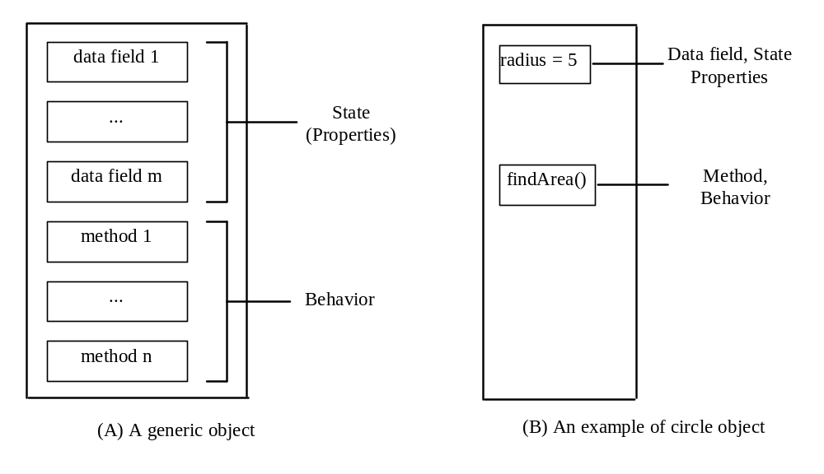
Objects
An object has both a state and behavior. The state defines the object, and the behavior defines what the object does.

Slide 5
Classes
Classes are constructs that define objects of the same type. A Java class uses variables to define data fields and methods to define behaviors. Additionally, a class provides a special type of methods, known as constructors, which are invoked to construct objects from the class.

Slide 6
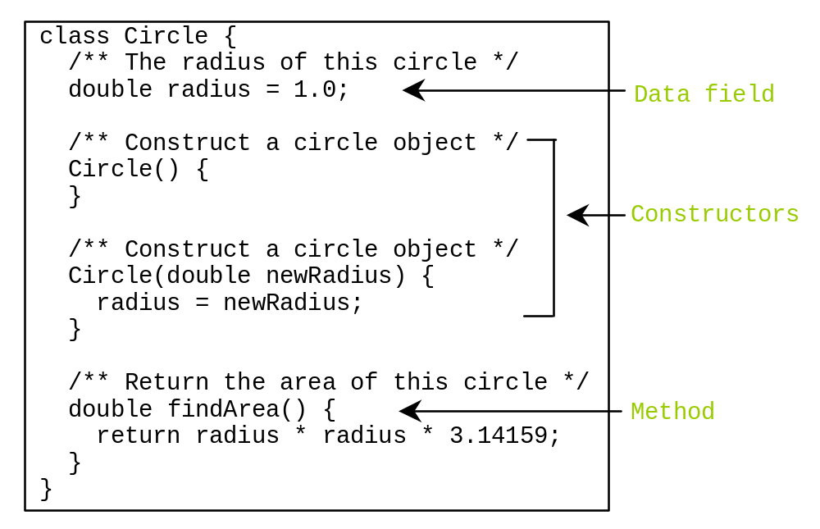
Classes

Slide 7
Constructors
Constructors are a special kind of methods that are invoked to construct objects.
Circle() {
}
Circle(double newRadius) {
radius = newRadius;
}

Slide 8
Constructors, cont.
A constructor with no parameters is referred to as a no-arg constructor.
· Constructors must have the same name as the class itself.
· Constructors do not have a return type—not even void.
· Constructors are invoked using the new operator when an object is created. Constructors play the role of initializing objects.

Slide 9
Creating Objects Using Constructors
new ClassName();
Example:
new Circle();
new Circle(5.0);

Slide 10
Default Constructor
A class may be declared without constructors. In this case, a no-arg constructor with an empty body is implicitly declared in the class. This constructor, called a default constructor, is provided automatically only if no constructors are explicitly declared in the class.

Slide 11
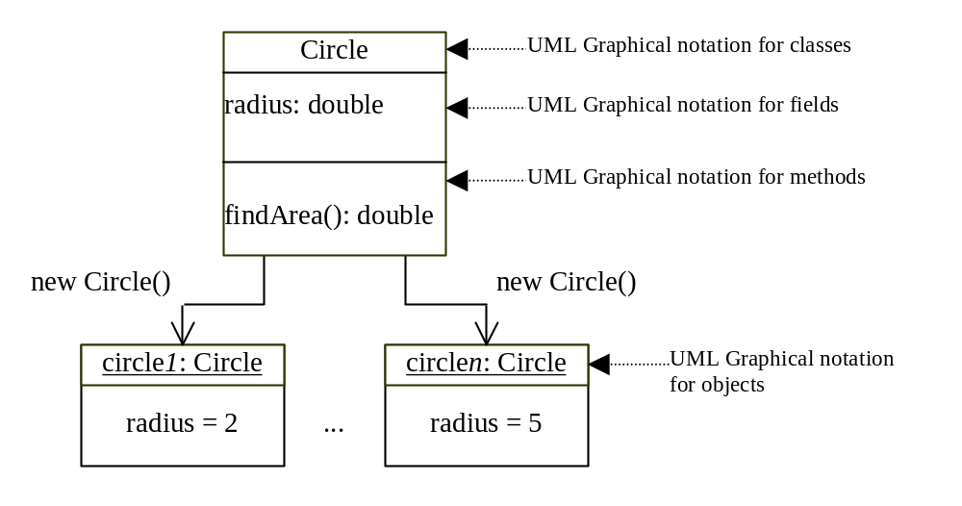
Constructing Objects, cont.

Slide 12
Declaring Object Reference Variables
To reference an object, assign the object to a reference variable.
To declare a reference variable, use the syntax:
ClassName objectRefVar;
Example:
Circle myCircle;

Slide 13
Declaring/Creating Objects in a Single Step
ClassName objectRefVar = new ClassName();
Example:
Circle myCircle = new Circle();
Assign object reference
Create an object

Slide 14
Accessing Objects
Referencing the object’s data:
objectRefVar.data
e.g., myCircle.radius
Invoking the object’s method:
objectRefVar.methodName(arguments)
e.g., myCircle.findArea()

Slide 15
Example 6.1 Using Objects
Objective: Demonstrate creating objects, accessing data, and using methods.

Slide 16
Caution
Recall that you use
  Math.methodName(arguments) (e.g., Math.pow(3, 2.5))
to invoke a method in the Math class. Can you invoke findArea() using SimpleCircle.findArea()? The answer is no. All the methods used before this chapter are static methods, which are defined using the static keyword. However, findArea() is non-static. It must be invoked from an object using
  objectRefVar.methodName(arguments) (e.g., myCircle.findArea()).
More explanations will be given in Section 6.7, “Static Variables, Constants, and Methods.”

Slide 17
The null Value
If a variable of a reference type does not reference any object, the variable holds a special literal value, null.

Slide 18
Default Value for a Data Field
The default value of a data field is null for a reference type, 0 for a numeric type, false for a boolean type, and '\u0000' for a char type. However, Java assigns no default value to a local variable inside a method.

Slide 19
Example
public class Student {
String name; // name has default value null
int age; // age has default value 0
boolean isScienceMajor; // isScienceMajor has default value false
char gender; // c has default value '\u0000'
public static void main(String[] args) {
Student student = new Student();
System.out.println("name? " + student.name);
System.out.println("age? " + student.age);
System.out.println("isScienceMajor? " + student.isScienceMajor);
System.out.println("gender? " + student.gender);
}
}

Slide 20
Example
public class Test {
public static void main(String[] args) {
int x; // x has no default value
String y; // y has no default value
System.out.println("x is " + x);
System.out.println("y is " + y);
}
}
Compilation error: variables not initialized

Slide 21

Differences between Variables of
Primitive Data Types and Object Types

Slide 22
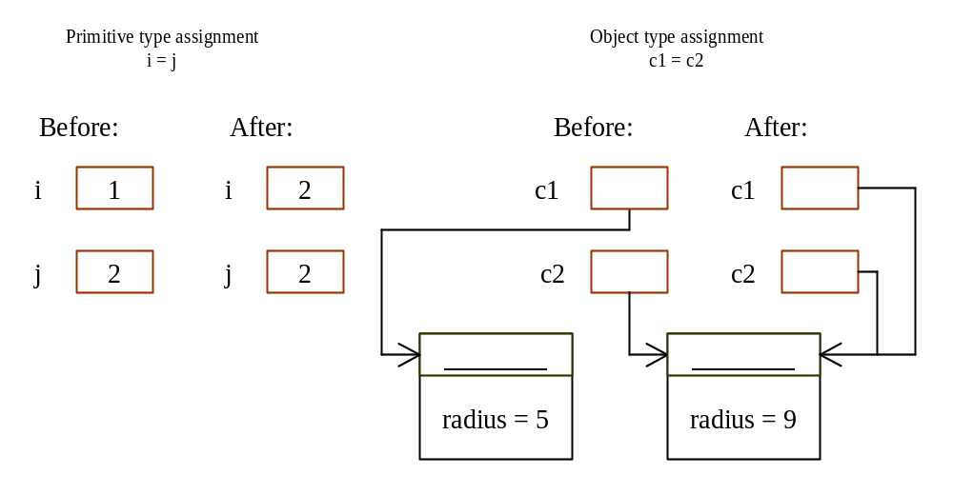
Copying Variables of Primitive Data Types and Object Types

Slide 23
Garbage Collection
As shown in the previous figure, after the assignment statement c1 = c2, c1 points to the same object referenced by c2. The object previously referenced by c1 is no longer useful. This object is known as garbage. Garbage is automatically collected by JVM.

Slide 24
Garbage Collection, cont
TIP: If you know that an object is no longer needed, you can explicitly assign null to a reference variable for the object. The Java VM will automatically collect the space if the object is not referenced by any variable.

Slide 25
Using Classes from the Java Library
Example 6.1 declared the SimpleCircle class and created objects from the class. Often you will use the classes in the Java library to develop programs. You learned to obtain the current time using System.currentTimeMillis() in Example 2.5, “Displaying Current Time.” You used the division and remainder operators to extract current second, minute, and hour.

Slide 26
The Date Class
Java provides a system-independent encapsulation of date and time in the java.util.Date class. You can use the Date class to create an instance for the current date and time and use its toString method to return the date and time as a string. For example, the following code
  java.util.Date date = new java.util.Date();
  System.out.println(date.toString());
displays a string like Sun Mar 09 13:50:19 EST 2003.

Slide 27
Example of Using Classes from the Java Library
Objective: Demonstrate using classes from the Java library. Use the JFrame class in the javax.swing package to create two frames; use the methods in the JFrame class to set the title, size and location of the frames and to display the frames.

Slide 28
Visibility Modifiers and
Accessor/Mutator Methods
By default, the class, variable, or method can be
accessed by any class in the same package.
public
The class, data, or method is visible to any class in any package.
private
The data or methods can be accessed only by the declaring class.
The get and set methods are used to read and modify private properties.

Slide 29
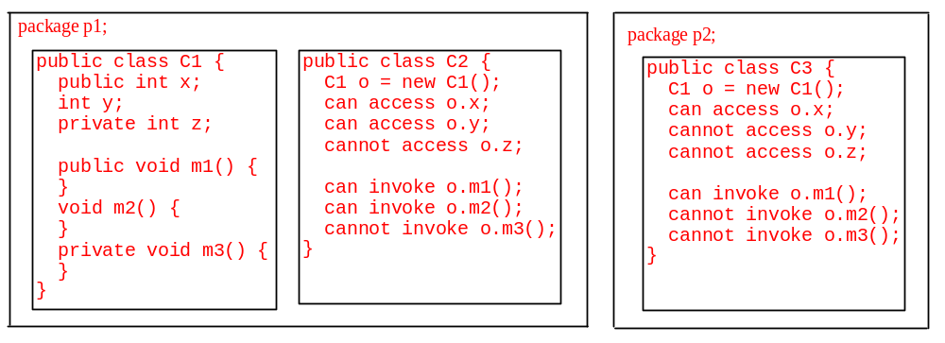
The private modifier restricts access to within a class, the default modifier restricts access to within a package, and the public modifier enables unrestricted access.

Slide 30
Why Data Fields Should Be private?
To protect data.
To make class easy to maintain.

Slide 31
Example of
Data Field Encapsulation
In this example, private data are used for the radius and the accessor methods getRadius and setRadius are provided for the clients to retrieve and modify the radius.

Slide 32
Passing Objects to Methods
Passing by value for primitive type value (the value is passed to the parameter)
Passing by value for reference type value (the value is the reference to the object)

Slide 33
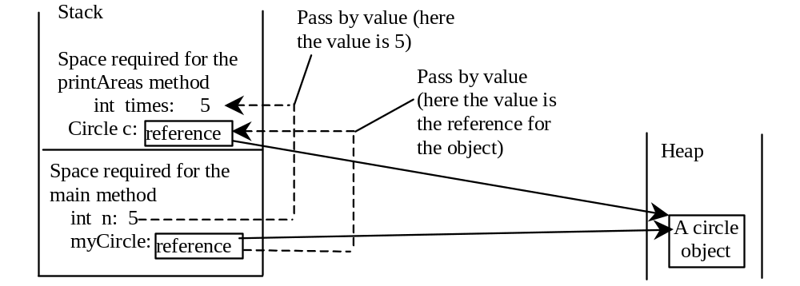
Passing Objects to Methods, cont.

Slide 34
Instance
Variables, and Methods
Instance variables belong to a specific instance.
Instance methods are invoked by an instance of the class.

Slide 35
Static Variables, Constants, and Methods
Static variables are shared by all the instances of the class.
Static methods are not tied to a specific object.
Static constants are final variables shared by all the instances of the class.

Slide 36
Static Variables, Constants, and Methods, cont.
To declare static variables, constants, and methods, use the static modifier.

Slide 37
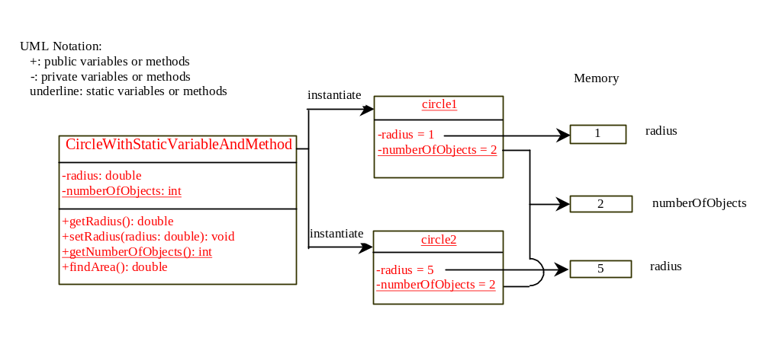
Static Variables, Constants, and Methods, cont.

Slide 38
Example of
Using Instance and Class Variables and Method
Objective: Demonstrate the roles of instance and class variables and their uses. This example adds a class variable numOfObjects to track the number of Circle objects created.

Slide 39
Scope of Variables
The scope of instance and static variables is the entire class. They can be declared anywhere inside a class.
The scope of a local variable starts from its declaration and continues to the end of the block that contains the variable. A local variable must be initialized explicitly before it can be used.

Slide 40
The this Keyword
Use this to refer to the object that invokes the instance method.
Use this to refer to an instance data field.
Use this to invoke an overloaded constructor of the same class.

Slide 41
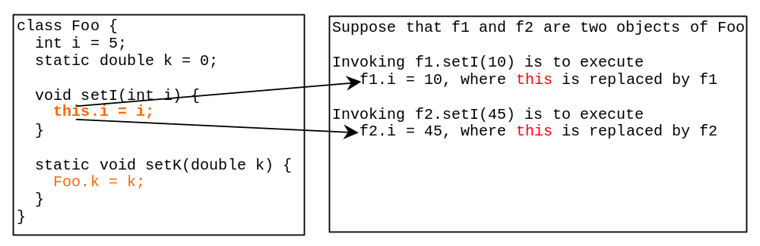
Serving as Proxy to the Calling Object

Slide 42

Calling Overloaded Constructor

Slide 43
Array of Objects
Circle[] circleArray = new Circle[10];
An array of objects is actually an array of reference variables. So invoking circleArray[1].findArea() involves two levels of referencing as shown in the next figure. circleArray references to the entire array. circleArray[1] references to a Circle object.

Slide 44
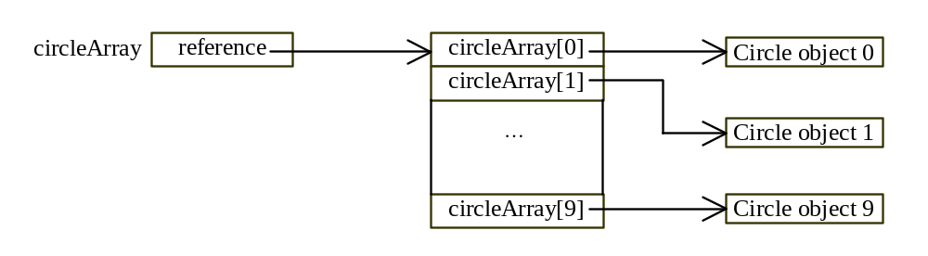
Array of Objects, cont.
Circle[] circleArray = new Circle[10];

Slide 45
Array of Objects, cont.
Example 6.2: Summarizing the areas of the circles

Slide 46

Class Abstraction and Encapsulation
Class abstraction means to separate class implementation from the use of the class. The creator of the class provides a description of the class and let the user know how the class can be used. The user of the class does not need to know how the class is implemented. The detail of implementation is encapsulated and hidden from the user.

Slide 47
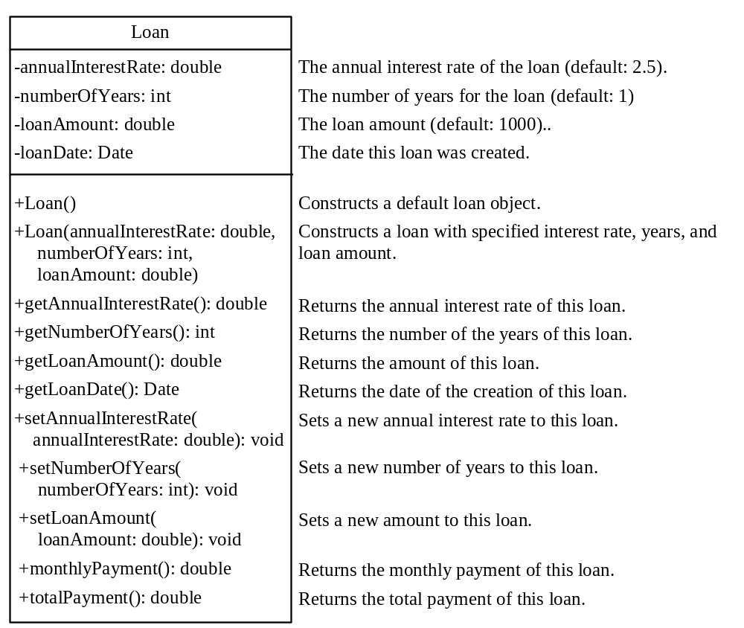
Example 6.3 The Loan Class

