Slide 1

Chapter 7 Strings
Chapter 5 Arrays
Chapter 6 Objects and Classes
Chapter 7 Strings
You can cover GUI after Chapt
er 8
Chapter 8 Inheritance and Polymorphism
Chapter 11 Getting Started with GUI Programming
Chapter 9 Abstract Classes and Interfaces
Chapter 12 Event
-
Driven Programming
Chapter 10 Object
-
Oriented Modeling
Chapter 15 Exceptions and Assertions
You can cover Exceptions and I/O after Chapter 8
Chapter 16 Simple Input and Output

Slide 2
Objectives
To use the String class to process fixed strings (§7.2).
To learn how to pass strings to the main method from the command line (§7.8).

Slide 3
The String Class
Constructing a String:
  String message = "Welcome to Java“;
  String message = new String("Welcome to Java“);
  String s = new String();
Obtaining String length and Retrieving Individual Characters in a string String
String Concatenation (concat)
Substrings (substring(index), substring(start, end))
Comparisons (equals, compareTo)
String Conversions
Finding a Character or a Substring in a String
Conversions between Strings and Arrays
Converting Characters and Numeric Values to Strings

Slide 4
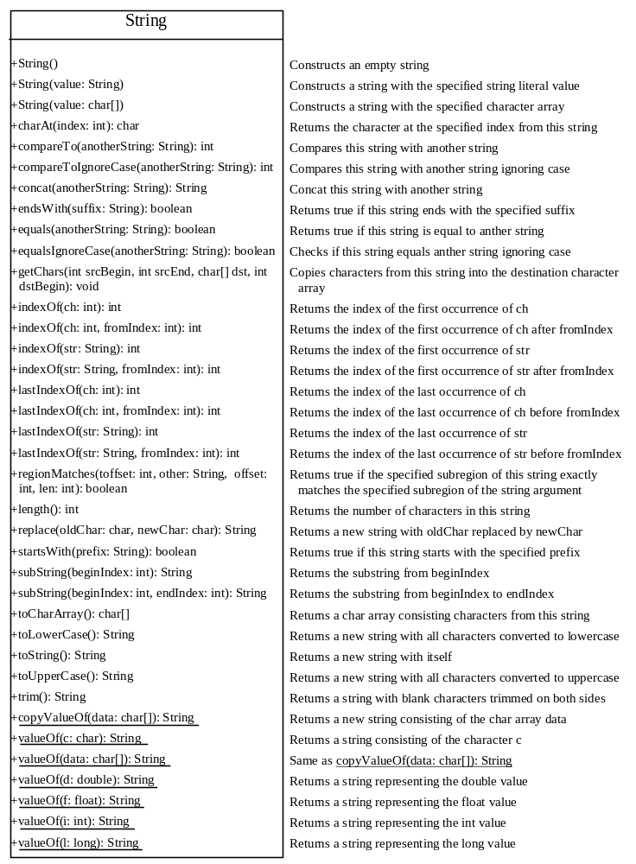

Slide 5
Constructing Strings
String newString = new String(stringLiteral);
String message = new String("Welcome to Java");
Since strings are used frequently, Java provides a shorthand initializer for creating a string:
String message = "Welcome to Java";

Slide 6
Finding String Length
Finding string length using the length() method:
message = "Welcome";
message.length() (returns 7)

Slide 7
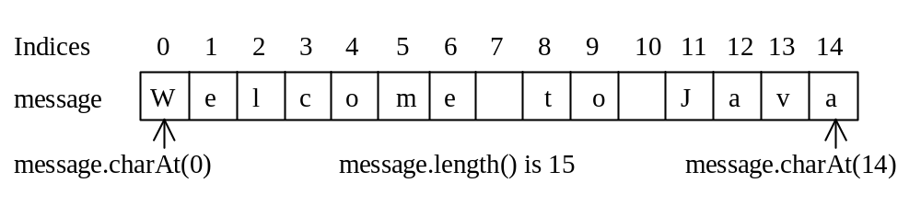
Retrieving Individual Characters in a String
Do not use message[0]
Use message.charAt(index)
Index starts from 0

Slide 8
String Concatenation
String s3 = s1.concat(s2);
String s3 = s1 + s2;
s1 + s2 + s3 + s4 + s5 same as
(((s1.concat(s2)).concat(s3)).concat(s4)).concat(s5);

Slide 9
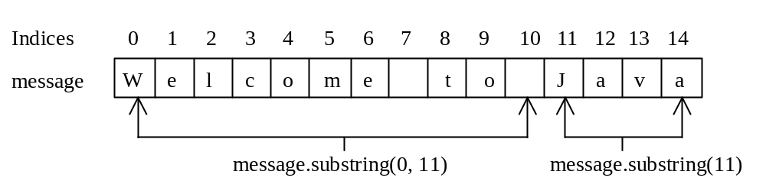
Extracting Substrings
String is an immutable class; its values
cannot be changed individually.
String s1 = "Welcome to Java";
String s2 = s1.substring(0, 11) + "HTML";

Slide 10
String Comparisons
equals
String s1 = new String("Welcome“);
String s2 = "welcome";
if (s1.equals(s2)){
// s1 and s2 have the same contents
}
if (s1 == s2) {
// s1 and s2 have the same reference
}

Slide 11
String Comparisons, cont.
compareTo(Object object)
String s1 = new String("Welcome“);
String s2 = "welcome";
if (s1.compareTo(s2) > 0) {
// s1 is greater than s2
}
else if (s1.compareTo(s2) == 0) {
// s1 and s2 have the same contents
}
else
// s1 is less than s2

Slide 12
String Conversions
The contents of a string cannot be changed once the string is created. But you can convert a string to a new string using the following methods:
toLowerCase
toUpperCase
trim
replace(oldChar, newChar)

Slide 13
Finding a Character or a Substring in a String
"Welcome to Java".indexOf('W') returns 0.
"Welcome to Java".indexOf('x') returns -1.
"Welcome to Java".indexOf('o', 5) returns 9.
"Welcome to Java".indexOf("come") returns 3.
"Welcome to Java".indexOf("Java", 5) returns 11.
"Welcome to Java".indexOf("java", 5) returns -1.
"Welcome to Java".lastIndexOf('a') returns 14.

Slide 14
Convert Character and Numbers to Strings
The String class provides several static valueOf methods for converting a character, an array of characters, and numeric values to strings. These methods have the same name valueOf with different argument types char, char[], double, long, int, and float. For example, to convert a double value to a string, use String.valueOf(5.44). The return value is string consists of characters ‘5’, ‘.’, ‘4’, and ‘4’.

Slide 15
Example 7.1
Finding Palindromes
Objective: Checking whether a string is a palindrome: a string that reads the same forward and backward.

Slide 16
Command-Line Parameters
class TestMain {
public static void main(String[] args) {
...
}
}
java TestMain arg0 arg1 arg2 ... argn

Slide 17
Processing
Command-Line Parameters
In the main method, get the arguments from args[0], args[1], ..., args[n], which corresponds to arg0, arg1, ..., argn in the command line.
Notes:
Example 12.4

Slide 18
Example 7.4
Using Command-Line Parameters
Objective: Write a program that will perform binary operations on integers. The program receives three parameters: an operator and two integers.
java Calculator 2 + 3
java Calculator 2 - 3
java Calculator 2 / 3
java Calculator 2 “*” 3

