Slide 1

Chapter 8 Inheritance and Polymorphism
Chapter 5 Arrays
Chapter 6 Objects and Classes
Chapter 7 Strings
You can cover GUI after Chapt
er 8
Chapter 8 Inheritance and Polymorphism
Chapter 11 Getting Started with GUI Programming
Chapter 9 Abstract Classes and Interfaces
Chapter 12 Event
-
Driven Programming
Chapter 10 Object
-
Oriented Modeling
Chapter 15 Exceptions and Assertions
You can cover Exceptions and I/O after Chapter 8
Chapter 16 Simple Input and Output

Slide 2
Objectives
    To develop a subclass from a superclass through inheritance (§8.2).
    To invoke the superclass’s constructors and methods using the super keyword (§8.3).
    To override methods in the subclass (§8.4).
    To comprehend polymorphism, dynamic binding, and generic programming (§8.6).
    To restrict access to data and methods using the protected visibility modifier (§8.9).

Slide 3
Inheritance
Inheritance allows a software developer to derive a new class from an existing one
The existing class is called the parent class, or superclass, or base class
The derived class is called the child class or subclass.
As the name implies, the child inherits characteristics of the parent
That is, the child class inherits the methods and data defined for the parent class

Slide 4
Inheritance
To tailor a derived class, the programmer can add new variables or methods, or can modify the inherited ones
Software reuse is at the heart of inheritance
By using existing software components to create new ones, we capitalize on all the effort that went into the design, implementation, and testing of the existing software

Slide 5
Inheritance
Inheritance relationships often are shown graphically in a UML class diagram, with an arrow with an open arrowhead pointing to the parent class
Vehicle
Car
Inheritance should create an is-a relationship, meaning the child is a more specific version of the parent

Slide 6
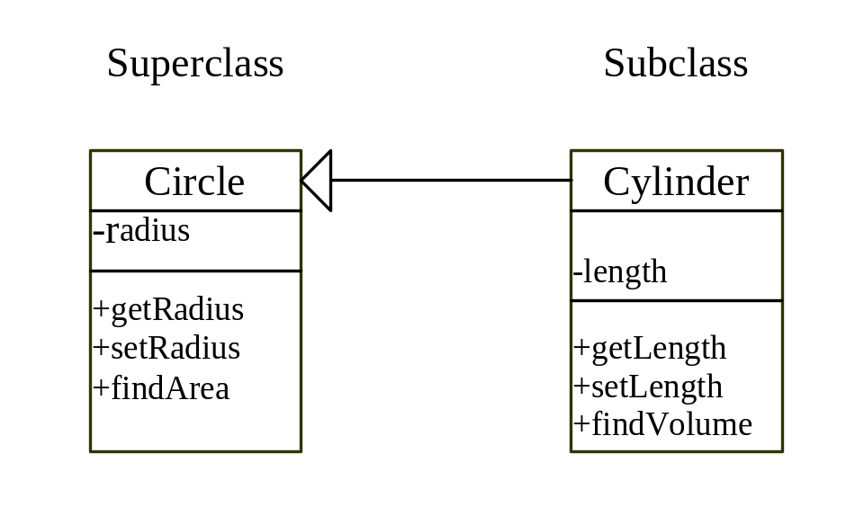
Superclasses and Subclasses
UML Diagram

Slide 7
// Cylinder.java: Class definition for describing Cylinder
public class Cylinder extends Circle {
private double length = 1;
/** Return length */
public double getLength() {
return length;
}
/** Set length */
public void setLength(double length) {
this.length = length;
}
/** Return the volume of this cylinder */
public double findVolume() {
return findArea() * length;
}
}
supertype
subtype

Slide 8
Cylinder cylinder = new Cylinder();
System.out.println("The length is " +
cylinder.getLength());
System.out.println("The radius is " +
cylinder.getRadius());
System.out.println("The volume of the cylinder is " +
cylinder.findVolume());
System.out.println("The area of the circle is " +
cylinder.findArea());
The output is
The length is 1.0
The radius is 1.0
The volume of the cylinder is 3.14159
The area of the circle is 3.14159

Slide 9
Using the Keyword super
The keyword super refers to the superclass of the class in which super appears. This keyword can be used in two ways:
To call a superclass constructor
To call a superclass method

Slide 10
CAUTION
You must use the keyword super to call the superclass constructor. Invoking a superclass constructor’s name in a subclass causes a syntax error. Java requires that the statement that uses the keyword super appear first in the constructor.

Slide 11
NOTE
A constructor is used to construct an instance of a class. Unlike properties and methods, a superclass's constructors are not inherited in the subclass. They can only be invoked from the subclasses' constructors, using the keyword super. If the keyword super is not explicitly used, the superclass's no-arg constructor is automatically invoked.

Slide 12
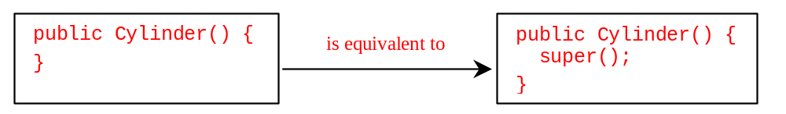
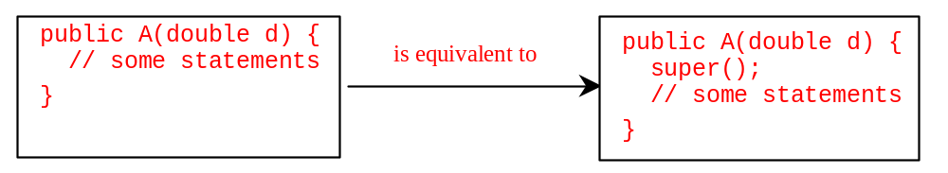
Superclass’s Constructor Is Always Invoked
A constructor may invoke an overloaded constructor or its superclass’s constructor. If none of them is invoked explicitly, the compiler puts super() as the first statement in the constructor. For example,

Slide 13
Constructor Chaining
Constructing an instance of a class invokes all the superclasses’ constructors along the inheritance chain. This is called constructor chaining.
public class Faculty extends Employee {
public static void main(String[] args) {
new Faculty();
}
public Faculty() {
System.out.println("Faculty's no-arg constructor is invoked");
}
}
class Employee extends Person {
public Employee() {
this("Invoke Employee’s overloaded constructor");
System.out.println("Employee's no-arg constructor is invoked");
}
public Employee(String s) {
System.out.println(s);
}
}
class Person {
public Person() {
System.out.println("Person's no-arg constructor is invoked");
}
}

Slide 14
Declaring a Subclass
A subclass extends properties and methods from the superclass. You can also:
  Add new properties
  Add new methods
  Override the methods of the superclass

Slide 15
Overriding Methods in the Superclass
A subclass inherits methods from a superclass. Sometimes it is necessary for the subclass to modify the implementation of a method defined in the superclass. This is referred to as method overriding.
// Cylinder.java: New cylinder class that overrides the findArea()
// method defined in the circle class.
public class Cylinder extends Circle {
/** Return the surface area of this cylinder. The formula is
* 2 * circle area + cylinder body area
*/
public double findArea() {
return 2 * super.findArea() + 2 * getRadius() * Math.PI * length;
}
// Other methods are omitted
}

Slide 16
NOTE
An instance method can be overridden only if it is accessible. Thus a private method cannot be overridden, because it is not accessible outside its own class. If a method defined in a subclass is private in its superclass, the two methods are completely unrelated.

Slide 17
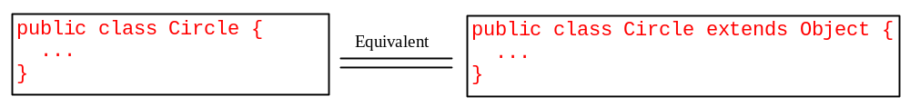
The Object Class
Every class in Java is descended from the java.lang.Object class. If no inheritance is specified when a class is defined, the superclass of the class is Object.

Slide 18
The toString() method in Object
The toString() method returns a string representation of the object. The default implementation returns a string consisting of a class name of which the object is an instance, the at sign (@), and a number representing this object.
Cylinder myCylinder = new Cylinder(5.0, 2.0);
System.out.println(myCylinder.toString());
The code displays something like Cylinder@15037e5. This message is not very helpful or informative. Usually you should override the toString method so that it returns a digestible string representation of the object.

Slide 19
Polymorphism
A reference can be polymorphic, which can be defined as "having many forms"
obj.doIt();
This line of code might execute different methods at different times if the object that obj points to changes
Polymorphic references are resolved at run time; this is called dynamic binding
Careful use of polymorphic references can lead to elegant, robust software designs
Polymorphism can be accomplished using inheritance or using interfaces

Slide 20
References and Inheritance
An object reference can refer to an object of its class, or to an object of any class related to it by inheritance
For example, if the Holiday class is used to derive a child class called Christmas, then a Holiday reference could be used to point to a Christmas object
Holiday
Holiday day;
day = new Christmas();
Christmas

Slide 21
References and Inheritance
Assigning a predecessor object to an ancestor reference is considered to be a widening conversion, and can be performed by simple assignment
Assigning an ancestor object to a predecessor reference can be done also, but it is considered to be a narrowing conversion and must be done with a cast
The widening conversion is the most useful
An Object reference can be used to refer to any object

Slide 22
Polymorphism via Inheritance
It is the type of the object being referenced, not the reference type, that determines which method is invoked
Suppose the Holiday class has a method called celebrate, and the Christmas class overrides it
Now consider the following invocation:
day.celebrate();
If day refers to a Holiday object, it invokes the Holiday version of celebrate; if it refers to a Christmas object, it invokes the Christmas version

Slide 23
Polymorphism
public abstract class Animal {
protected String name;
public String getName() {
return name;
}
public void setName(String n) {
name = n;
}
public abstract void speak();
}

Slide 24
Polymorphism
public class Dog extends Animal {
public void speak() {
System.out.println(“Awoo…”);
}
}
public class Cow extends Animal {
public void speak() {
System.out.println(“Moo…ving Van”);
}
}
public class Snake extends Animal {
public void speak() {
System.out.println(“Kikiki…”);
}
}

Slide 25
Polymorphism
public class Demo {
public static void main (String[] args) {
Animal anAnimal;
Cow aCow = new Cow();
Dog aDog = new Dog();
Snake aSnake = new Snake();
anAnimal = aCow;
anAnimal.speak();
anAnimal = aDog;
anAnimal.speak();
anAnimal = aSnake;
anAnimal.speak();
}
}

Slide 26
Using Dynamic Method Binding
The ability of the program to select the correct subclass method.
Polymorphic behavior of subclasses is possible by method overriding and dynamic method binding.
The correct method (which subclass’ method) is bound to the program at run time, not fixed at compile time.

Slide 27
Polymorphism, Dynamic Binding and Generic Programming
public class Test {
public static void main(String[] args) {
m(new GraduateStudent());
m(new Student());
m(new Person());
m(new Object());
}
public static void m(Object x) {
System.out.println(x.toString());
}
}
class GraduateStudent extends Student {
}
class Student extends Person {
public String toString() {
return "Student";
}
}
class Person extends Object {
public String toString() {
return "Person";
}
}
Method m takes a parameter of the Object type. You can invoke it with any object.
An object of a subtype can be used wherever its supertype value is required. This feature is known as polymorphism.
When the method m(Object x) is executed, the argument x’s toString method is invoked. x may be an instance of GraduateStudent, Student, Person, or Object. Classes GraduateStudent, Student, Person, and Object have their own implementation of the toString method. Which implementation is used will be determined dynamically by the Java Virtual Machine at runtime. This capability is known as dynamic binding.

Slide 28
Generic Programming
public class Test {
public static void main(String[] args) {
m(new GraduateStudent());
m(new Student());
m(new Person());
m(new Object());
}
public static void m(Object x) {
System.out.println(x.toString());
}
}
class GraduateStudent extends Student {
}
class Student extends Person {
public String toString() {
return "Student";
}
}
class Person extends Object {
public String toString() {
return "Person";
}
}
Polymorphism allows methods to be used generically for a wide range of object arguments. This is known as generic programming. If a method’s parameter type is a superclass (e.g., Object), you may pass an object to this method of any of the parameter’s subclasses (e.g., Student or String). When an object (e.g., a Student object or a String object) is used in the method, the particular implementation of the method of the object that is invoked (e.g., toString) is determined dynamically.

Slide 29
Demonstrating Polymorphism
This example creates two geometric objects: a circle, and a cylinder, invokes the displayGeometricObject method to display the objects. The displayGeometricObject displays the area and perimeter if the object is a circle, and displays area and volume if the object is a cylinder.
➔ Modify Example 8.1

Slide 30

The protected Modifier
The protected modifier can be applied on data and methods in a class. A protected data or a protected method in a public class can be accessed by any class in the same package or its subclasses, even if the subclasses are in a different package.
private, default, protected, public

Slide 31

Accessibility Summary

Slide 32
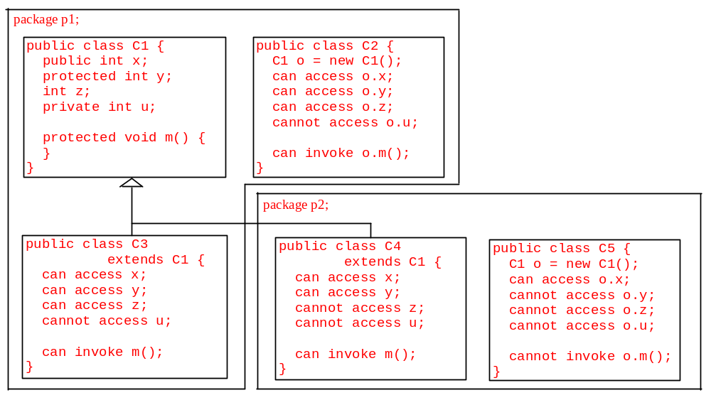
Visibility Modifiers

Slide 33
NOTE
The modifiers are used on classes and class members (data and methods), except that the final modifier can also be used on local variables in a method. A final local variable is a constant inside a method.

Slide 34
The final Modifier
The final class cannot be extended:
final class Math {
...
}
The final variable is a constant:
final static double PI = 3.14159;
The final method cannot be
overridden by its subclasses.

