Slide 1

Chapter 9 Abstract Classes and Interfaces
Chapter 5 Arrays
Chapter 6 Objects and Classes
Chapter 7 Strings
You can cover GUI after Chapt
er 8
Chapter 8 Inheritance and Polymorphism
Chapter 11 Getting Started with GUI Programming
Chapter 9 Abstract Classes and Interfaces
Chapter 12 Event
-
Driven Programming
Chapter 10 Object
-
Oriented Modeling
Chapter 15 Exceptions and Assertions
You can cover Exceptions and I/O after Chapter 8
Chapter 16 Simple Input and Output

Slide 2
Objectives
    To design and use abstract classes (§9.2).
    To declare interfaces to model multiple inheritance relationships (§9.4).
    To know the similarities and differences between an abstract class and interface (§9.4).
    To use wrapper classes (Byte, Short, Integer, Long, Float, Double, Character, and Boolean) to wrap primitive data values into objects (§9.5).

Slide 3
Abstract Classes
An abstract class is a placeholder in a class hierarchy that represents a generic concept
An abstract class cannot be instantiated
We use the modifier abstract on the class header to declare a class as abstract:
public abstract class Whatever
{
// contents
}

Slide 4
Abstract Classes
An abstract class often contains abstract methods with no definitions, but does not need to contain abstract methods
The abstract modifier must be applied to each abstract method
Abstract methods should be extended and implemented in subclasses
An abstract class typically contains non-abstract methods (with bodies)

Slide 5
Abstract Classes
The child of an abstract class must override the abstract methods of the parent, or it too will be considered abstract (→ note)
An abstract method cannot be defined as final (because it must be overridden) or static (because it has no definition yet)
The use of abstract classes is a design decision – it helps us establish common elements in a class that is too general to instantiate

Slide 6
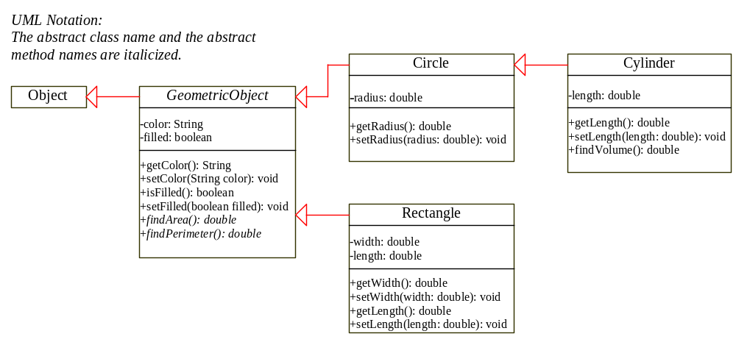
Abstract Classes

Slide 7
NOTE
An abstract method cannot be contained in a nonabstract class. If a subclass of an abstract superclass does not implement all the abstract methods, the subclass must be declared abstract. In other words, in a nonabstract subclass extended from an abstract class, all the abstract methods must be implemented, even if they are not used in the subclass.

Slide 8
NOTE
An abstract class cannot be instantiated using the new operator, but you can still define its constructors, which are invoked in the constructors of its subclasses. For instance, the constructors of GeometricObject are invoked in the Circle class and the Rectangle class.

Slide 9
NOTE
A subclass can be abstract even if its superclass is concrete. For example, the Object class is concrete, but its subclasses, such as GeometricObject, may be abstract.

Slide 10
NOTE
Cylinder inherits the findPerimeter method from Circle. If you invoke this method on a Cylinder object, the perimeter of a circle is returned. This method is not useful for Cylinder objects. It would be nice to remove or disable it from Cylinder, but there is no good way to get rid of this method in a subclass once it is defined as public in its superclass. If you define the findPerimeter method abstract in the Cylinder class, then the Cylinder class must be declared abstract.

Slide 11
Example 9.1
Using the GeometricObject Class
Objective: This example creates two geometric objects: a circle, and a rectangle, invokes the equalArea method to check if the two objects have equal area, and invokes the displayGeometricObject method to display the objects.

Slide 12
Interfaces
An interface is a classlike construct that contains only constants and abstract methods. In many ways, an interface is similar to an abstract class, but an abstract class can contain variables and concrete methods as well as constants and abstract methods.
To distinguish an interface from a class, Java uses the following syntax to declare an interface:
public interface InterfaceName {
constant declarations;
method signatures;
}

Slide 13
Interface is a Special Class
An interface is treated like a special class in Java. Each interface is compiled into a separate bytecode file, just like a regular class. As with an abstract class, you cannot create an instance from an interface using the new operator, but in most cases you can use an interface more or less the same way you use an abstract class. For example, you can use an interface as a data type for a variable, as the result of casting, and so on.

Slide 14
Define Interfaces
Suppose you want to design a generic method to find the larger of two objects. The objects can be students, circles, or cylinders. Since compare methods are different for different types of objects, you need to define a generic compare method to determine the order of the two objects. Then you can tailor the method to compare students, circles, or cylinders. For example, you can use student ID as the key for comparing students, radius as the key for comparing circles, and volume as the key for comparing cylinders. You can use an interface to define a generic compareTo method, as follows:

Slide 15
Example of an Interface
interface is a reserved word
None of the methods in
an interface are given
a definition (body)
public interface Doable
{
public void doThis();
public int doThat();
public void doThis2 (float value, char ch);
public boolean doTheOther (int num);
}
A semicolon immediately
follows each method header

Slide 16
Interfaces vs. Abstract Classes
  In an interface, the data must be constants; an abstract class can have all types of data.
  Each method in an interface has only a signature without implementation; an abstract class can have concrete methods.

Slide 17
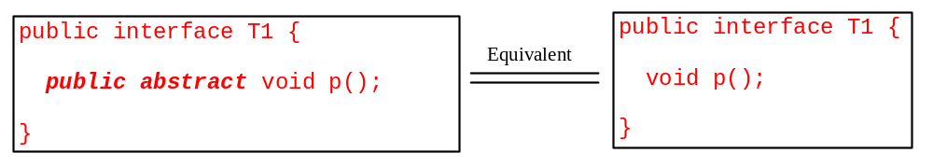
Interfaces vs. Abstract Classes, cont.
  All methods are public abstract in an interface. For this reason, these modifiers can be omitted, as shown below:

Slide 18
When to use an interface?
  Abstract classes and interfaces can both be used to model common features. When do you decide to use an interface? You can use interfaces to circumvent single inheritance restriction if multiple inheritance is desired. In the case of multiple inheritance, you have to design one as a superclass, and others as interface. See Chapter 10, “Object-Oriented Modeling,” for more discussions.

Slide 19
Multiple Inheritance
<<type>>
Vehicle
engine
move-forward()
LandVehicle
WaterVehicle
- Propulsion : Enum = wheel
- Propulsion : Enum = propeller
Car
Amphibious Vehicle
Boat

Slide 20
Creating Interfaces
public interface Edible {
/** Describe how to eat */
public String howToEat();
}
class Fruit implements Edible {
public String howToEat() {
return "Eat it fresh";
}
}
class Apple extends Fruit {
public String howToEat() {
return "Make apple cider";
}
}
class Orange extends Fruit {
public String howToEat() {
return "Make orange juice";
}
}
class Animal {
}
class Chicken extends Animal
implements Edible {
public String howToEat() {
return "Fry it";
}
}
class Tiger extends Animal {
}

Slide 21
Creating Interfaces, cont.
public interface Edible {
/** Describe how to eat */
public String howToEat();
}
public class TestEdible {
public static void main(String[] args) {
Object[] objects = {new Tiger(), new Chicken(), new Apple()};
for (int i = 0; i < objects.length; i++)
showObject(objects[i]);
}
public static void showObject(Object object) {
if (object instanceof Edible)
System.out.println(((Edible)object).howToEat());
}
}

Slide 22
abstract CardGame
shuffle()
abstract deal()
abstract listRules()
abstract keepScore()
interface MusicalInstrument
playNote()
outputSound()
Hearts
extends CardGame
deal()
listRules()
keepScore()
NameThatInstrument
extends CardGame
implements MusicalInstrument
……
Piano
implements MusicalInstrument
playNote()
outputSound()
Solitaire
extends CardGame
deal()
listRules()
keepScore()
Poker
extends CardGame
deal()
listRules()
keepScore()
Violin
implements MusicalInstrument
playNote()
outputSound()
© 2003 Ted Han

Slide 23
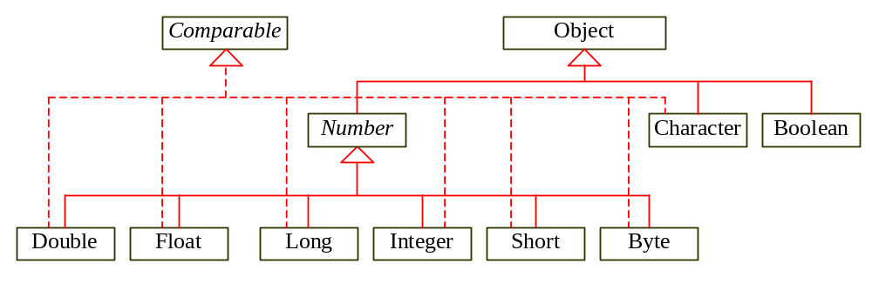
Wrapper Classes
Boolean
Character
Short
Byte
Integer
Long
Float
Double
NOTE: The instances of all wrapper classes are immutable, i.e., their internal values cannot be changed once the objects are created.

