Slide 1

Chapter 10 Object-Oriented Modeling
Chapter 5 Arrays
Chapter 6 Objects and Classes
Chapter 7 Strings
You can cover GUI after Chapt
er 8
Chapter 8 Inheritance and Polymorphism
Chapter 11 Getting Started with GUI Programming
Chapter 9 Abstract Classes and Interfaces
Chapter 12 Event
-
Driven Programming
Chapter 10 Object
-
Oriented Modeling
Chapter 15 Exceptions and Assertions
You can cover Exceptions and I/O after Chapter 8
Chapter 16 Simple Input and Output

Slide 2
Objectives
To become familiar with the process of program development (§10.2).
To the relationship types: association, aggregation, strong inheritance, and weak inheritance (§10.3).
To declare classes to represent the relationships among the classes (§10.3).
To design systems by identifying the classes and discovering the relationships among these classes (§10.4).
To design classes that follow the class-design guidelines (§10.6).

Slide 3
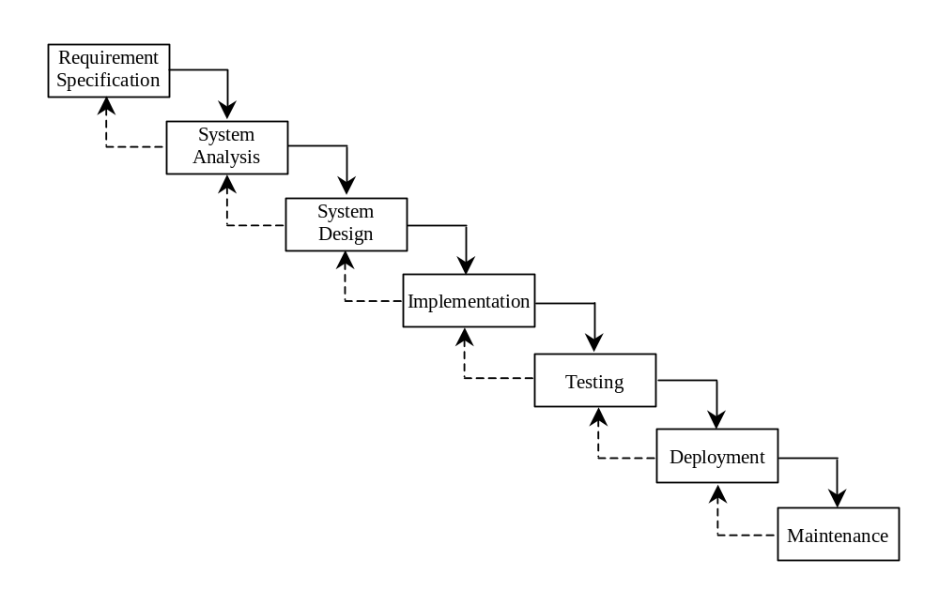
Software Development Process

Slide 4
Object-Oriented Modeling
One of the central tasks in object-oriented systems development is to design classes to model the system.
While there are many object-oriented methodologies, UML has become the industry-standard notation for object-oriented modeling, and itself leads to a methodology.
The process of designing classes calls for identifying the classes and discovering the relationships among them.

Slide 5
Relationships among Classes
Association
Aggregation/Composition
Inheritance
Dependency

Slide 6
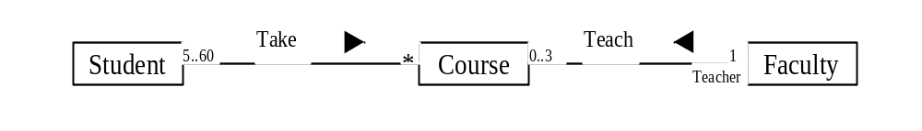
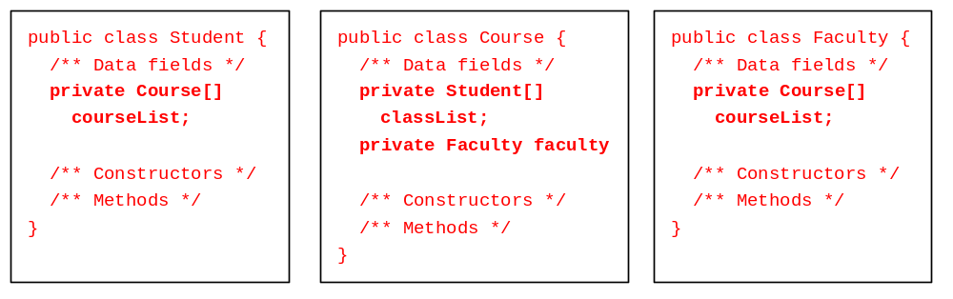
Association
Association represents a general binary relationship that describes an activity between two classes.
An association is usually represented as a data field in the class.

Slide 7
Translation is not Unique
NOTE: If you don’t need to know the courses a student takes or a faculty teaches, the data field coureList in Student or Faculty can be omitted.

Slide 8
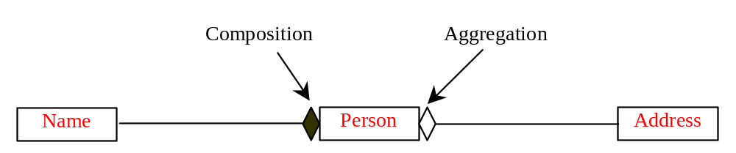
Aggregation/Composition
Aggregation is a special form of association, which represents an ownership relationship between two classes. Aggregation models the has-a relationship. If an object is exclusively owned by an aggregated object, the relationship between the object and its aggregated object is referred to as composition.

Slide 9
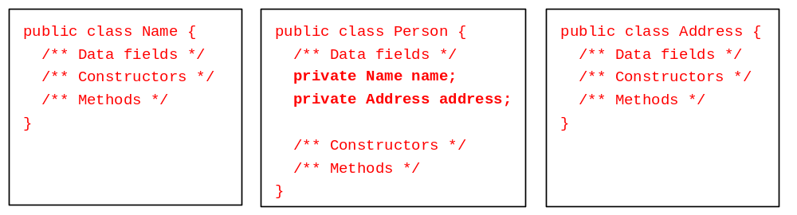
Representing Aggregation in Classes
An aggregation relationship is usually represented as a data field in the aggregated class.

Slide 10
Inner Classes Translation
If Name or Address is used in the Person class only, they can be declared as an inner class in Person. For example,
public class Person {
private Name name;
private Address address;
...
class Name {
...
}
class Address {
...
}
}

Slide 11
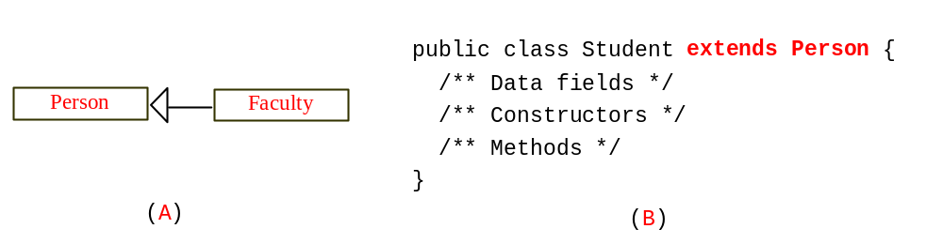
Inheritance
Inheritance models the is-a relationship between two classes.

Slide 12
Class Design
1. Identify classes for the system.
2. Describe attributes and methods in each class.
3. Establish relationships among classes.
4. Create classes.

Slide 13
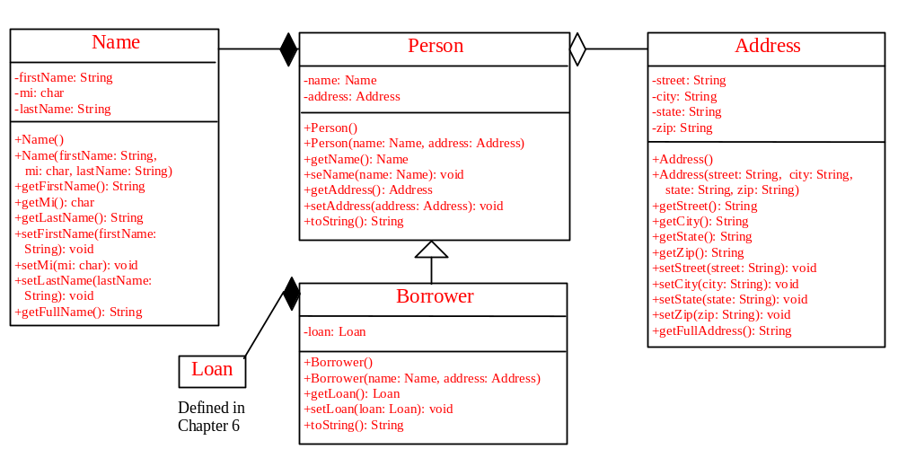
Example 10.1 Borrowing Loans

Slide 14
Example 10.1 Borrowing Loans, cont.
The BorrowLoan class is a test program that uses the classes Name, Person, Address, Borrower, and Loan.

Slide 15
Class Design Guidelines
Designing a Single Class.
Using Modifiers public, protected, private and static
Using Inheritance or Composition
Using Interfaces or Abstract Classes

Slide 16
Designing a Class
A class should describe a single entity or a set of similar operations. A single entity with too many responsibilities can be broken into several classes to separate responsibilities. The String class, StringBuffer class, and StringTokenizer class all deal with strings, for example, but have different responsibilities.

Slide 17
Designing a Class, cont.
Classes are designed for reuse. Users can incorporate classes in many different combinations, orders, and environments. Therefore, you should design a class that imposes no restrictions on what or when the user can do with it, design the properties to ensure that the user can set properties in any order, with any combination of values, and design methods to function independently of their order of occurrence.

Slide 18
Designing a Class, cont.
Follow standard Java programming style and naming conventions. Choose informative names for classes, data fields, and methods. Always place the data declaration before the constructor, and place constructors before methods. Always provide a constructor and initialize variables to avoid programming errors.

Slide 19
Using Visibility Modifiers
Each class can present two contracts – one for the users of the class and one for the extenders of the class. Make the fields private and accessor methods public if they are intended for the users of the class. Make the fields or method protected if they are intended for extenders of the class. The contract for the extenders encompasses the contract for the users. The extended class may increase the visibility of an instance method from protected to public, or change its implementation.

Slide 20
Using Visibility Modifiers, cont.
A class should use the private modifier to hide its data from direct access by clients. You can use get methods and set methods to provide users with access to the private data, but only to private data you want the user to see or to modify. A class should also hide methods not intended for client use.

Slide 21
Using the static Modifier
A property that is shared by all the instances of the class should be declared as a static property.

Slide 22
Using Inheritance or Composition
In general, the difference between inheritance and composition is the difference between the is-a relationship and the has-a relationship. For example, an apple is fruit; thus, you would use inheritance to model the relationship between the classes Apple and Fruit. A person has a name; thus, you would use composition to model the relationship between the classes Person and Name.

Slide 23
Using Inheritance or Composition, cont.
Sometimes, the choice between inheritance and composition is not obvious. For example, you have used inheritance to model the relationship between the classes Circle and Cylinder. One could argue that a cylinder consists of circles; thus, you might use composition to define the Cylinder class as follows:

Slide 24
Using Inheritance or Composition, cont.
public class Cylinder {
private Circle circle;
/** Constructors */
/** Methods */
}

Slide 25
Using Inheritance or Composition, cont.
Both designs are fine. Which one is preferred? If polymorphism is desirable, you need to use the inheritance design. If you don’t care about polymorphism, the composition design gives more flexibility because the classes are less dependent using composition than using inheritance.

